Slide 1

Healthy Skepticism
Session 3
Murray Cantor, PhD & Joel Keenan, MD [venue and date]
Notes:
EDITING: The course mark (top-right) and white background live in the slide master — change them once under View > Slide Master. To reuse a layout, right-click a slide and Duplicate. Swap the bell-curve graphic for a topic image on other talks. Palette: teal 15686B, terracotta C2683F, ink 262320. Fonts: Bookman Old Style (headings), Calibri (body).

Slide 2
Disclaimer
This presentation is for educational purposes only.
The content does not constitute medical advice and is not a substitute for professional diagnosis, treatment, or care. Nothing presented here should be used to make decisions about your health or the health of others. Always seek the advice of a qualified physician or other licensed healthcare provider with any questions you may have regarding a medical condition, test result, or treatment. Never disregard professional medical advice or delay seeking it because of something discussed in this presentation.

Slide 3
The Five Faults
1
Relative reporting
Day 1
What does a 36% improvement from taking a drug really mean?
2
Probability reversal
Day 2
What does a positive COVID test really mean?
3
Arbitrary categories
Day 3
How concerned should you be if your systolic BP goes from 119 to 120?
4
The Bernoulli fallacy
Day 3
Why does the published medical advice keep changing?
5
The causal leap
Day 4
Does bird watching prevent dementia?
Once you see them, you can’t unsee them.

Slide 4
Today’s Two Faults
3
Arbitrary categories
Blood pressure, body weight, and where the lines fall
4
The Bernoulli fallacy
The 0.05 line, and what a study can and cannot tell you

Slide 5
FAULT 3
Arbitrary Categories
Read the curve, not the cutoff

Slide 6
Where Does “High” Begin?
FAULT 3 · ARBITRARY CATEGORIES
Systolic this year: 120. Last year: 119.
Nothing about you changed. The label did.
Normal
Elevated
Stage 1
Stage 2
119 → 120 same risk, new label
One mmHg moved you across a line. It did not move your risk.
SCORE risk charts, low-risk regions: Conroy RM et al., Eur Heart J 2003;24:987-1003. Category boundaries: ACC/AHA 2017.

Slide 7
Systolic Categories Don’t Mean Much
FAULT 3 · ARBITRARY CATEGORIES
Normal
Elevated
Stage 1
Stage 2
SCORE risk charts, low-risk regions: Conroy RM et al., Eur Heart J 2003;24:987-1003. Category boundaries: ACC/AHA 2017 hypertension guideline.

Slide 8
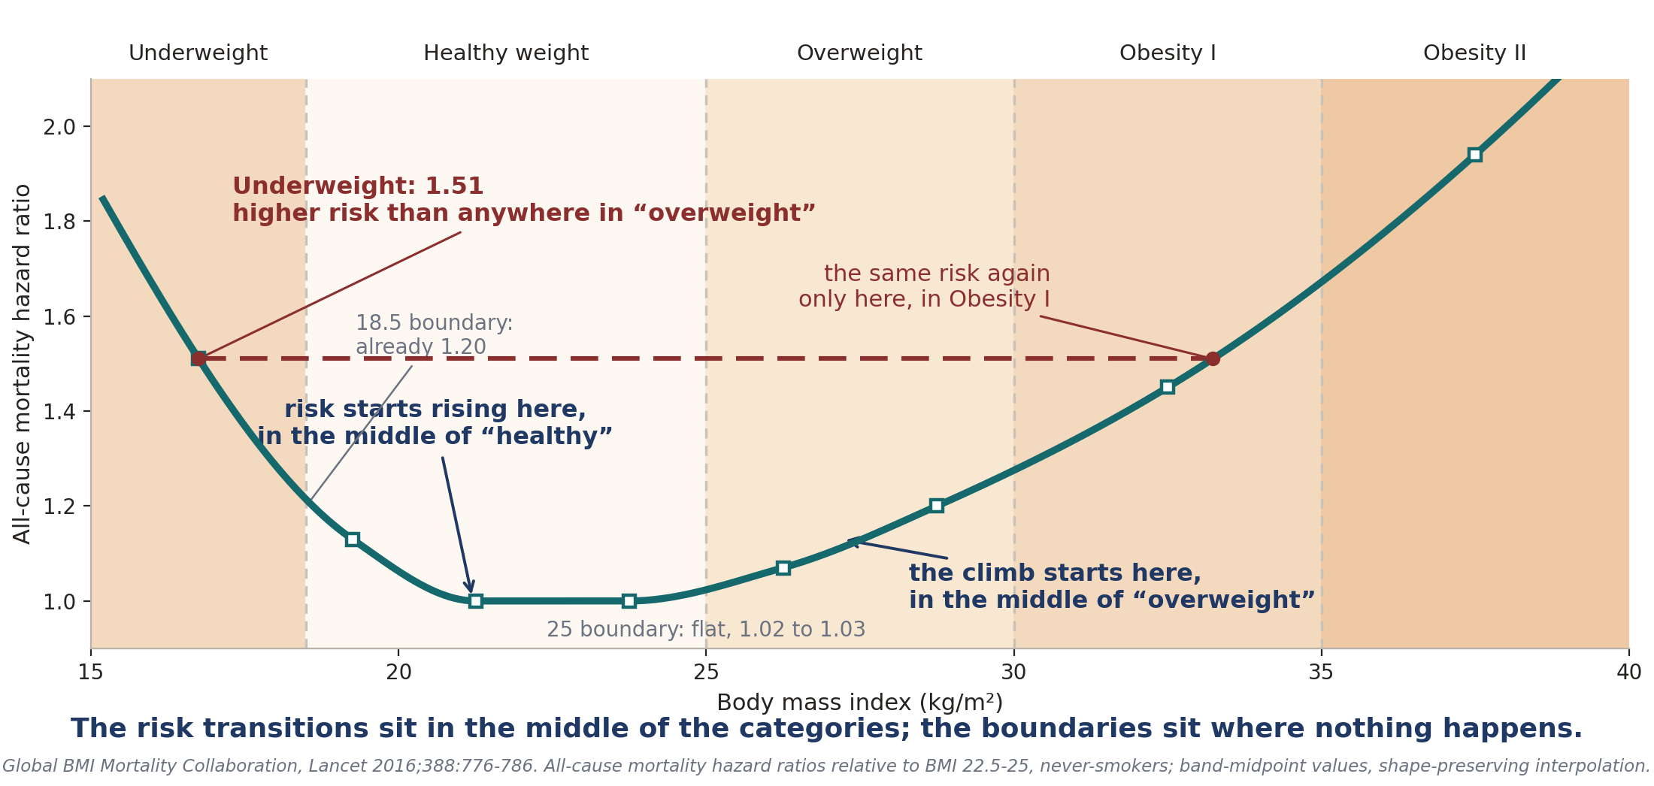
BMI Categories Are Worse
FAULT 3 · ARBITRARY CATEGORIES

Slide 9
So Why Have Categories at All?
FAULT 3 · ARBITRARY CATEGORIES
A box is a decision rule: triage in three seconds.
The trouble: the box gets read as a fact about your body.
A box cannot say how much risk you carry.
Normal
Elevated
Stage 1
Stage 2
Ask where you sit on the curve, not which side of the line.
SCORE risk charts, low-risk regions: Conroy RM et al., Eur Heart J 2003;24:987-1003. Category boundaries: ACC/AHA 2017.
Notes:
I

Slide 10
FAULT 4
The Bernoulli Fallacy
Why medical advice keeps changing

Slide 11
FAULT 4 · THE BERNOULLI FALLACY
Published Papers with Findings That Could be Repeated
Only 6 of 53 landmark cancer findings were confirmed on rerun.
Just 35 of 97 psychology findings stayed significant on rerun.
This is the Irreproducibility Crisis
Begley CG, Ellis LM. Nature 2012;483:531-533. Open Science Collaboration, Science 2015;349:aac4716. Clayton A, Bernoulli's Fallacy, 2021.

Slide 12
An Important Aside: P(A|B) is The Core Element of Inference
FAULT 4 · THE BERNOULLI FALLACY
It is called 'conditional probability'
It means the probability of A if B is true
Sometimes shortened to the probability of A, given B
Depending on the circumstances, B may be observed, believed, or imagined for argument's sake
Examples:
Courtrooms: P(Criminal guilt | evidence)
Gambling: P(Rolling 7 with 2 dice | Dice are fair)
Science: P(Tested hypothesis | data)
Causality: P(drowning | warm weather)
For the course, you only need to be aware of the concept

Slide 13
FAULT 4 · THE BERNOULLI FALLACY
Sometimes We Want to Reverse Conditional Probability
Day 2 had 2 examples
As we saw in Day 2, we can reverse P(A|B) to P(B|A) if we also have P(B)
P(B) is sometimes called the 'prevalence' or 'prior' depending on the circumstances
For example, in the mammogram example
P(called back | cancer) = 87%
P(cancer) = 0.6% (6 in 1000)
We computed using ratios P(cancer | called back) = 4.4%
This sort of calculation, reversing using the prior, is called 'Bayesian Analysis'

Slide 14
FAULT 4 · THE BERNOULLI FALLACY
The Fallacy Stems From Frequentist Reasoning
They want to know if a hypothesis is true.
Rather than compute P(hypothesis | data), they compute p = P(data | hypothesis is false)
If p is low enough, they say the observations are 'statistically significant' and submit the result for publication.
In medicine and the social sciences, the significance criterion is p < .05: if the hypothesis were false, the data would arise only 5% of the time.
In words: a false hypothesis would make this data very surprising, so treat it as true
This criterion means one would expect about 1 in 20 published experiments to be not reproducible.

Slide 15
FAULT 4 · THE BERNOULLI FALLACY
The Drawbacks
The significance setting is arbitrary, and often far too high. There is no formula or theorem that defines ‘significance’ .
1
Significance is not informative. Knowing P(hypothesis | data) enables risk-based decision support, like gambling; the p-value does not.
2
It invites p-hacking. Searching subsets of the data for those that meet the criterion by luck alone.
3
Together these feed the replication crisis
Five sigma, one-sided, corresponds to p = 0.000000287; ATLAS and CMS required it for the 2012 Higgs discovery. Ioannidis JPA. Why most published research findings are false. PLoS Med 2005;2:e124.

Slide 16
FAULT 4 · THE BERNOULLI FALLACY
Medical and Social Science Sets the p-value Far Too High for Significance
Medicine cannot wait for five-sigma data: patients are scarce, trials costly.
WHAT PHYSICS DEMANDS
p < 0.000000287
Five sigma: one chance in 3.5 million. The Higgs waited for that bar.
WHAT MEDICINE AND SOCIAL SCIENCE ACCEPT
p < 0.05
One chance in twenty. A no-effect test clears it 1 time in 20, by luck.
1 in 20 is the rate per test of nothing. The share of false findings is a reversal question: how many tested ideas were true? The prevalence, yet again.
Five sigma, one-sided, corresponds to p = 0.000000287; ATLAS and CMS required it for the 2012 Higgs discovery. Ioannidis JPA. Why most published research findings are false. PLoS Med 2005;2:e124.

Slide 17
FAULT 4 · THE BERNOULLI FALLACY
So Why Do They Adopt Frequentism?
Sometimes there is no prior:
Industrial quality control
Census survey sampling
Particle physics (which sets the criterion at p < 0.000000287)
Not using a prior is considered more objective and honest by its proponents.
As described in the book, a more rigorous standard disrupts the academic publication world.

Slide 18
FAULT 4 · THE BERNOULLI FALLACY
Evidence of p-hacking
Only 6 of 53 (11%) landmark cancer findings were confirmed on rerun.
Just 35 of 97 (36%) psychology findings stayed significant on rerun.
These are much lower than chance (95%)
Begley CG, Ellis LM. Nature 2012;483:531-533. Open Science Collaboration, Science 2015;349:aac4716. Clayton A, Bernoulli's Fallacy, 2021.

Slide 19
FAULT 4 · THE BERNOULLI FALLACY
Evidence for ‘p-hacking’, aka ‘data torturing’
The observed failure rate is far above the honest floor.
1 in 20
the failure rate honest testing would produce on its own, with no torturing at all.
47 of 53
landmark cancer findings that failed to repeat. Psychology: about 2 in 3.
The failure rate is too high for luck alone.
Begley CG, Ellis LM. Nature 2012;483:531-533. Open Science Collaboration, Science 2015;349:aac4716.

Slide 20
FAULT 4 · THE BERNOULLI FALLACY
The Baby Aspirin Recommendation Change
Trials stopped early tend to stop on a lucky high. On the retests, p never crossed the line again.
1988
Physicians' Health Study: aspirin cut first heart attacks 44%, p < 0.00001. Stopped early for benefit. Decades of daily-aspirin advice followed.
2018
The retests, ARRIVE and ASPREE: no net benefit (ARRIVE p = 0.60), more major bleeding. USPSTF 2022: do not start after 60.
The advice changed because the finding would not repeat, and the harm outweighed the benefit
Physicians' Health Study final report, N Engl J Med 1989;321:129-135. McNeil JJ et al. (ASPREE), N Engl J Med 2018;379:1509-1518. Gaziano JM et al. (ARRIVE), Lancet 2018;392:1036-1046. USPSTF, JAMA 2022;327:1577-1584.

Slide 21
FAULT 4 · THE BERNOULLI FALLACY
Autism: From a p-Value to Policy
31
autism cases, parent-reported, not medical records
3x
the reported odds, in boys only, not the full sample
p < 0.05
so it was written up as a finding
1
One study: 31 parent-reported cases.
2
One number: p below 0.05.
3
One citation: the CDC's Autism and Vaccines page.
4
One committee: ACIP, twice, days before a vote.
5
One policy: universal newborn hepatitis B vaccination, ended.
Never replicated. In May 2026 the journal retracted the paper, months after the vote.
Gallagher CM, Goodman MS. J Toxicol Environ Health A 2010;73(24):1665-1677; cited on the CDC Autism and Vaccines page, since retracted. No replication; large studies find no association (Price CS et al., Pediatrics 2010;126:656-664).

Slide 22
What We’ve Learned
Two faults, one shape.
1 · Arbitrary categories
1
The trap: A line drawn across a continuous measurement is read as a fact about your body.
Ask: What is my risk with my measurement?
2 · The Bernoulli fallacy
2
The trap: p below 0.05 is read as proof the effect is real, and that has made the medical literature unreliable.
Ask: Have these studies been replicated?

Slide 23
Questions, and a conversation
Murray Cantor PhD murray@murraycantor.com
Joel Keenan MD drkeenan@mdvip.com
Notes:
Closing slide. Leave it up during Q&A.

