Slide 1

Healthy Skepticism
Day 4
Does bird watching prevent dementia?
Murray Cantor, PhD & Joel Keenan, MD [venue and date]
Notes:
EDITING: The course mark (top-right) and white background live in the slide master — change them once under View > Slide Master. To reuse a layout, right-click a slide and Duplicate. Swap the bell-curve graphic for a topic image on other talks. Palette: teal 15686B, terracotta C2683F, ink 262320. Fonts: Bookman Old Style (headings), Calibri (body).

Slide 2
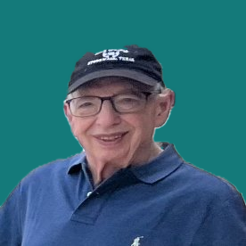

About Us
Dr. Murray Cantor
PhD, Mathematics — UC Berkeley
Dr. Joel Keenan
MD, Univ of Vermont
Not anti-vax or MAHA
From that perspective, there is a lot of confusion about medical claims
Respect for the challenge of medical research
Practicing physician with direct patient-care experience
Translates clinical evidence into plain-language guidance
Shares a commitment to honest, balanced medical communication
Notes:
Standard content layout. Title is a placeholder — click and type. Points left, one big number right.

Slide 3
Disclaimer
This presentation is for educational purposes only.
The content does not constitute medical advice and is not a substitute for professional diagnosis, treatment, or care. Nothing presented here should be used to make decisions about your health or the health of others. Always seek the advice of a qualified physician or other licensed healthcare provider with any questions you may have regarding a medical condition, test result, or treatment. Never disregard professional medical advice or delay seeking it because of something discussed in this presentation.

Slide 4
The Five Faults
1
Relative reporting
Day 1
What does a 36% improvement from taking a drug really mean?
2
Probability reversal
Day 2
What does a positive COVID test really mean?
3
Arbitrary categories
Day 3
How concerned should you be if your systolic BP goes from 119 to 120?
4
The Bernoulli fallacy
Day 3
Why does the published medical advice keep changing?
5
The causal leap
Day 4
Does bird watching prevent dementia?
Once you see them, you can’t unsee them.

Slide 5
FAULT 5
The Causal Leap
Confusing Correlation with Causation

Slide 6
A Positive Correlation: Two Things That Move Together
HOW IT'S MEASURED
The strength gets a number
Pearson r or Spearman ρ, each on a −1 to +1 scale.
NOT A CAUSE
The reason is a separate question
A correlation is a fact about the data, not an explanation.
Fault 5, the causal leap: treating this pattern as if it named a cause. The two series above are illustrative, drawn to show the shape rather than measured.

Slide 7
How Tight Is the Pattern? Strong and Weak Correlations
An r near ±1 means a tight pattern; an r near 0 means barely a pattern at all.
Strength still says nothing about cause: a weak tie can be causal, a strong one coincidence.
Illustrative data, 12 observations per panel; Pearson r calculated on the plotted points.

Slide 8
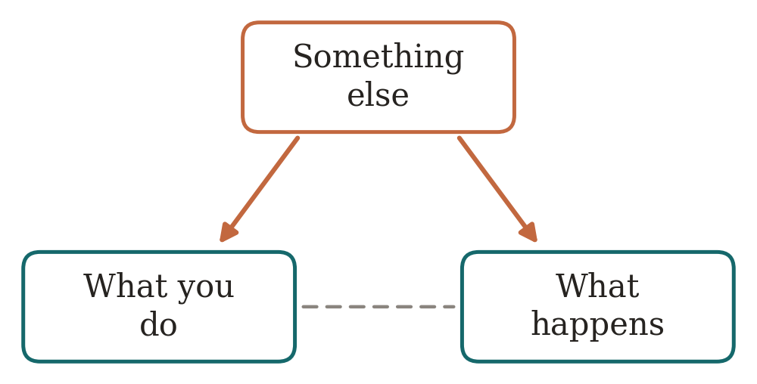
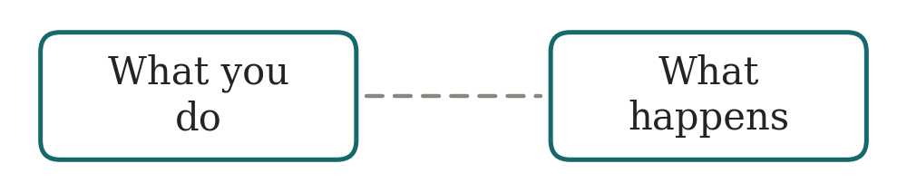
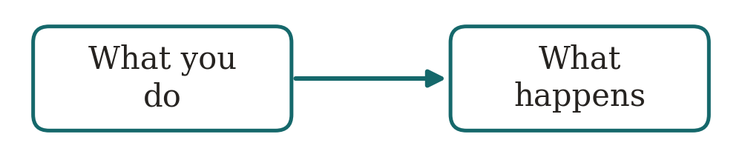
Three Explanations for a Strong Correlation
PURE COINCIDENCE
CONFOUNDERS
A GENUINE CAUSE
Nothing connects them.
Something else produces both.
The claim is true.
Solid arrow: causes. Dashed line: moves together, which is all the data shows you.
Only the right one is the claim being made.
All three produce the same correlation, and the data cannot tell you which one you are looking at.

Slide 9
Case 1: Pure Coincidence, Nothing Behind the Correlation
Tyler Vigen’s Spurious Correlations
THE SOURCE
A project that hunts for variables that happen to move together.
Thousands of variables, every pair tried
THE SEARCH
Out of hundreds of millions of pairs, the tightest are kept.
The fits are genuinely strong
NO CAUSE
High correlation, small p-value, and nothing connecting them.
Search enough pairs and a near-perfect match turns up somewhere, meaning nothing.
Two examples ahead: Saturn and degrees, then cheese and a share price.
Charts from Tyler Vigen, Spurious Correlations (tylervigen.com), CC BY 4.0. The next two: Saturn’s distance and physical-science degrees; cheese consumption and a share price.

Slide 10
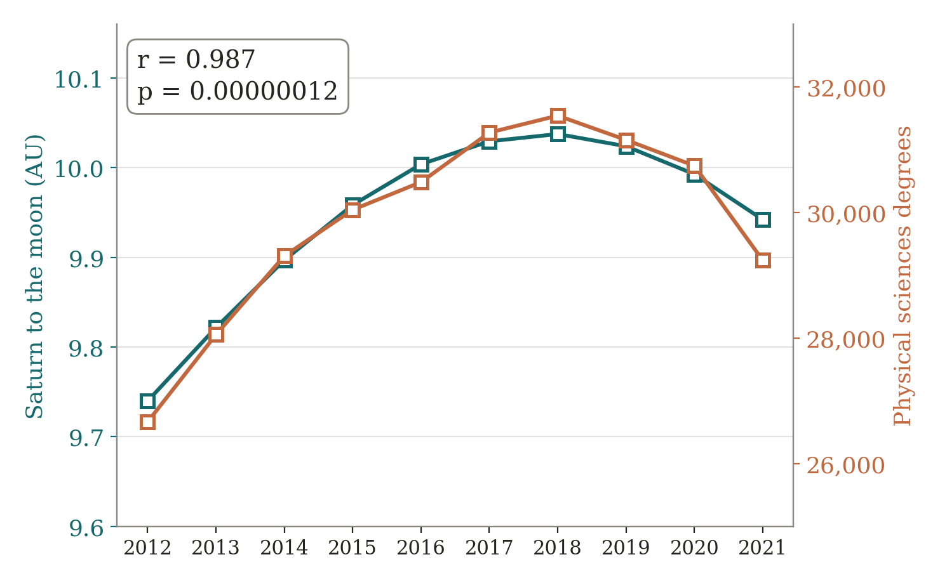
Coincidence: Saturn and Physical Science Degrees
How far Saturn sits from the moon tracks how many physical sciences degrees America awards.
p = 0.00000012. Past five sigma.
It would clear any journal's bar. It means nothing at all.
Data compiled by Tyler Vigen, tylervigen.com, spurious correlation #2,656, CC BY 4.0. Planetary distances calculated with Astropy; degrees from the National Center for Education Statistics, Digest of Education Statistics 2022. r = 0.987, r² = 0.974, p = 1.2 × 10⁻⁷ over 2012-2021.

Slide 11
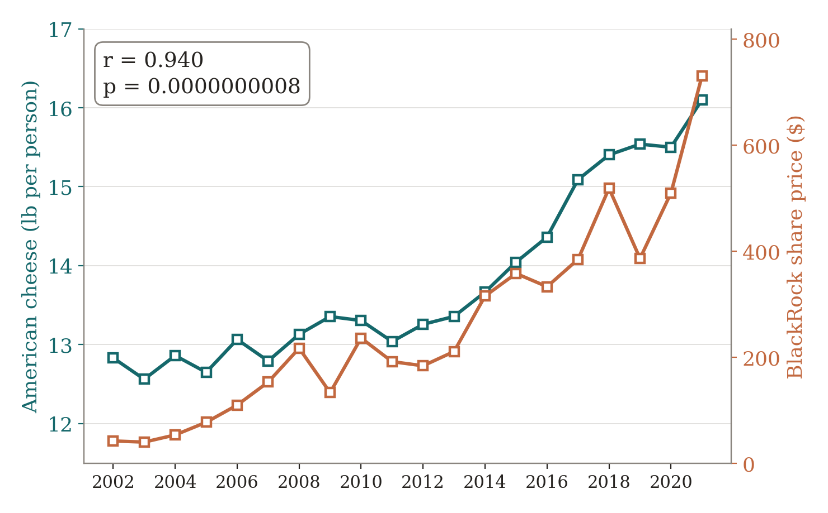
Coincidence: Cheese and BlackRock's Share Price
American cheese eaten per person tracks BlackRock's share price.
r = 0.94. p = 0.0000000008.
Both went up. That is the entire connection.
Correlate the year-to-year changes instead, and it is gone: r = 0.29, p = 0.23.
Any two things that grow will correlate. The trend is not the evidence.
Data compiled by Tyler Vigen, tylervigen.com, spurious correlation #4,018, CC BY 4.0. Cheese consumption from the USDA Economic Research Service; BlackRock opening price on the first trading day of each year from LSEG Analytics (Refinitiv). r = 0.940, r² = 0.883, p = 8.1 × 10⁻¹⁰ over 2002-2021. The differenced figures are calculated from the same data.

Slide 12
What Both Charts Are Missing: A Population
One square would be a year, not a person. There is no group of people the number could be about.
SATURN AND THE DEGREES
CHEESE AND BLACKROCK
Found by extensive search.
Many things rise year to year.
Millions of pairs of numbers were compared against each other. Some pairs were bound to line up.
Cheese eaten per person went up. So did the share price. So did most other things over those twenty years.
Compare the year-to-year changes instead of the totals, and the cheese link disappears: 0.94 becomes 0.29.
Neither chart has people in it.
That closes coincidence. Next come correlations that do have people in them, with something else behind the link.
Both compiled by Tyler Vigen, tylervigen.com, CC BY 4.0: correlations #2,656 (Astropy and the National Center for Education Statistics, 2012-2021) and #4,018 (USDA Economic Research Service and LSEG Analytics, 2002-2021). Vigen notes on each page that using years as the base variable is itself the problem. The year-to-year figure is calculated from his data.

Slide 13
Case 2: Confounders, a Third Factor Drives Both
The third factor sits behind both. Adjust for it, and the link between the other two thins out or vanishes.
Unlike Saturn and the cheese, these four have real people in them: statins and crashes, a sugar pill, bird watching, vaccines and autism.
In each, something about the people produces the correlation. The causal link is an illusion.
A real correlation with no real causation, produced by a lurking common cause. Examples ahead: Dormuth 2009 (statins and accidents); Sabia 2017, Whitehall II (bird watching and dementia).

Slide 14
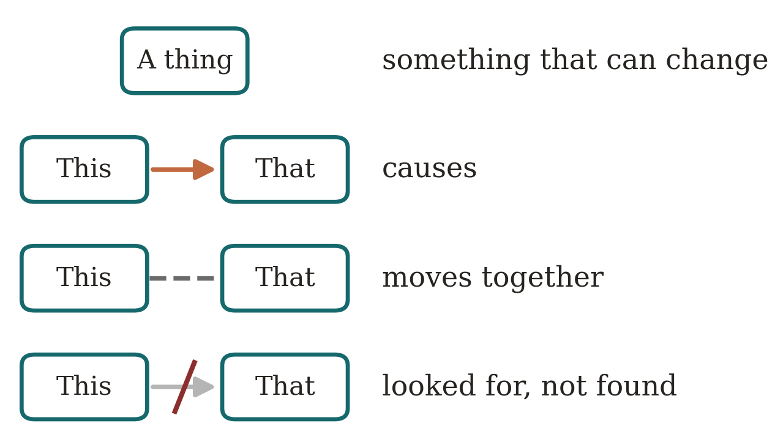
Reading the Diagram: Boxes, Arrows, Crossed Arrows
A box
A THING
An activity, a trait, a diagnosis.
An arrow
A CAUSE
One thing makes another more likely.
A crossed-out arrow
NOT A CAUSE
Looked for, and not found.
One box with arrows to two others is a single cause behind both.
The boxes stay the same. Only the arrows change the story.
The same notation is used on every diagram in this session.

Slide 15
The Claim: Statins Prevent Car Crashes
141,086 people starting statins
THE STUDY
British Columbia, grouped by how faithfully they took the pill.
Faithful takers had fewer accidents
THE FINDING
Car crashes, workplace injuries, falls, fractures, poisonings.
And they used more screening
THE TELL
Preventive services a cholesterol pill has no way to affect.
Published under the title, a cautionary tale.
No mechanism in the pill reaches any of these. Something about the people produces all of them.
Dormuth CR et al. Statin adherence and risk of accidents: a cautionary tale. Circulation 2009;119:2051-2057. Adjusted hazard ratios 0.75 for vehicle accidents, 0.77 for workplace accidents, 1.17 for screening use, among 141,086 statin initiators.

Slide 16
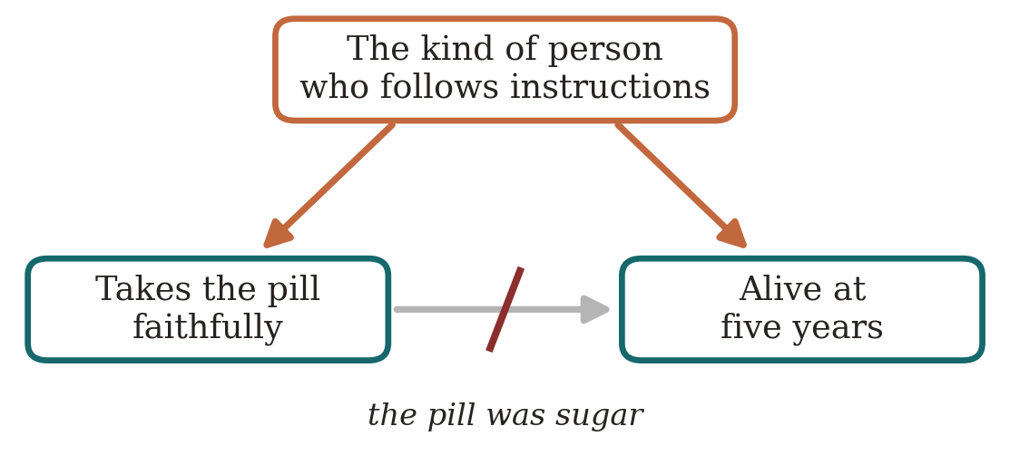
Faithful Takers of a Sugar Pill: The Coronary Drug Project
15.1%
five-year mortality, faithful takers of the dummy pill
28.3%
five-year mortality, unfaithful takers of the dummy pill
The pill was sugar. The difference was the person.
The gap carries P = 4.7 × 10⁻¹⁶. Significant at any bar you like, and still not the pill.
People who follow health instructions live longer, and it is the person, not the pill.
Coronary Drug Project Research Group. Influence of adherence to treatment and response of cholesterol on mortality. N Engl J Med 1980;303:1038-1041.

Slide 17
The Claim: Bird Watching Prevents Dementia
The headline is illustrative
ILLUSTRATIVE
No study makes this exact claim about birds.
The real study is Whitehall II
THE STUDY
10,308 British civil servants, followed for 28 years.
It measured activity, not birds
THE FINDING
At first look, active people developed dementia less often.
A real association, in one real population.
The next slides ask what produces the pattern.
Sabia S et al. Physical activity, cognitive decline, and risk of dementia: 28 year follow-up of the Whitehall II cohort. BMJ 2017;357:j2709. 10,308 participants. The bird-watching headline is illustrative.

Slide 18
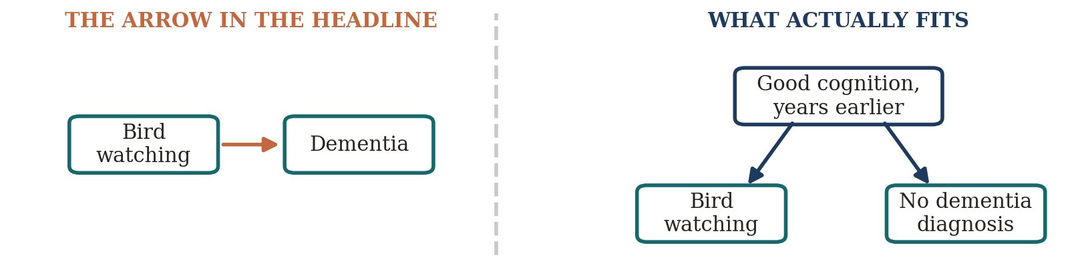
Three Candidates for the Bird Watching Correlation
“Bird watchers show lower rates of dementia, study finds.” (illustrative headline)
A coincidence? No. These are people, and the grid can be drawn.
A common cause? Maybe. Education, income, mobility, green space.
Cognition itself? A sharp mind sends people out with binoculars and keeps them off the diagnosis list.
Counting the two groups cannot pick the diagram. Cognition drives both columns, years before any diagnosis; the bird watching itself does nothing.
Sabia S et al. Physical activity and risk of dementia: 28 year follow-up of Whitehall II. BMJ 2017;357:j2709.
Notes:
This is a confounding case, and the confounder is cognition itself. People whose minds are still sharp go out with binoculars and are not diagnosed; the decline that will become a diagnosis starts years earlier and removes the hobby first.
The waffle test cannot settle this one. Both groups are real people, one population, one split. The grid looks fine. What is wrong is that a third thing drives both columns, and a count of two groups cannot see it.
Whitehall II is the real version, with exercise instead of birds. They asked when the two trajectories separate. Identical from 28 years before diagnosis down to about 10, then activity falls away over the last nine. The timing is what identifies cognition as the common cause.
Point at the fork on the next slide and say that this is what the data fits.

Slide 19
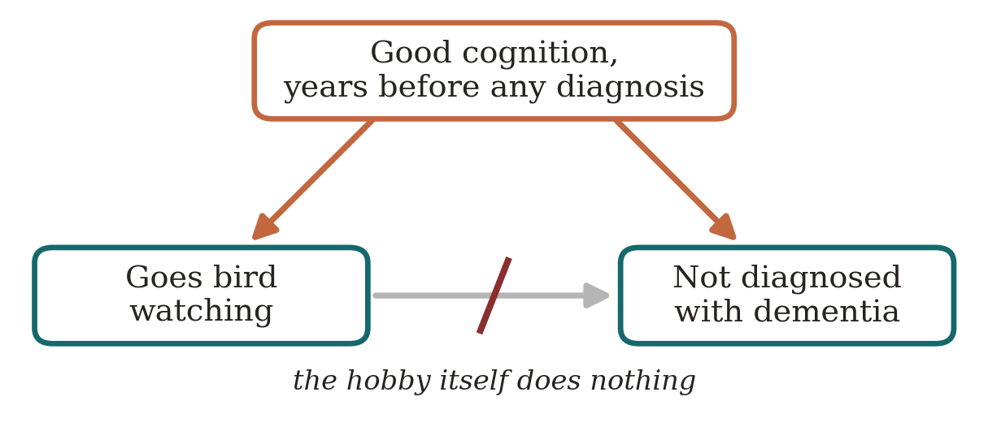
What Explains the Bird Watching Data Instead
Whitehall II watched for 28 years. Activity was identical until about ten years before diagnosis, then fell away: cognition was already declining, and it took the hobby with it.
Followed for 28 years, the activity made no difference. Bird watching does not prevent dementia; the correlation is real and the arrow is not.
Sabia S et al., physical activity, cognitive decline, and risk of dementia: 28 year follow-up of the Whitehall II cohort. BMJ 2017;357:j2709. 10,308 people; hazard ratio for meeting activity guidelines 1.00, 95% CI 0.80 to 1.24; activity fell in the nine years before diagnosis.

Slide 20
The Claim: Vaccines Cause Autism
1 in 150
8-year-olds identified as autistic, CDC surveillance year 2000
1 in 31
8-year-olds identified as autistic, surveillance year 2022
Over the same years the childhood vaccine schedule grew. Both lines went up.
Two rising lines, like the cheese chart, but this time with children in it. The question is what drives the second line.
Two rising series make a correlation. Something else may be driving the count.
Shaw KA et al. Prevalence and early identification of autism spectrum disorder among children aged 4 and 8 years, ADDM Network, 16 sites, United States, 2022. MMWR Surveill Summ 2025;74(2):1-22. 6.7 per 1,000 in 2000; 32.2 per 1,000 in 2022.

Slide 21
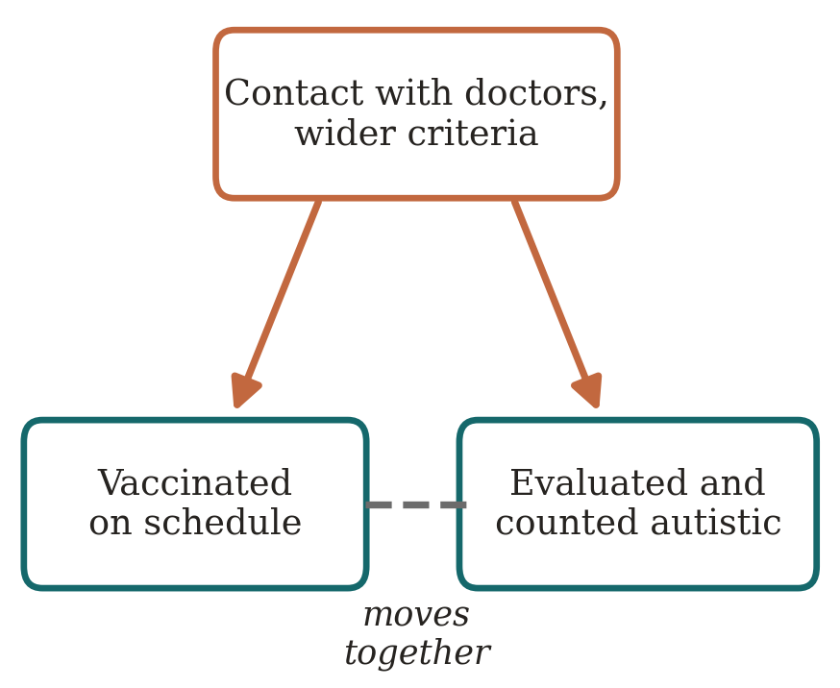
The Autism Count Measures a Moving Category
60%
of Denmark's rise explained by the 1994 criteria change and 1995 outpatient recording alone (95% CI 33 to 87%)
5×
spread between CDC sites in one year: 9.7 per 1,000 in Laredo, 53.1 in California, same criteria
1 in 3
of British Columbia's increase was children moved in from another special-education category
Criteria broadened in 1994 and again in 2013 when Asperger's was folded in. Outpatient cases entered the registries, schools reclassified, and insurance began paying for the diagnosis.
The confounders are contact with doctors and a widening category. Both raise the count; neither is the vaccine.
Hansen SN, Schendel DE, Parner ET. JAMA Pediatr 2015;169(1):56-62 (677,915 children born 1980-1991). Shaw KA et al. MMWR Surveill Summ 2025;74(2):1-22. Coo H et al. J Autism Dev Disord 2008;38(6):1036-1046. Mandell DS et al. JAMA Pediatr 2016;170(9):887-893 (insurance mandates raised treated prevalence 0.21 per 1,000).

Slide 22
The Studies That Settled It: Child Against Child, Same Era
537,303 Danish children, MMR
THE FIRST
Madsen 2002. Relative risk of autism 0.92 (95% CI 0.68 to 1.24).
657,461 Danish children, MMR
THE REPLICATION
Hviid 2019. Hazard ratio 0.93 (0.85 to 1.02), high-risk siblings included.
1.2 million Danish children, aluminum adjuvant
THE LATEST
Andersson 2025. Neurodevelopmental disorders 0.93 (0.88 to 1.03).
Vaccinated and unvaccinated children, the same years, the same diagnostic rules. No trend to confound.
Compared child against child, the diagnosis arrives at the same rate. The trend was the measure moving; the cause was never there.
Madsen KM et al. N Engl J Med 2002;347:1477-1482. Hviid A et al. Ann Intern Med 2019;170:513-520. Andersson NW et al. Ann Intern Med 2025;178:1369-1377. Also Taylor LE et al. Vaccine 2014;32:3623-3629, meta-analysis of 1.26 million children, odds ratio 0.99 (0.92 to 1.06).

Slide 23
Case 3: A Genuine Cause, Smoking and Lung Cancer
The correlation was real and huge
THE STUDIES
1950s cohorts of hundreds of thousands; smokers got lung cancer far more often.
The era’s top statistician objected
THE OBJECTION
R. A. Fisher: perhaps a gene drives both the smoking and the cancer.
And the objection can be tested
THE ANSWER
A common cause that strong would leave a mark you can measure.
This is the question the whole day teaches: could a common cause be doing the work?
Here, for once, the arrow survives it. The next four slides show what that took.
Correlation from the 1950s cohort studies (Doll and Hill; Hammond and Horn, 187,783 men). Fisher RA. Cigarettes, cancer, and statistics. Nature 1958;182:596. Stolley PD. Am J Epidemiol 1991;133:416-425. Answered by Cornfield J et al. J Natl Cancer Inst 1959;22:173-203.

Slide 24
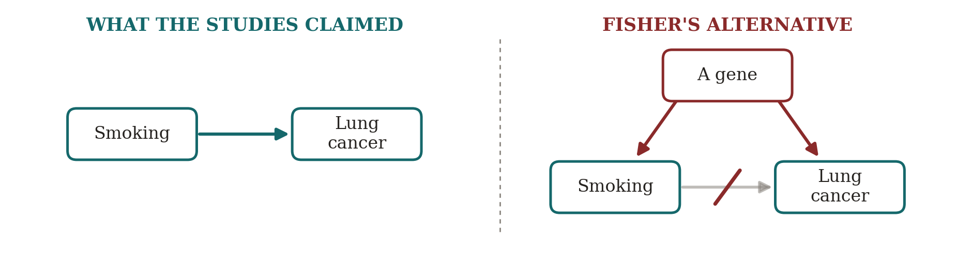
Fisher's Objection: Perhaps a Gene Causes Both
R. A. Fisher, inventor of the significance test, said the link could be a gene that produces both the craving and the cancer.
He was a paid consultant to the tobacco industry. And a smoker.
The right-hand diagram was a legitimate question. Answering it took arithmetic, not indignation.
Fisher RA. Cigarettes, cancer, and statistics. Nature 1958;182:596. Stolley PD. Am J Epidemiol 1991;133:416-425.
Notes:
Fisher's hypothesis is the constitutional hypothesis. In diagram terms it is the middle card from earlier: a common cause, plus the deliberate claim that the arrow between smoking and cancer is not there at all. That is why the arrow on the right is struck through.
Say plainly that the right-hand diagram is a fair thing to draw. It is the question this session teaches them to ask. What makes Fisher a cautionary tale is that he would accept no answer, and that he was on the payroll while asking.
The next slide is the answer, and it is about the size of the two arrows coming out of the gene.

Slide 25
Lung Cancer in One Hundred British Men, Around 1950
THE FORWARD DIRECTION
P( lung cancer | cigarettes )
10 / 65 = 16%
Never-smokers: 2%. Eight times apart.
Smoked, lung cancer: 10
Smoked, no cancer: 55
Never smoked, lung cancer: 1
Never smoked, no cancer: 34
THE REVERSE DIRECTION
P( cigarettes | lung cancer )
10 / 11 = 91%
But 65% of all men smoked anyway.
About 65% of British men smoked around 1950 (Doll R. Br J Cancer 1953;7:303). Lung cancer risk by age 75 is 15.7% for continuing smokers (Crispo A et al. Br J Cancer 2004;91:1280-1286); the 2% for never-smokers is approximate. Counts rounded to whole men, so the reverse conditional reads 10 of 11 (91%), not 94%.
Notes:
One population, two denominators. That is the whole slide, and it is Day 2's machinery on the day's one genuine cause.
The split is cigarettes, because that is what the argument was about. Everyone else is in the other group: pipe and cigar smokers, ex-smokers, and the few who never smoked. Nobody is left out.
Point at the grid. 65 of the 100 smoked cigarettes, and 10 of those 65 got lung cancer by 75. One of the other 35 got it too.
Forward: the denominator is 65. 10 of 65, about 16 in 100, against 1 in 35, about 2 in 100. Eight times apart.
Reverse: the denominator is the 11 who got lung cancer. 10 of the 11 smoked cigarettes. About 94%.
The trap, and the line to land: the 94% is inflated by the base rate. Two men in three smoked cigarettes, so two in three of any group of them smoked, whether or not the group has anything to do with smoking. Two in three of the men run over by buses smoked too.
The forward comparison owes nothing to how common smoking was. That is the difference between the two directions, and it is the whole point of the slide.
The 2% is the one approximate figure here. It is mostly pipe, cigar and ex-cigarette smokers, so it sits above the never-smoker rate of under 1% and well below the cigarette rate. Nothing turns on it: at 1% the reverse conditional is 97%, at 3% it is 91%, and the story is the same.
This slide does not answer Fisher. His gene predicts this grid just as well. The next slide is the answer.

Slide 26
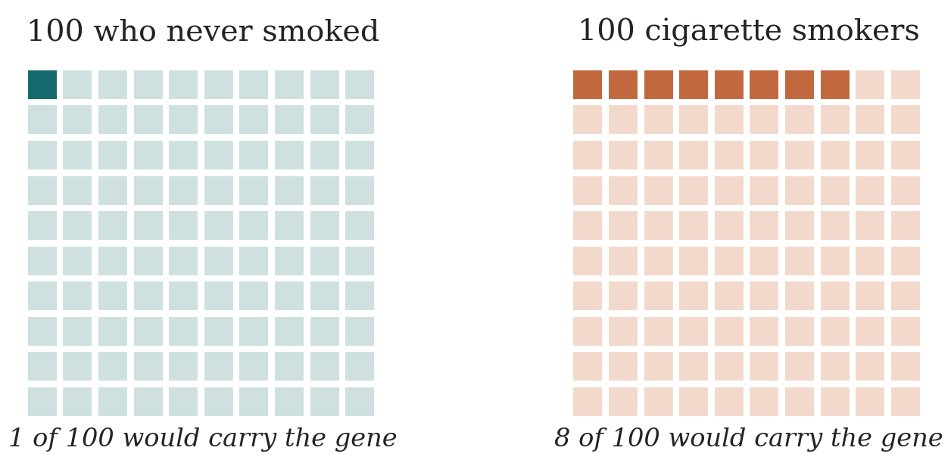
How Big Would Fisher's Gene Have to Be?
For a gene to produce an eightfold risk on its own, it would have to be at least eight times as common among smokers as among never-smokers. That is a prevalence, and it can be checked.
The rival was ruled out by a prevalence it would need and does not have. The arrow survives because the arithmetic was done, not because the correlation was strong.
Cornfield J et al. Smoking and lung cancer: recent evidence and a discussion of some questions. J Natl Cancer Inst 1959;22:173-203. The 1-in-100 and 8-in-100 prevalences are illustrative; only the ratio is forced by the eightfold risk. Later confirmation from twins discordant for smoking: the smoking twin carried the excess risk (NorTwinCan, Hjelmborg J et al. Thorax 2017;72:1021-1027).

Slide 27
A Correlation Becomes a Cause Only When Confounders Are Ruled Out
The correlation was the easy part — everyone had one
THE COINCIDENCE
Saturn's orbit tracked engineering degrees at r = 0.987. Smoking tracked lung cancer. The number alone cannot tell coincidence from cause.
The forward probability is what made the case
THE FORWARD QUESTION
16% of smokers got lung cancer vs. 2% of never-smokers — an eight-fold gap. “91% of patients smoked” just echoes that 65% of all men smoked.
The rival explanation failed the same arithmetic
THE RULED-OUT RIVAL
Fisher's gene could only explain the gap if it were eight times as common among smokers. No trait was. The causal arrow survived.
Saturn had the correlation; smoking had the forward gap and no rival left standing.
Doll R. Br J Cancer 1953;7:303 (about 65% of British men smoked cigarettes c. 1950). Cornfield J et al. J Natl Cancer Inst 1959;22:173-203. The counts on the previous two slides are rounded to whole men and labelled illustrative where noted.

Slide 28
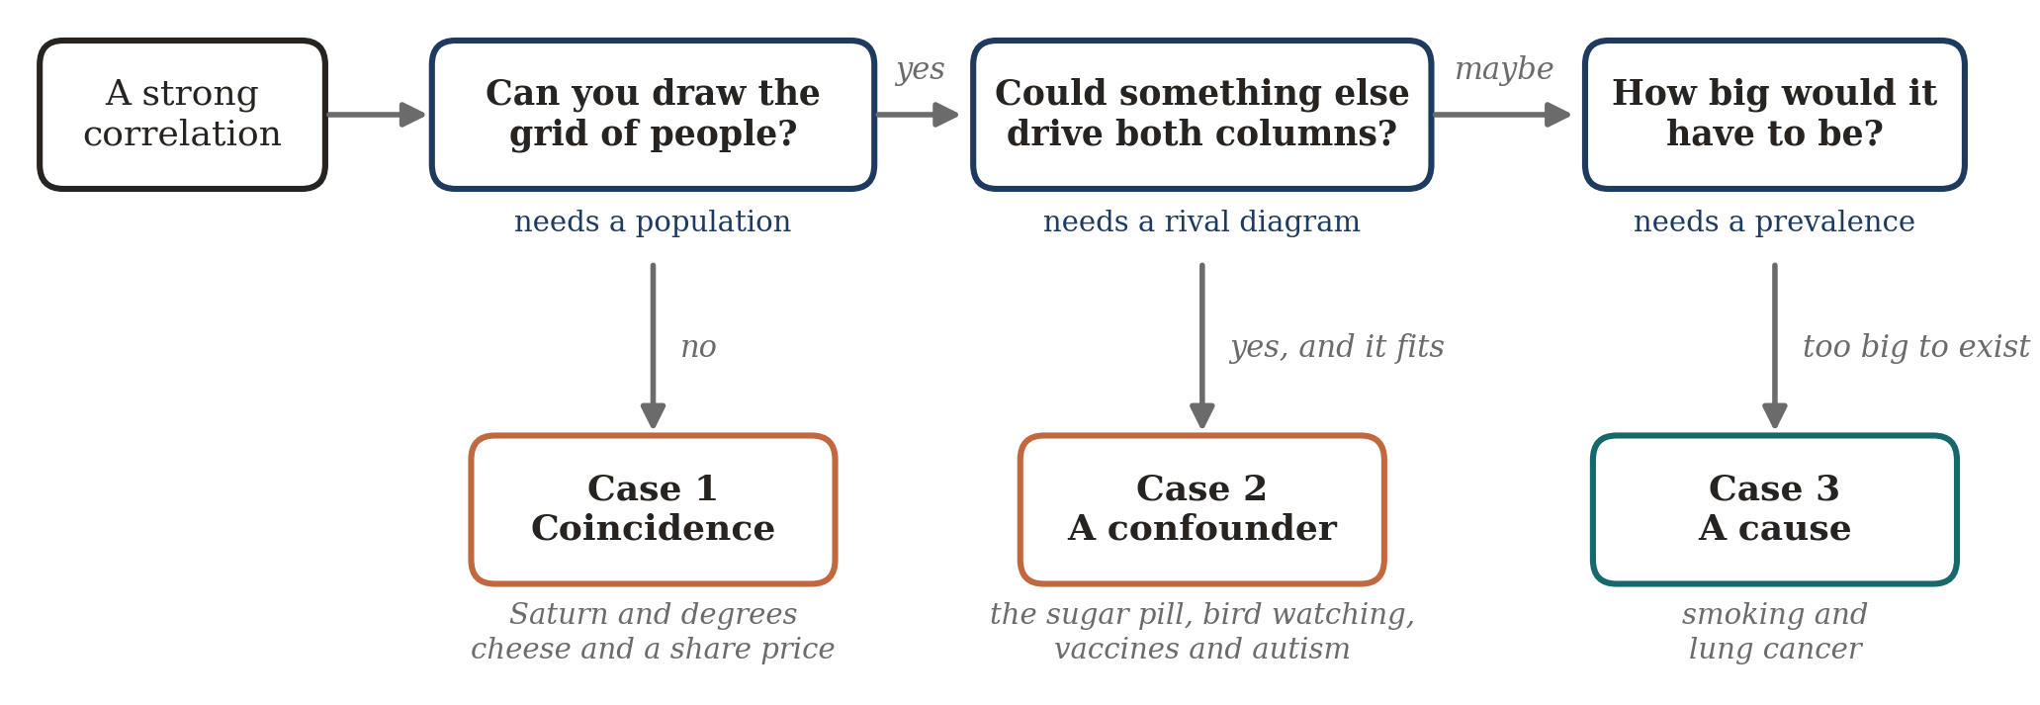
The Whole Day in Three Questions
Notes:
This is the payoff of the day. Every case they saw, in one notation, with the dashed observation identical in all four.
Walk left to right. Saturn and the degrees: no arrow anywhere, and no population to draw, because the unit is a year. The pill takers: two arrows out of something else, and Dormuth's own conclusion was that adherers are systematically more health-seeking. Bird watching: the same arrow, pointing back. Smoking: the arrow survived, and it survived because Cornfield showed how large the rival would have to be.
The closing question is the one to leave them with. When you read a claim, ask which of these four the claim assumes, and ask what evidence would rule the other three out.
If anyone asks what the diagrams are called and where this goes next: they are causal diagrams, and Pearl's Book of Why, already on the reading slide, is the entry point. Reasoning with them by arithmetic is a Bayesian network.

Slide 29
The Course Topics and Takeaways
1
Relative reporting | Ask: 36% of what?
A change with no baseline is half a fact.
2
Probability reversal | A positive test is not a diagnosis.
What it means depends on how common the condition is.
3
Arbitrary categories | Just over the line is still you.
119 to 120 moved the label, not your body.
4
The Bernoulli fallacy | One study is not proof.
Run enough studies and something looks significant.
5
The causal leap | Moving together is not cause.
Two things track, and a third usually drives both.
Once you see them, you can’t unsee them.

Slide 30
Questions, and a conversation
Murray Cantor PhD murray@murraycantor.com
Joel Keenan MD drkeenan@mdvip.com
Notes:
Closing slide. Leave it up during Q&A.

