Slide 1
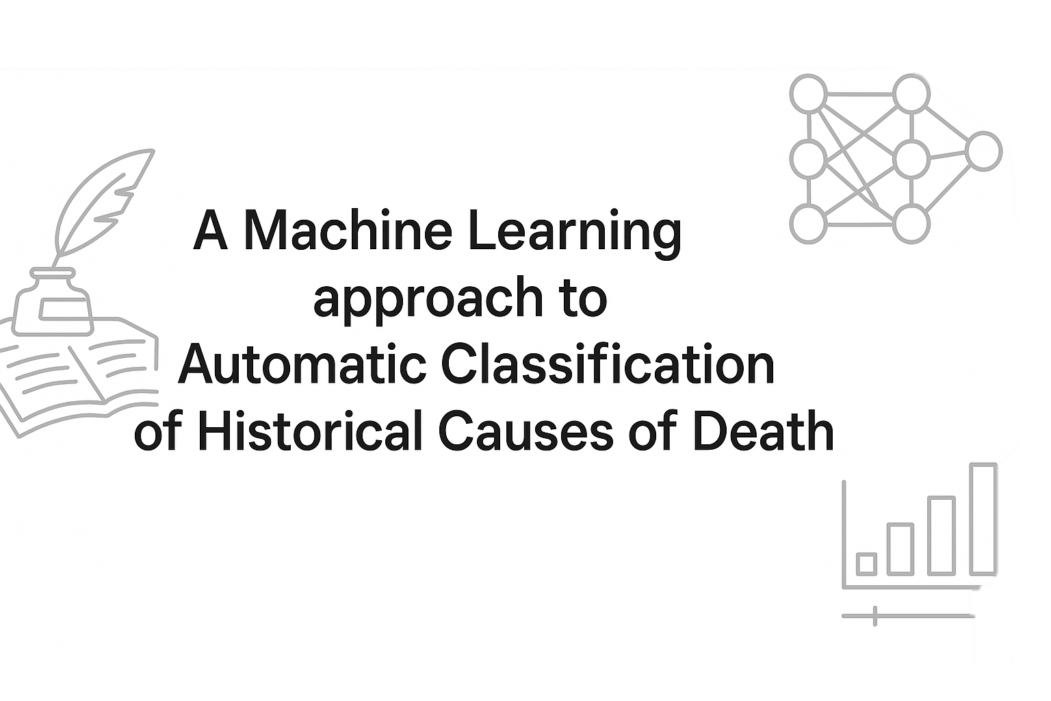

Lucas Mortensen & Mads Perner
Student Research Assistant @ PandemiX Center
Roskilde University, Denmark

Slide 2
Motivation
Large cause-of-death datasets have become available in recent years
Coding causes of d eath by hand is very time-consuming and it is often impossible to hand-code a full dataset
Machine Learning methods for automatic classification can probably help, but with what effort and precision?
Notes:
Cause of death datasets have become available recently, which is nice
Coding cause of death by hand takes a lot of time and nearly impossible to code a full dataset
Machine learning (might) be a great help here, to classify some of the dataset and use for training to classify the rest!

Slide 3
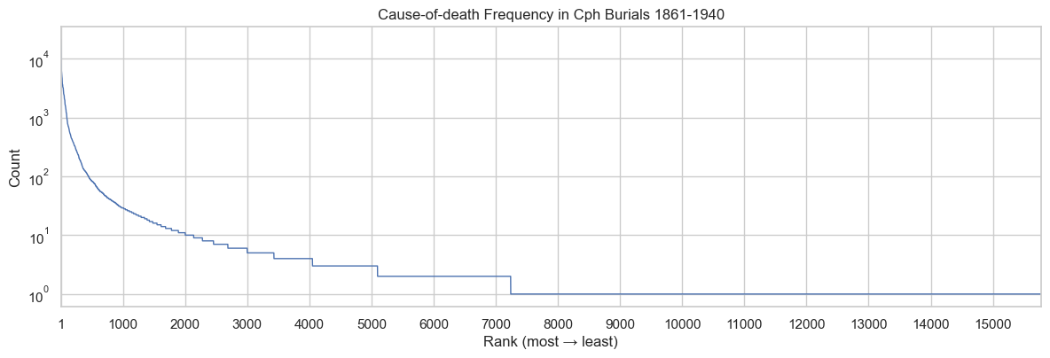
Test case: hand-coded causes from Copenhagen
ICD10h code | Description
B03.000 | smallpox not known if vaccinated
B03.001 | smallpox not known if vaccinated (blackpox)
B03.002 | smallpox not vaccinated
B05.000 | Measles complicated by encephalitis
B05.100 | Measles complicated by meningitis
B05.200 | Measles complicated by pneumonia
B05.201 | Measles complicated by bronchitis or laryngitis
B05.202 | Measles with other pulmonary complications
B05.203 | measles complicated by phthisis
B05.300 | measles complicated by otitis media
B05.400 | Measles with intestinal complications
B05.800 | measles with other complications
B05.801 | Measles with diphtheria
B05.802 | Measles with whooping cough
B05.900 | measles, no mention of complication
The data: ~ 550.000 individual-level burials from 1861 to 1940. Contains 15.776 unique causes of death. 16.3% of these have been hand-coded (top-down) to ICD10h, covering 86.6% of all deaths (in individualized dataset).
To study the trade-off between amount of training data and prediction accuracy in automatic classification, we use only the hand-coded causes to simulate a 100% coded dataset.
We define an accurate prediction by the model as one that hits the same ICD10h “block” as the manual coder.
Notes:
550.000 individuals in the dataset, 16.000 unique death causes
76% have been hand-coded, which covers around 30% of the individual cases.
To study how model precisions evolve, we created a subset using only classified causes of death, simulating a 100% classified dataset
Accurate prediction is the model hitting ICD10h *block*
*We are asking how much data is needed to be coded so a ML model can do the rest?

Slide 4
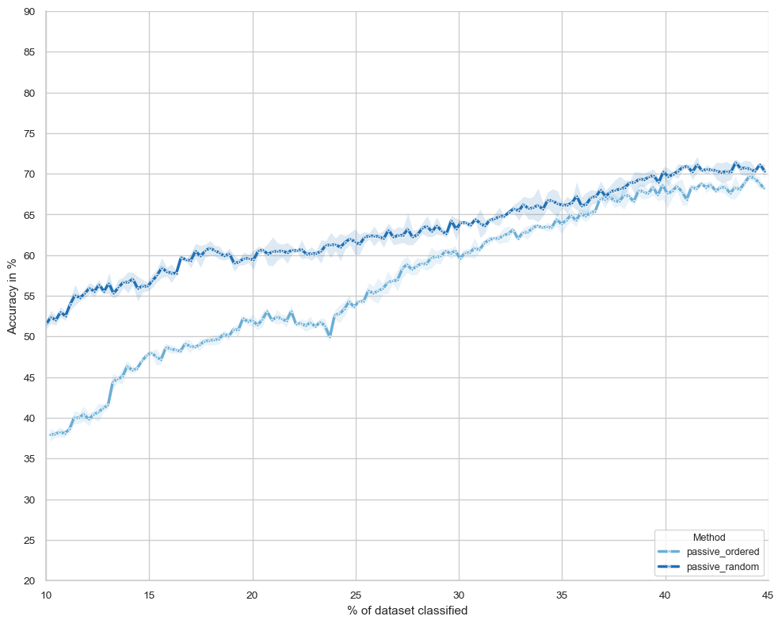
Selecting what to code matters
The accuracy of the classification model is higher if the training data is randomly selected rather than selected from the top-down.
Notes:
The way you select cause-of-deaths to classify matters.
Two main ways of doing it:
top-down, ordering by most to least frequent, and classifying from the top.
randomly selecting from the dataset
Look at the figure,
x-axis is % of dataset
y-axis is model accuracy (on a test-set)
Random selection is better

Slide 5
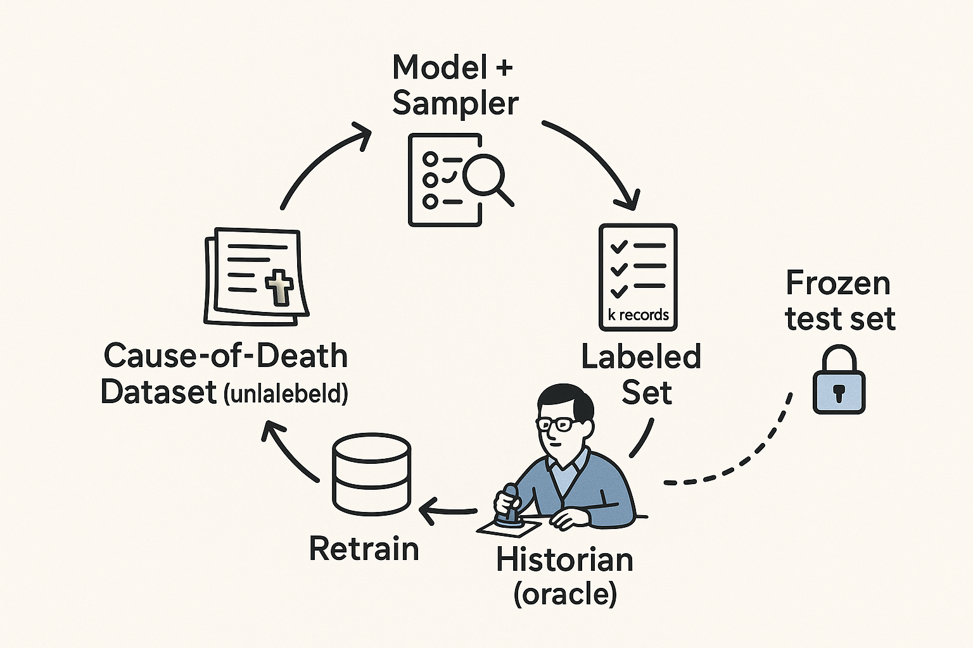
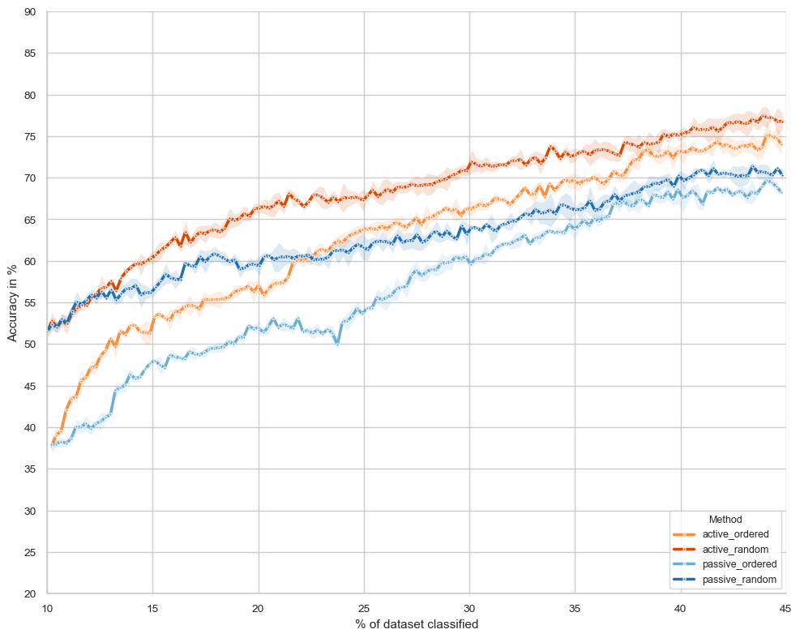
Active Learning: provide feedback during learning
A method for creating more efficient training data when classification is particularly time-consuming or expensive
Notes:
There’s a third option for selecting how you classify causes of death: active learning, machine learning technique
The method allows you to be part of the training process, getting feedback from the model along the way
Initially, you have a classified set (either top-down or randomly). Here 10%.
Here, model tells you which unclassified causes of death it’s most uncertain about
These are the causes which you must classify, as the model gains most from them
Then you add them to the classified dataset and train a new model using this – model gives uncertainty, and this loop continues.

Slide 6
What does this mean?
Random selection is better than top-down (for machine learning models)
Active learning outperforms passive learning, but there are diminishing returns from around 40% in our case
In all researched cases, (done correctly) active learning is better or just-as-good as random selection.
If you’re working with detailed datasets, like individualized (with age, gender, year, etc) machine learning methods could be great. Machine learning LOVES data!
Notes:
Random selection > top down
Active learning outperforms passive learning, but both will eventually converge
Active learning > random selection
Detailed datasets that provide context is great for machine learning

