Slide 1

E-Commerce Web App. In Cloud Computing
Submitted to
Prof. Emiliano Casalicchio
Project By
Mursal Furqan Kumbhar ←
kumbhar.2047419@studenti.uniroma1.it
(matricola: 2047419)
Srinjan Ghosh ←
ghosh.2053796@studenti.uniroma1.it
(matricola: 2053796)
A Cloud Computing Project

Slide 2


Table of Content
Introduction
Problem
Implementation
Tools Used
Testing & Validation
Demonstration
Future Work
Conclusion

Slide 3
Introduction

Slide 4
Project Overview
In response to the growing demand for scalable and robust e-commerce platforms, our project aims to develop a cloud-based application using microservice architecture. By leveraging the benefits of cloud computing technologies, particularly amazon web services (AWS), we seek to create a feature-rich platform that caters to both customers and sellers. Our project's objectives are to enable customers to search for products & place orders, and track their status, while providing sellers with tools to list products, manage inventory, and track deliveries. This project holds great significance as it addresses the challenges of scalability, fault isolation, and independent deployment, offering an efficient and user-friendly solution for the e-commerce industry.

Slide 5
Objectives and Goals
Develop a scalable e-commerce platform.
Enable seamless customer experience.
Empower sellers with efficient management tools.
Ensure system reliability and robustness.
Incorporate security and privacy measures.
Foster future growth and scalability.

Slide 6
Problem

Slide 7
Problem
Existing E-commerce Platforms Struggle To Provide Scalable And Robust Solutions, Resulting In Suboptimal User Experiences And Limited Management Capabilities For Sellers. There Is A Need For A Modern, Cloud-based E-commerce Application That Can Efficiently Scale, Offer Seamless User Experiences, And Empower Sellers With Effective Management Tools.

Slide 8
Proposed Solution

Slide 9
Implementation
Our goal is to develop a cloud-based e-commerce application that leverages microservice architecture and modern technologies. By utilizing scalable cloud computing services, such as AWS, and adopting a modular approach, we aim to create a robust and scalable platform. This solution will provide customers with seamless user experiences, enable efficient inventory management for sellers, and ensure system reliability and security.

Slide 10
Implementation
ReactJS: The frontend of our application was developed using ReactJS, providing a dynamic and responsive user interface.
API Request to AWS Lambda: To manage scaling and optimize performance, we made API requests to AWS Lambda functions, which handled backend processes.
MongoDB: We utilized MongoDB as our database for efficient data storage and retrieval, completing the cycle back to the ReactJS frontend.
Data pushed to GitHub through Git: To ensure version control and collaborative development, we pushed the project's data to GitHub using Git, allowing for effective version management and improved project utilization.
Deployed to S3 using CloudFront: For deployment, we hosted the application on Amazon S3, leveraging CloudFront as the content delivery network (CDN). This setup enabled efficient content delivery, low latency, and scalability.
Backup Deployment on GitHub Pages: As an additional deployment option for increased availability, we deployed the application on GitHub Pages, providing a backup hosting solution.
Continuous Deployment: With the help of AWS CodePipeline and AWS Codebuild, we have also created an entire CI/CD Pipeline keeping in view for future updates.

Slide 11
Tools Used

Slide 12

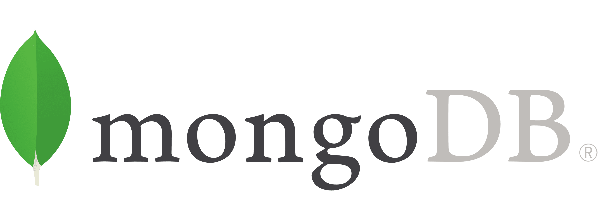
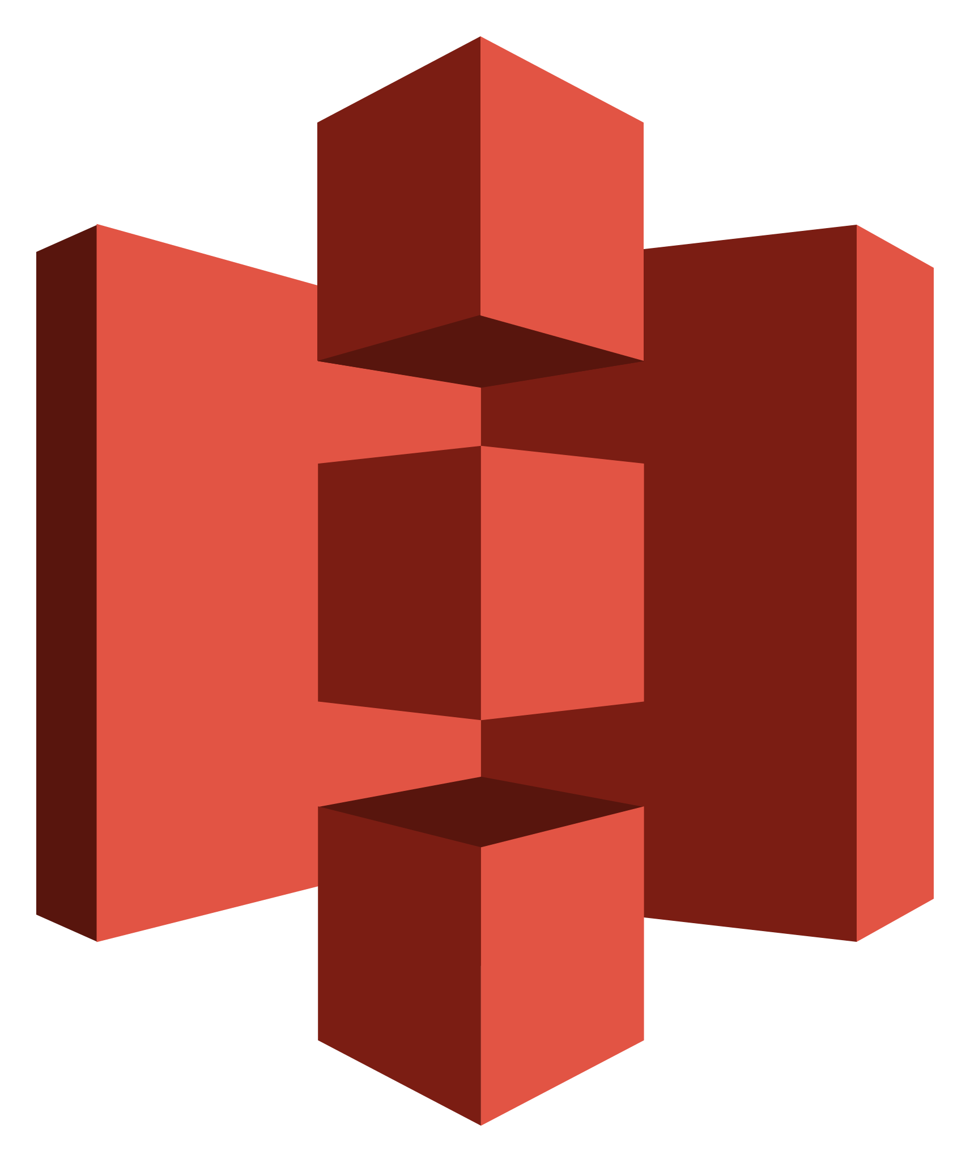
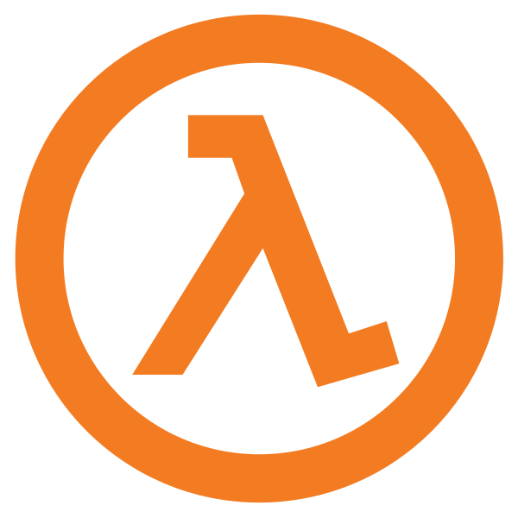
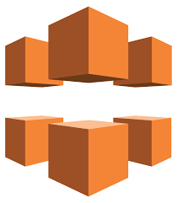
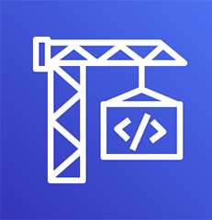
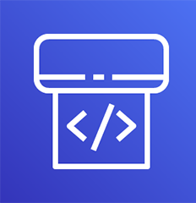



Tools Used
ReactJS
MongoDB
AWS Lambda & S3
AWS Cloudfront
Git & GitHub
VS Code
AWS Code Pipeline & AWS CodeBuild

Slide 13
Why Mongodb & not AWS Services?
Flexibility: Mongodb Offers A Flexible Data Model, Allowing Us To Store And Manage Data In A Document-oriented Format.
Compatibility: Mongodb Is Compatible With A Wide Range Of Programming Languages And Frameworks.
Developer-friendly: Mongodb's Query Language And Api Are Intuitive And Developer-friendly, Making It Easier To Work With And Perform Database Operations.
Scalability: Mongodb Offers Horizontal Scalability Through Sharding, Allowing The Database To Handle Large Volumes Of Data And High Traffic Loads.
Cost Considerations: Utilizing An Aws Database Service May Involve Additional Costs, Such As Data Transfer Fees And Storage Costs.

Slide 14
Testing & Validation

Slide 15
Testing
Unit Testing
Ensured component correctness and reliability through focused unit tests.
Integration Testing
Validated seamless communication and functionality across the application's components.
Scalability Testing
Evaluated performance and scalability under different workloads to optimize system efficiency.

Slide 16
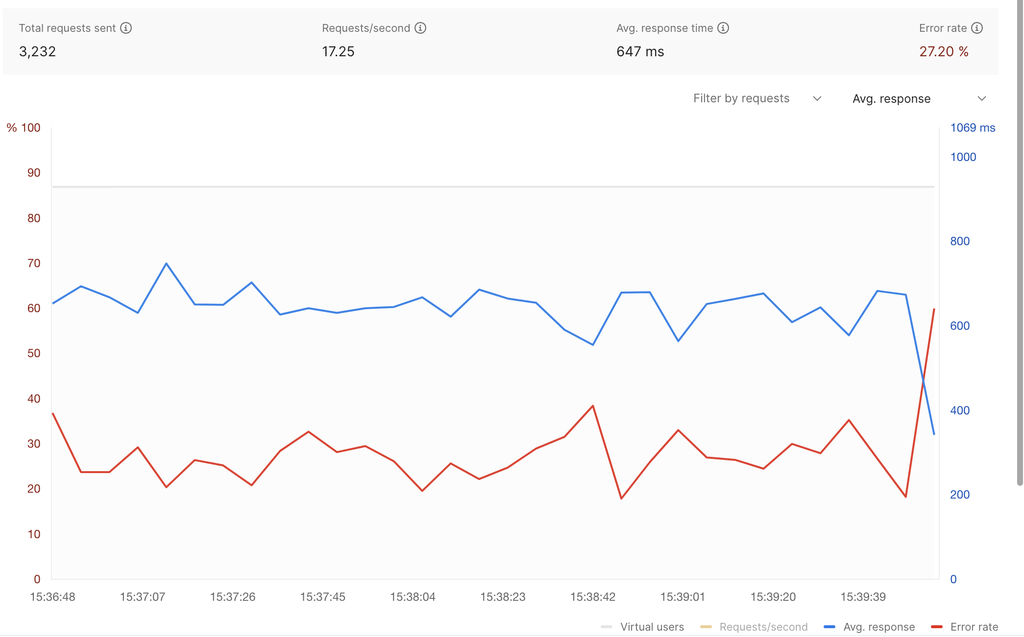
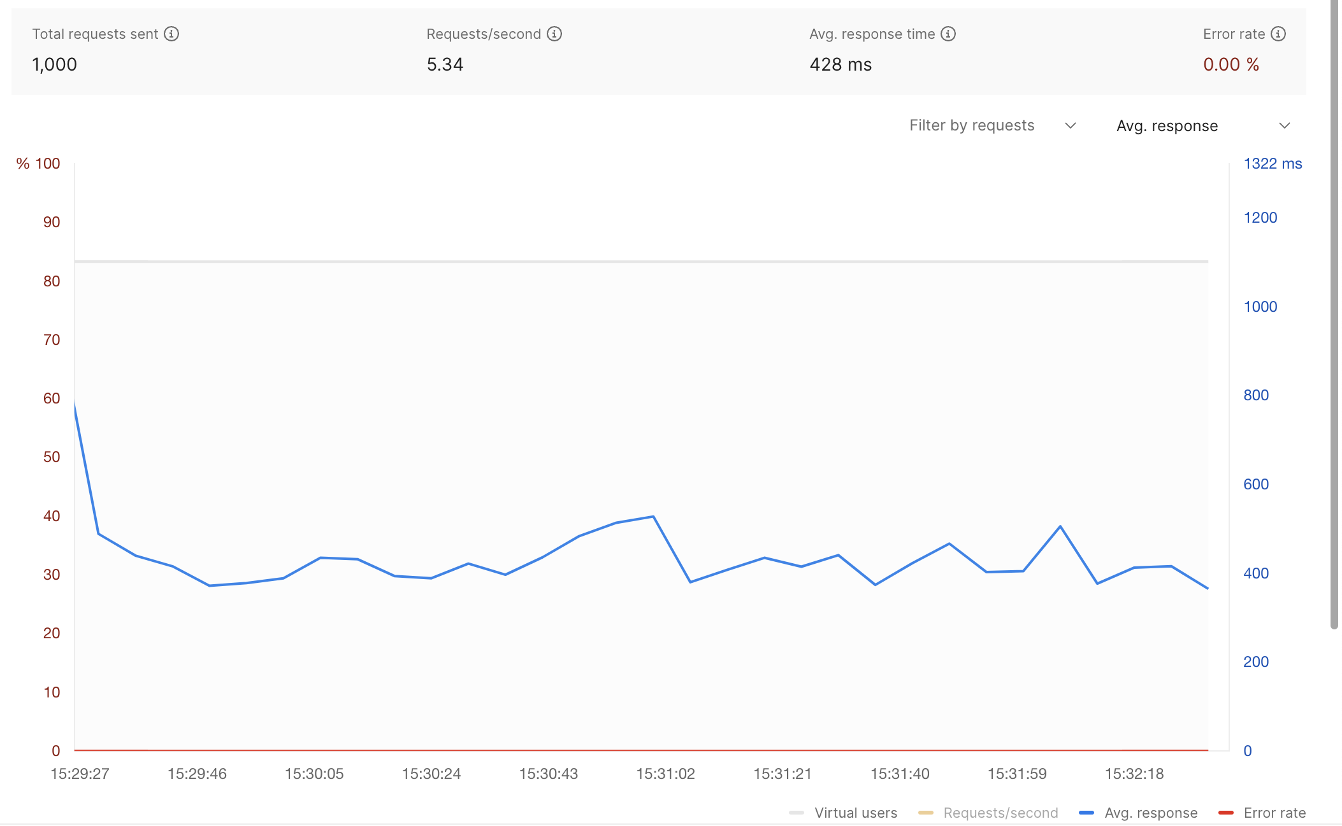
Scalability Testing

Slide 17

Validation
End-to-End (E2E) Testing: Rigorous tests simulated real user interactions, validating critical functionalities and error handling.
Usability Testing: Extensive user testing sessions gathered feedback to enhance the user experience.

Slide 18
Future Work

Slide 19
Future Work
Enhanced personalization
Advanced analytics and insights
Integration with third-party services
Mobile application development
Performance optimization
Enhanced security measures

Slide 20
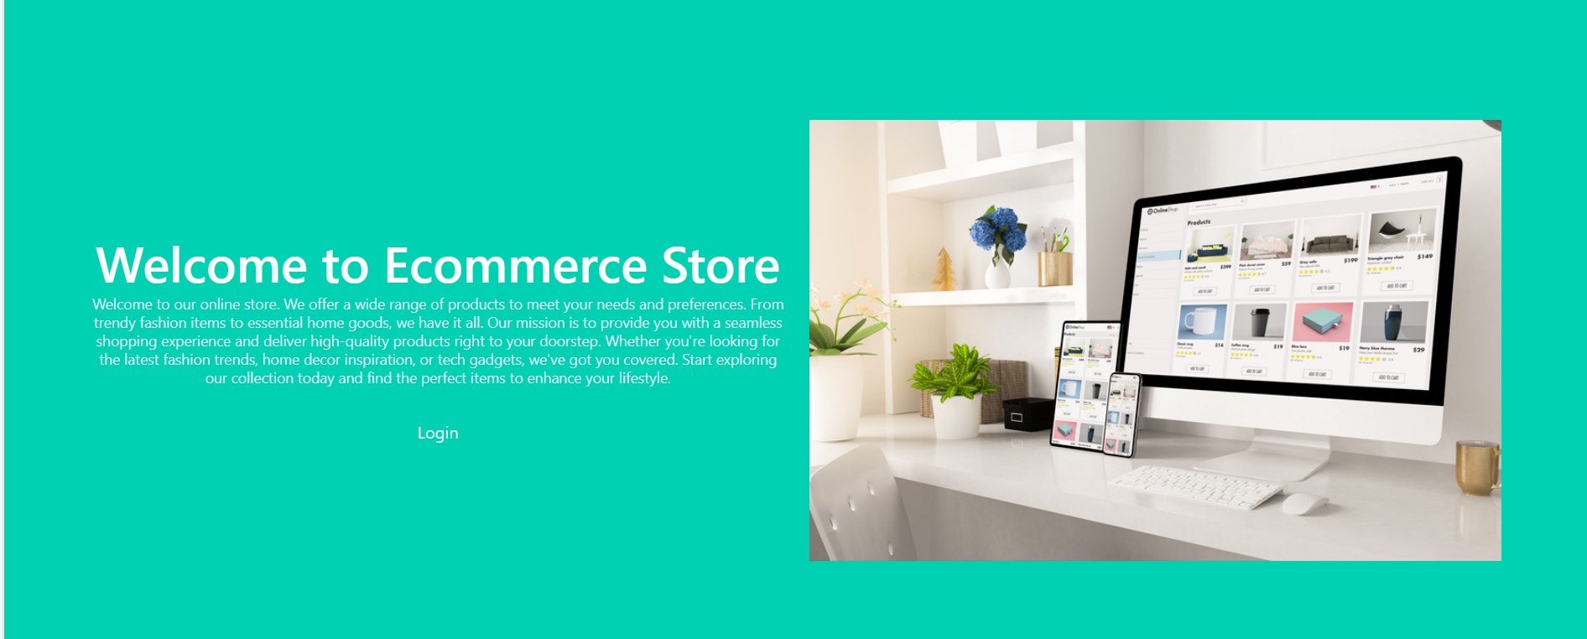
Demo
E-Commerce Store

Slide 21
Conclusion

Slide 22
Conclusion
Our project created a scalable e-commerce platform with seamless user experiences. Through testing and validation, we ensured reliability. Future work includes personalization, analytics, and mobile app development.

Slide 23
THANK YOU

