Slide 1
Chip Category Strategic Review
Customer Analytics & Trial Store Performance
Quantium Retail Analytics Team
Prepared for: Julia — Category Manager
Date: May 2019
Analyst: Elchin Murshudlu

Slide 2
Agenda
_________________________________________________________________________________________________
01 - Executive Summary
02 - Customer Segment Analysis
03 - Product & Brand Insights
04 - Trial Store Performance
05 - Recommendations & Next Steps

Slide 3
Executive Summary
_____________________________________________________________________________________
Key Finding 1 — Top Customer Segments
Budget Older Families and Mainstream Young
Singles/Couples are the highest revenue-generating
segments, contributing $156.9K and $147.6K respectively.
Key Finding 2 — Product Preferences
Kettle is the dominant chip brand with $390K in sales.
The 175g pack size is the most preferred across all segments.
Key Finding 3 — Trial Store Results
Store 88 demonstrated a strong sales uplift during the
trial period. Stores 77 and 86 showed moderate results.
The trial layout is recommended for broader rollout.
$156.9K
Budget Older Families
Top Revenue Segment
$390K
Kettle — #1 Brand
175g Most Popular Pack
Store 88 ↑
Strongest Trial Uplift
Rollout Recommended

Slide 4
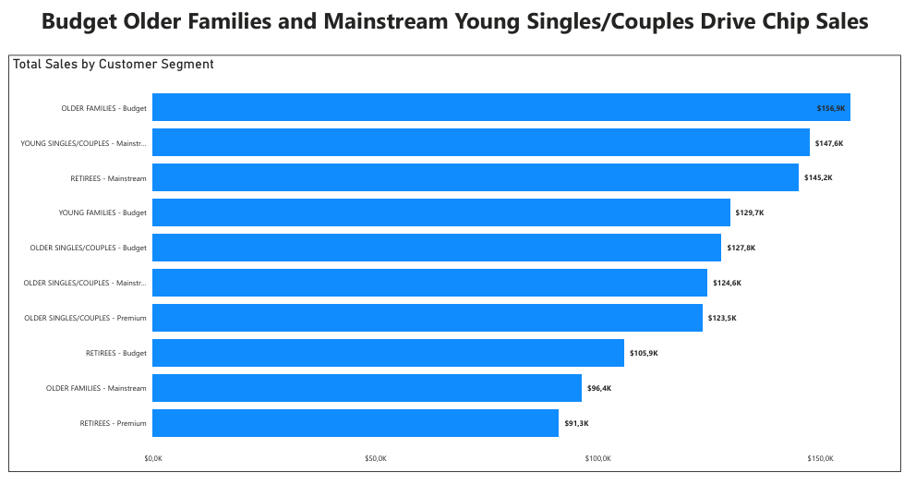
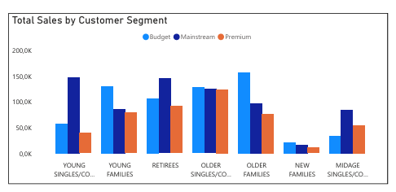
Customer Segment Analysis Budget Older Families and Mainstream Young Singles/Couples are the top revenue-generating segments.
- Budget Older Families: $156.9K total sales — largest segment
- Mainstream Young Singles/Couples: $147.6K — highest customer count
- Retirees (Mainstream): $145.2K — consistent spending pattern
- Premium customers show higher average price per unit ($4.1)
- 175g pack size dominates across all segments
Recommendation: Focus promotional activities on Budget Older Families and Mainstream Young Singles/Couples to maximize revenue.

Slide 5
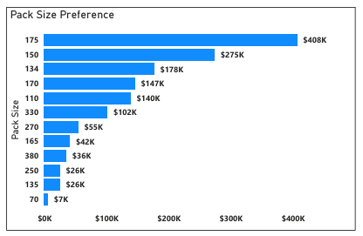
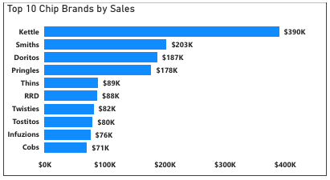
Product & Brand Insights Kettle dominates chip sales with $390K, while 175g is the most preferred pack size.
- Kettle: $390K — #1 brand across all segments
- Smiths: $203K — #2 brand
- Doritos: $187K — #3 brand
- Top 3 brands account for majority of total sales
- 175g pack: $408K — most purchased size
- 150g pack: $275K — second most popular
Recommendation: Prioritize shelf space and promotions for Kettle and Smiths in 175g and 150g pack sizes.

Slide 6
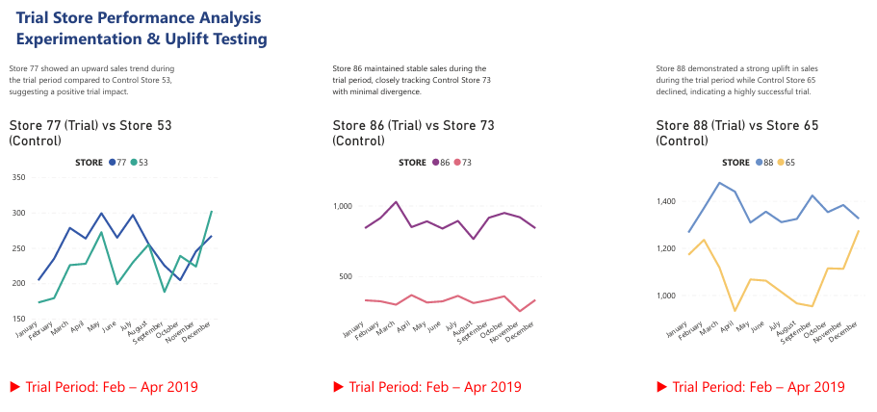
Trial Store Performance Store 88 demonstrated the strongest uplift during the trial period (Feb — Apr 2019).
- Trial Stores: 77, 86, 88 | Trial Period: Feb – Apr 2019
- Store 88 vs Control Store 65: Strong sales uplift ↑
- Store 77 vs Control Store 53: Moderate upward trend ↑
- Store 86 vs Control Store 73: Stable, minimal divergence →
Store 88 showed the most significant trial impact. Results support a broader rollout of the new layout.

Slide 7
Recommendations & Next Steps
01 Target Key Segments
Focus marketing budget on Budget Older Families
and Mainstream Young Singles/Couples.
02 Prioritize Top Brands
Ensure Kettle and Smiths are well-stocked,
especially in 175g and 150g pack sizes.
03 Roll Out Trial Layout
Store 88 results strongly support expanding
the new store layout to all locations.
04 Next Steps
• Conduct further analysis on underperforming segments
• Monitor Store 77 and 86 post-trial performance
• Review pricing strategy for Premium customers

