Slide 1
GOVERNMENT OF ALBERTA
IFTA Audit ML System
Evidence Normalization, Analytics & Machine Learning
3 files
7 used
4 applied
2 / 40
Data Sources
AWS Services
ML Approaches
Critical Records Flagged
Data Scientist Assessment | ca-central-1 | May 2026

Slide 2
Agenda
01
Problem Understanding
IFTA context and audit objectives
02
Data Sources & Extraction
4 files + Esso Express ZIP extraction fix
03
Data Curation
Cleaning, AWS Location Service, quality flags
04
Feature Engineering
5 IFTA features + correlation heatmap
05
ML Modelling & Results
Z-Score, Rules, Isolation Forest, K-Means, SHAP
06
AWS Architecture & Demo
7 services + live Athena queries
07
Limitations & Roadmap
Data quality, model limits, future supervised learning

Slide 3
01
Audit Objective
Problem
Understanding
🔍
Identify Anomalies
Detect implausible fuel/distance patterns indicating compliance risk
What is IFTA?
⚖️
Support Audit Risk
International Fuel Tax Agreement
• Simplifies fuel tax across multiple jurisdictions
• Reconcile fuel purchased per province with distance driven
• Canada + USA — provincial tax rates differ significantly
• Core fraud: buy fuel in low-tax province, claim distance in high-tax
Prioritize records — Critical, High, Medium, Low
💬
Explain Findings
Plain English per flagged record — defensible in court
☁️
Use AWS at Scale
Serverless reproducible pipeline from raw files to queryable results

Slide 4
02 Data Sources & Extraction
Fuel_Invoices.docx
Distance_log_2.pdf
Distance_log_1.xlsx
Assessment_Handout.pdf
12 images (ZIP extracted)
7 pages, image-based
21 rows, structured
Requirements doc
Textract
AnalyzeExpense
Textract
Async Tables+Forms
Pandas
Direct Read
Reference
Only
OCR Required
OCR Required
No OCR Needed
Reference
Total Invoice:-12 Avg Confidence:- 95.5% Low Confidence (<80%):- None.
🔑 Key Insight:
Textract Extraction Confidence (all 12 invoices):

Slide 5
03 Data Curation & Preparation
Raw Files
in S3
ZIP Image
Extract
Textract
OCR
Parse &
Clean
AWS Location
Service
Quality
Flags
ML-Ready
CSV
Zip extract
AWS Location
Service
→
→
→
→
→
→
Data Quality Issues Found & Handled:
📅
Mixed date formats
❓
Missing dates (9 rows) See missing value breakdown →
Fix: parse_date() handles Excel serials, DD-MM-YYYY, text
Fix: Flagged date_missing=True — RETAINED, never dropped
🏙️
City name typos. See province distribution →
🚗
No VIN/truck identifier
Fix: AWS Location Service auto-corrects via geocoding
Fix: Documented — assumes single vehicle fleet
📍
Compound location strings
🐛
Floating image missed (Esso)
Fix: split_location() splits 'nisku to grande prairie'
Fix: Fixed: ZIP extraction captures all embedding types
🔑 Audit Principle: We NEVER drop rows. Every row is evidence. Issues documented in data_quality_flags.

Slide 6
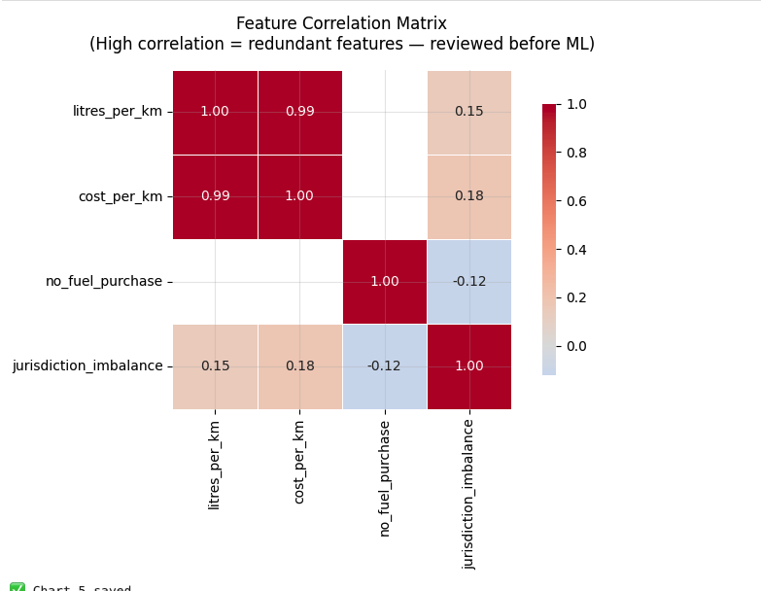
04 Feature Engineering
5 features, each tied directly to an IFTA compliance check
F1
Fuel Litres per km
Feature Correlation Matrix
Outside 0.20-0.80 L/km = physically implausible → odometer fraud
F2
Fuel Cost per km
Spike without price increase = invoice inflation for tax credits
F3
Trips Without Fuel Purchases
No receipt = unreconciled IFTA distance — primary audit signal
F4
Jurisdiction Distance vs Fuel %
Fuel in low-tax, distance in high-tax = core IFTA fraud pattern
F5
Temporal Trends
Spikes in monthly distance = fabricated trips or bulk invoice fraud
See full feature distributions →
🔑 litres_per_km vs Cost_per_km: 0.99. Strongest relationship. Isolation Forest is tree-based, handles correlated features natively.

Slide 7
05 ML Modelling — 4 Approaches
01
Statistical
Outlier (Z-Score)
02
Rule-Based
Detection
03
Isolation
Forest (ML)
04
K-Means
Clustering
Per-feature Z-score
|Z| > 2.5 = flag
Transparent to auditors
Easily verifiable
4 hard IFTA rules
Tied to compliance req.
Most defensible in court
Auditor-verifiable
Unsupervised ML
contamination=0.05
SHAP explainability
3 clusters chosen
(K=5 better by score
but K=3 maps to audit
workflow: H/M/L Risk)
See full Z-Score analysis
See rule details →
See IF analysis →
See Clustering details→
Result:
Result:
Result:
Result:
4 records flagged
33 records flagged
2 records flagged
3 risk groups
🧠 SHAP Explainability: WHY each record was flagged. Red deer – Edmonton : litres_per_km.
See SHAP explainability →

Slide 8
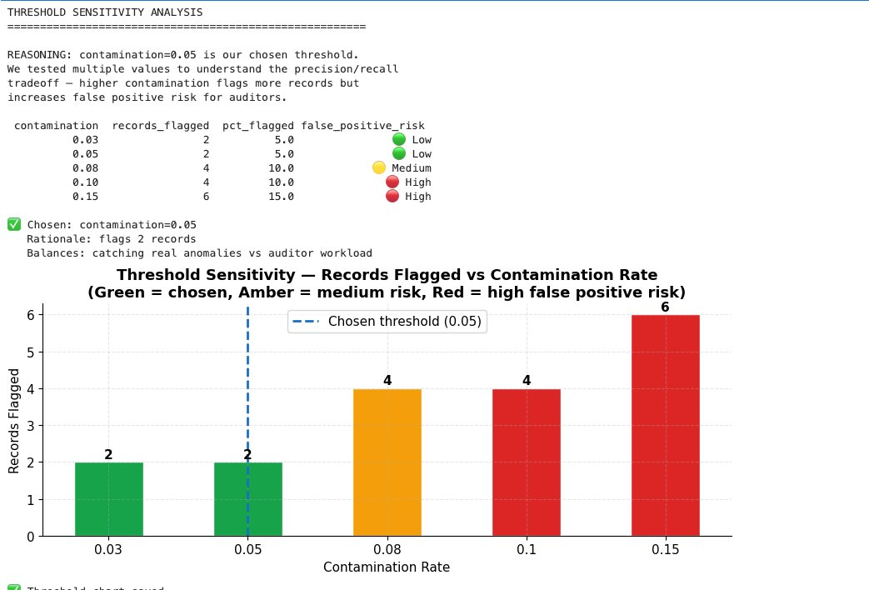
05 Threshold Analysis & False Positive Awareness
✅ Chosen: contamination = 0.05
Flags 2 records (5% of 40)
Balances anomaly detection vs auditor workload
Esso Express stable across ALL 20 seed runs
See Stability Score →
See anomaly score distribution →
⚠ False Positive Awareness:
Rules flagged 33/40 (82.5%) :— too broad because no_fuel_purchase is SYSTEMIC (80% of trips have no receipt).
Isolation Forest flags only 2 records :— those anomalous RELATIVE to each other. Records flagged by ALL 3 approaches = Critical = lowest false positive risk.

Slide 9
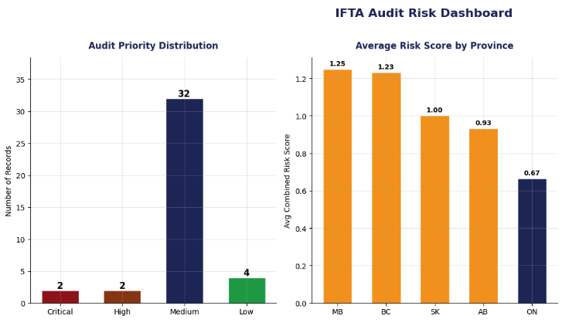
05 Audit Results
🟠 MB highest risk province (avg 1.25)
🧮 Combined risk = Statistical(×1) + Rules(×1) + Isolation Forest(×2)

Slide 10
05 Practical Effectiveness
🔍
No Labels Needed
⚖️
Audit-Defensible by Design
Real IFTA fraud cases are rarely confirmed
SHAP explains WHY each record is flagged
Isolation Forest works purely unsupervised
Plain English report per record for auditors
Day-1 deployment — no historical fraud data required
Z-Score transparent — any accountant can verify
Rules cover known IFTA compliance checks directly
Nothing is deleted — full data lineage preserved
☁️
Scales to Production on AWS
🔄
Improves Over Time
S3 + Glue + Athena: handles millions of records
Phase 1 now: unsupervised, works immediately
Textract: parallel invoice processing, no limits
Phase 2: XGBoost once auditors label 50 outcomes
Location Service: any Canadian city, no code changes
Phase 3: real-time SageMaker endpoint on new uploads
contamination=0.05: flags ~2,000 from 40,000 records
Each audit cycle produces labels for next model
vs Manual Review: faster, consistent, traceable. vs Simple Rules Only: ML catches patterns rules miss. vs Black-Box ML: SHAP makes every flag explainable.

Slide 11
06 AWS Architecture — 7 Services
Raw Files
(S3)
Textract
AnalyzeExpense
Location
Service
SageMaker
Notebooks + ML flow.
AWS Glue
Crawler
Amazon
Athena
→
→
→
→
→
Versioned
immutable
OCR + confidence
scores
City + province
auto-resolve
4 notebooks
ca-central-1
Auto schema
catalog
SQL on S3
serverless
Amazon S3
Amazon Textract
Central storage for all raw files, curated data, results, charts. Versioning enabled — original evidence can never be lost.
AnalyzeExpense for invoices — extracts vendor, date, total, litres. Async Tables+Forms for multi-page PDF. Per-field confidence scores.
AWS Location Service
SageMaker + Glue + Athena + MLflow
Automated city standardization and province resolution. 36 unique API calls — cached. Replaces hardcoded city lists entirely.
SageMaker runs all 4 notebooks. MLflow tracks experiments. Glue auto-catalogs results. Athena enables SQL for auditors — no Python needed.

Slide 12
06 Live Demo — Amazon Athena
SQL on ML results — any auditor can run from browser. No Python needed.
Q1: Priority Breakdown
SELECT audit_priority, COUNT(*) as total,
ROUND(AVG(combined_risk_score),2) as avg_risk
FROM goa_audit_db.audit_results
WHERE audit_priority IN ('Critical','High','Medium','Low')
GROUP BY audit_priority ORDER BY avg_risk DESC;
Result: Critical:2(3.0) | High:2(2.0) | Medium:32(1.0) | Low:4(0.0)
Q2: Province Risk Ranking
SELECT province_from, COUNT(*) as trips,
SUM(CASE WHEN audit_priority IN ('Critical','High')
THEN 1 ELSE 0 END) as high_risk_trips
FROM goa_audit_db.audit_results
GROUP BY province_from ORDER BY high_risk_trips DESC;
Result: AB: 0/15 high risk | BC: 3/13 high risk | ON: 0/6 | SK: 0/2 | MB: 1/4

Slide 13
07 Limitations & Future Roadmap
Current Limitations
Future Supervised Learning Roadmap
1
Small Dataset (40 rows)
Phase 1
Unsupervised (Current)
Needs 1000+ rows. Results are INDICATIVE not definitive.
Isolation Forest + Rules
No labels needed
AUC not computable
2
No VIN Identifier
Cannot separate trips by truck. Single vehicle assumed.
Phase 2
Semi-supervised
3
OCR Confidence Errors
50+ labelled audit outcomes
XGBoost on confirmed fraud
Expected AUC: 0.88+
Textract <80% may corrupt features. Low-conf flagged.
4
No Labels = No ROC Curve
Cannot compute precision/recall without fraud ground truth.
Phase 3
Fully Supervised
200+ cases + VIN + GPS
Random Forest / XGBoost
SageMaker real-time endpoint
5
Date Matching +/-1 Day
May inflate no_fuel_purchase. True rate may be lower.

Slide 14
Thank You
IFTA Audit ML System — Government of Alberta
7
4
12
2
Esso ✅
Athena
AWS Services
Used
Notebooks
Delivered
Invoices
Extracted
Critical
Audit Records
Missing Invoice
Recovered
SQL-Queryable
Results
Live AWS Access for Reviewers
Account ID: 657167956806 | User Name: GoA-Reviewer | Console Password: Murtaza_Data_Scientist10

Slide 15
Appendix

Slide 16
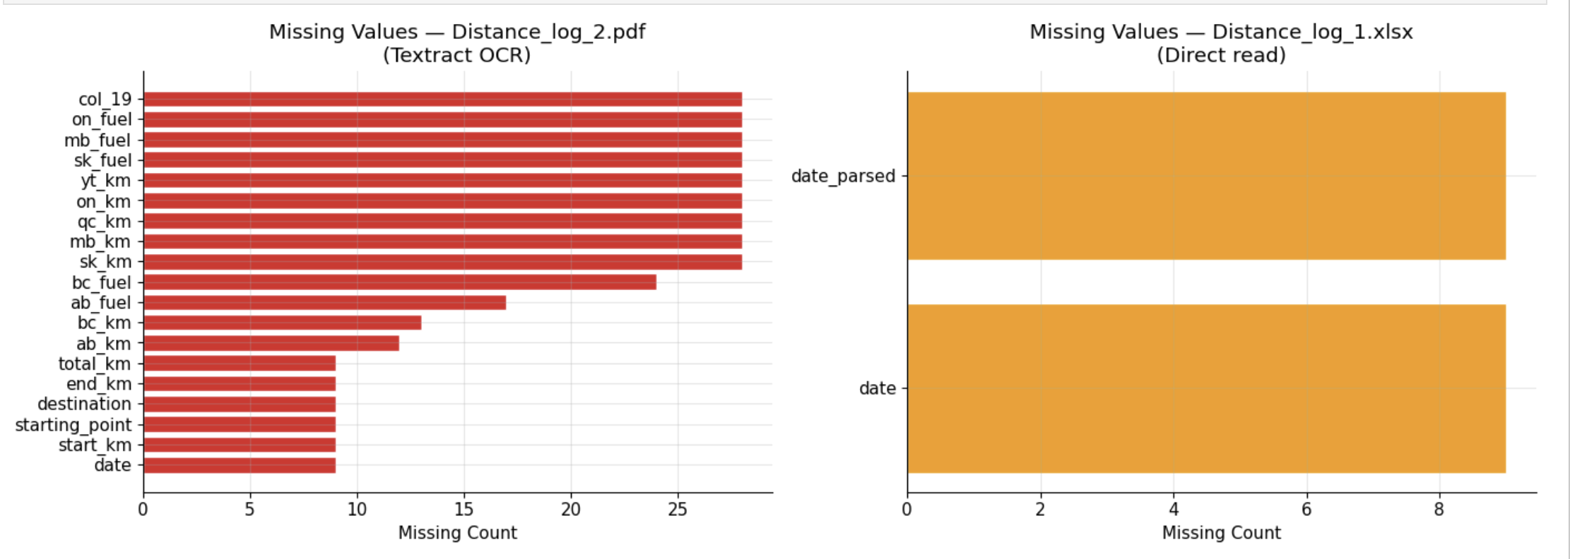
Appendix A:- Missing values.

Slide 17
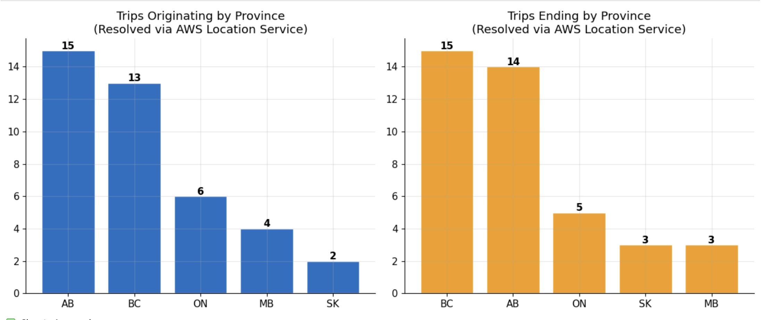
Appendix B:- Province Distribution.

Slide 18
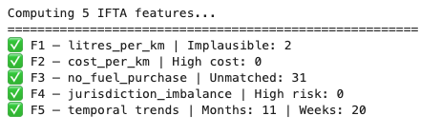
Appendix C:- Feature Engineering.

Slide 19
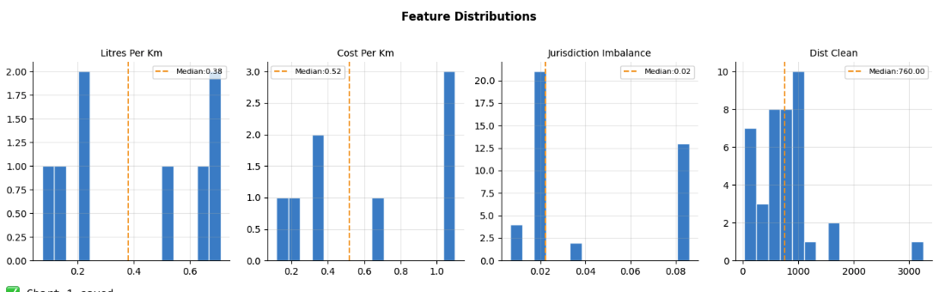
Appendix C1:- Feature Distribution.

Slide 20
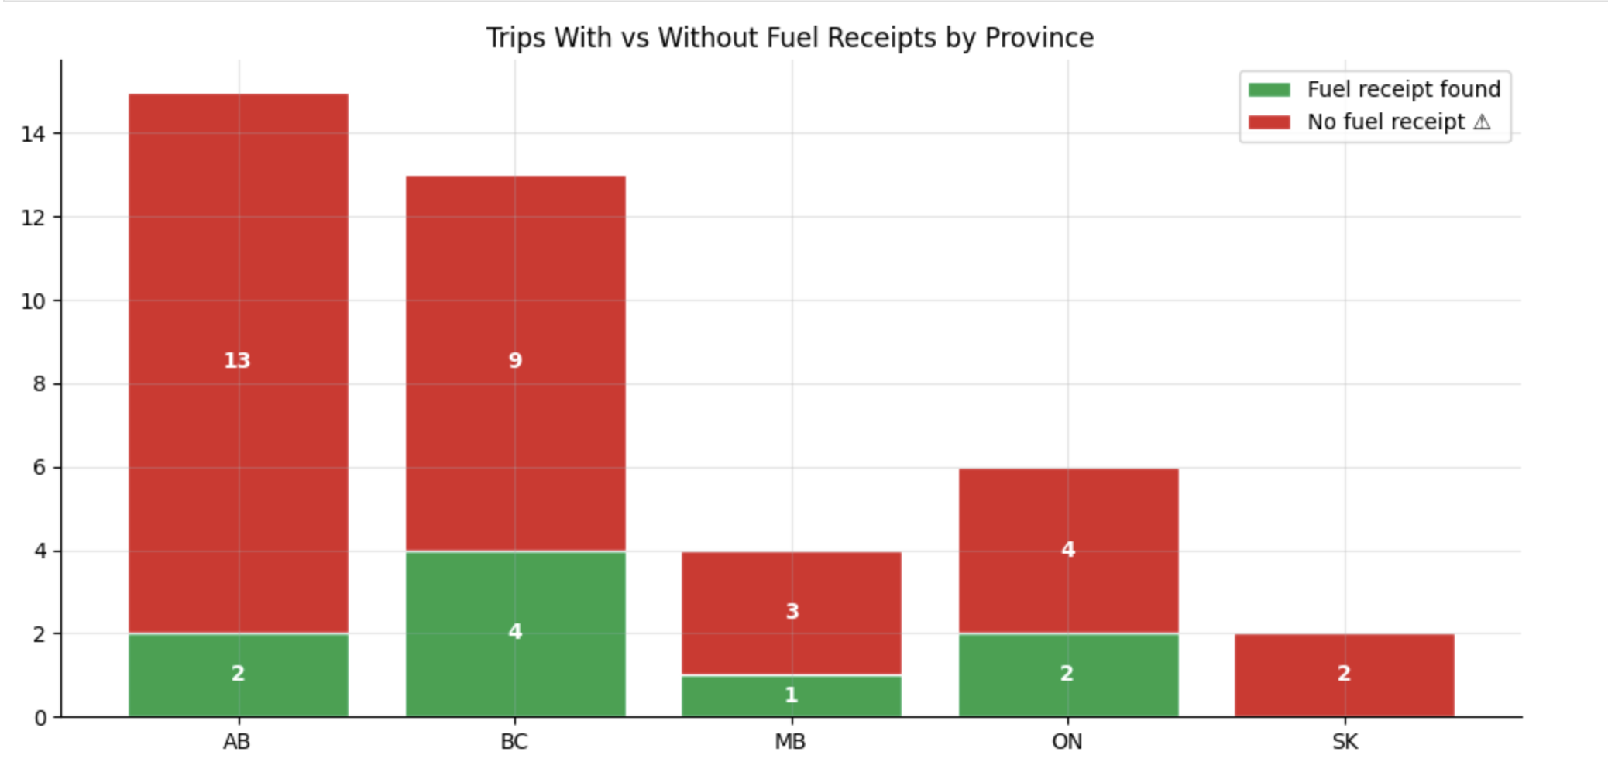
Appendix C2:- Fuel Match.

Slide 21
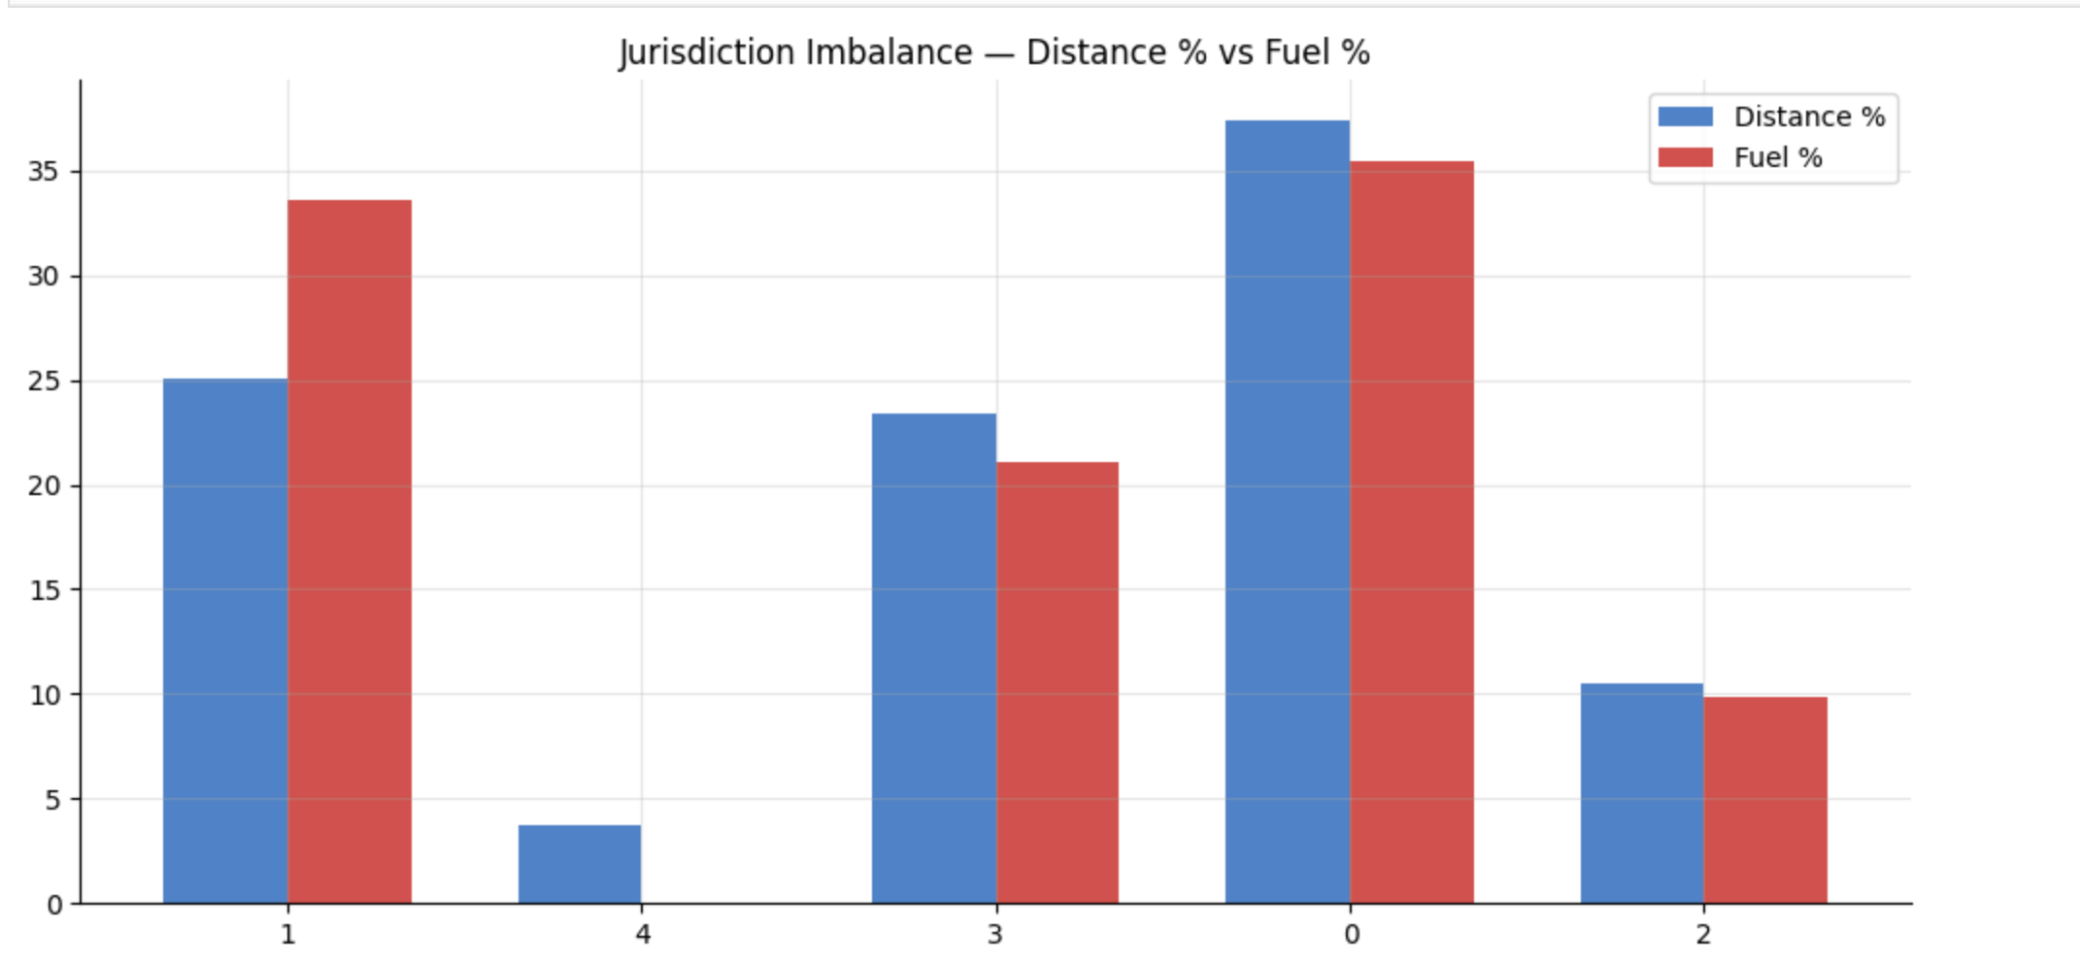
Appendix C3:- Jurisdiction Imbalance.

Slide 22
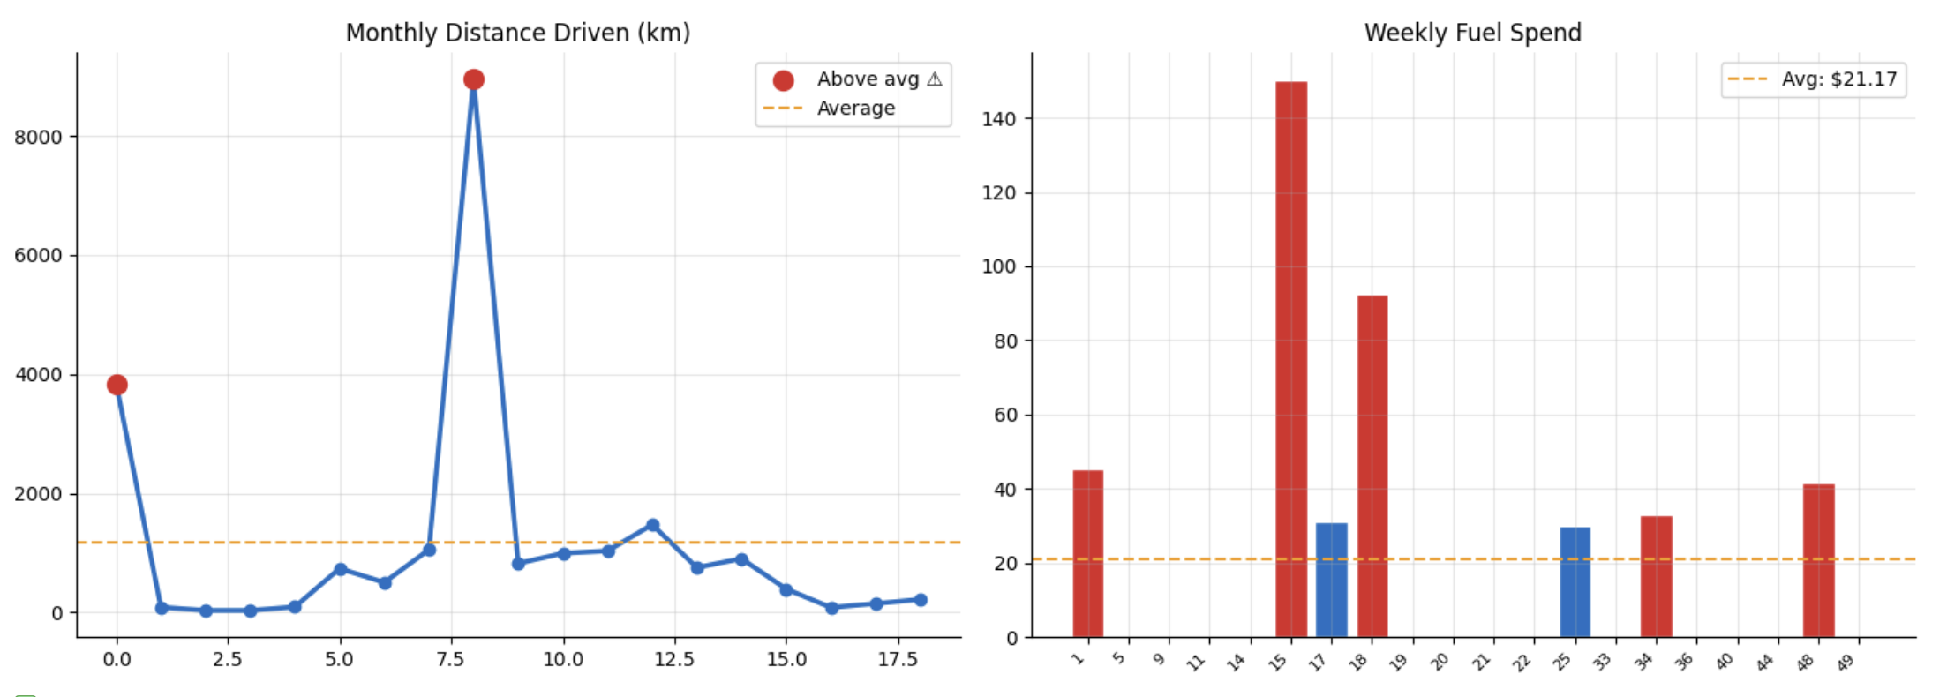
Appendix C4:- Temporal Trends.

Slide 23
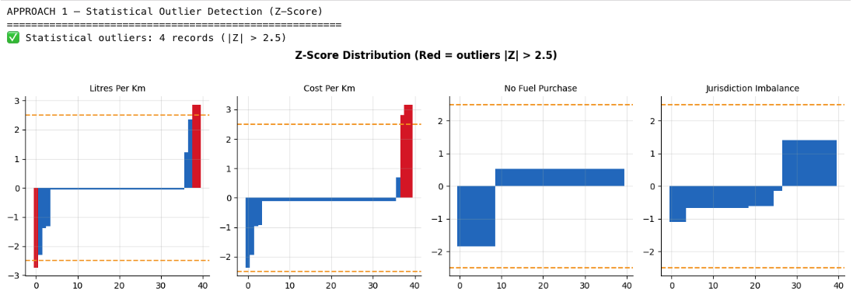
Appendix D1:- Statistical Analysis(Z-Score).

Slide 24
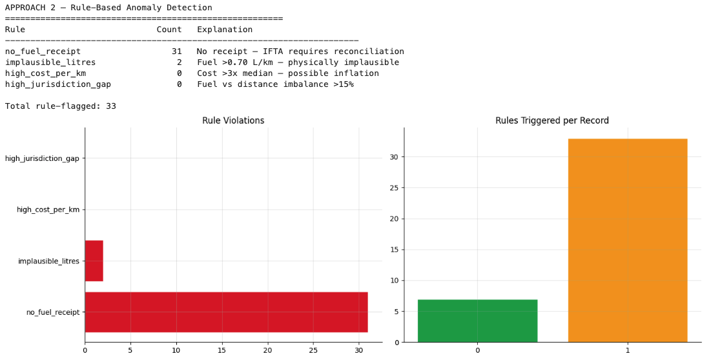
Appendix D2:- Rule Based Detection.

Slide 25
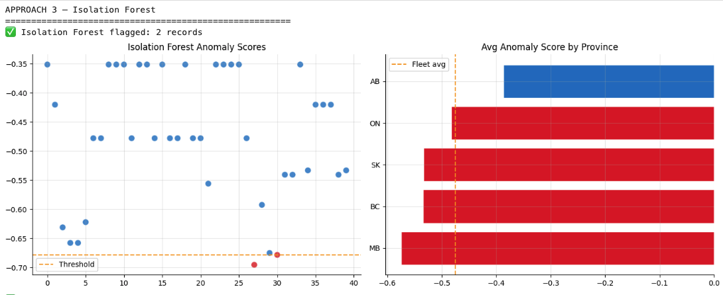
Appendix D3:-Isolation Forest.

Slide 26
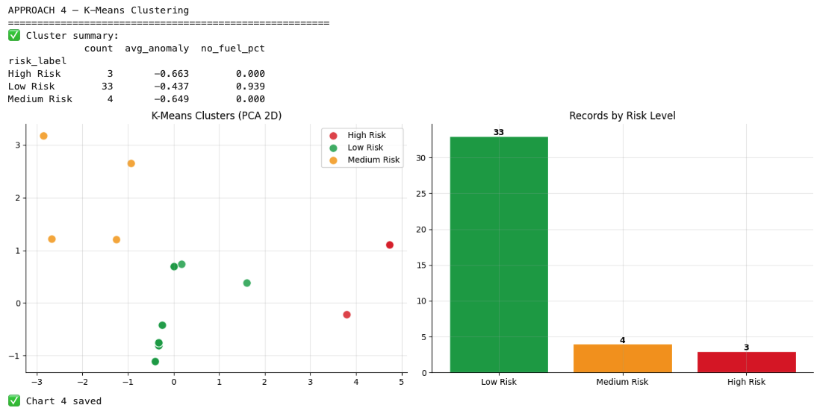
Appendix D4:- K-Means Clustering.

Slide 27
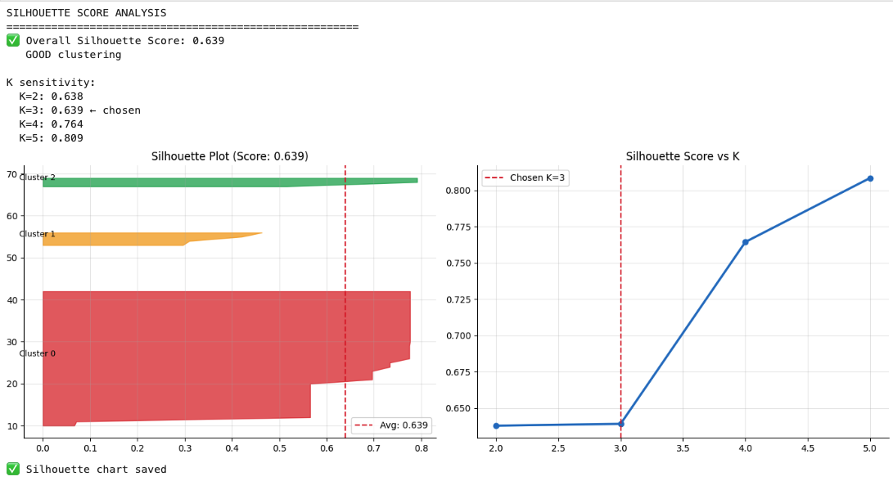
Appendix D4a:- Silhouette Score.

Slide 28
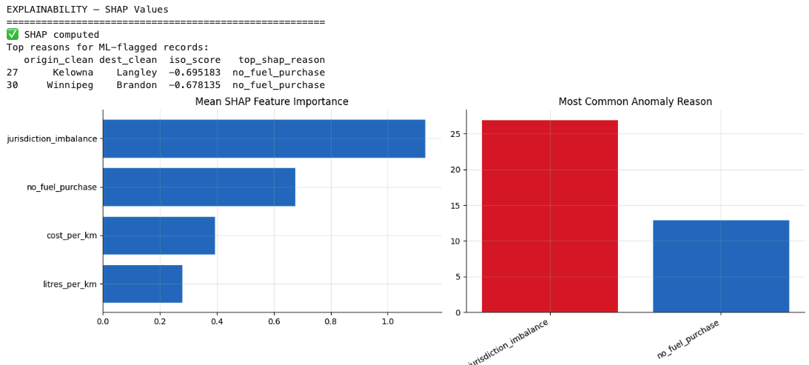
Appendix D5:- SHAP Explainability.

Slide 29
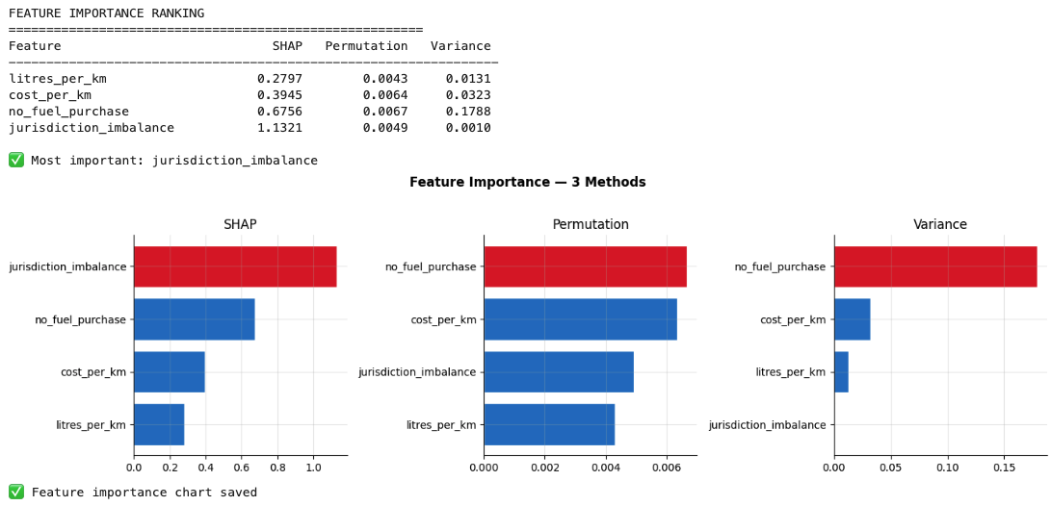
Appendix D6:-Feature Importance.

Slide 30
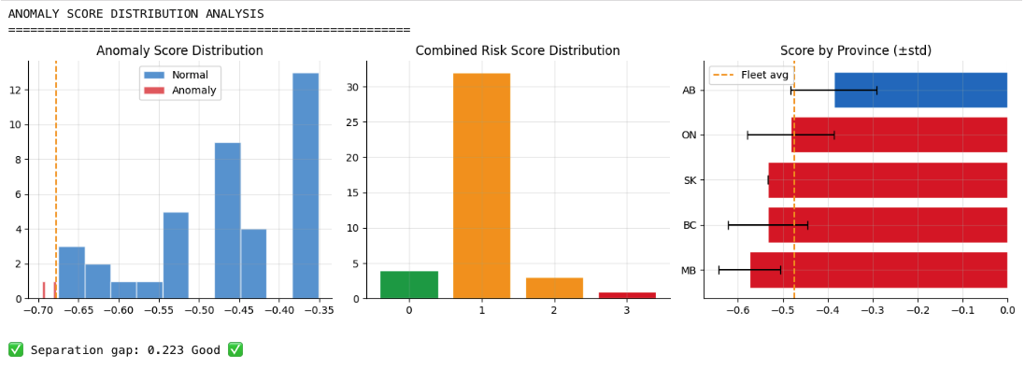
Appendix D7:-Anomaly Score Distribution.

Slide 31
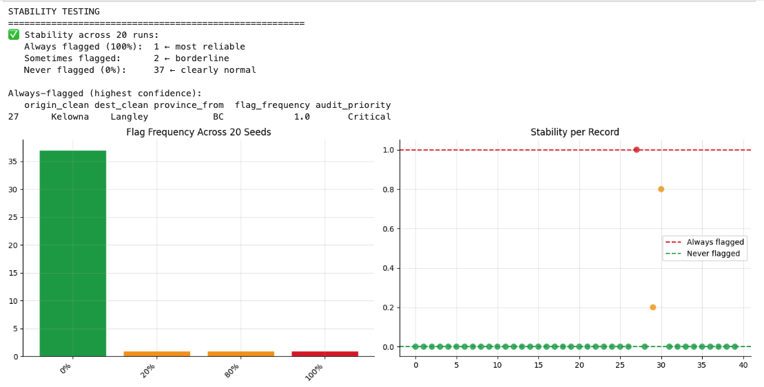
Appendix D8:-Stability Testing.

