Slide 1
SMART SCHOOL
Asad Aslam
Murtaza Fakhruddin Ahmed Abbas
Adnan Khan
Abdul Wasi

Slide 2
All Software Do Some CRUD But We Have Some Features In Our Smart School Software

Slide 3
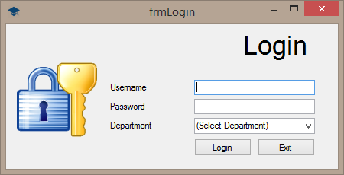
Login

Slide 4
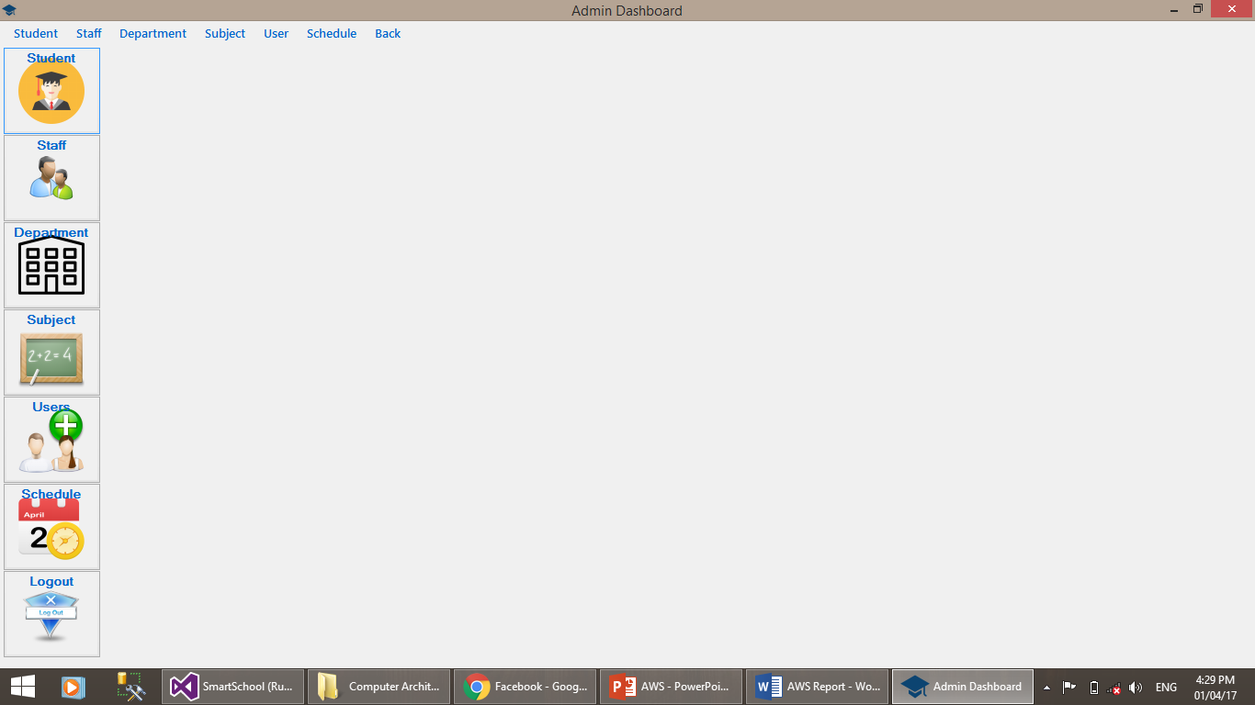
Admin Dashboard

Slide 5
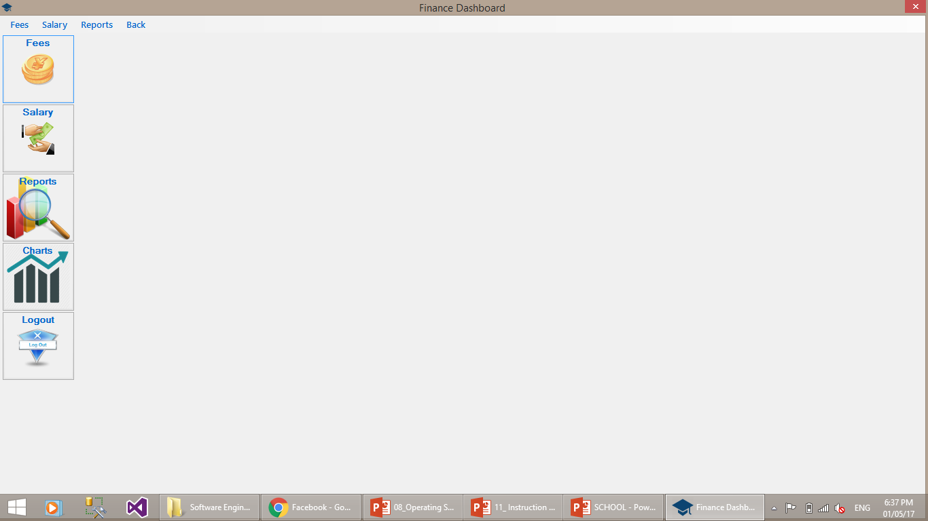
Finance Dashboard

Slide 6
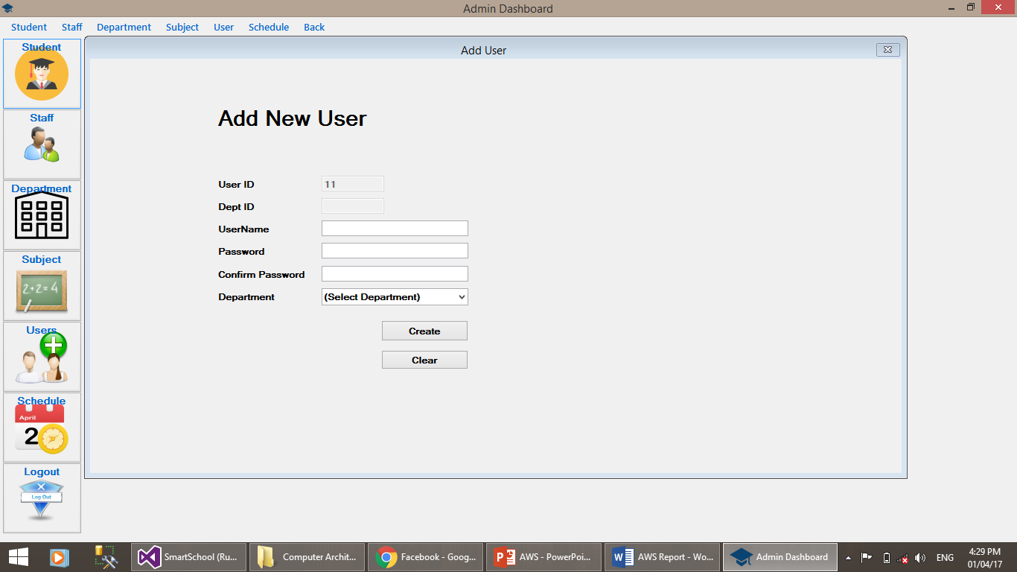
Only admin have rights to create user

Slide 7
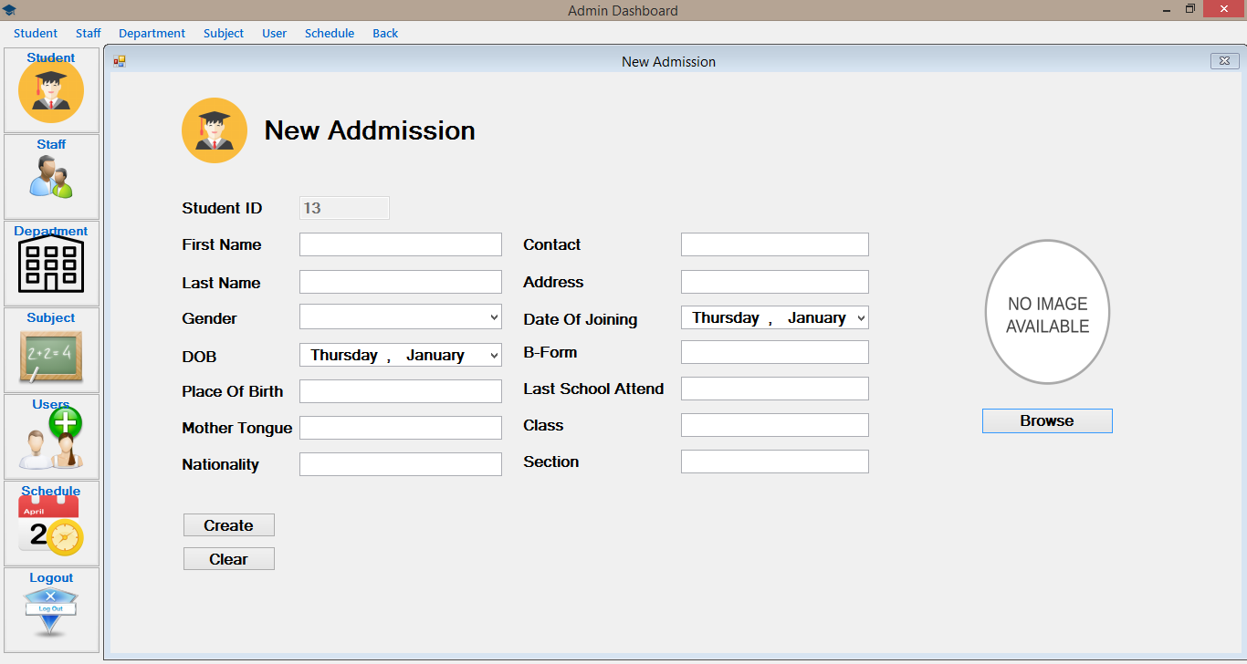
Image Browsing Option

Slide 8
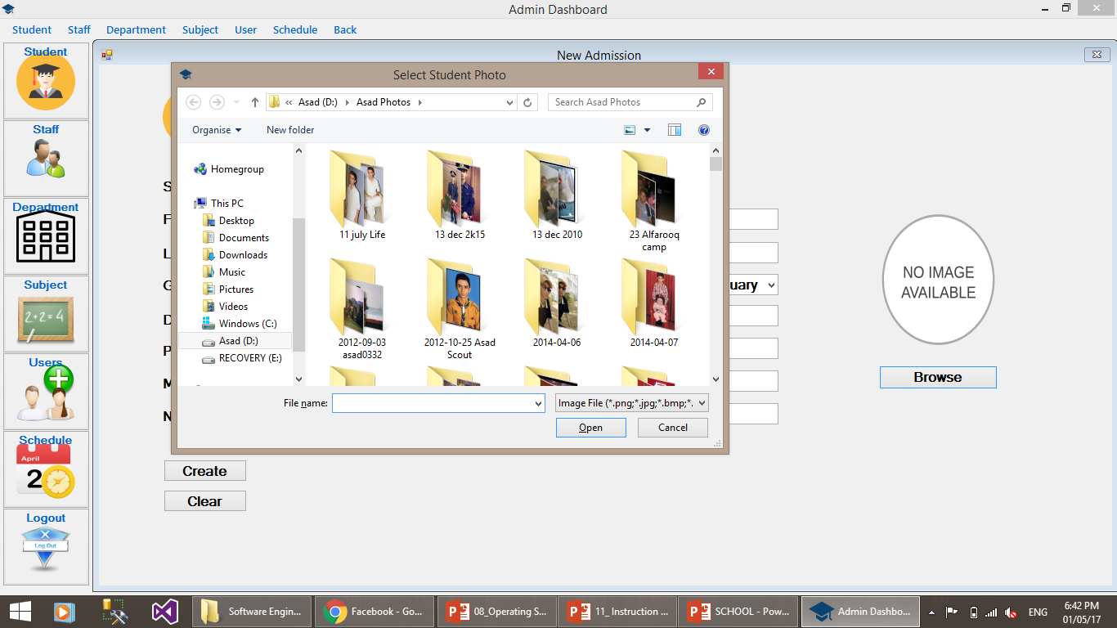
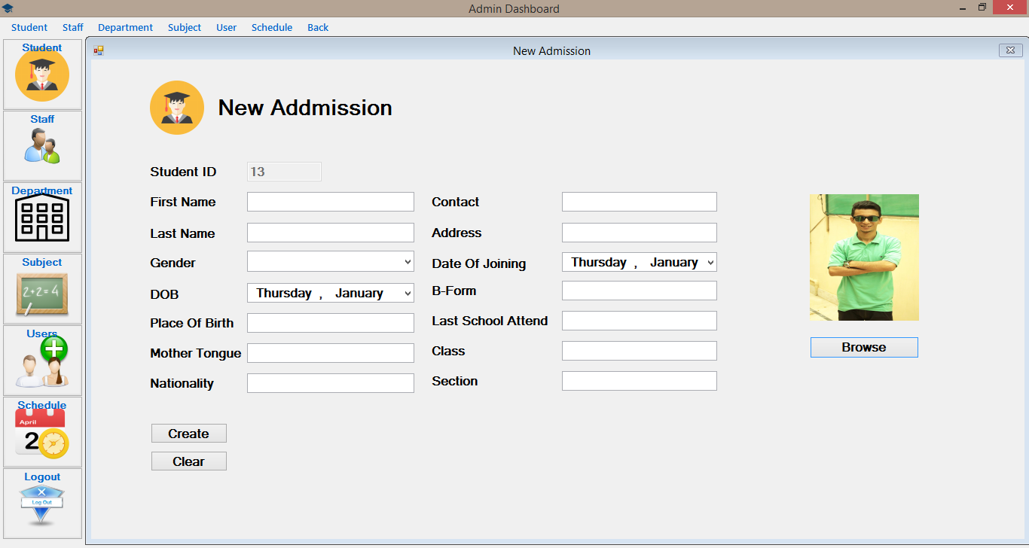

Slide 9
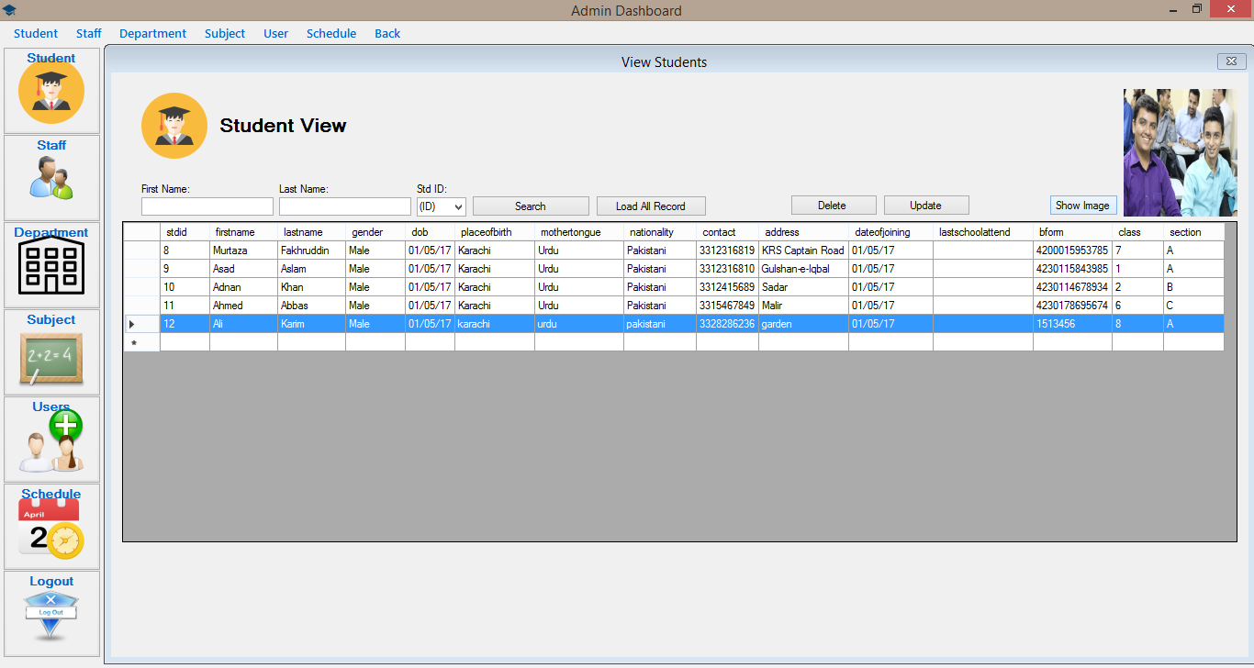
Image View With Record

Slide 10
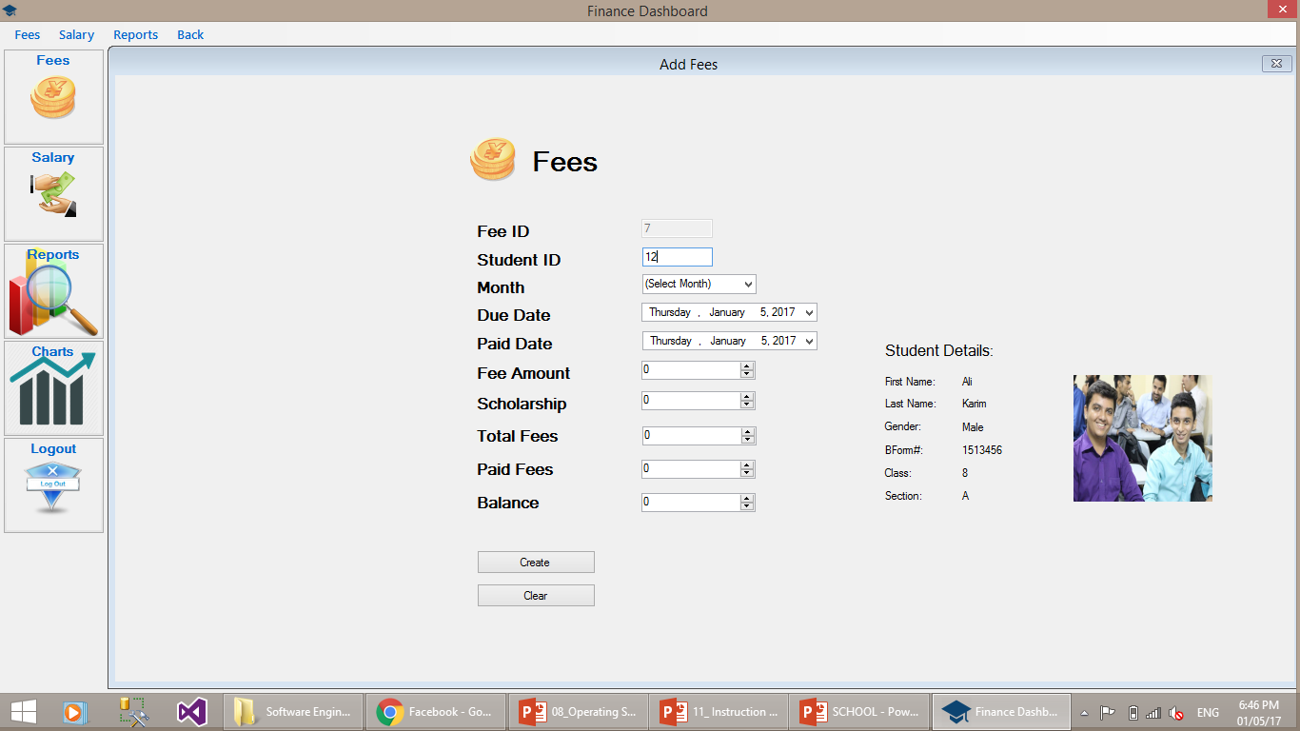
Fees Payment

Slide 11
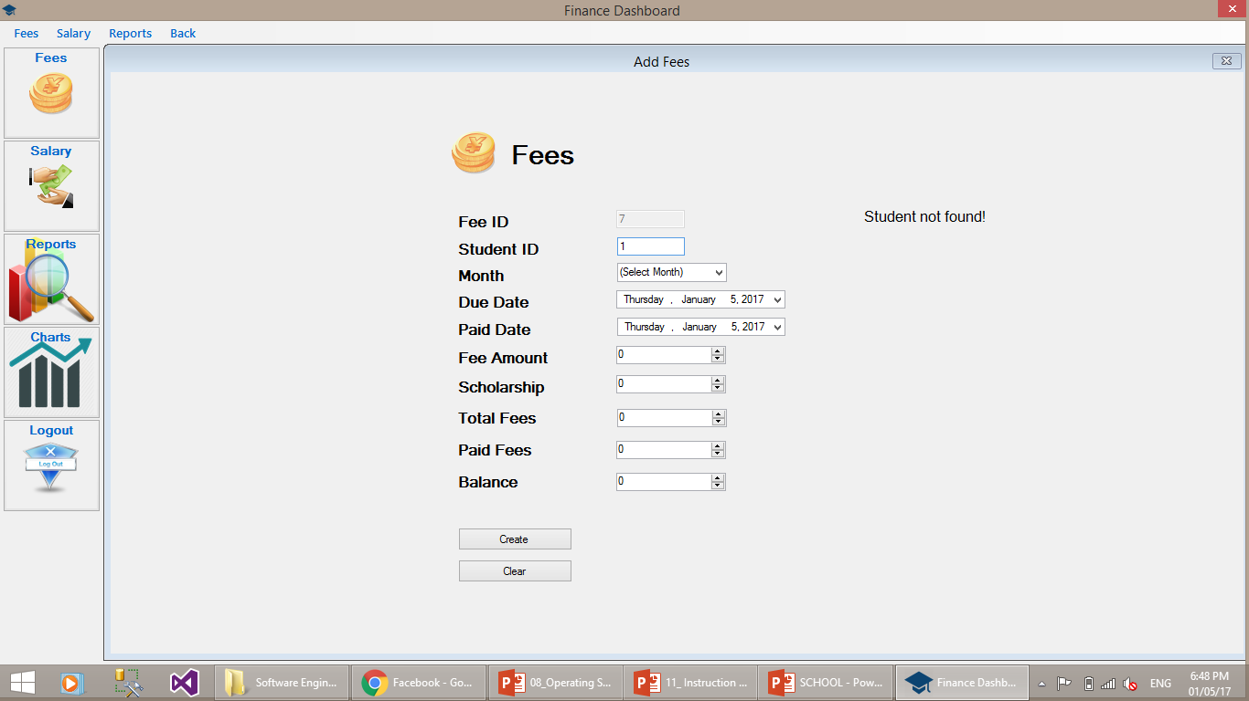

Slide 12
Schedule Forms
If room is not available then it tell us that room is not available
If room is available but a class has already have another class at that time then it tell us Choose another time slot

Slide 13
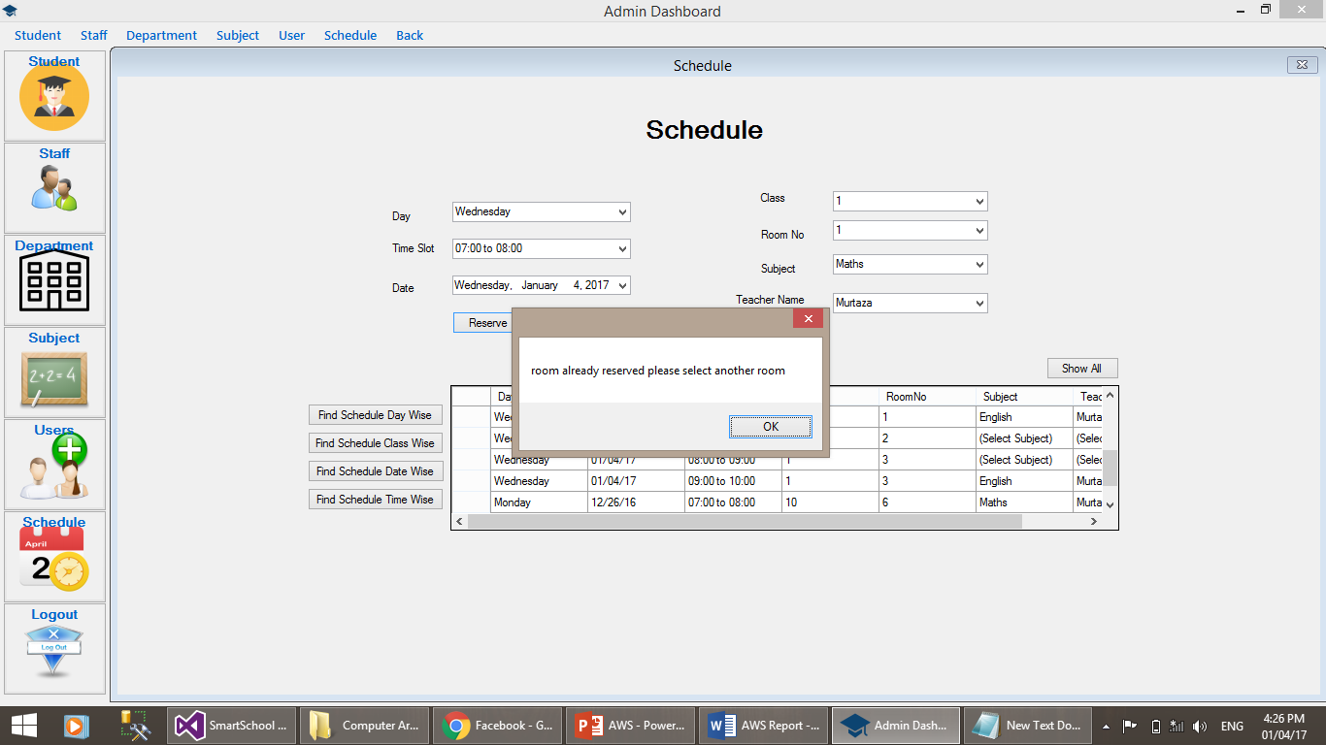

Slide 14
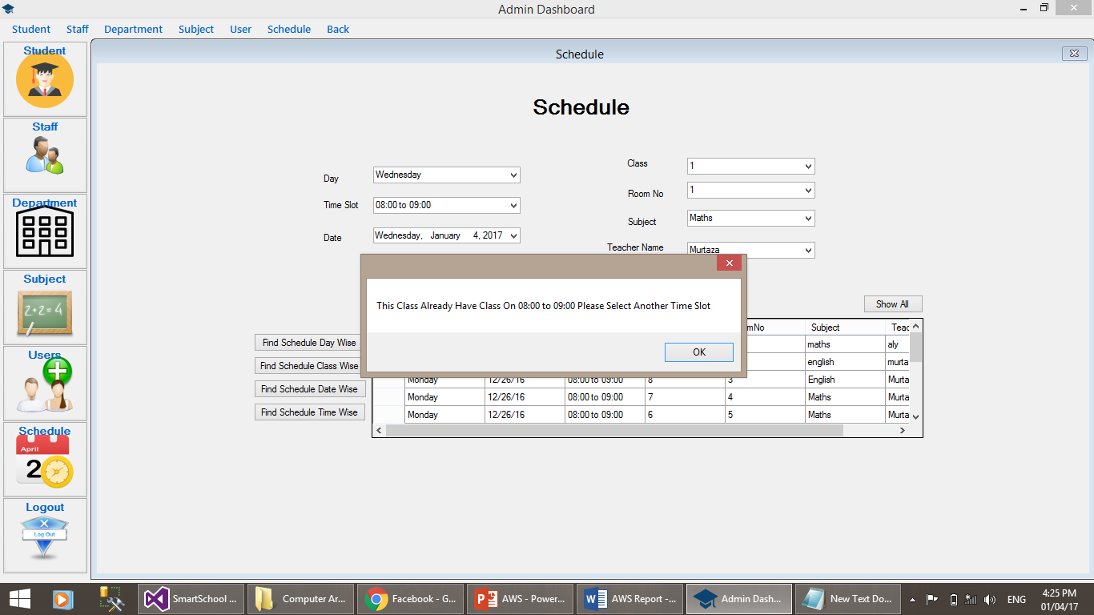

Slide 15
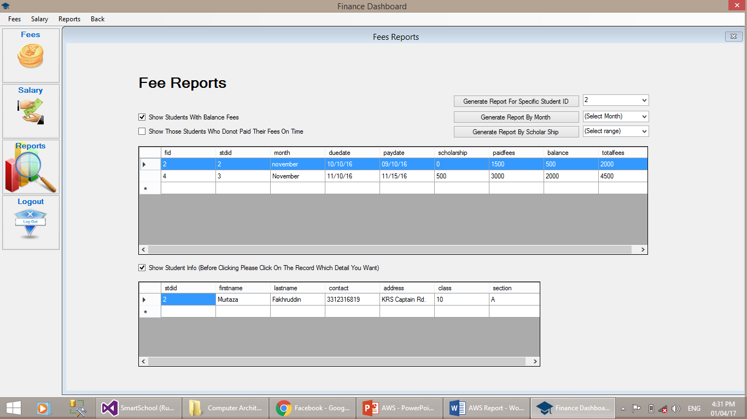
FEE REPORTS

Slide 16
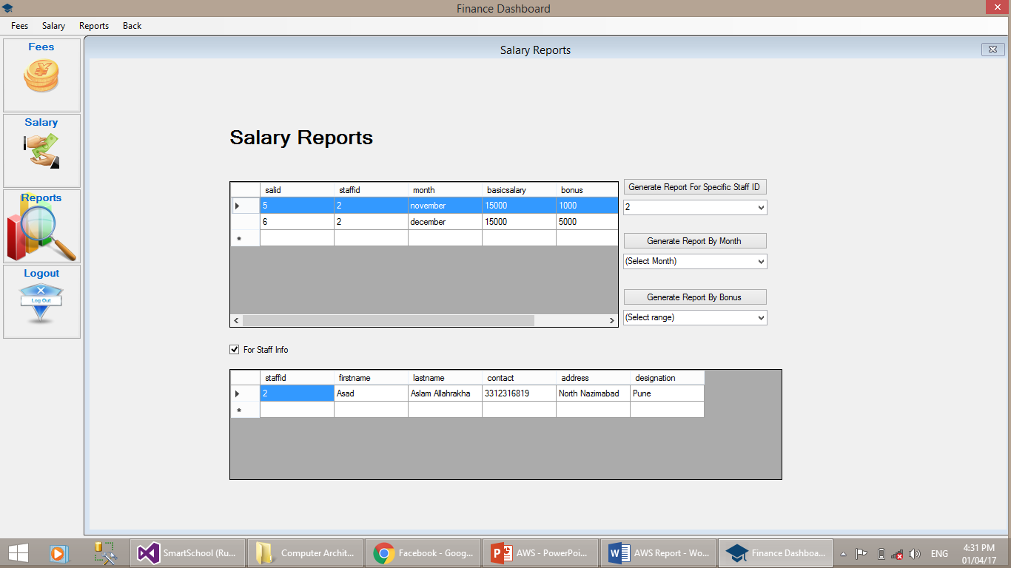
SALARY REPORTS

Slide 17
We also implement crystal reports in our SmartSchool

Slide 18
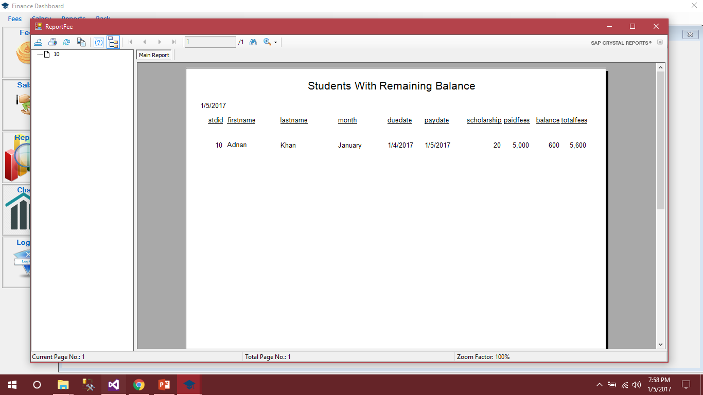
Students with Remaining Balance Report

Slide 19
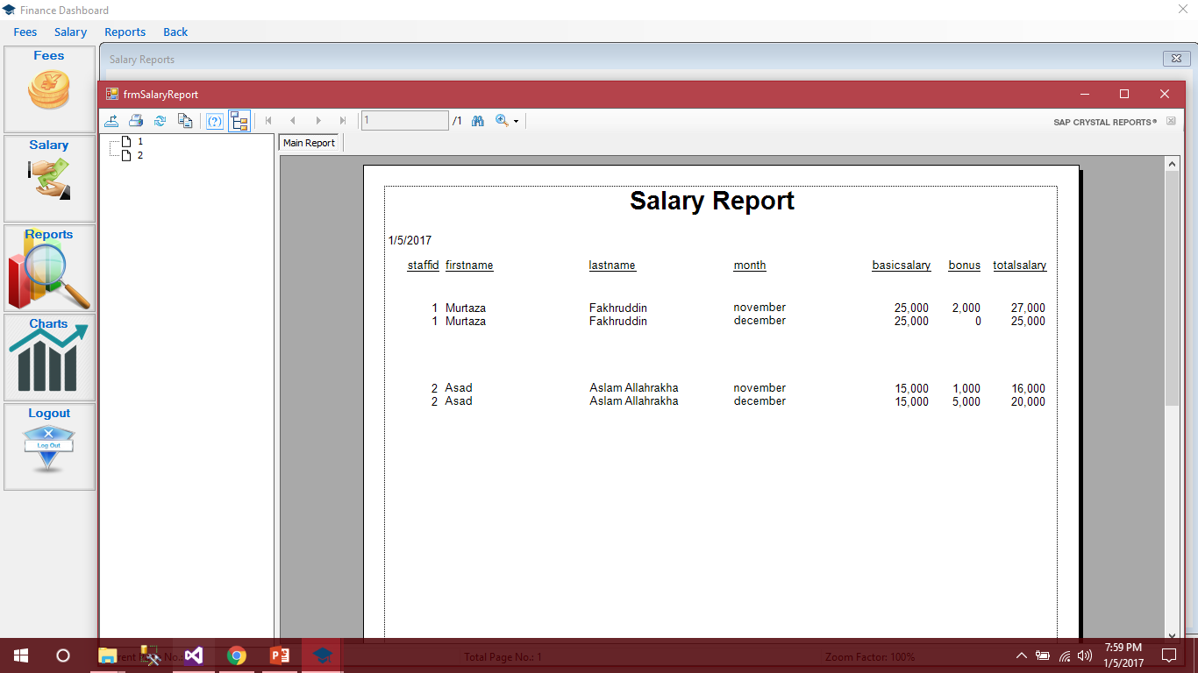
Salary Report

Slide 20
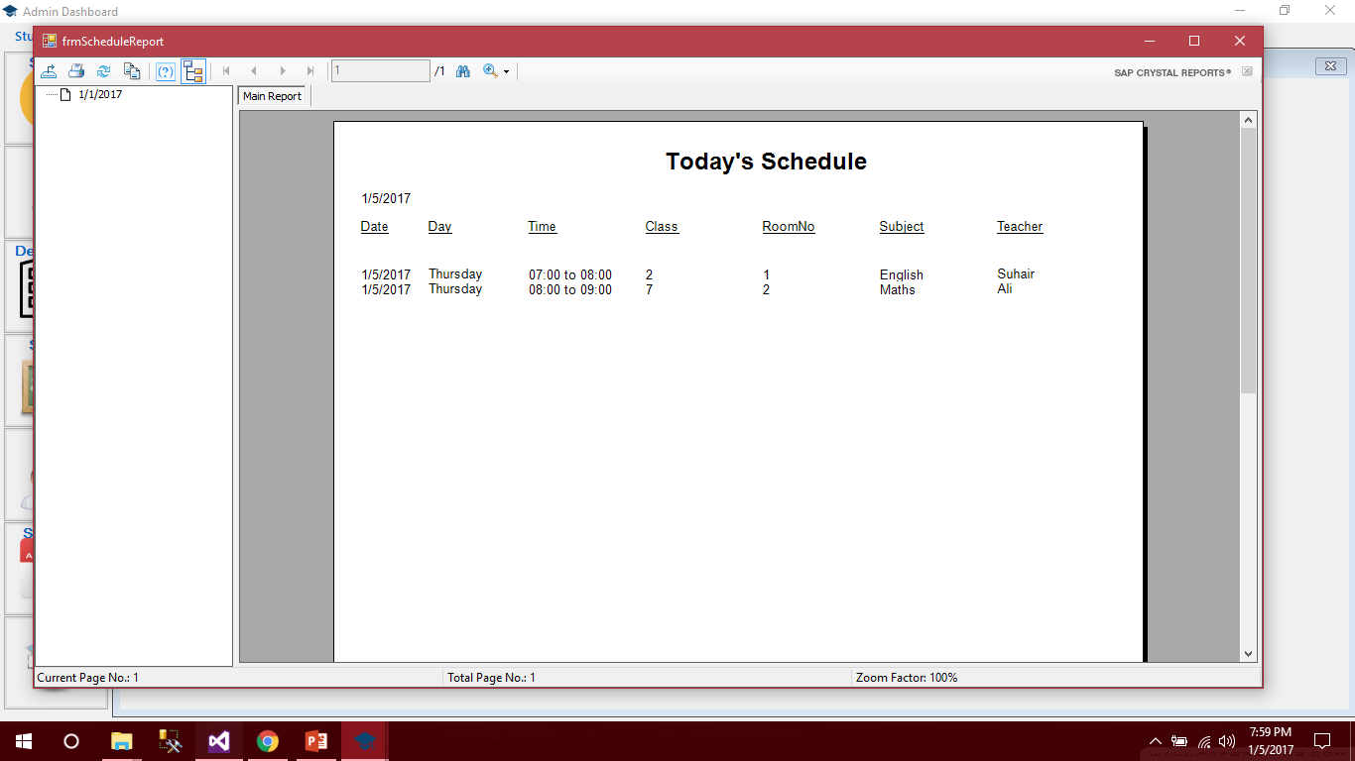
Current Date Schedule

Slide 21
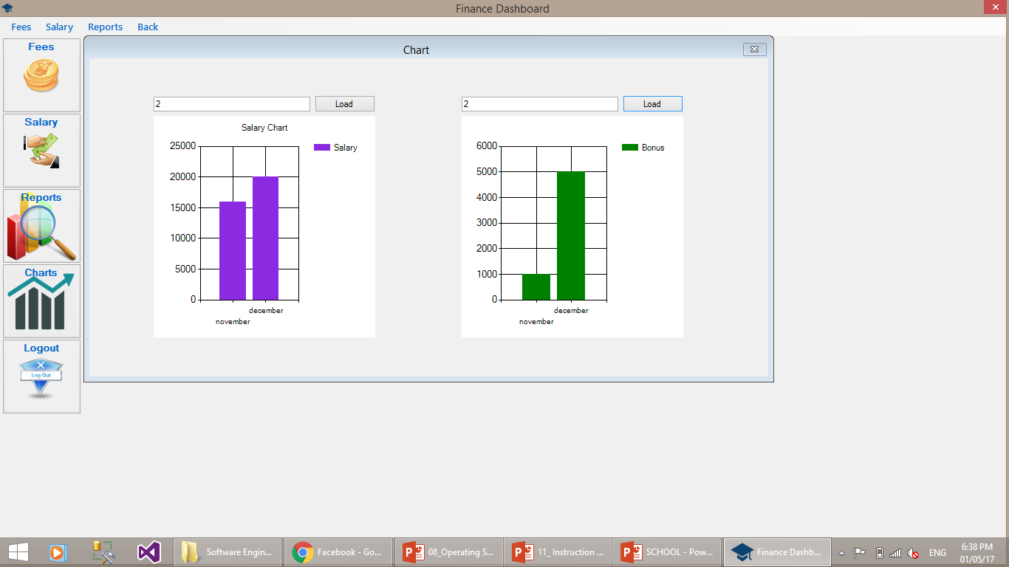
We make a graph which shows month wise salary and bonus of specific staff

Slide 22
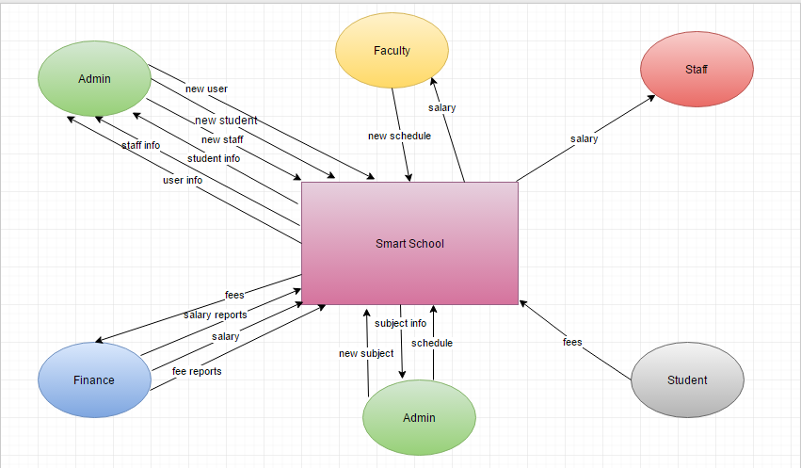
DFD

Slide 23
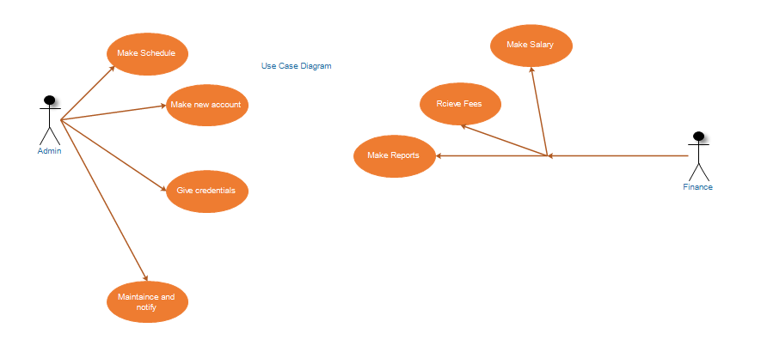
USECASE

Slide 24
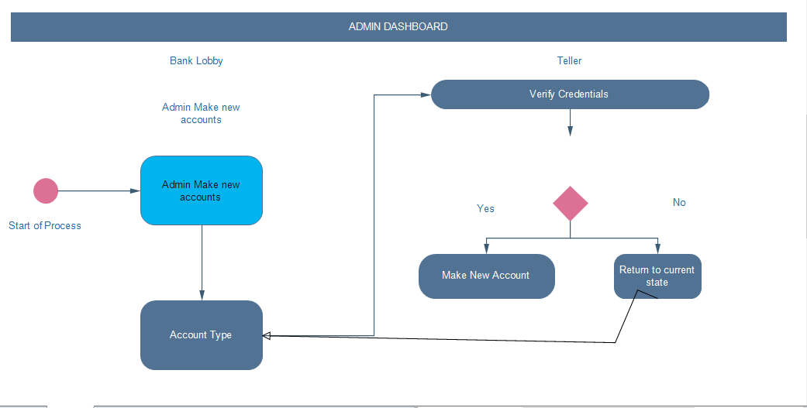
ACTIVITY DAIGRAM

Slide 25
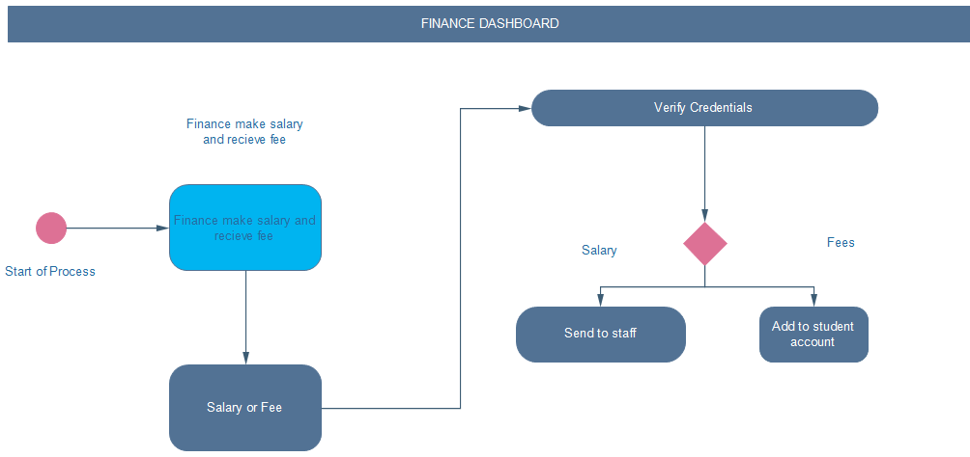
Finance Dashboard

Slide 26
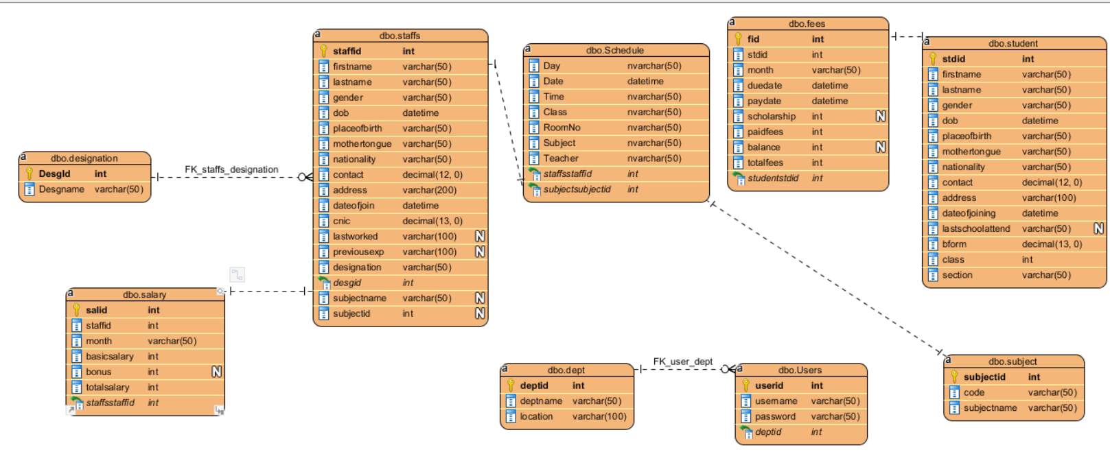
ERD

Slide 27
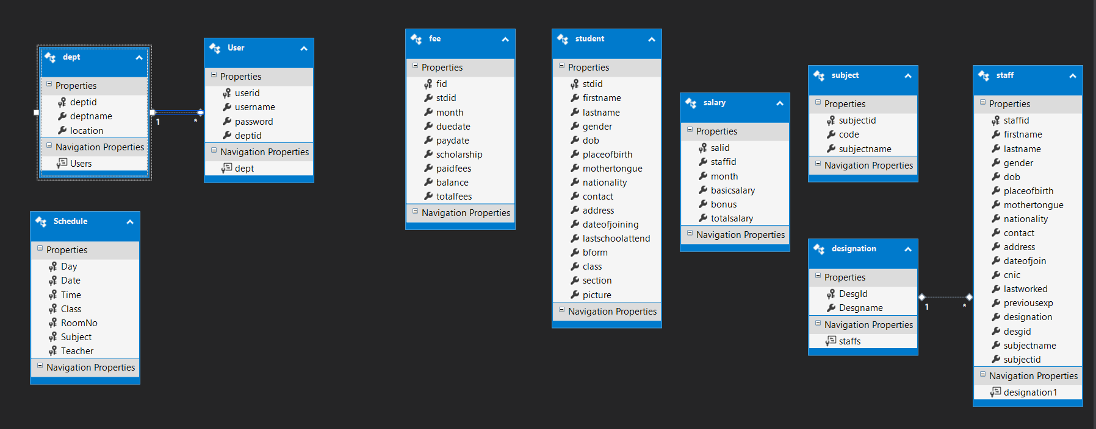
CLASS DIAGRAM

Slide 28
Smart School Software Just in $200.. Thank You ☺

