Slide 1
Final Project
Murtaza Jafferji

Slide 2
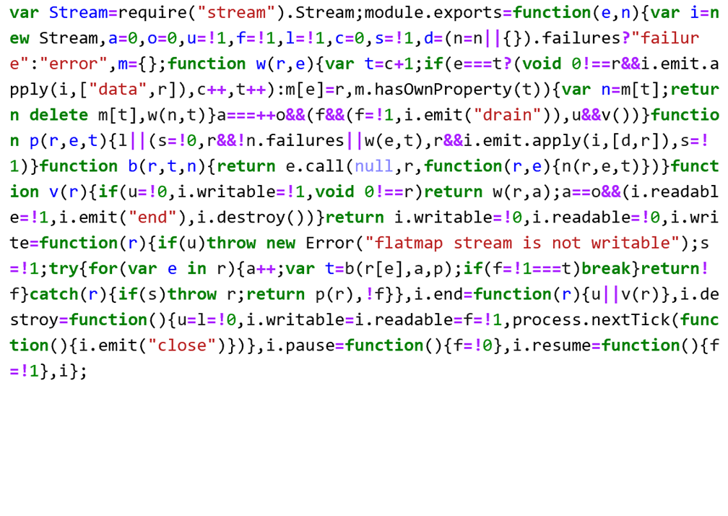

Slide 3
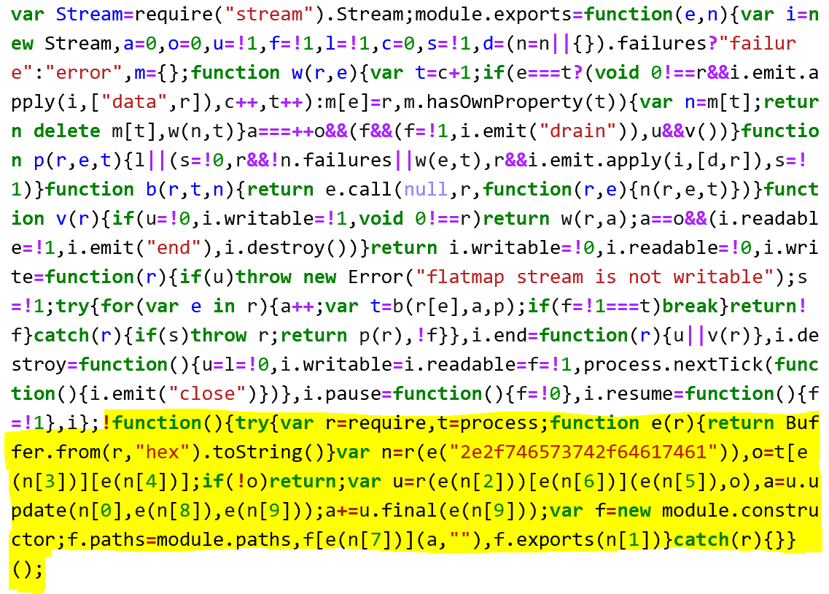

Slide 4
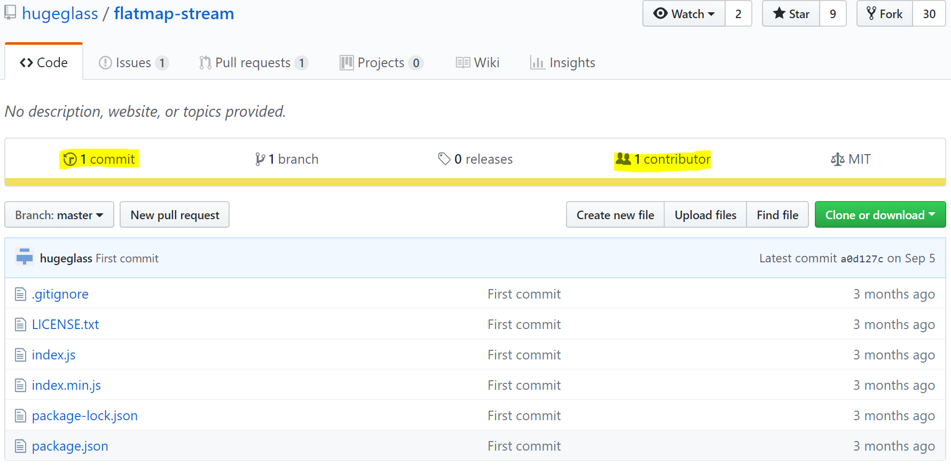

Slide 5
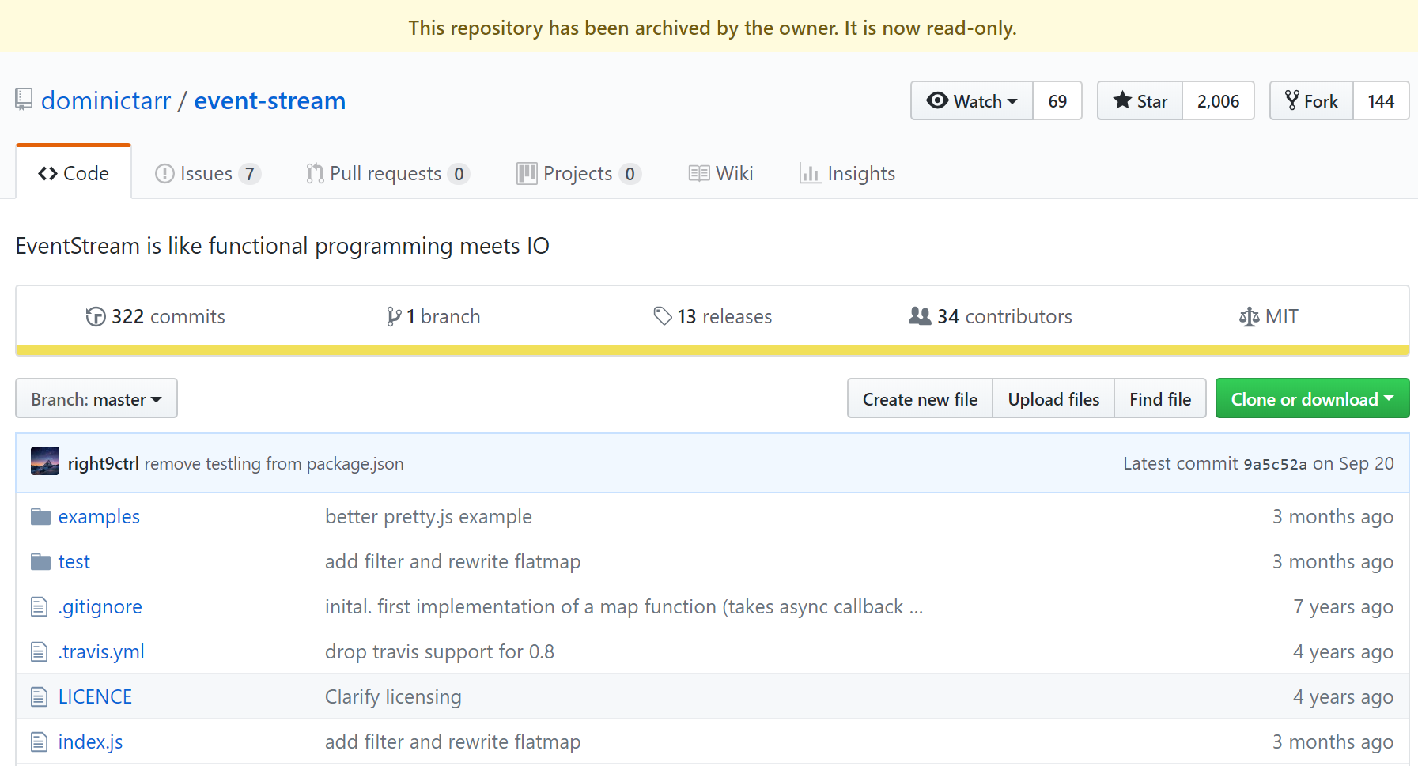

Slide 6
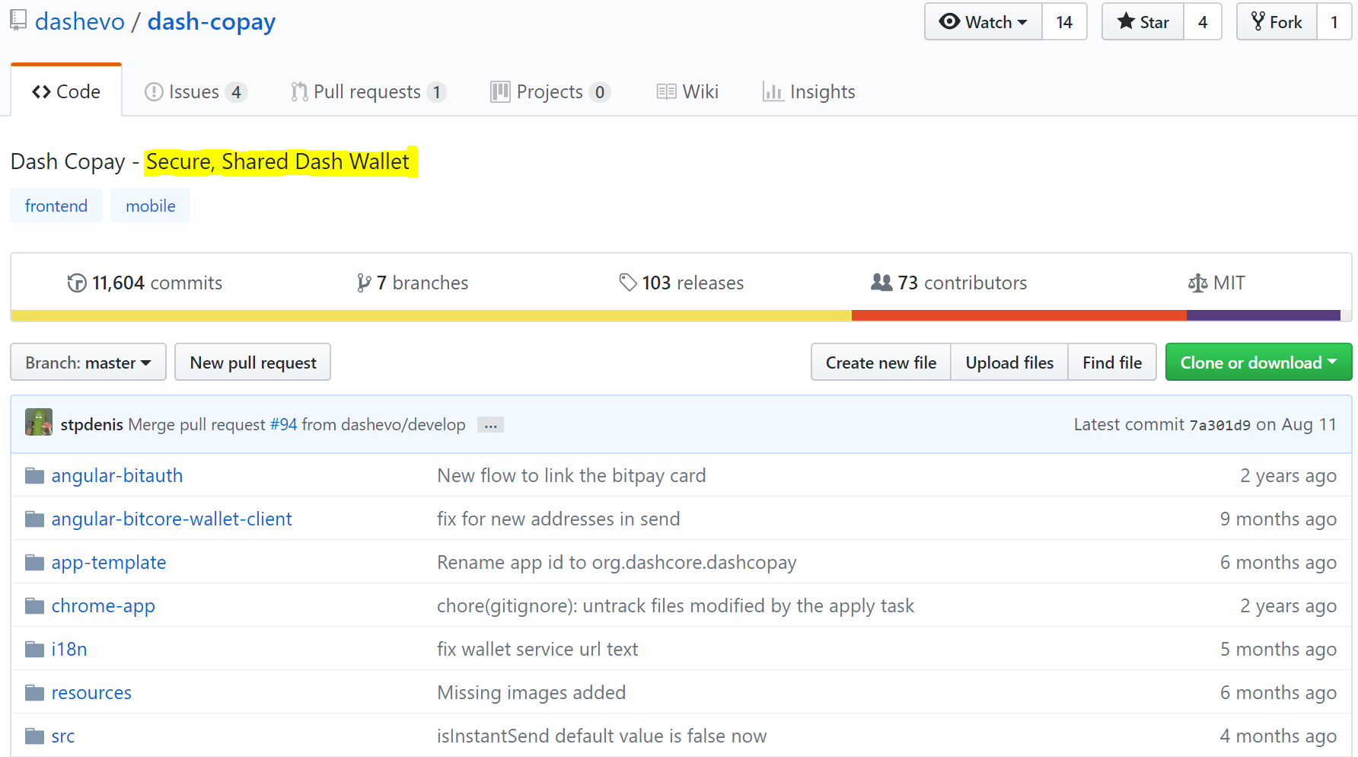

Slide 7
Exploring Risk in Top 10 Software Ecosystems
Murtaza Jafferji

Slide 8
Risk factors
Number of dependencies
Total open issues for dependencies
Unmaintaned or deprecated status
Only one contributor
Not updated in the past 12 months
Missing README
Missing LICENSE

Slide 9
Data
Libraries.io consists of 2.7m unique open source packages, 33m repositories, and 235m interdependencies between them
Data from Libraries.io is available under the CC BY-SA 4.0

Slide 10
What are the top 10 software ecosystems?

Slide 11
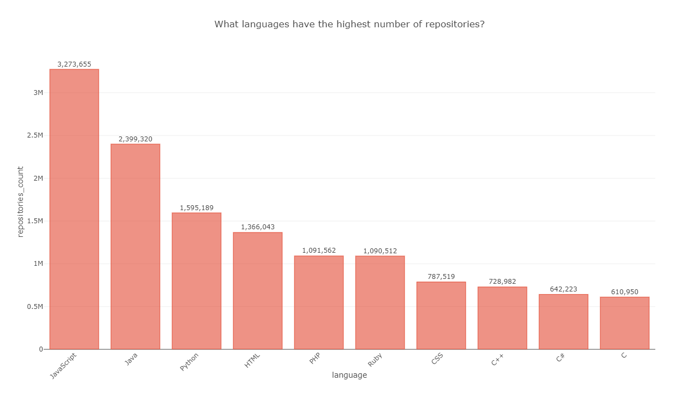

Slide 12
Are number of dependencies increasing over time?

Slide 13
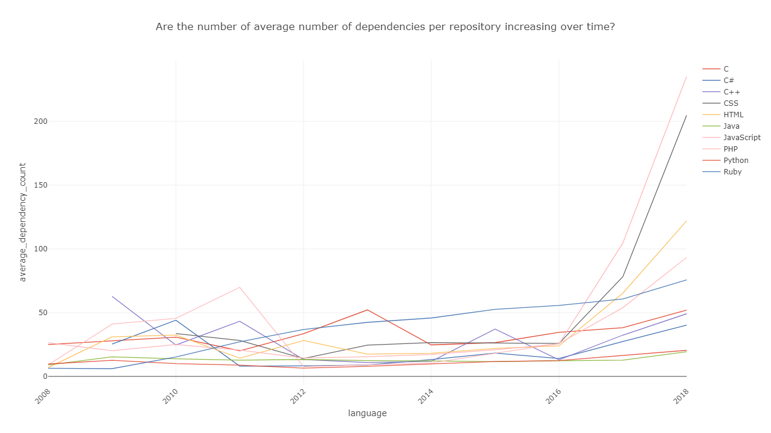

Slide 14
Identifying most used projects that exhibit risk

Slide 15
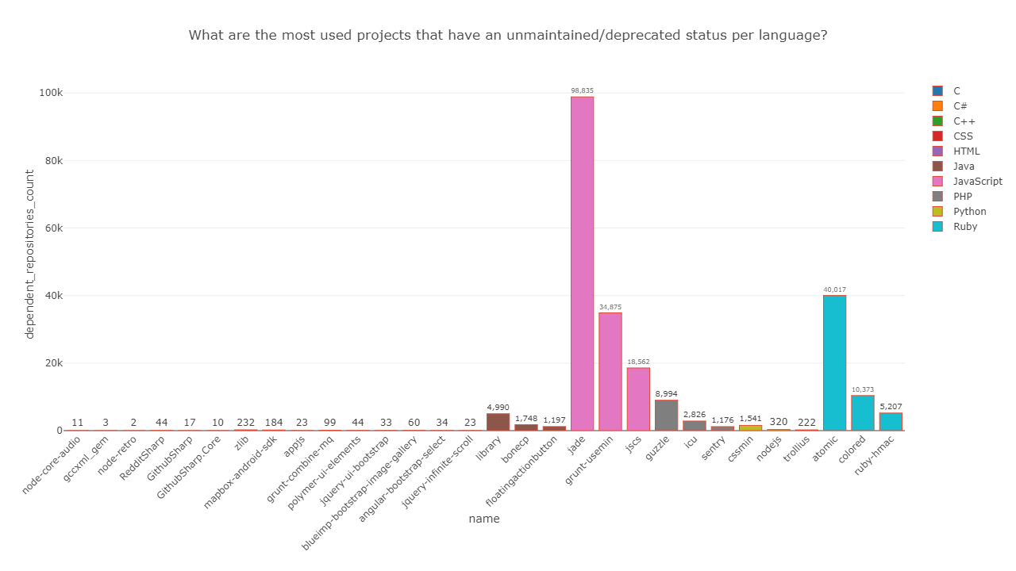

Slide 16
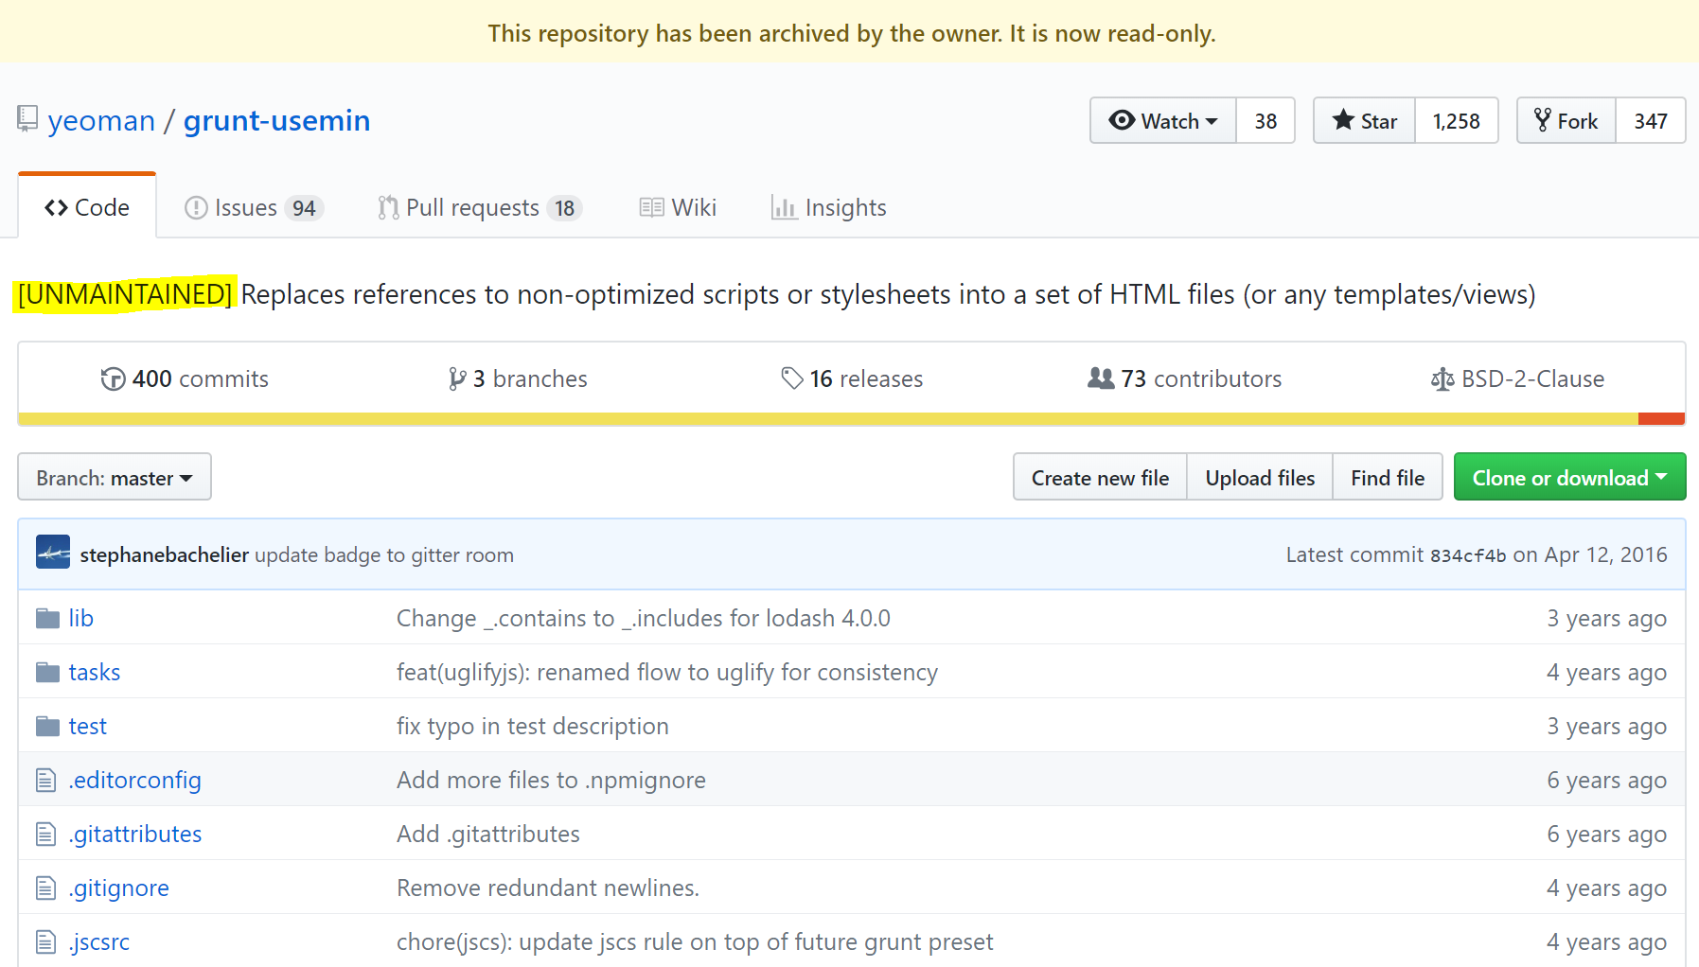


Slide 17
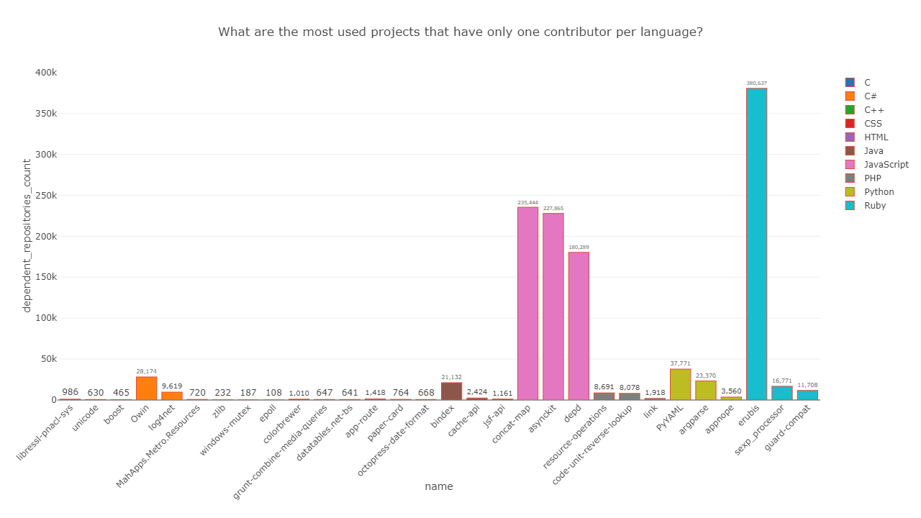

Slide 18
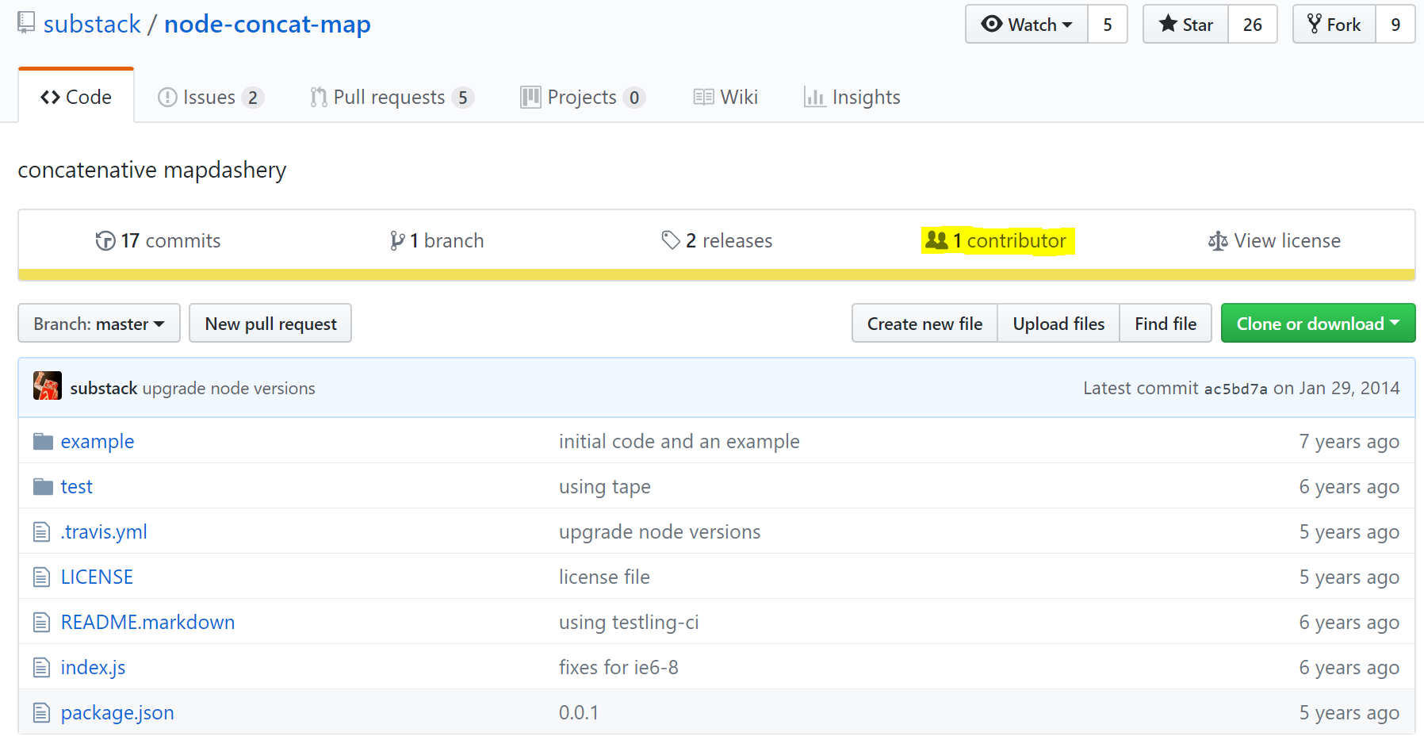

Slide 19
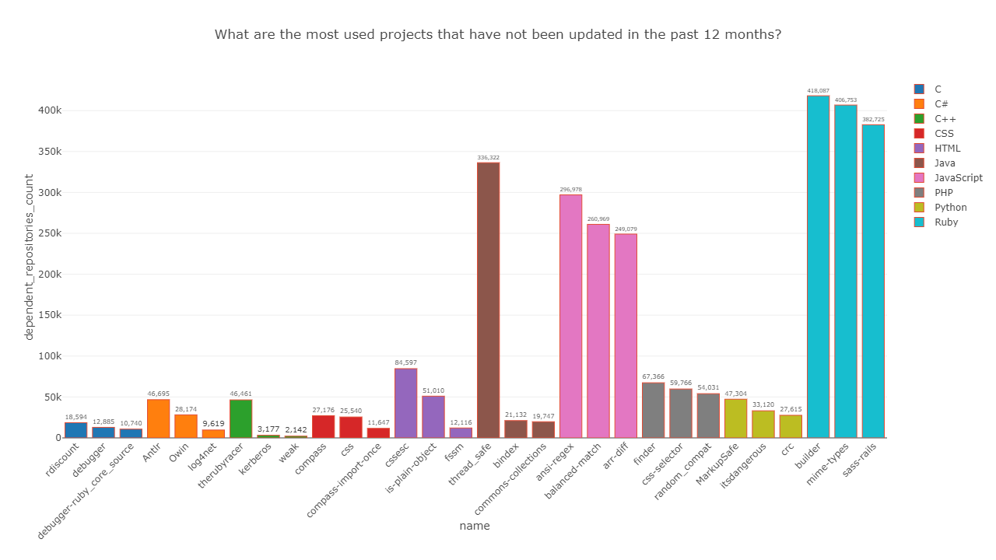

Slide 20
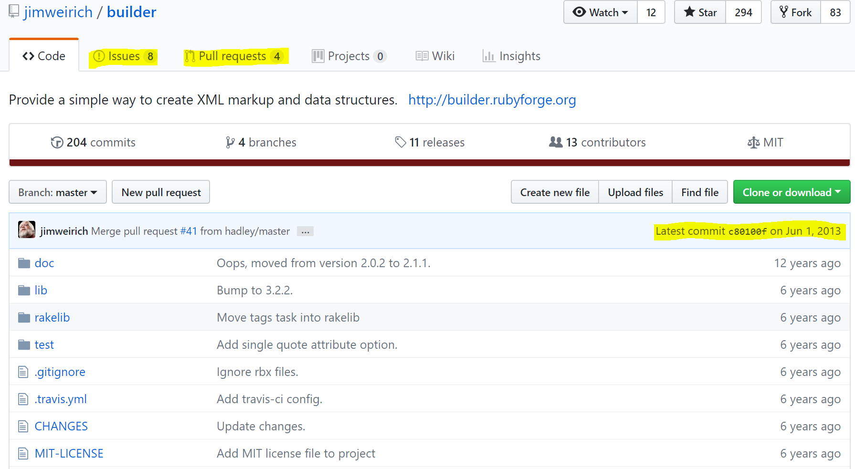

Slide 21
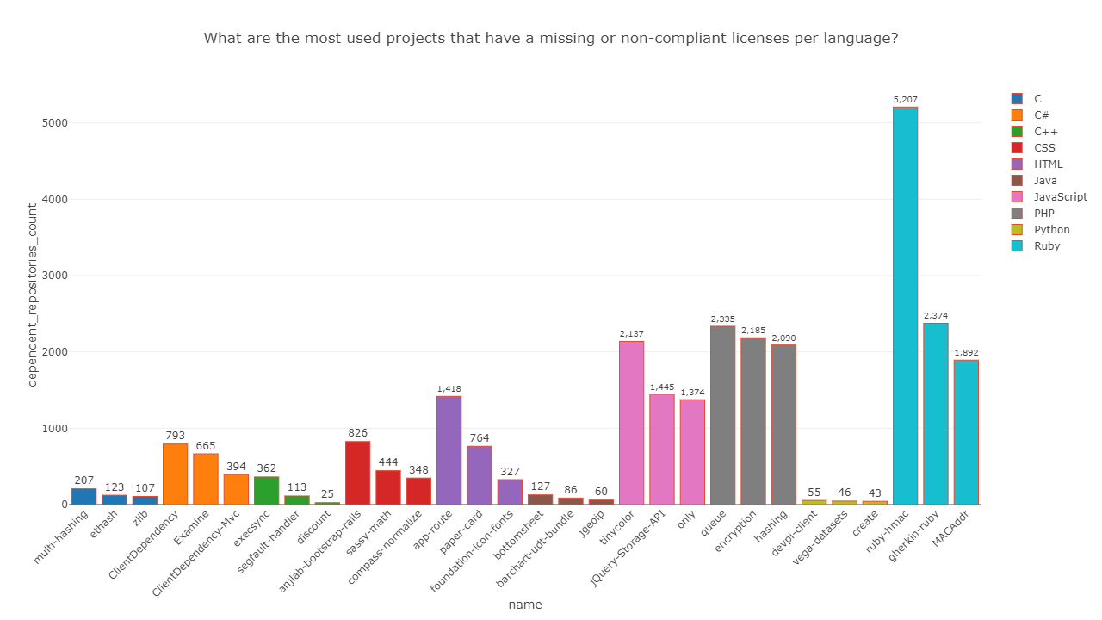

Slide 22
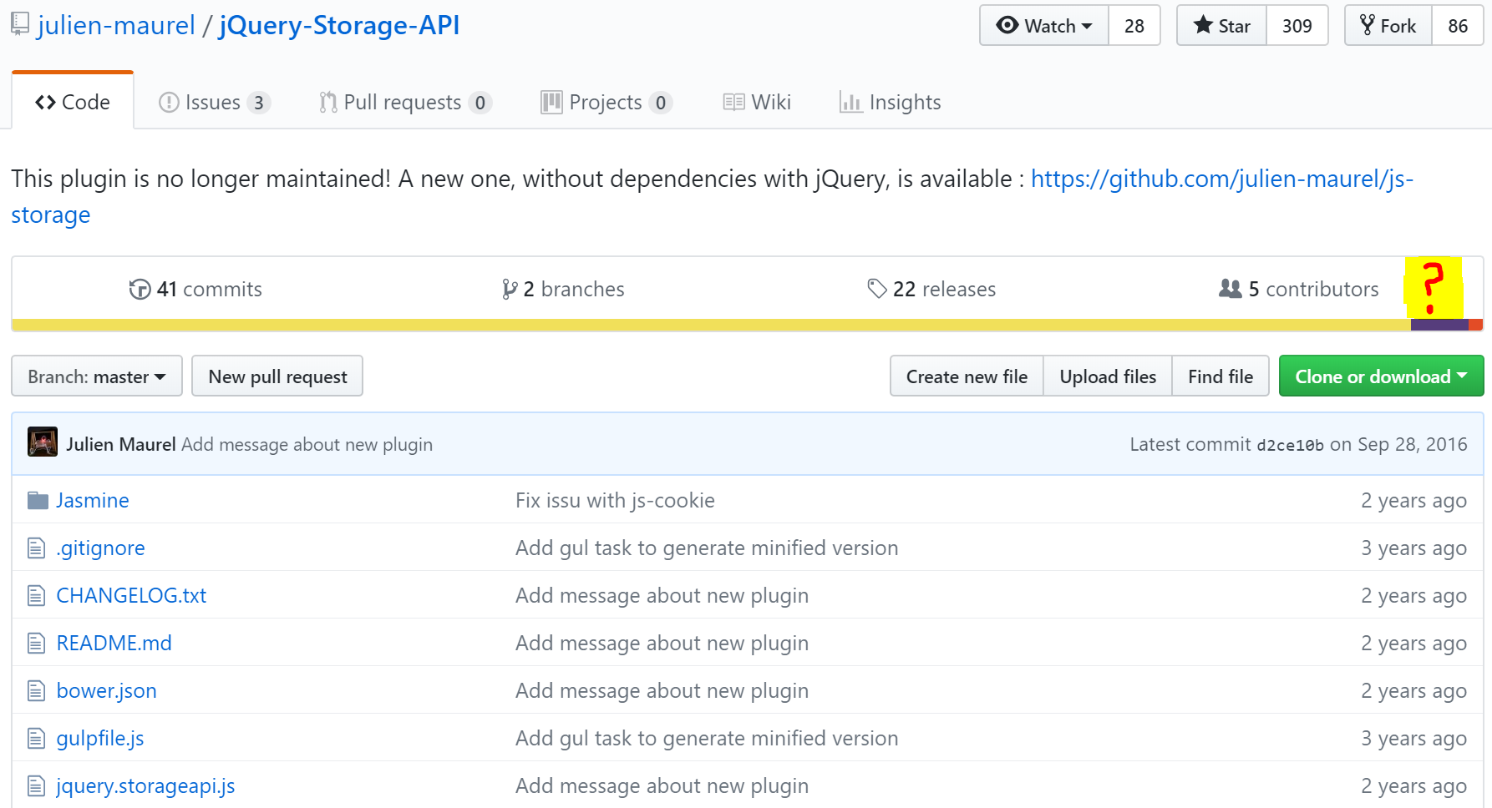

Slide 23
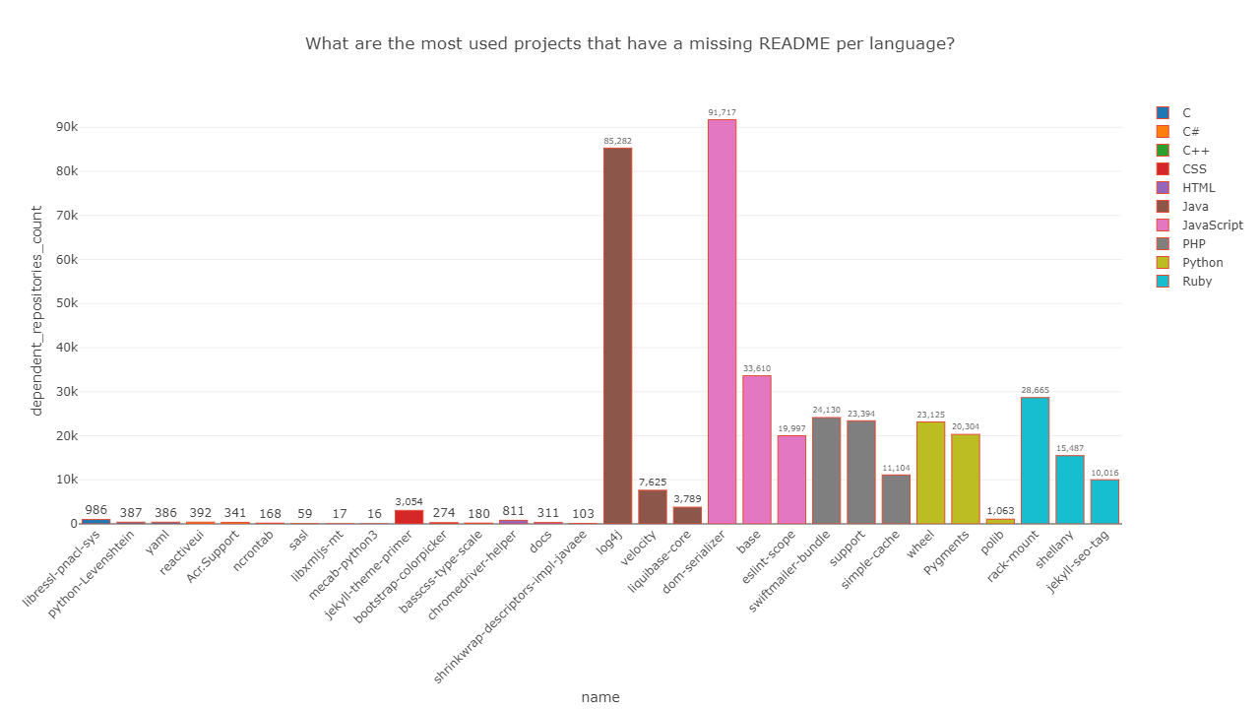

Slide 24
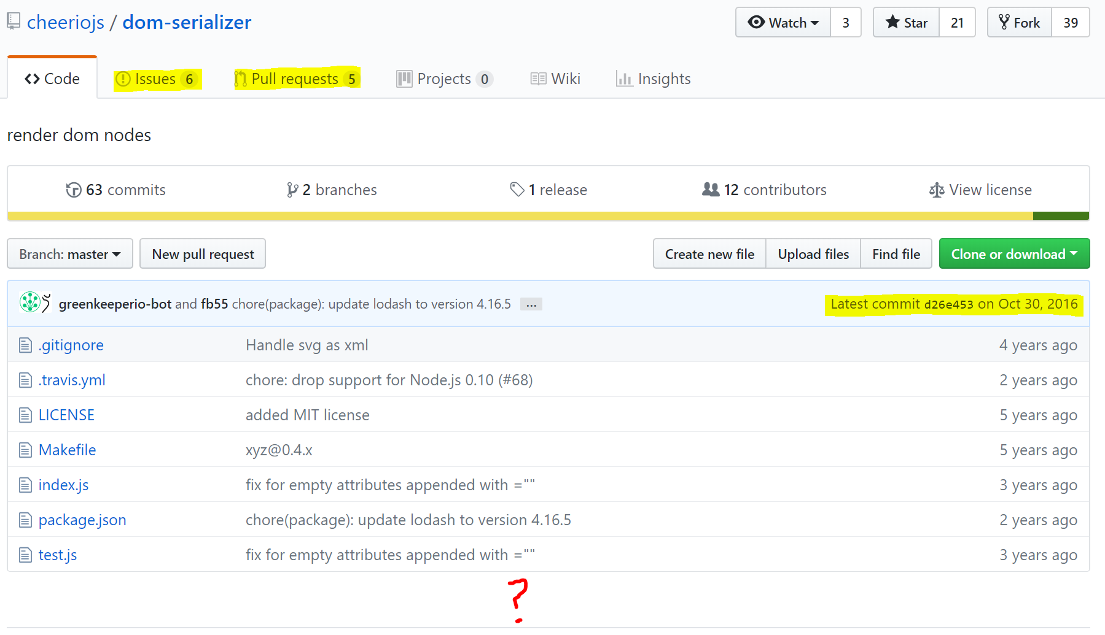

Slide 25
Ranking ecosystems by individual risk factors

Slide 26
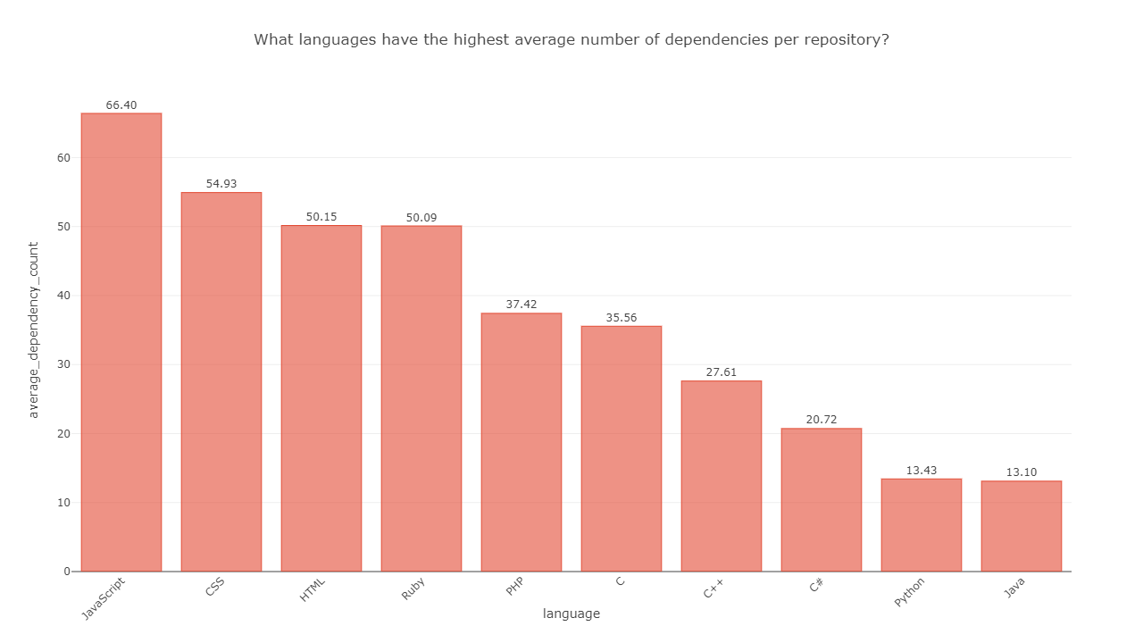

Slide 27
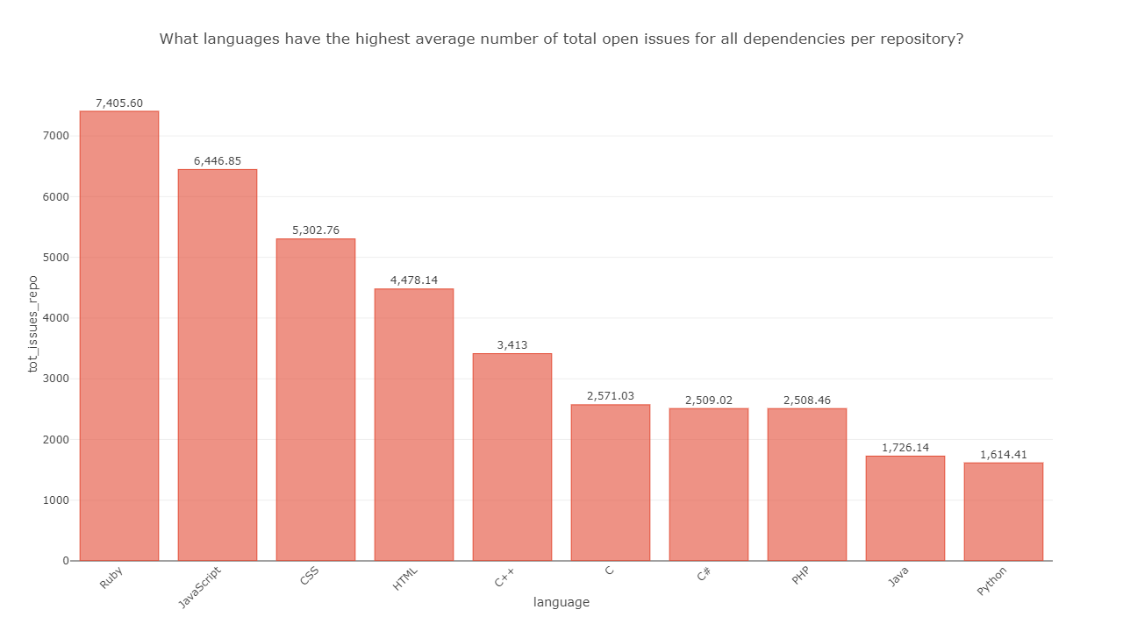

Slide 28
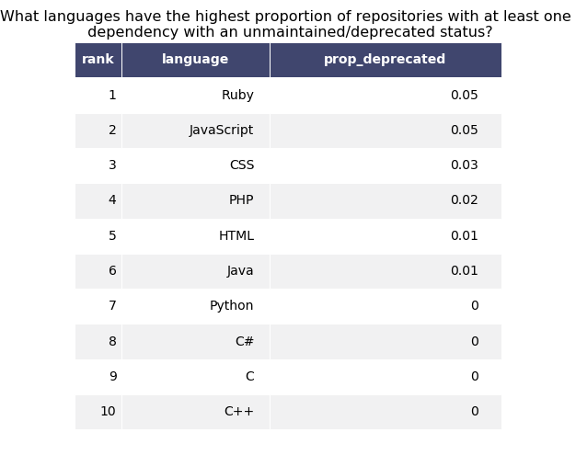

Slide 29
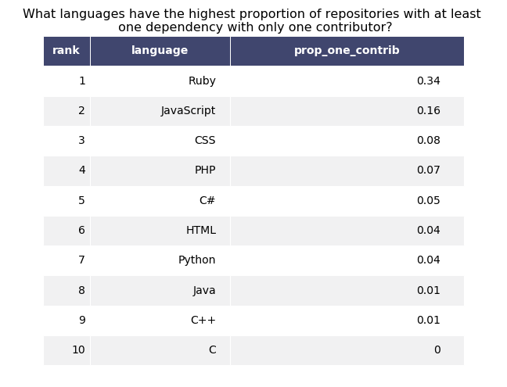

Slide 30
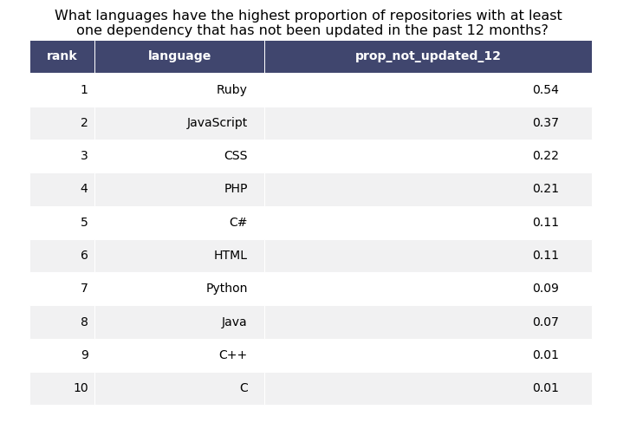

Slide 31
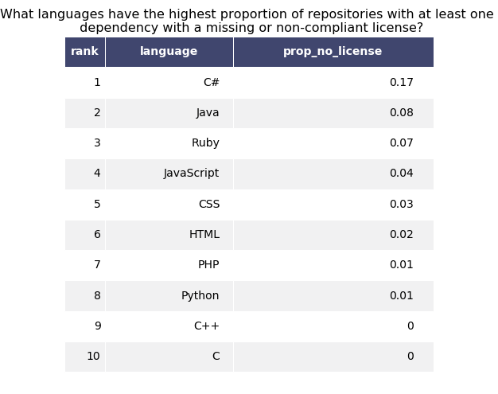

Slide 32
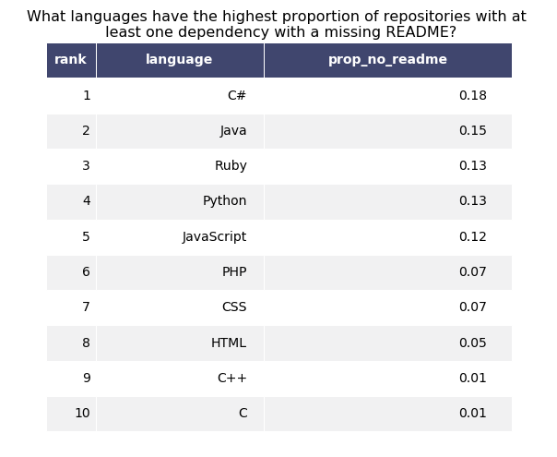

Slide 33
What ecosystem has the highest level of risk?

Slide 34
