Slide 1
Problem statement 1: Customer churn prediction
Predicting the probability of customer churn of a telecommunication company. "Churn" refers to whether the customer will discontinue the service or not.
Development and deployment of predictive model on cloud platform.
Dataset contains information about:
Customers who left within the last month – the column is called Churn
Services that each customer has signed up for – phone, multiple lines, internet, online security, online backup, device protection, tech support, and streaming TV and movies
Customer account information – how long they’ve been a customer, contract, payment method, paperless billing, monthly charges, and total charges
Demographic info about customers – gender, age range, and if they have partners and dependents

Slide 2
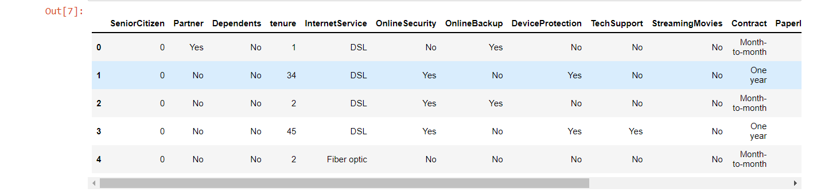
An overview of the dataset

Slide 3
Work done
A Random Forest Classifier model was developed to predict customer churn.
HTML template was created and wrapped using Flask framework.
The finished project was deployed on an AWS server.

Slide 4
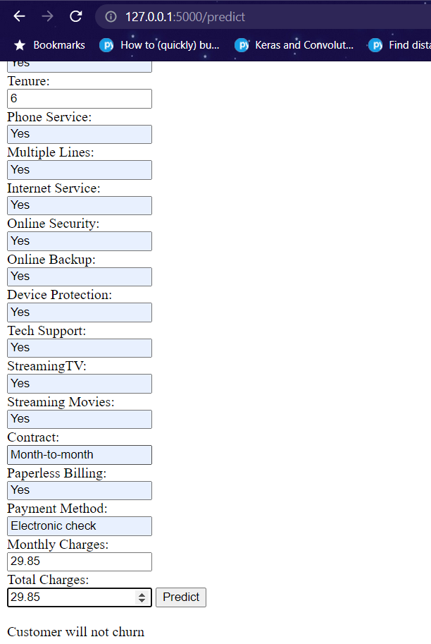
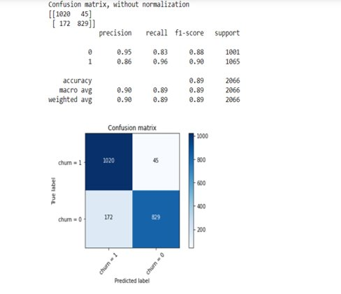
The confusion matrix of the model shows the accuracy of the model.
The final result

Slide 5
Problem statement 2: Banknote authentication
Determining the authenticity of banknotes.
Development and deployment of predictive model on cloud platform.
Dataset contains features extracted from images that were taken from genuine and forged banknote-like specimens. For digitization, an industrial camera usually used for print inspection was used. The final images have 400x400 pixels. Wavelet Transform tool were used to extract features from images.

Slide 6
Work done
A Logistic Regression model was developed to classify whether the note was fake or authentic.
HTML template was created and wrapped using Flask framework.
The finished project was deployed on an AWS server.

Slide 7
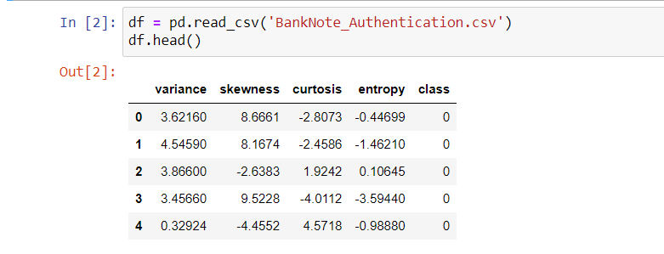
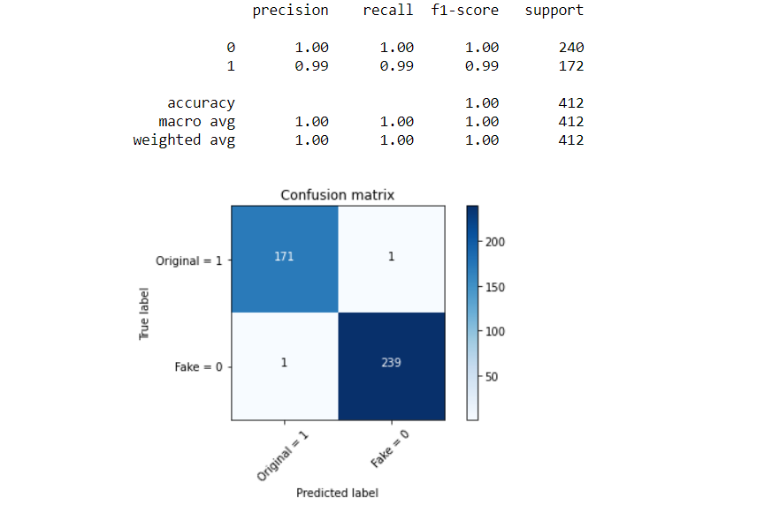
The dataset contains the extracted features from the images of notes which were transformed using Wavelet Transform.
The confusion matrix of the model shows the accuracy of the model.

Slide 8
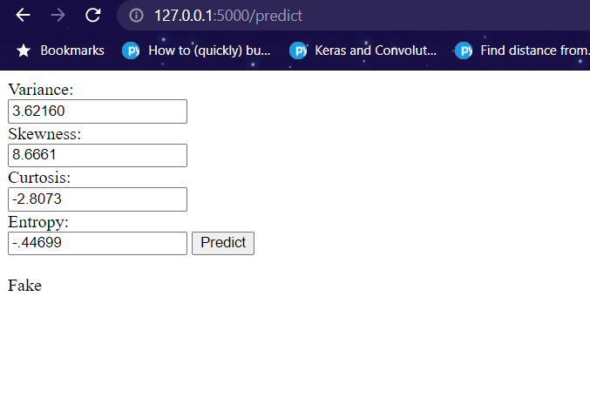
The final result

Slide 9
Problem statement 3: ASL to text
Translating American Sign Language to English text.
Development of an Image Recognition model to identify ASL gestures and convert them to text.
The data set is a collection of images of alphabets from the American Sign Language, separated in 29 folders which represent the various classes.
The training data set contains 87,000 images which are 200x200 pixels. There are 29 classes, of which 26 are for the letters A-Z and 3 classes for SPACE, DELETE and NOTHING. These 3 classes are very helpful in real-time applications, and classification. The test data set contains a mere 29 images, to encourage the use of real-world test images.

Slide 10
Work done
An Image Recognition model was created using Deep Learning and Convolutional Neural Networks.
The dataset contains images of ASL alphabets and a few words.
The model was saved in a .h5 file along with the LabelBinarizer file.

Slide 11
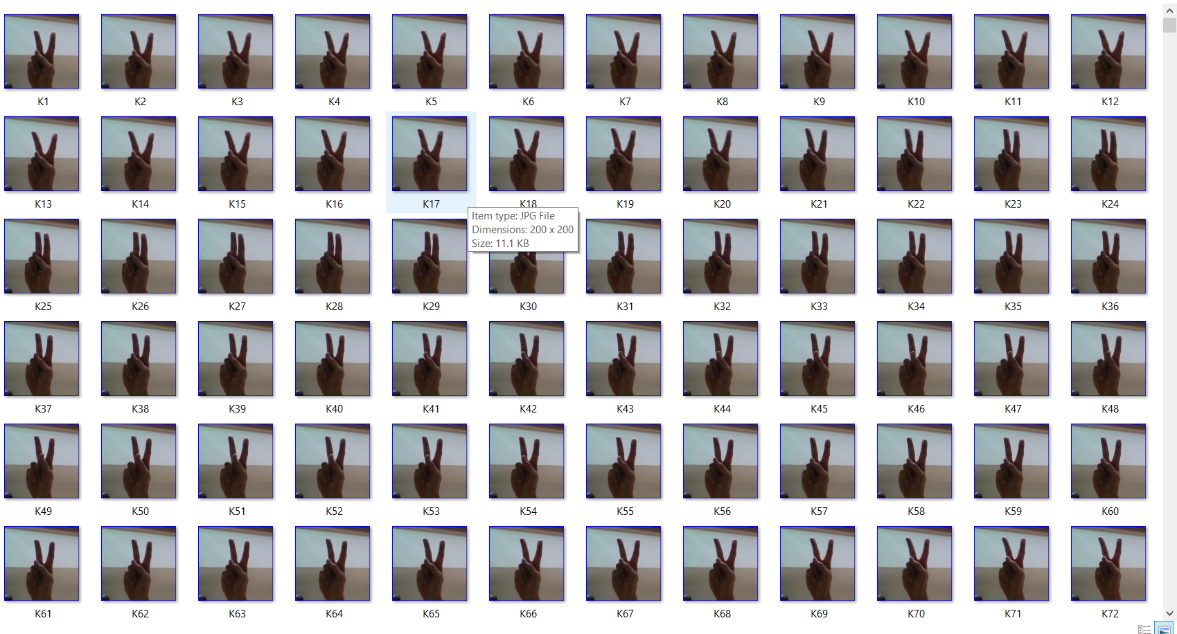
Contents of the dataset

Slide 12
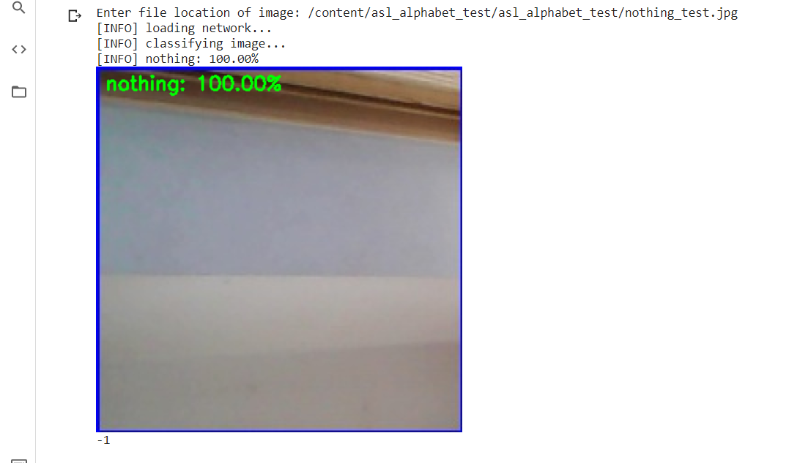
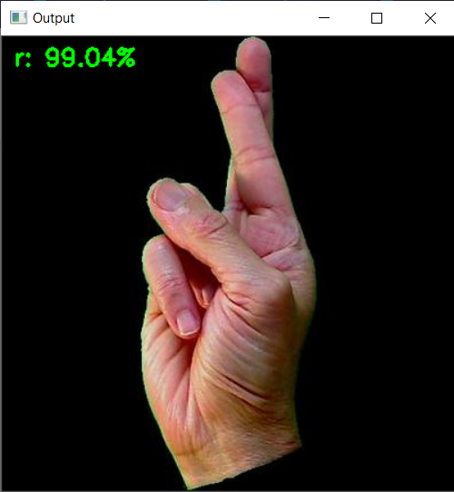
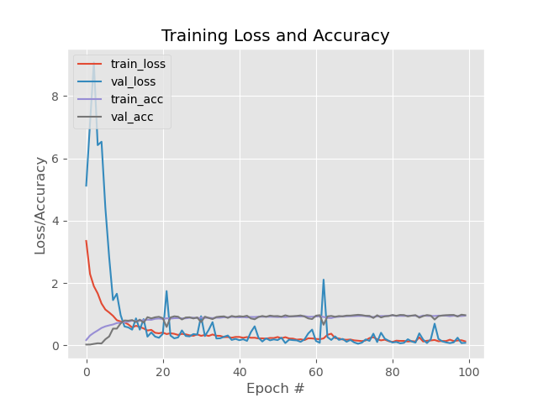
Output of the model
The loss and accuracy graph

Slide 13
Problem statement 4: Medical specialty prediction
Predicting the correct medical specialty from the given transcription.
Dataset contains information about patient's basic details, symptoms, diagnosis and treatment by the doctor along with the medical specialty and keywords from the transcription.

Slide 14
Work done
Since the dataset was particularly noisy, it had to be cleaned extensively.
Categories were reduced, same fields with different names were masked together and oversampling was performed to wield decent results.
Due to overlapping of the medical specialties, accuracy is low. Accuracy can further be increased by applying domain knowledge.

Slide 15
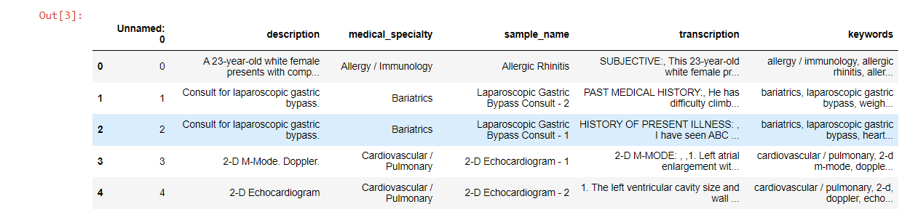
An overview of the dataset

Slide 16
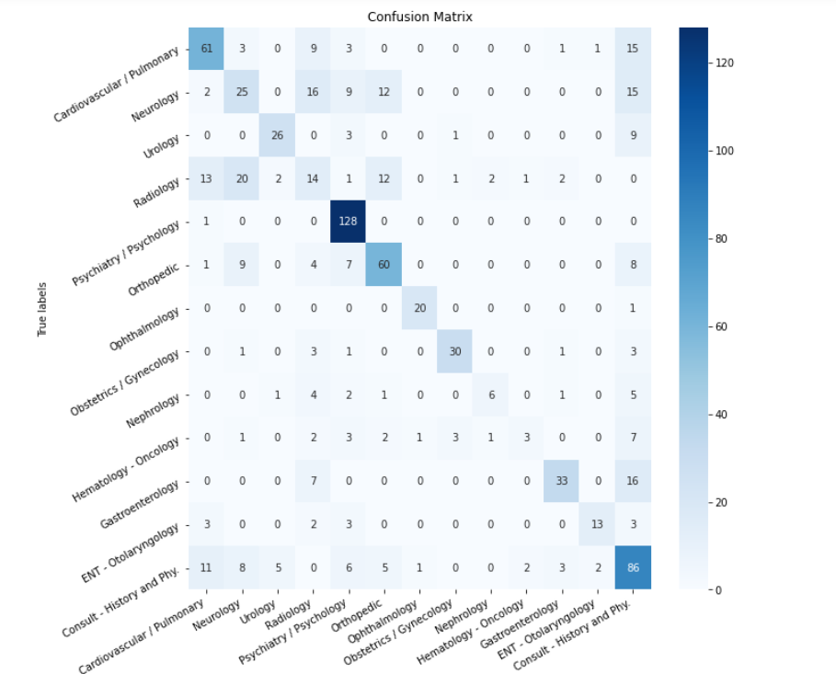
The confusion matrix shows the accuracy of the model. If you look closely, you can see the overlapping of the various specialties.

Slide 17
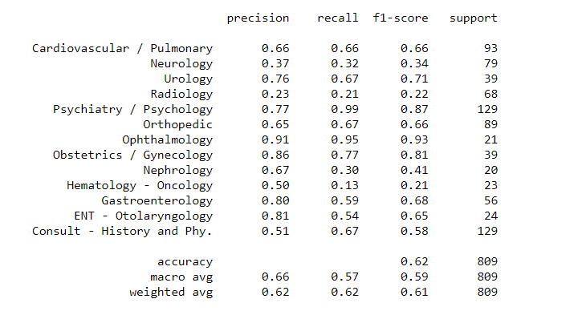
The score of the confusion matrix

