Slide 1
TABLE OF CONTENTS
What is RISC-V
RISC-V Terminology
  Hart
RISCV-ISA
  Previlege ISA
  Unprivileged ISA
RISC-V Registers
Calling Convention
Instruction Types
Addressing modes
Build Process
  Compiling,assembling,linking stages
  Different data and sections of program
Traps
Sifive Hifive1 board
  Boot Process
Interrupt/Exception handling in E31 core

Slide 2
RISCV-ISA
RISC-V ISA is an open source implementation of a Reduced Instruction Set Computing(RISC) based instruction set architecture(ISA) driven through open collaboration, enabling freedom of design across all industries and domains.
What is ISA
  An instruction set architecture (ISA) is an abstract model of a computer. It is also referred to as architecture or computer architecture. A realization of an ISA, such as a central processing unit (CPU), is called an implementation. Some ISAs you may have heard of include x86, ARM.These ISAs require a license to implement them. On the other hand, the RISC-V ISA is provided under open source licenses that do not require fees to use
RISC-V was begun with a goal to make a practical ISA that was open-sourced, usable academically, and deployable in any hardware or software design without royalties.
The RISC-V authors are academics who have substantial experience in computer design, and the RISC-V ISA is a direct development from a series of academic computer-design projects, especially Berkeley RISC. RISC-V was originated in part to aid all such projects
                https://en.wikipedia.org/wiki/RISC-V

Slide 3
What is not Risc-V
As an Instruction Set Architecture, RISC-V itself is not “open source” in the same way that software is open, as an ISA is not made of source code. It is, however, an open specification, and it is released under a Creative Commons license
Not open source hardware as Linux is for operating systems Although there are few chips that companies are making that are open source .

Slide 4
RiSC-V Terminology
Core
  A component is termed as core if it contains an independent instruction fecth unit
HART
  A hardware execution context, which contains all the state mandated by the RISC-V ISA: a PC and some registers. This terminology is designed to disambiguate software's view of execution contexts from any particular microarchitectural implementation strategy.
  Each hart has its own user register state and program counter and executes sequential instruction stream
A single core may have one harts or more than one harts.

Slide 5
UnPrivileged Specification
Simply put, the unprivileged specification details items that are not related to machine mode (M-mode) or to Supervisor Mode (S-mode). The unprivileged specification includes the base ISA as well as extensions to that base like integer (I), float (F), double (D), compressed instructions (C), and many more
The base instruction sets describe the instruction format, basic integer instructions, load and store instructions, and other fundamental details of the ISA. We break these up into several bases:
  RV32I - Integer 32 bit
    contains 47 unique instructions.
  RV32E - Reduced RV32I for embedded purposes
  RV64I - Integer 64 bit
  RV128I - Integer 128 bit
  All these “Base ISA’s” either reduce or extend off the RV32I base instruction set. As an example, RV64I widens the integer registers and the supported user address space to 64 bits.

Slide 6
Privileged Specification
As its name suggests, the privileged specification contains descriptions of the RISC-V ISA which operate in Machine Mode (M-mode) or Supervisor Mode (S-mode)
Each privilege level has access to specific Control and Status Registers (CSRs), and higher privilege levels can access the CSRs of those less privileged levels
This specification also contains additional functionality required for running rich operating systems like Linux.

Slide 7
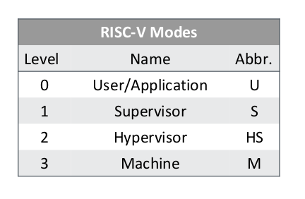
RISC-V ISA
Risc-v ISA is broken in two parts
  Unprivileged Specification
  Privileged Specification
RISC-V Privilege Specification defines 3 levels of privilege,called modes.
  User Mode (U-mode) is for user processes
  Supervisor Mode (S-mode) is for kernel and/or device drivers
  Machine Mode (M-mode) is used for bootloader and/or firmware.

Slide 8
          Machine Mode
M-mode is used for low-level access to a hardware platform and is the first mode entered at reset, when the processor finishes initializing and is ready to execute code
M-mode can also be used to implement features that are too difficult or expensive to implement in hardware directly.
  A good example of this would be a watchdog timer implemented in low level software (firmware) which helps the system recover from faults.
Machine mode has highest privileges and is the only mandatory privilege level for risc-v platform

Slide 9
Risc-V Registers
The RV32I base integer ISA includes 32 registers, named x0 to x31. The program counter PC is separate from these registers, in contrast to other processors such as the ARM-32.
The first register, x0, has a special function: Reading it always returns 0 and writes to it are ignored.
CSRs are Registers which contain the working state of a RISC-V machine
Reading/writing to a csr will affect processor operation.
Csr are used for example knowing the system configurations,handing exception,switching to different priviledge mode and handling interrrupt are some examples for which these csr are needed.
https://github.com/riscv-non-isa/riscv-asm-manual/blob/master/riscv-asm.md

Slide 10
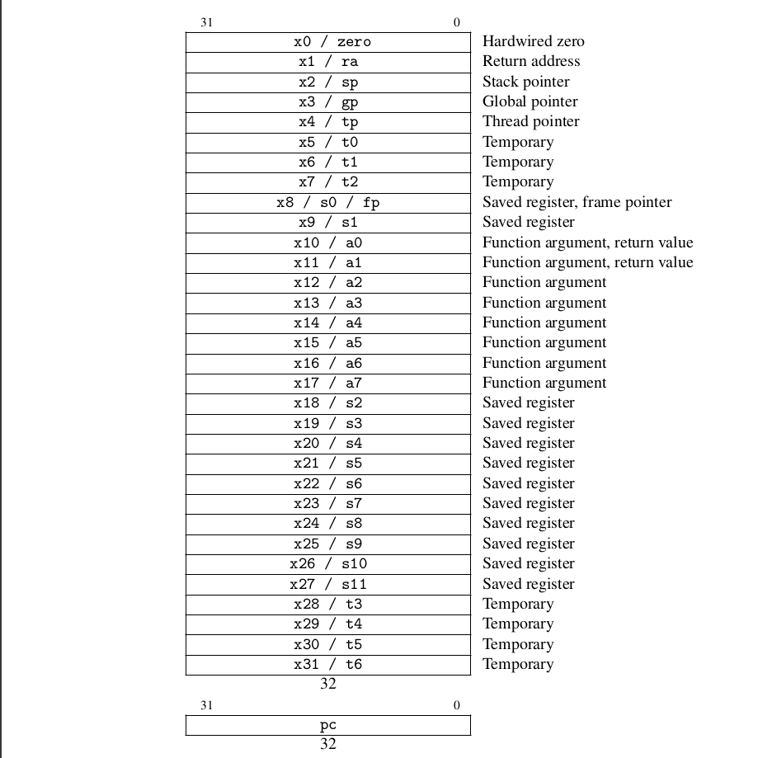
RISC-V REGISTERS

Slide 11
          Identification CSR’s
Misa
  Contains ISA supported by HART
MhartId
  Integer ID of Hardware Thread
Mvendorid
  Machine Vendor ID
Marchid
  Used along with mvendorid to identify a implementation

Slide 12
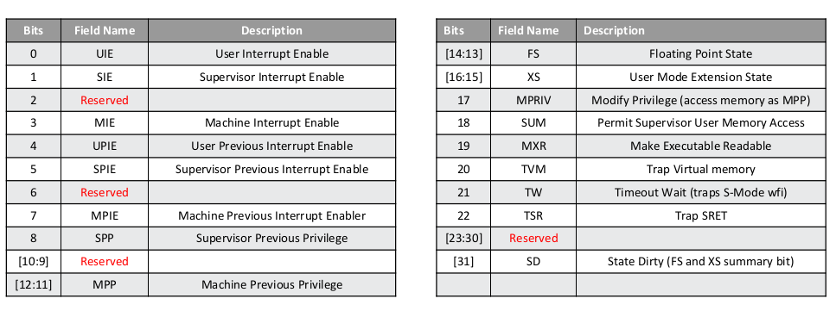
mstatus
Is used to enable/disable interrupts
It is also used to track harts current operating state

Slide 13
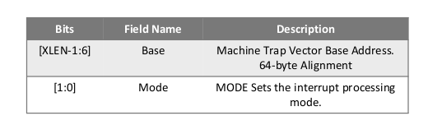
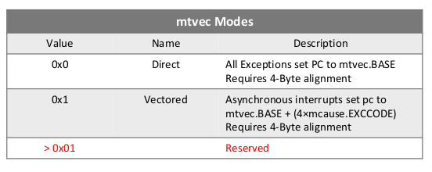
Machine trap vector base address register
This register has the address of trap handler in direct mode
For vector mode we have to write the base address of vector table to this register.
mtvec.Mode = Direct
  All Interrupts trap to the address mtvec.Base
  Software must read the mcause CSR and react accordingly
mtvec.Vectored
  Interrupts trap to the address mtvec.Base + (4*mcause.ExCode)
  Eliminates the need to read mcause for asynchronous exceptions
Mtvec register
Modes

Slide 14

Machine Interrupt registers
Mie
  Machine mode interrupt enable register is read/write register, containing interrupt enable bits.
  Timer,software and external interrupts can be controlled

Slide 15

Machine Interrupt Pending register
Mip
  Machine mode interrupt register is read/write register which holds the information regarding interrupts which are pending

Slide 16
Machine timer registers
Mtime
  Risc-V defines a counter which is memory mapped.
  64 bit register
Mtimecmp
  Risc-V defines memory mapped timer compare register
  Triggers an interrupt when mtime is greater than equal to mtimecmp
  64 bit register

Slide 17
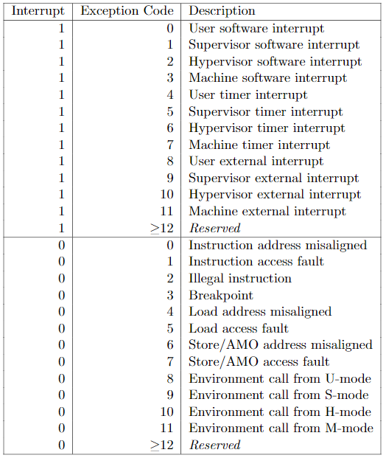
Machine cause register
Machine cause register contains reason for the exception or interrupt that happened

Slide 18
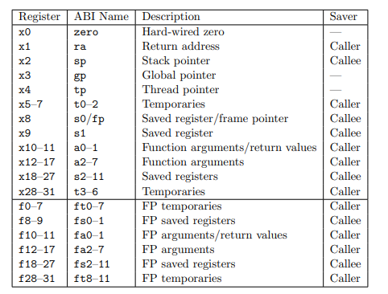
RISC-V calling Convention
https://riscv.org/wp-content/uploads/2015/01/riscv-calling.pdf

Slide 19
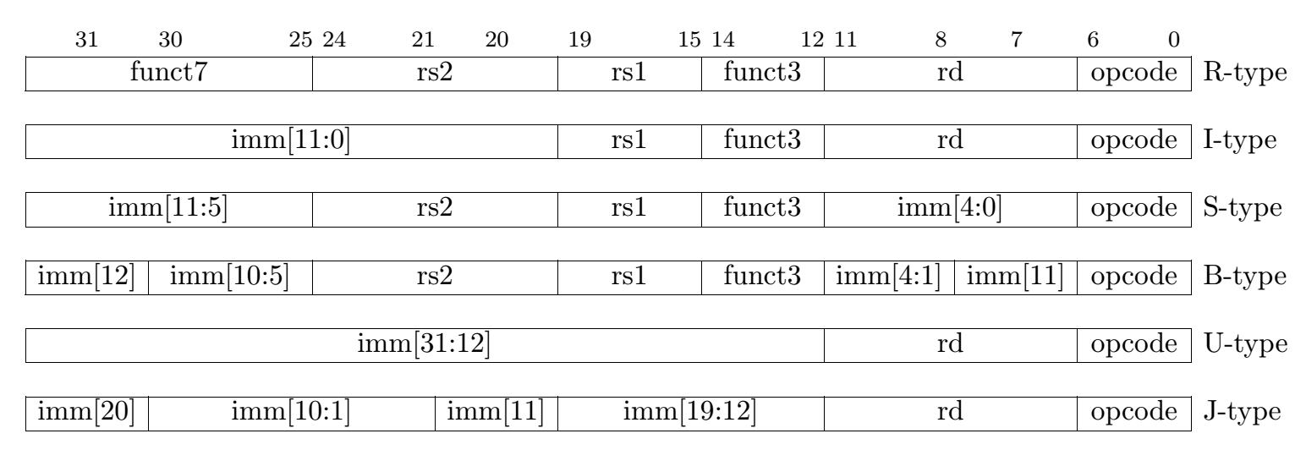
Base Instruction formats
There are four core instruction formats.
All are fixed 32 bits in length and must be aligned on a four-byte boundary in memory.
Register-type contains 3 registers 2 source and 1 destination registers
Immediate type contains 1 source register, 1 destination register and 12 bit immediate.
Store type is used to store the value in rs2 to a certain address which is calculated using rs1 and 12 bit immediate.
  Fun3 defines what type of store
B-type Check the conditions using rs1,rs2 and jump to 12 bit immediate
U-Type(upper Immediate) constans defined by 20 bit immediate is stored in destination register rd.
J –type(jump) jump to immediate location.
Instruction formats

Slide 20
Instructions Types
Arithmetic
Logical
Load/Store
Branch
  Conditional
  Unconditional
Set Instructions(flag instructions)
System instructions

Slide 21
Addressing modes
RISC-V has three addressing modes:
  PC-relative(via the auipc, jal instructions)
  Register-immediate(via the jalr, addi and all memory instructions)
  Absolute, via the lui instruction (though arguably this is just x0-offset).

Slide 22
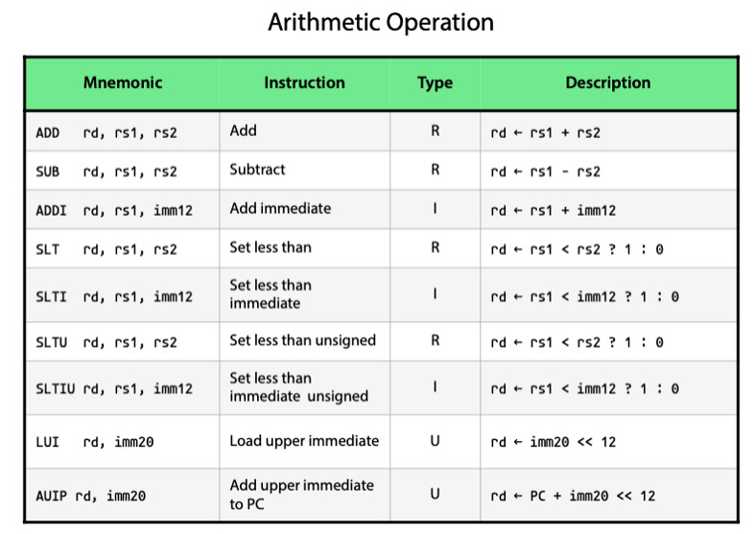
Arithmetic Instructions
LUI (load upper immediate) is used to build 32-bit constants and uses the U-type format. LUI places the U-immediate value in the top 20 bits of the destination register rd, filling in the lowest 12 bits with zeros.
AUIPC (add upper immediate to pc) is used to build pc-relative addresses and uses the U-type format. AUIPC forms a 32-bit offset from the 20-bit U-immediate, filling in the lowest 12 bits with zeros, adds this offset to the pc, then places the result in register rd.

Slide 23
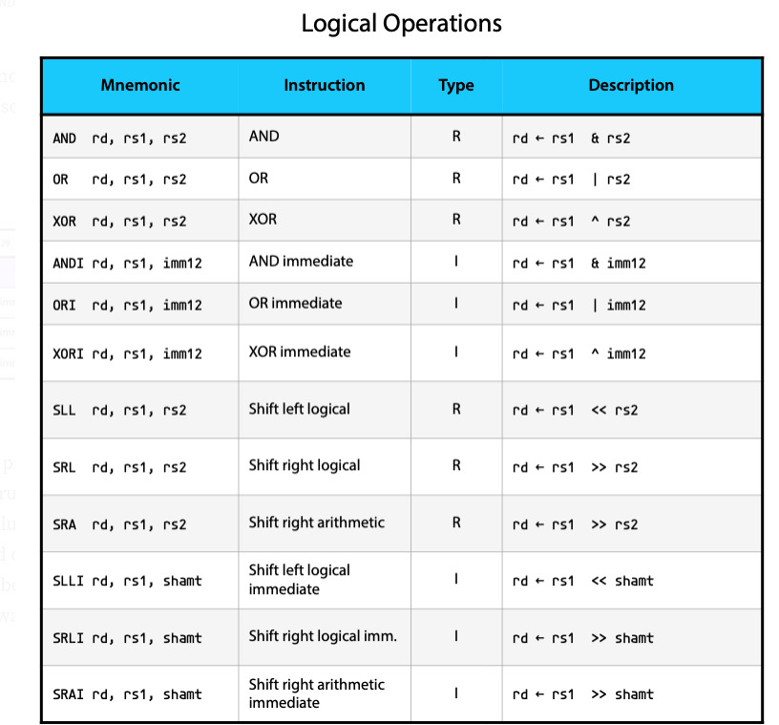
Logical

Slide 24
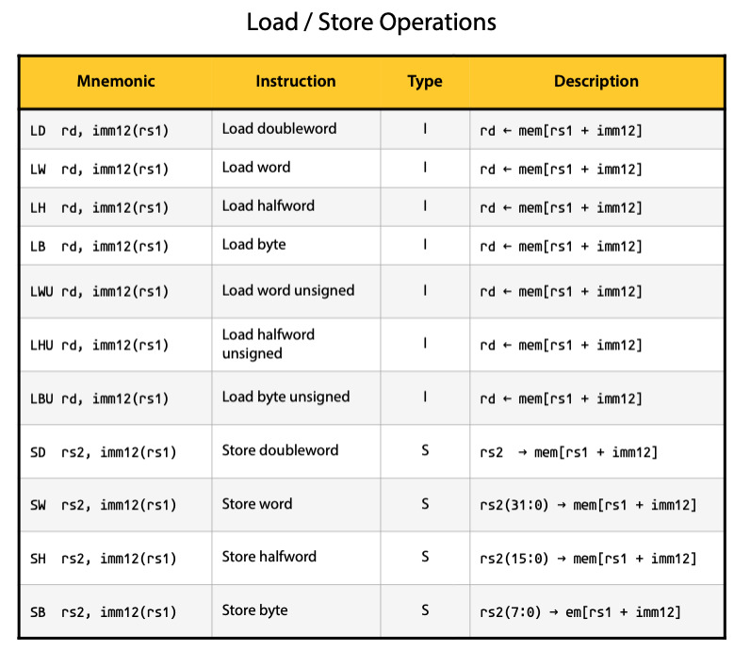
Load/Store
Load instruction loads value from memory to register
Store instruction stores value from register to memory

Slide 25
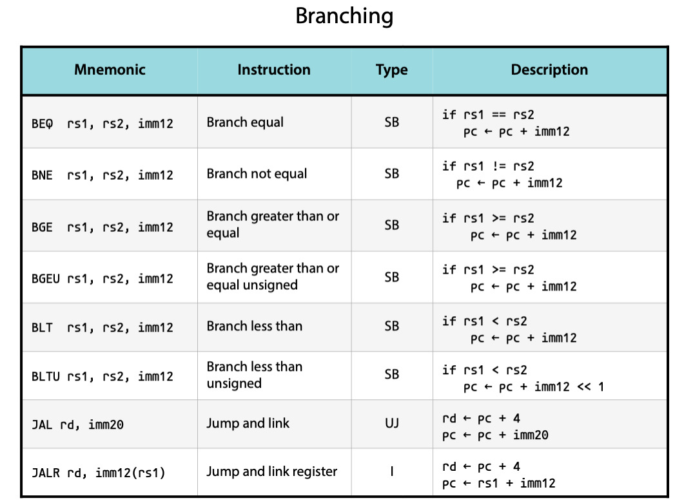
Branch

Slide 26
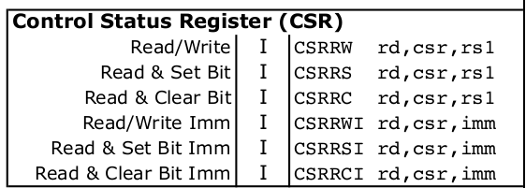
CSR instructions
CSRRW
CSRRS
CSRRC
CSRRWI
CSRRCI
The Control Status Register instructions (csrrc, csrrs, csrrw, csrrci, csrrsi, csrrwi) provide easy access to registers that help measure program performance.

Slide 27
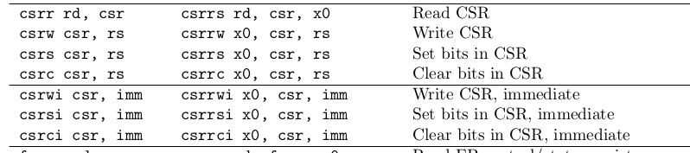
CSR INSTRUCTIONS
PSEUDO BASE INSTRUCTIONS Meaning

Slide 28
Traps
Trap is specific scenario caused by an exceptional condition or interrupt.
In RISC-V the term trap refers to,transfer of control to a trap handler caused either by an exception or interrupt
A trap handler is subroutine that handles trap in software
Exception is an unusual condition occuring at run time of instruction in the current risc-v hart.Exceptions are usually synchronous.
  Illegal Instruction
  Instruction/Load/Store address misaligned
  Instruction/Load/store access fault
  Environment call

Slide 29
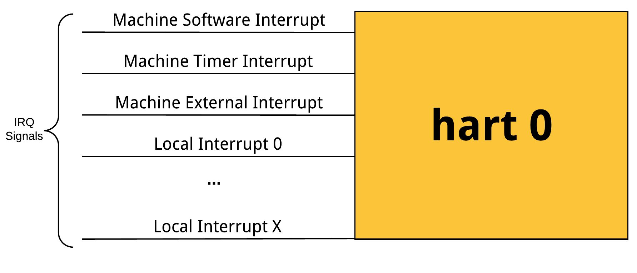
Interrupts
Interrupts are another form of traps which can occur from timer or peripherals.Interrupts are asynchronous events
Risc-V defines the following interrupts per Hart
  Software
  Timer
  Local --> Hart specific peripheral interrupts
  External/Global --> Peripheral Interrupts

Slide 30
Local Interrupt Sources
Each hart has a number of local interrupt sources that do not pass through the PLIC, includingthe standard software interrupts and timer interrupts for each privilege level.
Local interrupts canbe serviced quickly since there will be minimal latency between the source and the servicing hart,no arbitration is required to determine which hart will service the request, and the servicing hartcan quickly determine the interrupt source using the mcause register.
All local interrupts follow a level-based model, where an interrupt is pending if the correspondingbit in mip is set. The interrupt handler must clear the hardware condition that is causing the mip bit to be set to avoid retaking the interrupt after re-enabling interrupts on exit from the interrupt handler.

Slide 31
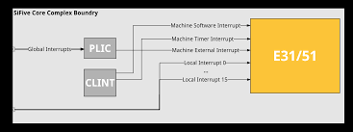
Global Interrupt Sources
Global interrupt sources are those that are prioritized and distributed by the PLIC. Depending on the platform-specific PLIC implementation, any global interrupt source could be routed to any hart context.
Global interrupt sources can take many forms, including level-triggered, edge-triggered, and message-signalled. Some sources might queue up a number of interrupt requests. All global interrupt sources are converted to a common interrupt request format for the PLIC.
Example -> Sifive e31 core interrupt

Slide 32
Riscv-Exceptions
Instruction address misaligned
  The exception occurs when the programs tries to execute an unconditional jump or take a branch, wherein the target address is not 4 byte aligned
Instruction access fault
  The exception occurs when the programs tries to access an instruction on a invalid memory location.For example executing unconditional jump instruction to a memory location which is out of boundsof the physical memory
Illegal instruction
  The exception occurs when the programs tries to execute any illegal instruction.For example when the program tries to write on read only csr
  Example
    Li t0,1
    Csrrs x0,mhartid,t0
Breakpoint
  The exception occurs when the programs executes a break-point set in the program to enter debug mode

Slide 33
Cont...
Load address misaligned
  The exception occur when the programs tries to execute an load instruction to access data from misaligned address or an address that is not 4 byte aligned. For example, trying to access a data section without using a properly aligning it would cause this exception.
Load access fault
  The exception occurs when the programs attempt to do a load on a invalid memory location. For example trying to load from address which is more than the bound of memory or inaccessible by memory
Store address misaligned
  The exception occurs when the programs tries to execute an store instruction at a misaligned address (Address that is not four byte aligned). For example trying to store data into a data section without using proper alignment, would cause this exception
Store access fault
  The exception occurs when the programs attempts to do a store on an invalid memory location. For example, trying store to address which is more than the bound of memory or inaccessible by memory.

Slide 34
Software
Spike ??
  Proxy kernel
Riscv32 toolchain
Freedom studio

Slide 35
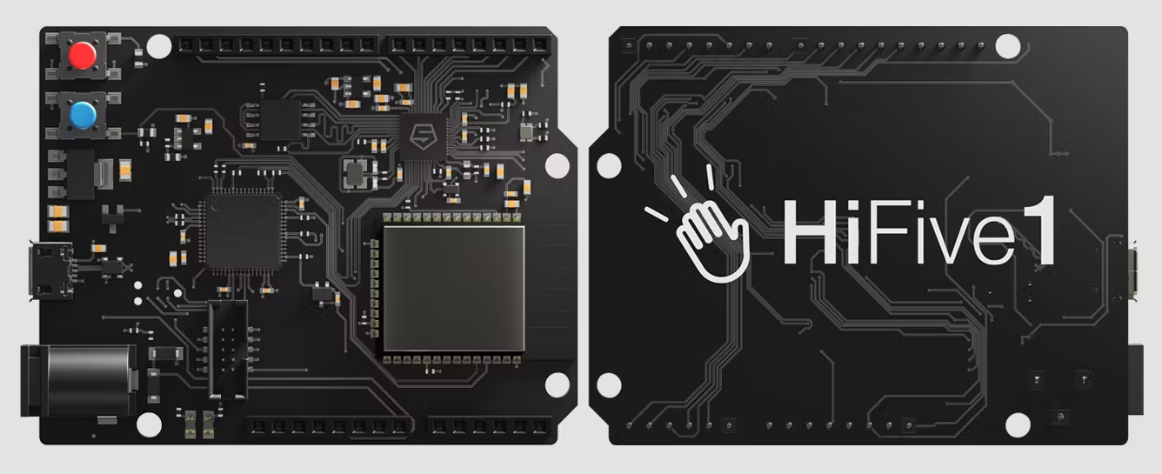
Sifive Hifive-1 board

Slide 36
E31 Local Interrupts
Core Local Interrupter (CLINT) with a fixed priority scheme,with preemption support for interrupts from higher privilege levels only. The primary purpose of the CLINT is to serve as a simple CPU interrrupter for software and timer interrupts.
There are two different CLINT modes of operation, direct mode and vectored mode.To configure CLINT modes, write mtvec.mode field, which is bit[0] of mtvec CSR

Slide 37
Exception handling
A hart normally runs application code in U-mode until some trap forces a switch to a trap handler, which usually runs in a more privileged mode. The hart will then execute the trap handler, which will eventually resume execution at or after the original trapped instruction in U-mode.
Inbetween this, the processor privilege is set to Machine mode and processor sets the mcause register with exception code. The mepc is set with the pc of the instruction that caused the exception. All exception’s come to the Machine Mode trap handler first.
This applies for exceptions that arise from different privilege levels. The Machine Mode trap handler executes in Machine Mode. In the trap handler, first the context of the registers are saved in stack. Then the trap is serviced. After this the saved context in stack is restored back. This way, the trap is handled without causing much trouble to the execution flow.
Now, a question may arise on how the hardware jumps to the trap handler. This is established bysetting the mtvec register with Tap handler’s physical address. Usually the value in mtvec is called as “Trap entry”. Incase, we may not want to handle the exception in Machine Mode. we might want to handle it in Supervisor Mode or even User Mode. As such, there is a facility to “delegate” some or all exceptions to the lower privilege levels.

Slide 38
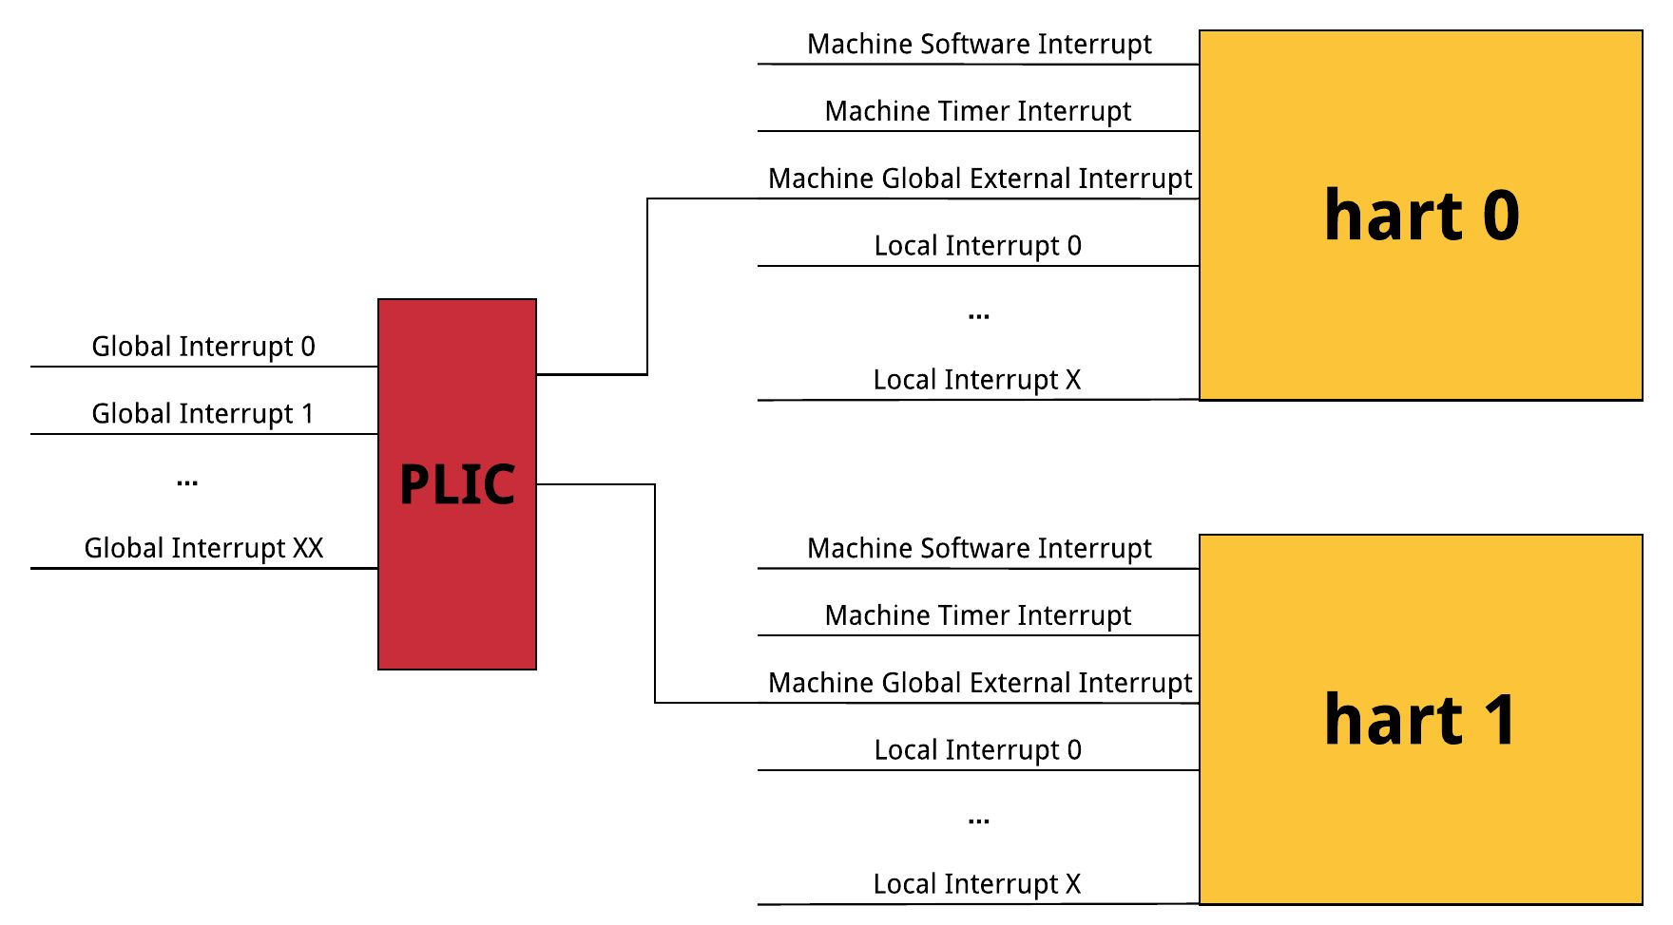
Global Interrupts
The global interrupt controller is termed as the Platform Local Interrupt Controller (PLIC).
PLIC provides system level flexibility for dispatching interrupts to a single CPU or multiple CPU’s in the system. Global interrupts that route through the PLIC arrive at the CPU through a single interrupt connection with a dedicated interrupt ID.
Each global interrupt has a programmable priority register available in the PLIC memory map.

Slide 39
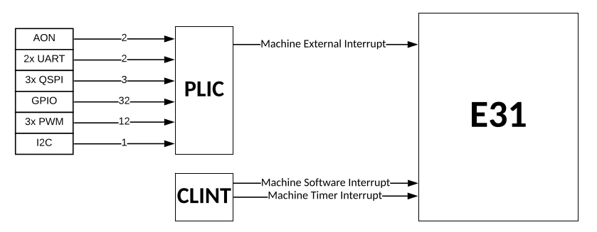
Interrupts
FE310-G002 Interrupt architecture block diagram

Slide 40
Interrupt Entry
Mtvec.mode=Direct
On entry, the Risc-V hart will save current context
Then set PC=mtvec.base,mstatus.mie=0
MEPC
Mstatus.mpp
Mstatus.mpie
PC
Priv
MIE

Slide 41
Interrupt Exit
Mret instruction restores state
PC
Priv
MIE
MPEC
Mstatus.mpp
Mstatus.mpie

Slide 42
Questions???

