Slide 1

DA 204o: Data Science in Practice Course Project Final Presentation Detecting Human Activities Through Smartphone and Smartwatch Sensor Intelligence
Moushumi Mahato, IISc, moushumim@iisc.ac.in
Murthy L, IISc, murthyl@iisc.ac.in
Shashankgoud Patil, IISc, shashankgoud@iisc.ac.in

Slide 2






Problem Definition
Background of the problem
The growing popularity and computational power of wearable technology and smartphones has made them ideal candidates for non-intrusive body-attached sensors.
The demands for understanding human activities have grown in healthcare domain, insurance, sports, security and retail sector. A huge number of resources can be saved if sensors can help record and monitor humans all the time and report automatically.
Why is it important?
Improves health monitoring, fitness tracking, improved security.
Enhances user experience with personalized services.
Added advantage to drive revenue.
Objectives of the project
Use time-series sensor data (accelerometer and gyroscope) from smartphone and smartwatch with over 15 million data points to classify 18 physical activities (eg. Walking, sitting, dribbling, eating etc.)
Develop accurate machine learning models to learn large-scale sensor data.
Provide classification of physical activities on test data.
How can Data Science solve the problem?
Analyze movement patterns from the sensor dataset.
Applies machine learning to learn the patterns/activities from sensor data.
Use the learnt model to classify the activities on unseen data for future scenario.
Healthcare
Insurance
Sports Analysis
Video Surveillance
Security
Energy Management
The goal of human activity detection using smartphone and smartwatch sensors is to enhance user experience, health tracking, and security. Companies use sensor data to personalize services, improve fitness apps, and support industries like healthcare, insurance, and retail with better activity tracking, predictions, and recommendations. This helps increase customer satisfaction and boost revenue.

Slide 3
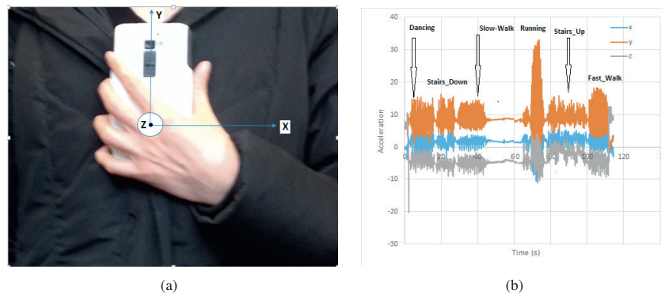
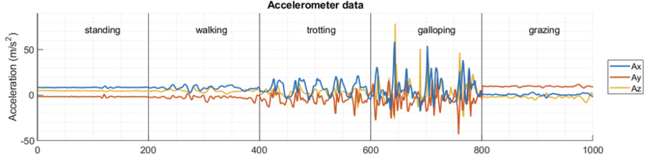
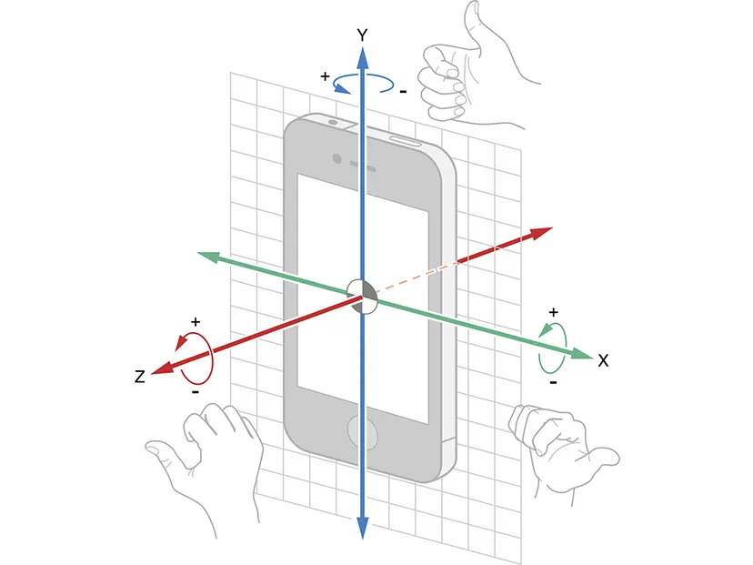
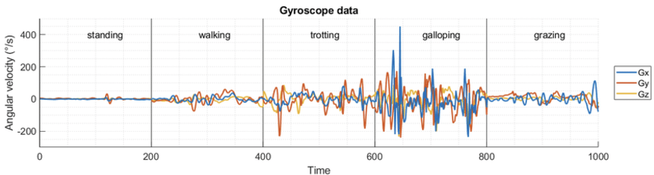
Accelerometer & Gyroscope Sensors
Accelerometer
Triaxial accelerometer measures the acceleration. Data from this accelerometer includes the acceleration along the x-axis, y-axis and z-axis. These axes capture the horizontal/sideway movement of the user (x-axis), upward/downward movement (y-axis), and forward/backward movement (z-axis).
Gyroscope
Triaxial gyroscope measures angular velocity and direction along three perpendicular axes (x, y, z), capturing the rotational motion of a device in three dimensions. It helps distinguish between activities involving significant rotational motion, such as turning, twisting, or specific arm movements, which accelerometers alone may not capture accurately.

Slide 4


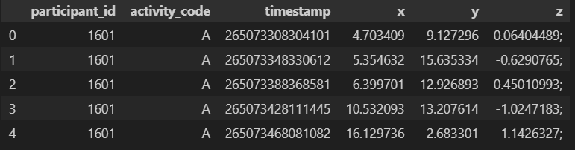


Data Collection
Data source(s) (where it's from, how it was collected)
WISDM Smartphone and Smartwatch Activity and Biometrics Dataset - UCI Machine Learning Repository
51 subjects performed 18 diverse activities of daily living.
Each activity was performed for 3 minutes, so that each subject contributed 54 minutes of data.
Description of the data (features, size, format)
The data set contains the low-level time-series sensor data from the phone’s accelerometer, phone’s gyroscope, watch’s accelerometer and watch’s gyroscope.
Sliding window approach to transform the time-series data into labeled examples
sensor data was collected at a rate of 20 Hz (i.e., every 50ms)
The features include:
Subject-id: Type: Symbolic numeric identifier. Uniquely identifies the subject. Range: 1600-1650.
Activity code: Type: Symbolic single letter. Identifies a specific activity. Range: A-S (no “N” value)
Timestamp: Type: Integer. Linux time
x: Type Numeric: real. Sensor value for x axis. May be positive or negative.
y: Type Numeric: real. Sensor value for y axis. May be positive or negative.
z: Type Numeric: real. Sensor value for z axis. May be positive or negative.
Size of the dataset:
raw/phone/accel: 4,804,403
raw/phone/gyro: 3,608,635
raw/watch/accel: 3,777,046
raw/watch/gyro: 3,440,342
Format of the dataset:
Within each time-series sensor file is one sensor reading per line.
The format of this line is identical across both devices and both types of sensors.
The data on each line is comma separated, and each line ends with a semicolon.
The format of each line is as follows: Subject-id, Activity Code, Timestamp, x, y, z
The project employed two types of devices for data collection: a Samsung Galaxy S5 smartphone and an LG G smartwatch. Both devices are equipped with kinematic sensors that enable the tracking of motion and orientation, the accelerometer measures linear acceleration in meters per second squared (m/s²) and the gyroscope that measures angular velocity in radians per second (rad/s), capturing rotational movements.
Accel
Gyro

Slide 5
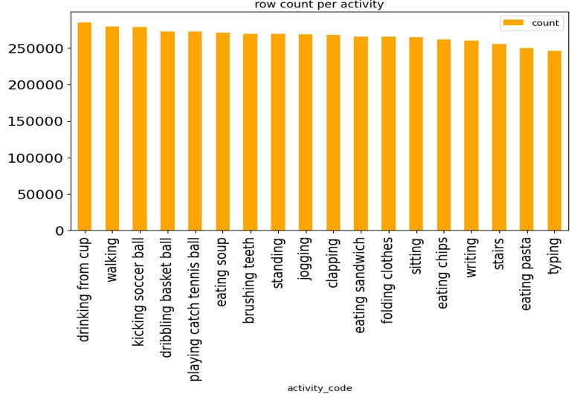
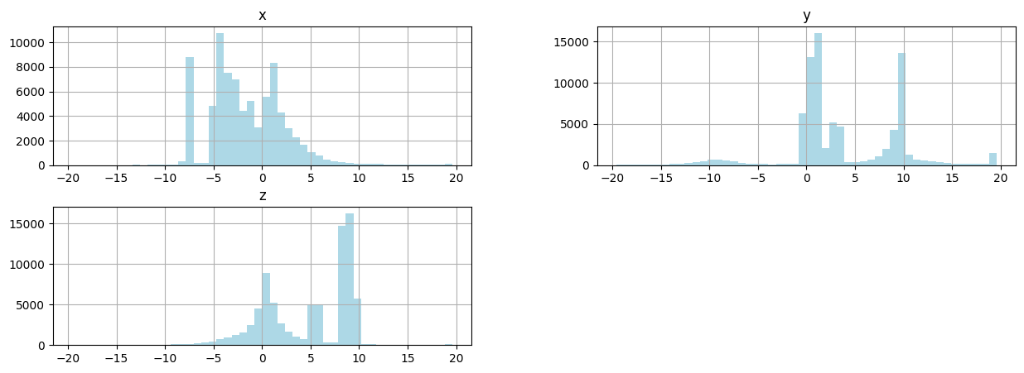
Data Exploration
Missing values:
It is observed that there are no missing values in any of the dataset.
Activity Distribution:
It is observed that data is mostly balanced.
Axes Mapping for one participant (Phone - Accelerometer):
The bimodal pattern observed in the accelerometer data is likely due to the separation between standing and sitting postures. The distinct peaks in the data reflect the different accelerations experienced by the phone when it is in these two different postures.
Initial analysis shows class balances. Time-series plots reveal distinct patterns for certain activities but also overlapping signals for others. Key statistics, such as mean and standard deviation, highlight variability in sensor data, while correlation analysis identifies dependencies between sensors.

Slide 6
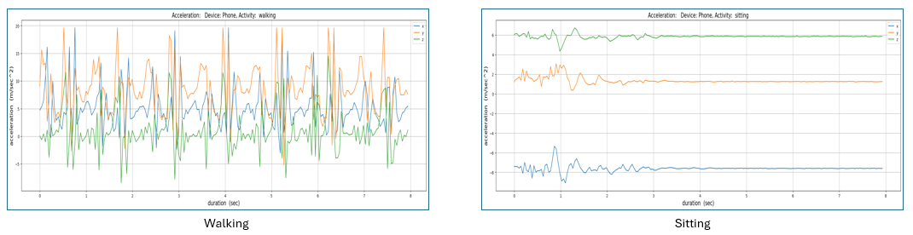
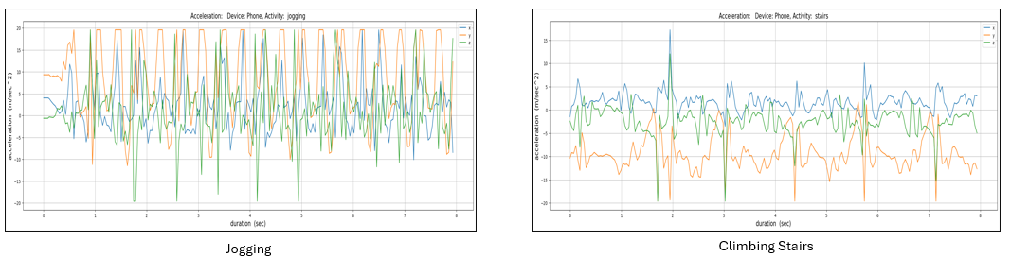
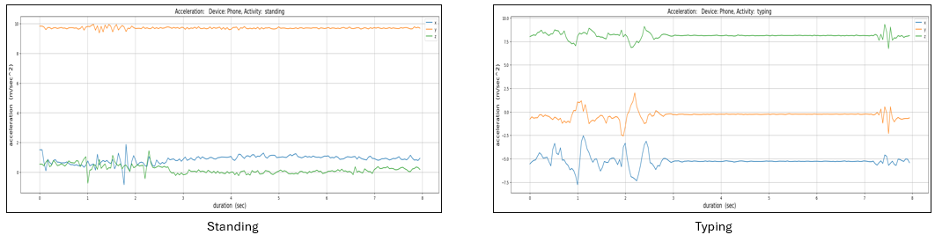
Data Exploration
Activity tracking for one participant (Phone – Accelerometer):
The accelerometer data shows distinct patterns corresponding to various activities, reflecting the nature of the movements involved.
Initial analysis shows class balances. Time-series plots reveal distinct patterns for certain activities but also overlapping signals for others. Key statistics, such as mean and standard deviation, highlight variability in sensor data, while correlation analysis identifies dependencies between sensors.

Slide 7
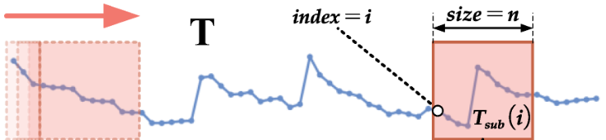
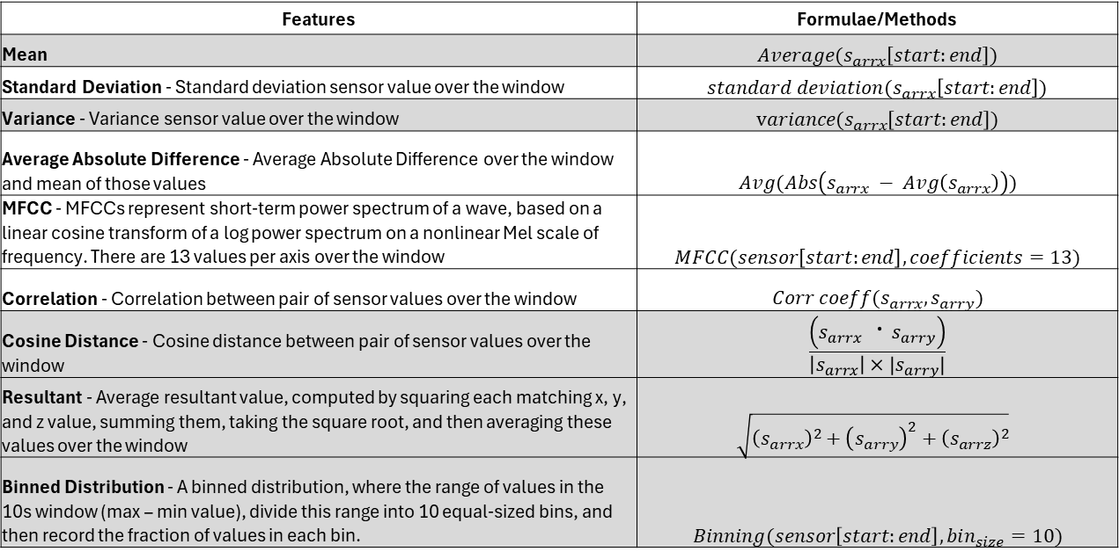
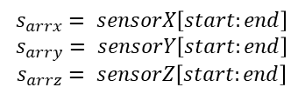
Feature Generation
Feature extraction for the WISDM dataset involves deriving meaningful statistics and representations from the sensor data, focusing on: Statistical Features, Frequency-Domain Features, Relationship and Distance Features.
$$s_{arrx}= sensorX\left[start:end\right]$$
$$s_{arry}= sensorY\left[start:end\right]$$
$$s_{arrz}= sensorZ\left[start:end\right]$$
Features | Formulae/Methods
Mean | $$Average(s_{arrx}\left[start:end\right])$$
Standard Deviation - Standard deviation sensor value over the window | $$standard deviation(s_{arrx}\left[start:end\right])$$
Variance - Variance sensor value over the window | $$variance(s_{arrx}\left[start:end\right])$$
Average Absolute Difference - Average Absolute Difference over the window and mean of those values | $$Avg(Abs\left(s_{arrx} − Avg\left(s_{arrx}\right)\right))$$
MFCC - MFCCs represent short-term power spectrum of a wave, based on a linear cosine transform of a log power spectrum on a nonlinear Mel scale of frequency. There are 13 values per axis over the window | $$MFCC(sensor\left[start:end\right], coefficients=13)$$
Correlation - Correlation between pair of sensor values over the window | $$Corr coeff(s_{arrx},s_{arry})$$
Cosine Distance - Cosine distance between pair of sensor values over the window | $$\frac{\left(s_{arrx} ⋅s_{arry}\right)}{\left|s_{arrx}\right|×|s_{arry}|}$$
Resultant - Average resultant value, computed by squaring each matching x, y, and z value, summing them, taking the square root, and then averaging these values over the window | $$\sqrt{{\left(s_{arrx}\right)}^{2}+{\left(s_{arry}\right)}^{2}+{\left(s_{arrz}\right)}^{2}}$$
Binned Distribution - A binned distribution, where the range of values in the 10s window (max – min value), divide this range into 10 equal-sized bins, and then record the fraction of values in each bin. | $$Binning(sensor\left[start:end\right], bin_{size}=10)$$
Features are generated from the x, y, and z axes of sensor data to capture activity patterns effectively. Common features include statistical measures like mean, standard deviation, and range for each axis. Combining these features enhances model understanding of complex activity signals.

Slide 8
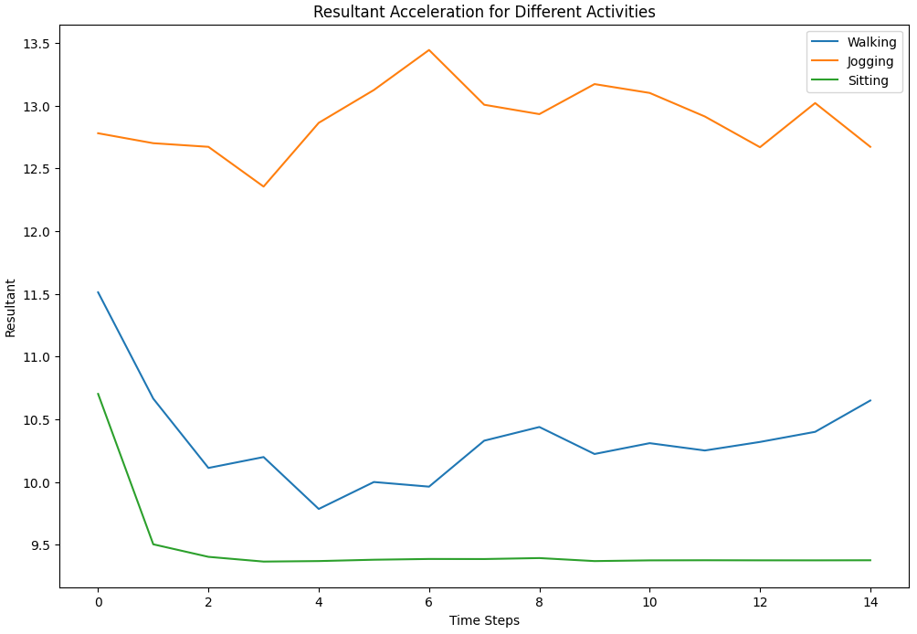
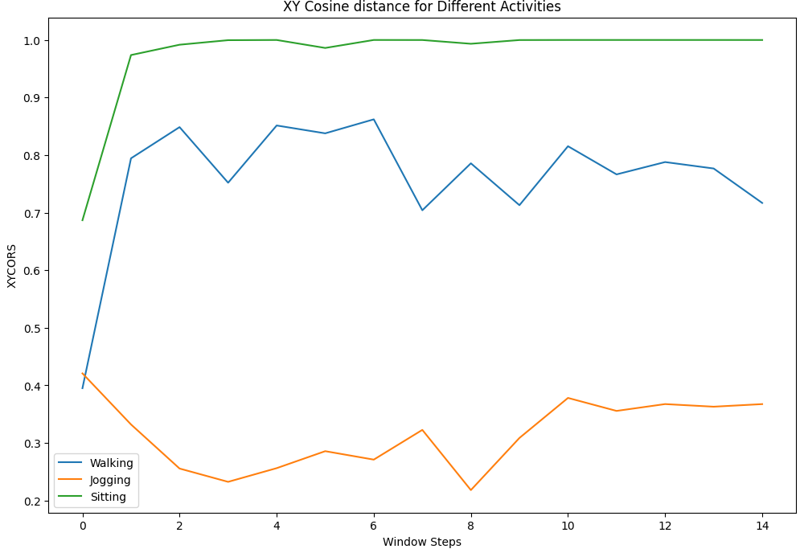
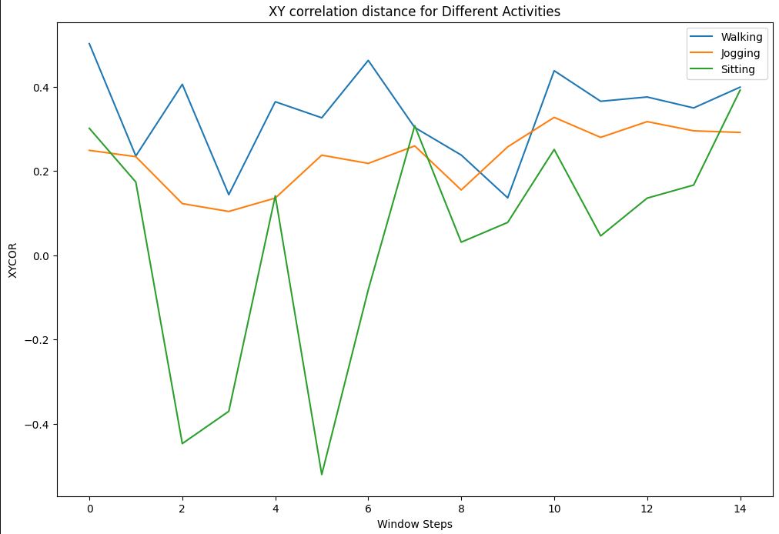
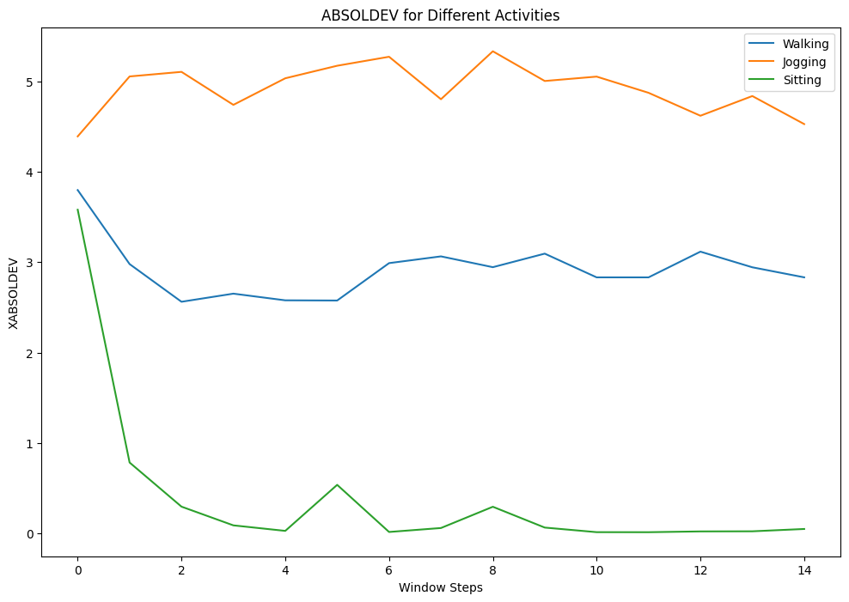
Data Exploration on Generated Features
Visualizing extracted features

Slide 9
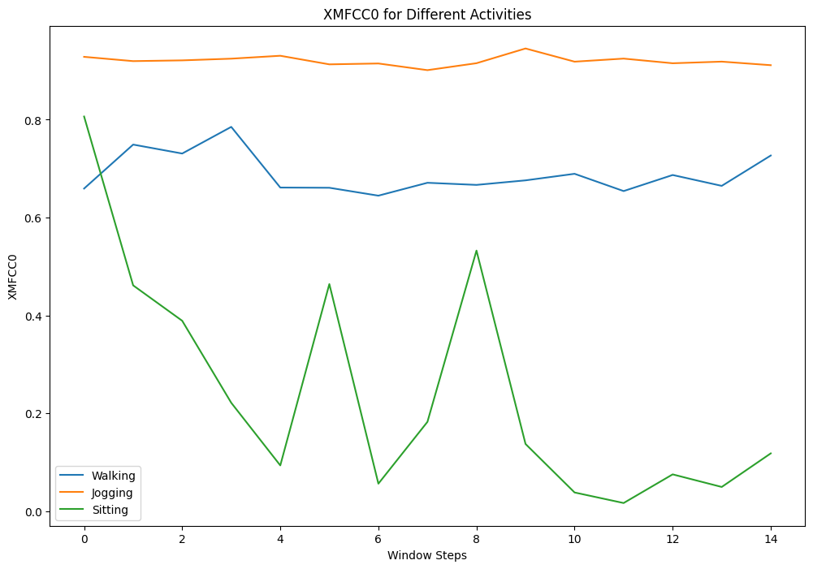
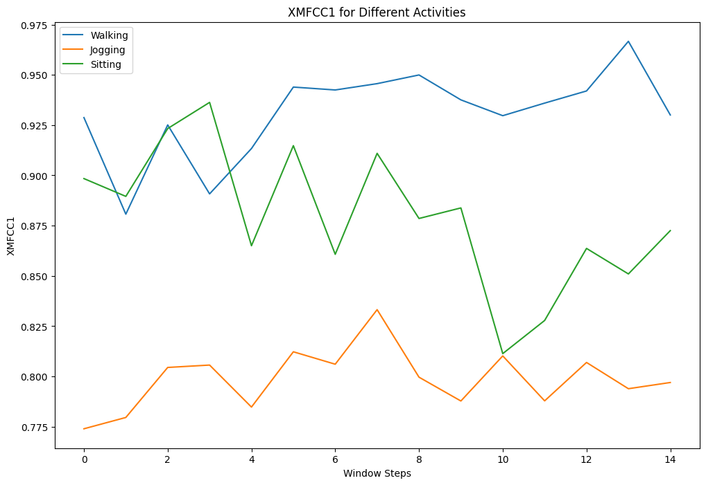
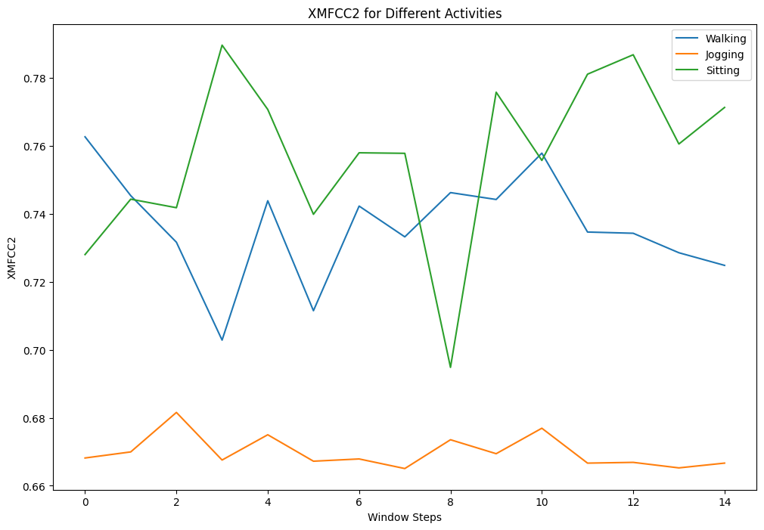
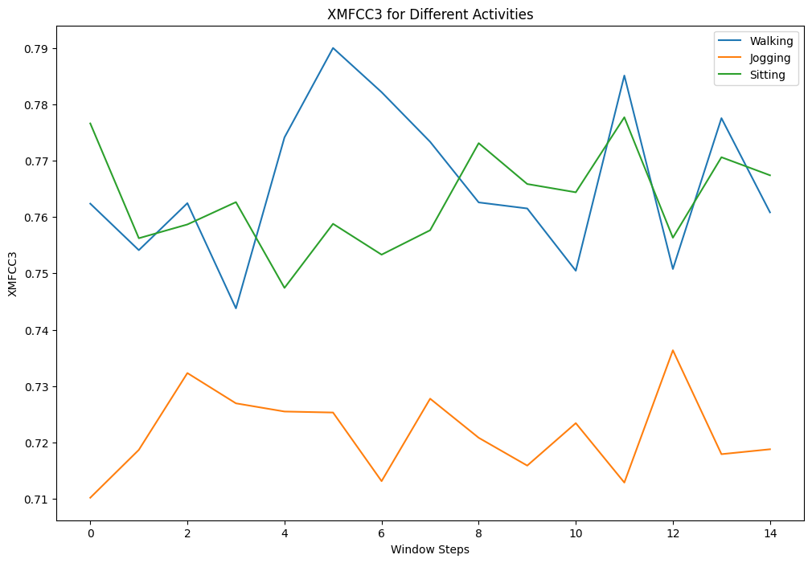
Data Exploration on Generated Features
Visualizing MFCC coefficient for a given sensor data

Slide 10
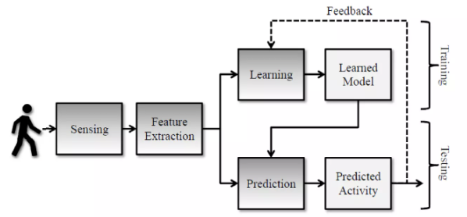
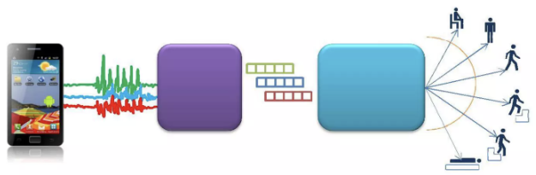
Model Training
The model training process involves preparing and fine-tuning five algorithms for human activity detection. First, data is preprocessed, including feature extraction from sensor readings (accelerometer, gyroscope) and normalization. For each algorithm, the dataset is split into training and testing sets, with cross-validation used to optimize hyperparameters and prevent overfitting. Logistic Regression is trained with regularization to ensure generalization, while Random Forest's trees are fine-tuned for optimal depth and splits. KNN’s performance is optimized by selecting the best value for K. LSTM and GRU models are trained on sequential data, with attention to learning rates and batch sizes to capture temporal dependencies. Finally, each model is evaluated based on accuracy, precision, recall, and F1-score, with performance compared across algorithms to determine the best-fit model for the task.
Human Activity Detection Process Pipeline
Learning Loop
Data Collection
Learned Model
Data Exploration
Feature Extraction
Human Activity Detection

Slide 11
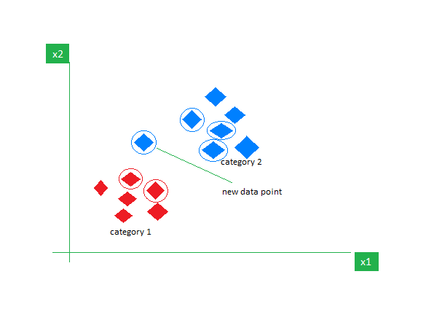
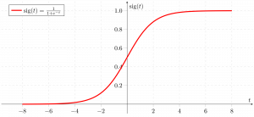
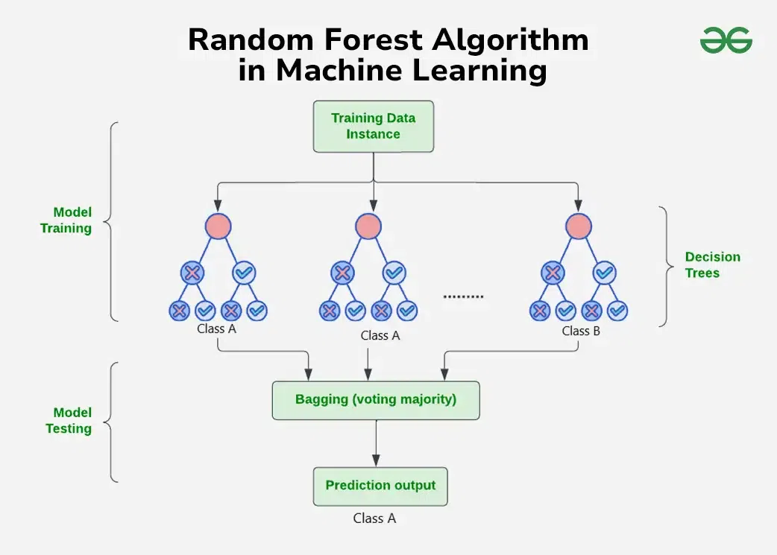
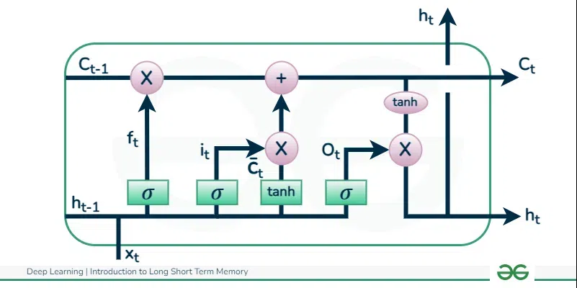







Proposed Methodology
Overview of methods
Classification Models:
Logistic Regression
Random Forest
K Nearest Neighbor(KNN)
Long Short Term Memory
Gated Recurrent Unit
Evaluation Metrics: Accuracy, Precision, Recall, F1-Score
Justification for choosing these methods, if any
Logistic Regression: Basic model to start with.
Random Forest: Handles large datasets and reduces overfitting with ensemble learning
K Nearest Neighbor(KNN): Can effectively capture non-linear decision boundaries
LSTM: They can deal with variable-length sequences and detect temporal connections in data.
GRU: Improved LSTM with better computational efficiency.
Tools/Technologies (e.g., Python, libraries)
Python
Pandas
Numpy
Sci-kitLearn
Matplotlib
Seaborn
Keras
The proposed methodology evaluates five algorithms for human activity detection, balancing simplicity, performance and computational needs.

Slide 12
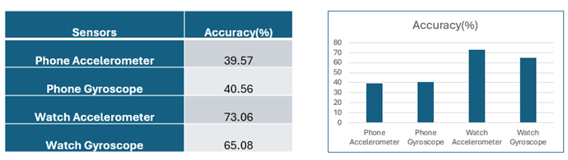
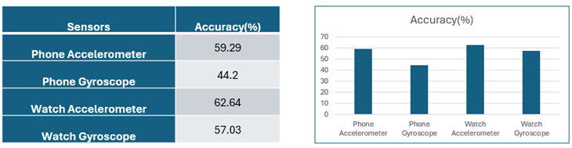
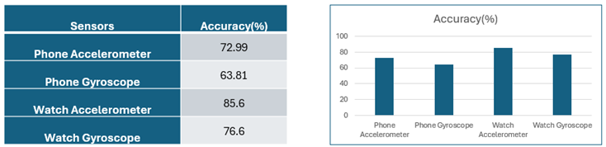
Results
Single Sensor: Individual sensors data for each individual device is trained and tested.
1. Logistic Regression
2. K-Nearest Neighbors
3. Random Forest

Slide 13
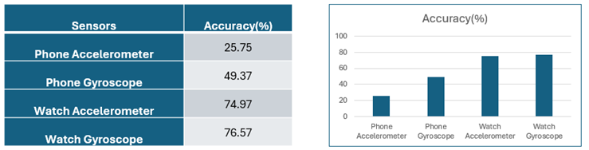
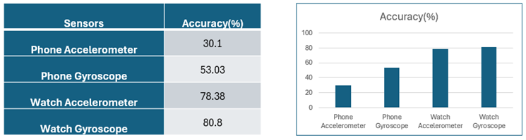
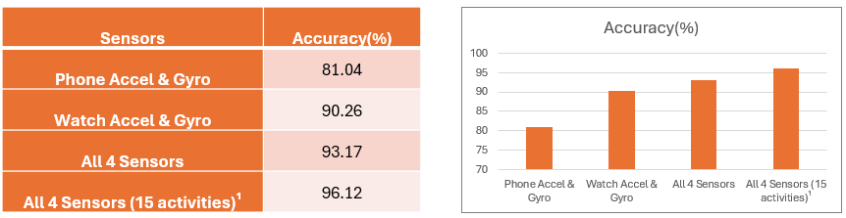
Results
4. Long Short Term Memory (LSTM)
5. Gated Recurrent Unit (GRU)
Multiple Sensor: Combined sensors data for each individual/combined devices is trained and tested.
1. Random Forest
Best model !!!

Slide 14
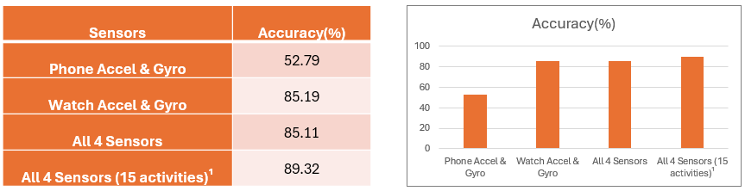
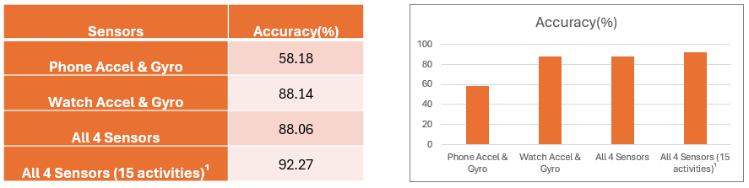
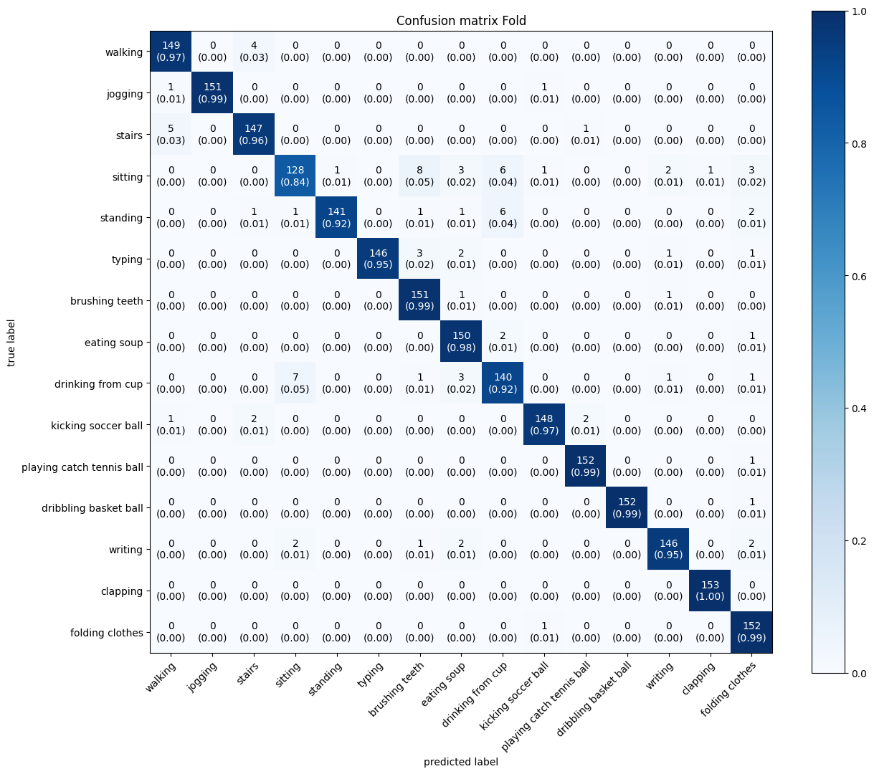
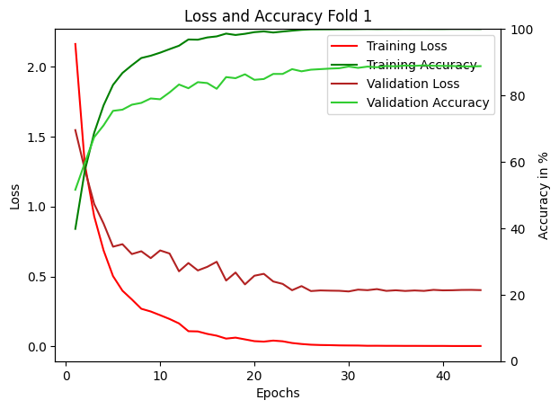
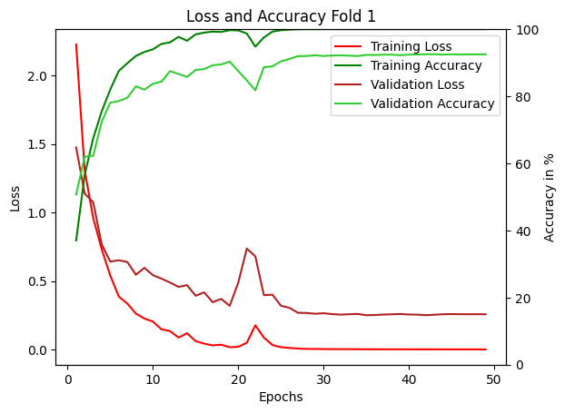

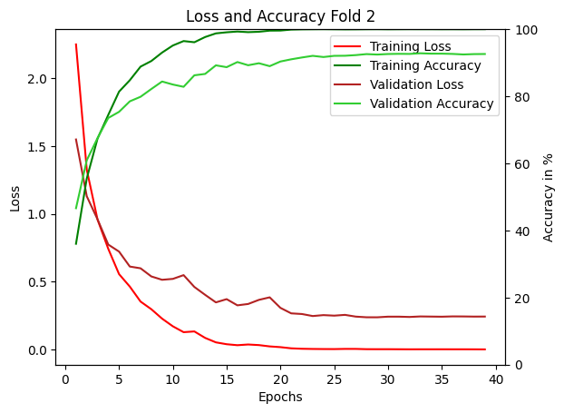
Results
2. Long Short Term Memory (LSTM)
3. Gated Recurrent Unit (GRU)
Other Metrics:
All sensors (15 activities) Loss-Accuracy Graph in LSTM
All sensors (15 activities) Loss-Accuracy Graph in GRU
All sensors (15 activities) Random Forest

Slide 15
Discussion
Logistic regression was initially used as a baseline model on the extracted features, starting with individual sensors for training. Subsequently, KNN and Random Forest models were trained on individual sensors, with Random Forest demonstrating excellent accuracy for smartwatch sensors. To explore deep learning approaches, LSTM was tested, and GRU was preferred for creating a deeper model due to its efficiency in reducing parameter complexity compared to LSTM. Models with sensor accuracy above 75% were selected for multi-sensor training. As a result, Random Forest, LSTM, and GRU were trained on multiple sensors within the same device and across devices. Random Forest outperformed others with the highest accuracy and F1 score for detecting all 18 activities. Activities like "eating chips," "eating pasta," and "eating sandwich" were consolidated under the broader category of eating, with only "Eating Soup" retained for training. In this scenario, Random Forest achieved an impressive accuracy of 96%.

Slide 16
Data Science Canvas |  |  | Project: | Detecting Human Activities Through Smartphone Sensor Intelligence
 |  |  | Team: | Moushumi Mahato, Murthy L, Shashankgoud Patil
Problem Statement |  |  |  | Execution & Evaluation |  | Data Collection & Preparation
Business Case & Value Added The business case focuses on leveraging smartphone and smartwatch sensors for Human Activity Detection (HAD) to enhance personalized health and fitness tracking applications. This approach adds value by providing an improved user experience through tailored recommendations based on accurate activity recognition, facilitating better health monitoring with continuous tracking of activities. It also increases customer satisfaction by boosting user engagement and loyalty through personalized insights. | Model Selection Which analysis methods can be considered on the basis of the specific data landscape and the business case? Logistic Regression, Random Forest, K-NN, Long Short Term Memory (LSTM), Gated Recurrent Unit (GRU) | Model Requirements Which model requirements must be complied with in order to obtain a valid model? The model should achieve high accuracy, precision, recall, and F1-scores for the classification of different activities. The model should generalize well across different subjects and environments. | Skills What skills are needed to provide the data and model development? Proficiency in machine learning, data preprocessing, time-series analysis, and feature engineering for sensor data. Experience with Python and relevant libraries. | Model Evaluation Which indicators require quality control and validation and how should they be interpreted? Is real-time monitoring necessary? Accuracy: Ensure correct activity classification; a drop may indicate misclassification due to sensor noise. Precision and Recall: Validate precision for activities with similar patterns and recall for critical activities F1-Score: Assess overall balance between precision and recall. Confusion Matrix: Analyze misclassifications to identify commonly confused activities (e.g., walking vs. jogging). Real-Time Monitoring: Required for applications like health monitoring, fitness tracking, or security to detect and respond to activity changes immediately. | Data Storytelling What requirements does the target group have for the presentation of the results and how do I effectively communicate this data? Target Group Requirements: Clarity: Simplify technical terms for non-technical audiences. Relevance: Focus on key activities and metrics that align with their goals (e.g., health tracking or app optimization). Visualization: Use charts, graphs, or infographics to make patterns and trends easily understandable. Actionable Insights: Highlight findings that suggest clear next steps or decisions. Effective Communication: Use Visuals: Include bar graphs for accuracy comparison, heatmaps for confusion matrices, and time-series plots for activity trends. Storytelling: Narrate insights through relatable examples, such as how detecting prolonged inactivity helps improve user health. | Data Selection & Cleansing Which of the available data is relevant? Do the data have to be cleaned up? Sensor Data: Accelerometer, gyroscope, heart rate, and GPS data for activity patterns. Timestamps: Essential for sequence tracking and time-series analysis. Data Cleaning Requirements: Handle Missing Data: Impute or remove incomplete sensor readings. Remove Noise: Filter out irrelevant signals or environmental artifacts. Outlier Detection: Identify and address anomalies (e.g., sudden spikes in sensor values). | Data Collection How and with which methods should additionally required data be collected? What properties has this data to fulfil? Wearable Devices: Use fitness trackers or IoT devices to capture continuous activity data. Surveys or Logs: Gather self-reported activity labels to complement sensor data. Simulated Activities: Record controlled activity sessions to ensure labeled data diversity. Required Properties: Accuracy, Consistency, Diversity, Completeness, Privacy Compliance
Data Landscape The project requires sensor data from smartphones and smartwatches, including accelerometer and gyroscope readings, along with activity labels for the 18 targeted activities. Available data includes publicly available time-series sensor data with labeled activities. WISDM Smartphone and Smartwatch Activity and Biometrics Dataset - UCI Machine Learning Repository |  | Software & Libraries Which software should be used? Is there already a standard solution? Which libraries are used? Python with libraries such as Scikit-learn, Pandas, and NumPy for data processing and model development. For visualization and data analysis, libraries like matplotlib and seaborn is required. To train deep learning models like LSTM and GRU, Keras API is required. |  |  |  | Data Integration In which system should the data from different sources be migrated? The integration of data was carried out locally using Python on a standalone system. | Explorative Data Analysis Are there outliers or structures to be considered? Creation of descriptive key figures for the first assessment of the data. Found no outliers in the data. Descriptive Key figures include: Mean, Standard Deviation, Correlation, Activity duration, Distribution, Missing Data percentage etc.
Adopted from: https://github.com/tomalytics/datasciencecanvas

