Slide 1
Analysis of Variance in Big Data Cloud Networks in Azure Cloud
Jithin Babu
Satyanarayana Murthy Kaja
Ashley Lobo

Slide 2
WHY?
Big Data operations are moved to cloud as it provides on-demand instances.
Variability plays an important as big data technologies like spark which internally uses spark context to transfer data across nodes and perform computation.
Many articles disregard network variability in the cloud which poses a serious threat to the conclusions drawn from such experiment designs.
Variability in the performance of the network can hurt application’s overall performance if proper measures are not taken.

Slide 3
Goal: Measure variability in Bandwidth and Latency
Replicated the measurements mentioned in GCP cloud
The paper focused on AWS, GCP and HPC cloud platforms. We extended the idea of the paper to determine the impact of variability on Azure cloud platform
Experimented different scenarios in Azure on regions and Vnet, that were not mentioned in the paper.

Slide 4
Measurement Setup
Cloud Technologies
Azure {performed the setup using Azure portal}
Virtual Machines - F series - CPU memory optimized , Used for big data cluster like spark HDInsight
GCP {performed the setup using google portal}
Virtual Machines - N1-standard-4 - 1 Master N nodes Configuration, Nodes are of the high CPU configuration
Measurement Technologies
iperf3 : for bandwidth and retransmission measurement
tshark : for Latency measurement

Slide 5
Google Cloud Platform

Slide 6
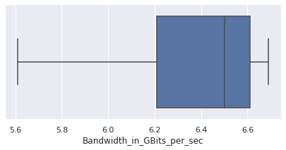
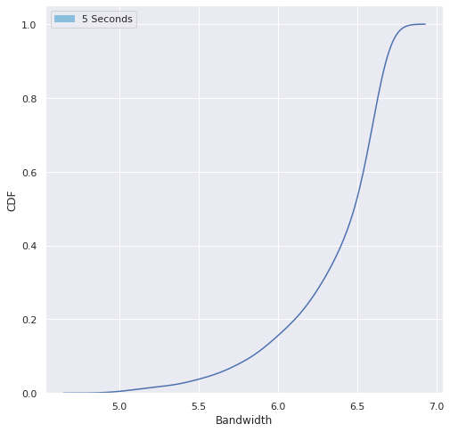
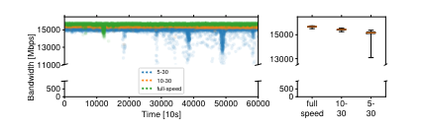
Box Plot from our GCP Measurements
Image from GCP Measurement from Base Paper
CDF from our GCP measurements

Slide 7
Bandwidth in Azure

Slide 8
Bandwidth
Type for 5 Seconds run time | Min Bandwidth | Max Bandwidth | Average retransmissions
Same Region Different Vnet | 0.605 GBits/sec | 2.82 GBits/sec | 113
Different Region Different Vnet | 0.443 GBits/sec | 1.07 GBits/sec | 16
Same Region Same Vnet | 1.38 GBits/sec | 2.51 GBits/sec | 101
Type for 10 Seconds run time | Min Bandwidth | Max Bandwidth | Average retransmissions
Same Region Different Vnet | 1.28 GBits/sec | 2.71 GBits/sec | 130
Different Region Different Vnet | 0.111 GBits/sec | 1.11 GBits/sec | 34
Same Region Same Vnet | 2.18 GBits/sec | 2.74 GBits/sec | 117

Slide 9
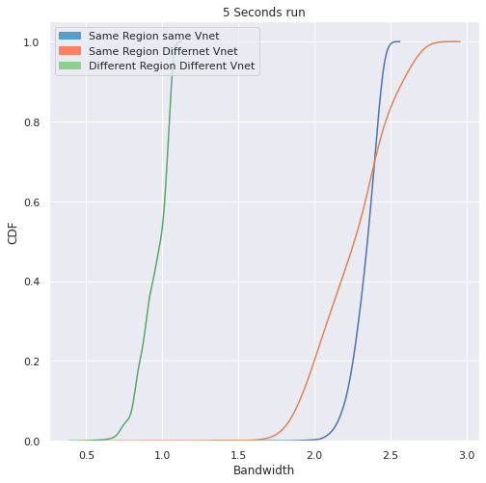
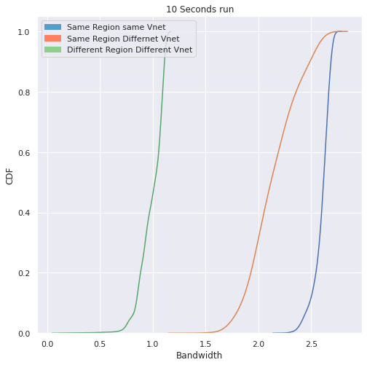

Slide 10
Latency

Slide 11
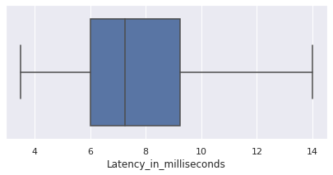
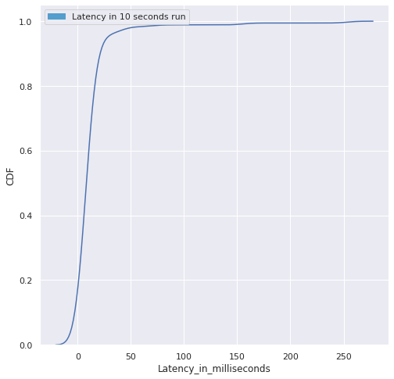

Slide 12
Observations
As the bandwidth increased, the variability also increased
Using Accelerated network feature, bandwidth can be increased. But that doesn’t negate the impact of variability
We observed that US-East region has a slightly greater bandwidth when compared to Asia region. This could be because US-East region is very popular and they have larger network footprint.
While testing variability for instances in different regions, we noticed that iperf test terminated frequently, which can be the future scope of the project.

