Slide 1

Airbnb in Boston and Seattle
Duyen Nguyen, Bill Bastan, Malini Murthy and Pournima Joshi
Research Project using Airbnb Data for the cities of Boston & Seattle. Our analysis relies on Open data from Kaggle based on
Listings: Location, Host, Neighborhood Overview of Listings
Reviews: Review Score Rating of Listings
Calendar: Airbnb listings with Ids, Price and Availability
Coverage : 2016 and 2017
10/02/2019

Slide 2

Analysis
Comparisons between Boston and Seattle
How does average price compare month-wise?
Are there differences between weekday and weekend average pricing?
Outliers & Hypothesis
Property-wise count breakdown by the Top 5 properties
Review Scoring of the Top 5 properties
Heatmap for Property Type - Distribution around the towns
10/02/2019

Slide 3
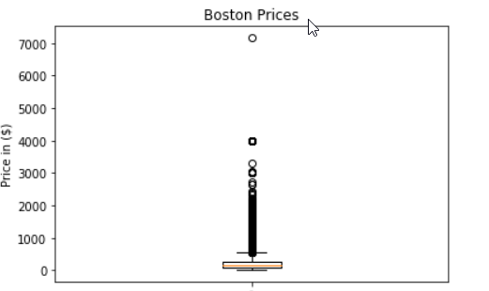
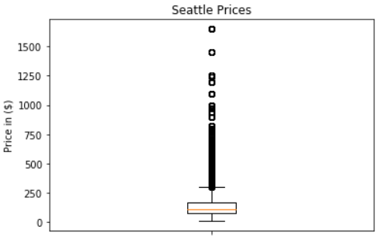
Average Price Comparison between Boston & Seattle
There are 409,460 records for Boston area and 590,693 records for Seattle
Minimum price is 11$/day in Boston and 10$/day in Seattle respectively.
Maximum price reaches 7163$/day in Boston, which is likely an outlier and 1650$/day in Seattle
10/02/2019

Slide 4
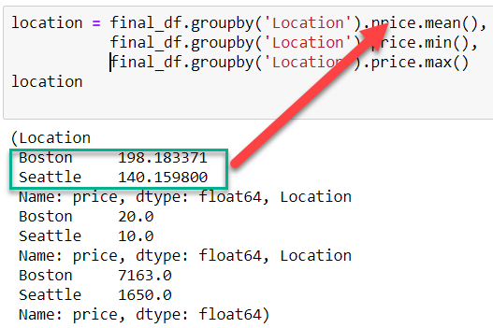
Average Price Comparison between Boston & Seattle
Renting price in Boston seems to be more variant than Seattle. What we care most is the average price in these two cities.
If we take a look at the below, it’s easy to guess that the price in Boston is higher than mean price in Seattle
After conducting t-test using two dataset by sample, we got p-value <0.05, which means we should reject null hypothesis
10/02/2019

Slide 5
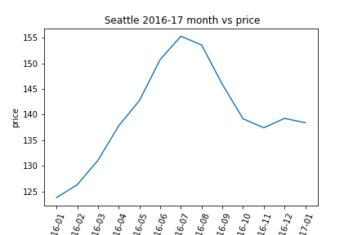
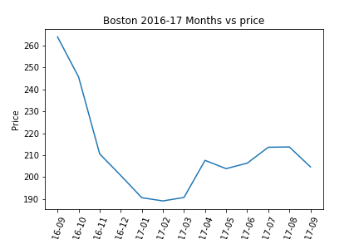
Average Price Distribution between Boston and Seattle
Boston prices > Seattle prices
Positive Correlation between month and price
10/02/2019
Notes:
Talking points : Looking at this chart you could see that there is definitely positive correlation between month and price.we found very limited data (price) on Seattle. That leads me to combine 2 yrs in per chart for each city. We can tell that prices are higher in Boston than Seattle. And prices goes down in winter.

Slide 6
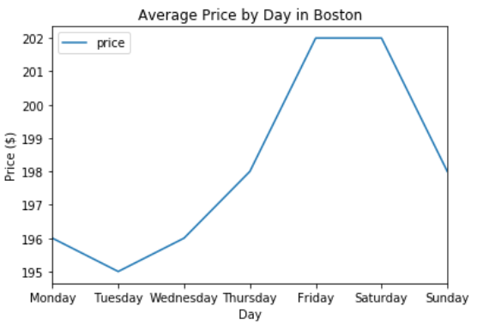
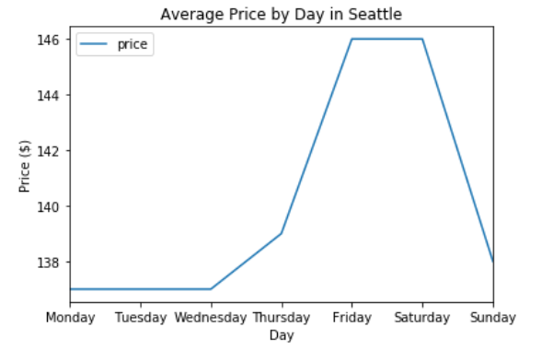
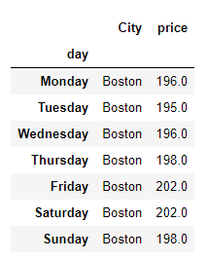
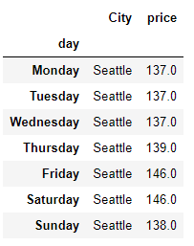
Average Price Distribution by Day of Week
Friday night prices are higher than other days.
10/02/2019

Slide 7
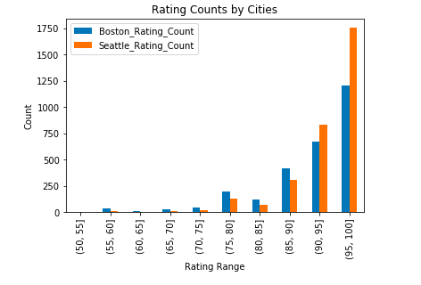
Review Scoring for Boston and Seattle (Bar Chart)
10/02/2019
Notes:
On this slide, we are showing a bar chart for the review scores for both Boston and Seattle. It appears that more people write reviews on Seattle than Boston. In general, the customers give very good reviews, it could be that they are either very generous or they are satisfied with their experience with Airbnb

Slide 8
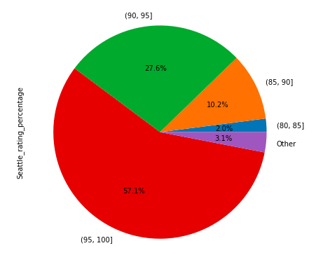
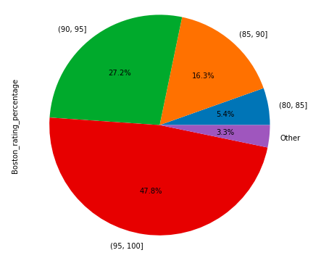
Review Scoring for Boston and Seattle - Percentage (Pie Charts)

Slide 9
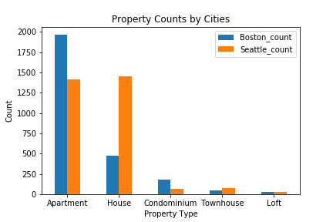
Property-wise count breakdown by the Top 5 properties for Boston and Seattle
10/02/2019
Notes:
Based on this chart, we could see that Apartment and House are the most common property types for both Boston and Seattle Airbnb.
There are more apartments in Boston than Seattle and there are more houses in Seattle than Boston.
It makes sense because Boston population density is higher than Seattle population density. (Boston: 13,843.9, Seattle: 8,207.0 people per square miles - Realtor.com 2019)

Slide 10
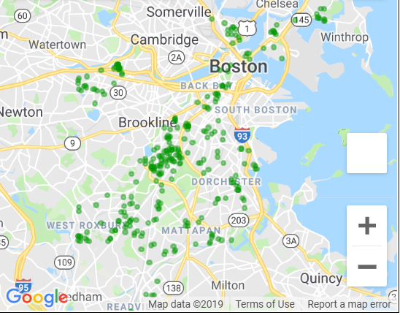
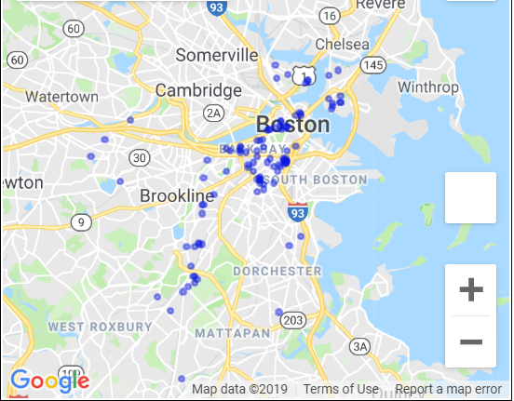
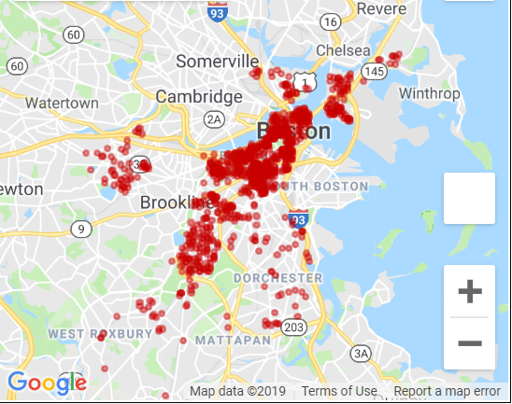
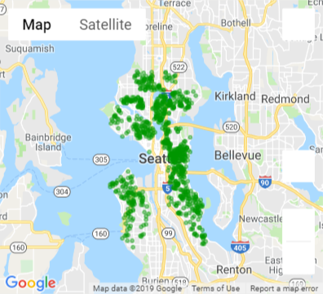
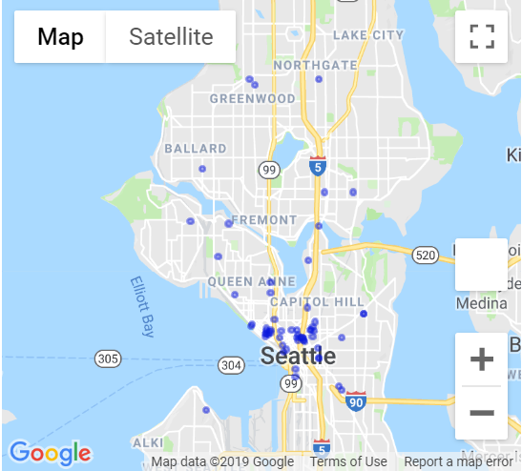
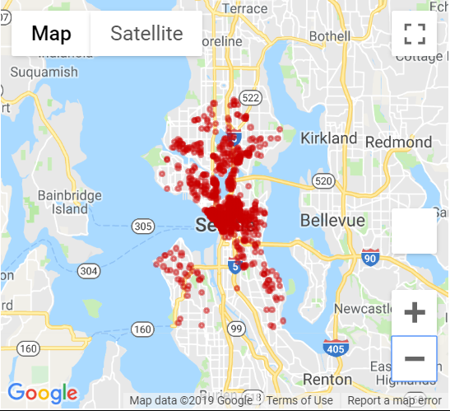
2016 Distribution of Property Types
Boston
Homes
Condos
Apartments
Seattle
10/02/2019

Slide 11
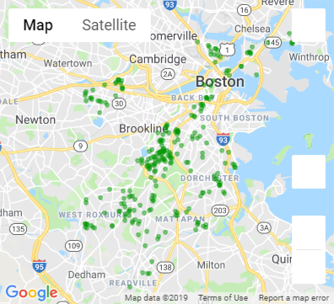
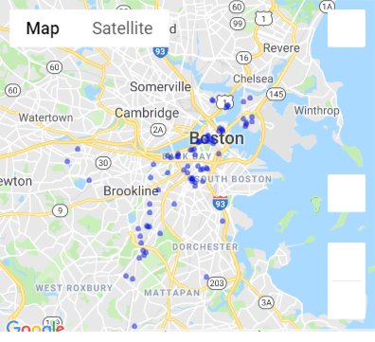
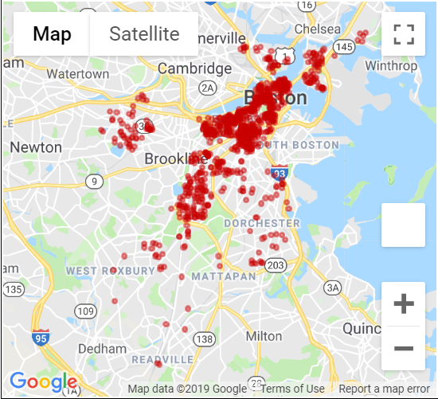
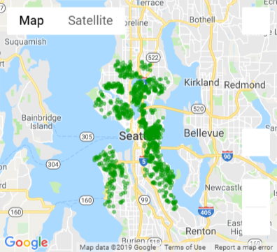
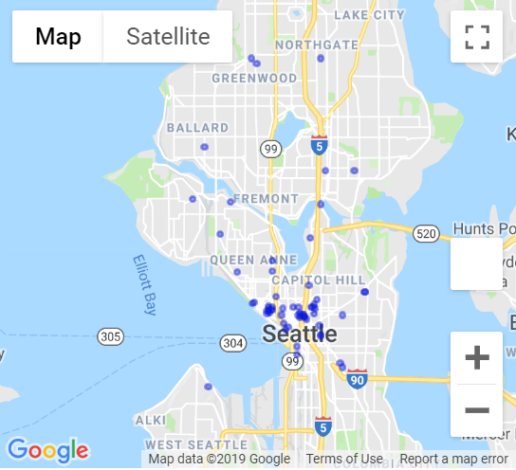
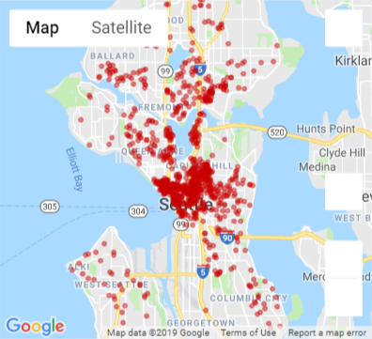
2017 Distribution of Property Types
Boston
Homes
Condos
Apartments
Seattle
10/02/2019

Slide 12
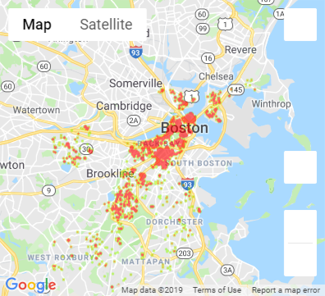
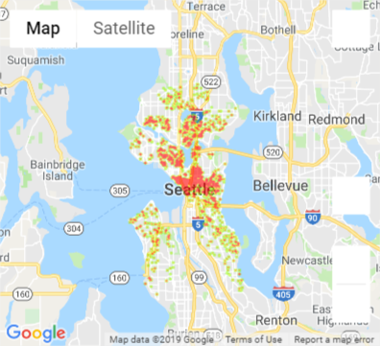
Are prices higher closer to the city?

Slide 13
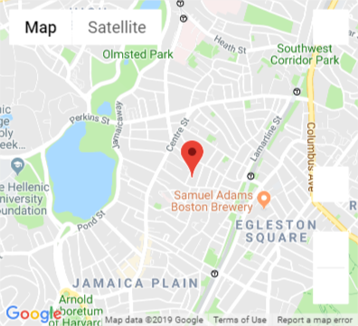

Summarizing Findings :
Fairly consistent Weekday and Weekend Prices in both locations
Prices in Boston are not significantly higher than Seattle
Apartments and Houses are more in number than other Property Types in both locations
There are more apartments in Boston than Seattle and there are more houses in Seattle than Boston
More Reviews are written for Seattle than Boston
Listings & Usage increased but not a drastic change in price as seen on the weighted average price on heatmap
The day of the highest pricing of $ 7,163 was 10/26/2016 in a listing near Boston Sam Adams Brewery
September is a good time to visit Boston & rent AirBnb
Prices increased in April 2017 during Boston Marathon
Data doesn't speak for itself !!!
WE HAD FUN!!!!!!!!!!!
10/02/2019

Slide 14
Appendix :
Data Sources : Kaggle https://www.kaggle.com/airbnb/boston https://www.kaggle.com/airbnb/seattle
Weather Data https://openweathermap.org/api*
Project Repo https://github.com/murthymalini/Project1
10/02/2019

