Slide 1

Studying the Effect of Vectorization Techniques in Mix-Code (Hinglish Language) on Open-Source Data Using Machine Learning and Transfer Learning Methodology.

Slide 2
Introduction
Sentiment Analysis
Natural Language Processing
YouTube Comments
Help the YouTubers to know the intention of viewers
Mix-Code
Hinglish

Slide 3
Methodology
Data collected from 2 famous cooking channels – Kabita’s Kitchen and Nisha
Data Cleaning
Data Visualization
Vectorization
Feature Scaling
Component Analysis
Machine Learning
Hyper-Parameter Tuning
Evaluation and Results

Slide 4
Vectorizations
Bag of Words
Term Frequency – Inverse Document Frequency
Count Vectorizer
Term Frequency Vectorizer
Sentence Transformers
BERT Base
Ganesh BERT
Narasimha Distil BERT
Verloop BERT
GPT Base
XLM Base
Fine Tuned Transformers
BERT Base
BERT Hinglish
GPT Base
GPT Hinglish
XLM Base

Slide 5
Feature Scaling
Min-Max
Standard Scaler
Normalized Scaler

Slide 6
Dimension Reduction
Principal Component Analysis
Scree Plots
Independent Component Analysis

Slide 7
Machine Learning - Classification
Parametric models | Logistic Regression Bernoulli Naïve Bayes Gaussian Naïve Bayes Multinomial Naïve Bayes
Non-parametric models | Decision tree Random forest K-Nearest Neighbors Support Vector Machines

Slide 8
Hyper-Parameter Tuning
Random Search CV
Grid Search CV

Slide 9
Evaluation Metrics
Classification Report
Accuracy
Precision
Recall
F1-Score
AUC-ROC

Slide 10
Results – Kabita’s Dataset
Vectorizer | Model | Accuracy | Precision | Recall | F1-Score
Normalize Scaled Verloop BERT Hinglish Sentence Transformer | SVM-RBF | 0.82 | 0.82 | 0.82 | 0.82
Standard Scaled Verloop BERT Hinglish Sentence Transformer | SVM-RBF | 0.82 | 0.82 | 0.82 | 0.82
Standard Scaled Fine Tuned GPT Hinglish | SVM-RBF | 0.81 | 0.81 | 0.81 | 0.81
Verloop BERT Sentence Transformer | Logistic | 0.79 | 0.79 | 0.79 | 0.79

Slide 11
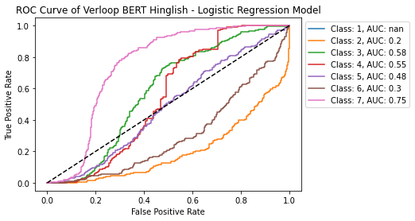
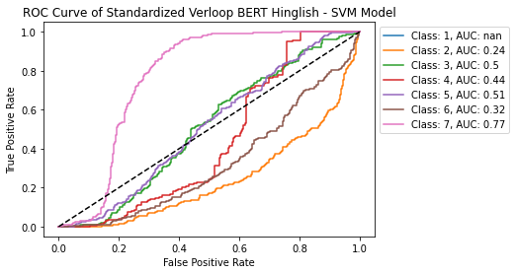

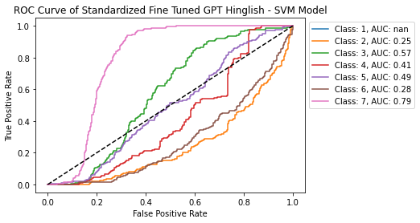
AUC-ROC

Slide 12
Results – Nisha’s Dataset
Vectorizer | Model | Accuracy | Precision | Recall | F1-Score
Normalize Scaled Verloop BERT Hinglish Sentence Transformer | SVM-RBF | 0.77 | 0.77 | 0.77 | 0.77
Standard Scaled Verloop BERT Hinglish Sentence Transformer | SVM-RBF | 0.78 | 0.78 | 0.78 | 0.78
Normalize Scaled XLM Base Sentence Transformer | SVM-RBF | 0.78 | 0.77 | 0.78 | 0.77
Standard Scaled XLM Base Sentence Transformer | SVM-RBF | 0.78 | 0.78 | 0.78 | 0.78

Slide 13
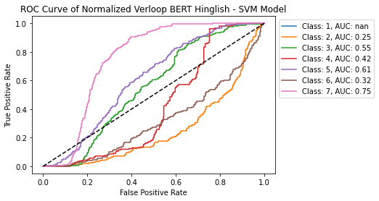
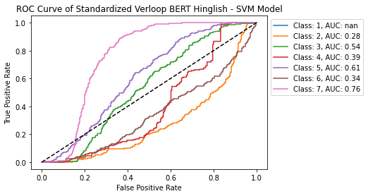
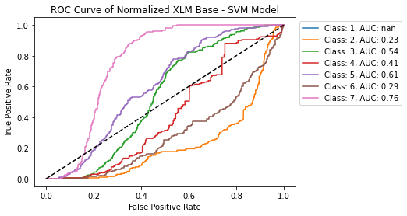
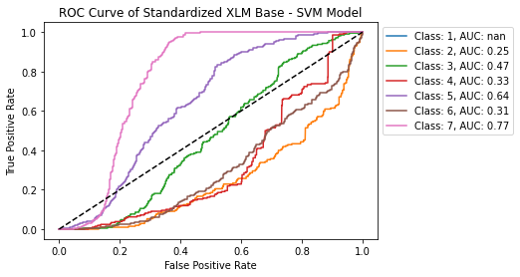
AUC-ROC

Slide 14
Thank you

