Slide 1

Introduction to Tor Project

Slide 2
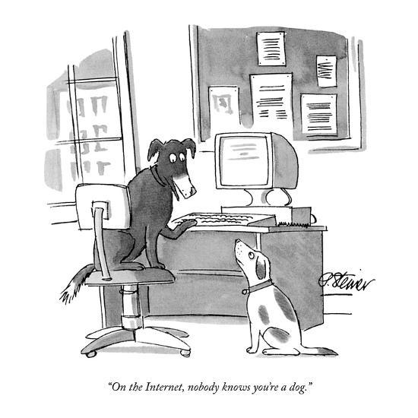

Slide 3
Outline
How the Internet works
Packet headers
Problem
How Tor works?
Example of using Tor in Web scrapping
Questions/Comments

Slide 4
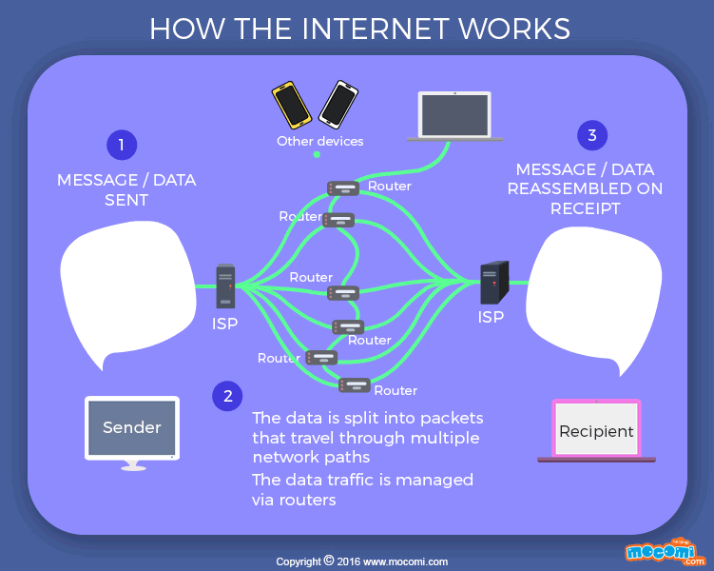
How the Internet works?

Slide 5
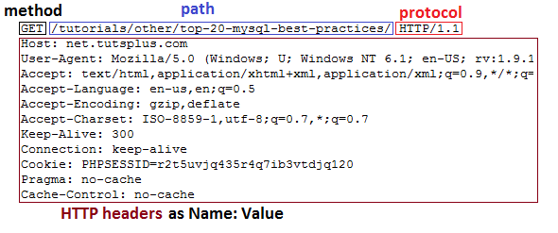
Packets

Slide 6

Problem
Internet surveillance, like traffic analysis, reveals users privacy.
Encryption does not work, since packet headers still reveal a great deal about users.
End-to-end anonymity is needed.
Solution: a distributed, anonymous network

Slide 7

What is Tor?
Tor is comprised of two parts: software you can download that allows you to use the Internet anonymously, and the volunteer network of computers that makes it possible for that software to work..
Individuals use Tor to keep websites from tracking them, or to connect to those internet services blocked by their local Internet providers.
Tor's hidden services let users publish web sites and other services without needing to reveal the location of the site.

Slide 8
Design
Overlay network on the user level
Onion Routers (OR) route traffic
Onion Proxy (OP) fetches directories and creates virtual circuits on the network on behalf of users.
Uses TCP with TLS
All data is sent in fixed size (bytes) cells

Slide 9
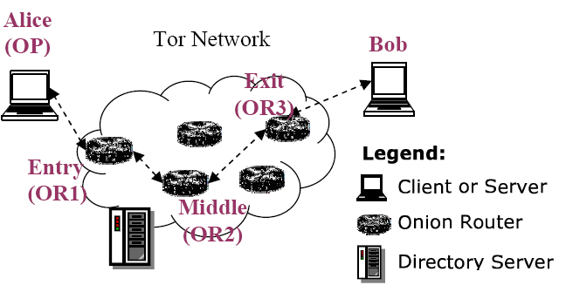



Components of Tor
Client: the user of the Tor network
Server: the target TCP applications such as web servers
Tor (onion) router: the special proxy relays the application data
Directory server: servers holding Tor router information
<number>/41

Slide 10
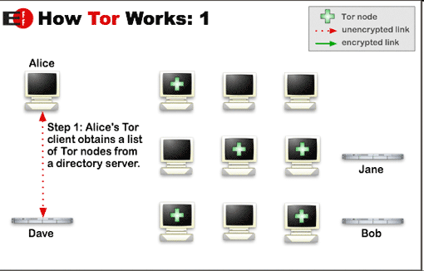
How does Tor work?

Slide 11
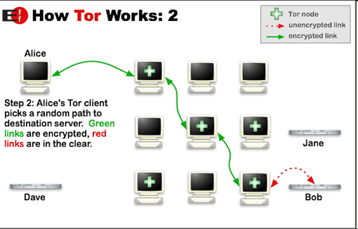
How does Tor work?

Slide 12
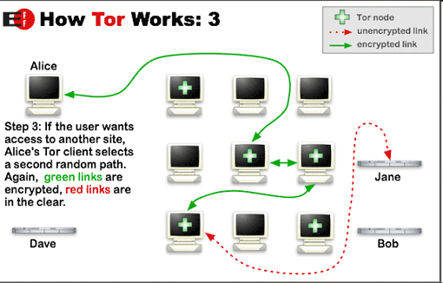
How does Tor work?

Slide 13

How Tor Works? --- Onion Routing
Alice
Bob
C2
√
M
M
OR2
C3
M
C2
C3
M
C1
OR1
OR3
C1
C2
C3
Port
A circuit is built incrementally one hop by one hop
Onion-like encryption
  Alice negotiates an AES key with each router
  Messages are divided into equal sized cells
  Each router knows only its predecessor and successor
  Only the Exit router (OR3) can see the message, however it does not know where the message is from
<number>/41

Slide 14
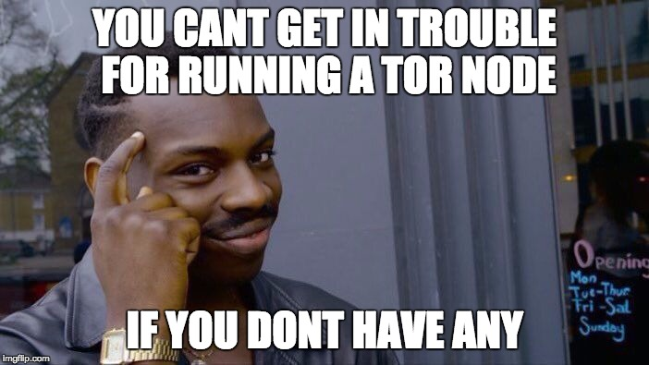
To Web scrapping using Tor!

Slide 15
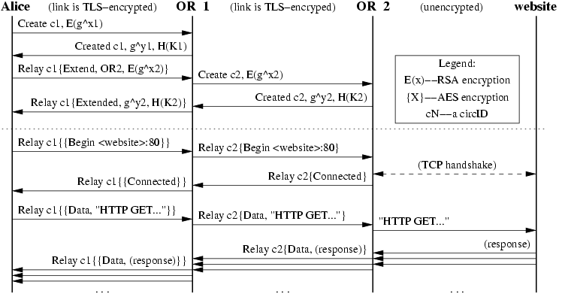
Commands in Use

Slide 16
Additional functionality
Integrity checking
  Only done at the edges of a stream
  SHA-1 digest of data sent and received
  First 4 bytes of digest are sent with each message for verification

Slide 17
Congestion Control
OR-to-OR congestion might happen if too many users choose the same OR-to-OR connection.
Circuit Level throttling
  2 windows keep track of relay data to be transmitted to other ORs (packaging window) and data transmitted out of the network (delivery window)
  Windows are decremented after forwarding packets and increments on a relay sendme message towards OP with streamID zero.
  When a window reaches 0, no messages are forwarded

Slide 18
Hidden Service and Rendezvous Points
Location-hidden services allow Bob to offer a TCP service without revealing his IP address.
Tor accommodates receiver anonymity by allowing location hidden services
Design goals for location hidden services
  Access Control: filtering incoming requests
  Robustness: maintain a long-term pseudonymous identity
  Smear-resistance: against socially disapproved acts
  Application transparency
Location hidden service leverage rendezvous points

Slide 19





Creating and connecting to a Location hidden service

Slide 20
Questions about Tor?

Slide 21
I2P: The Invisible Internet Project

Slide 22
What is I2P?
An anonymizing P2P network providing end to end encryption*.
Utilizes decentralized structure to protect the identity of both the sender and receiver.
It is built for use with multiple applications including email, torrents, web browsing, IM and more.
UDP based (unlike Tor’s TCP streams)

Slide 23
What is I2P Not?
I2P is not Tor even though they are similar in some ways.
While you can use it as an anonymizing gateway to the internet, that is not its intended purpose
I2P was designed primarily to host its own services

Slide 24
I2P Definitions
Router
Tunnel
Gateway
Endpoint
NetDB

Slide 25
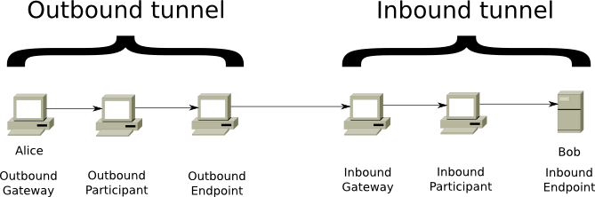
I2P Tunnels

Slide 26
NetDB
Each router holds a network database
This contains both “routerInfo” and “leaseSets”
rotuerInfo – stores information on specific I2P routers and how to contact them
leaseSets – stores information on a specific destinations (i.e. I2P websites, email servers, etc.)

Slide 27
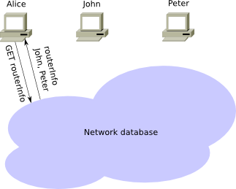
Joining the Network

Slide 28
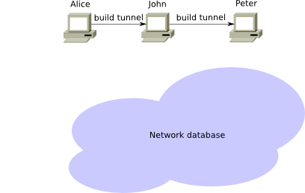
Establishing a Tunnel

Slide 29
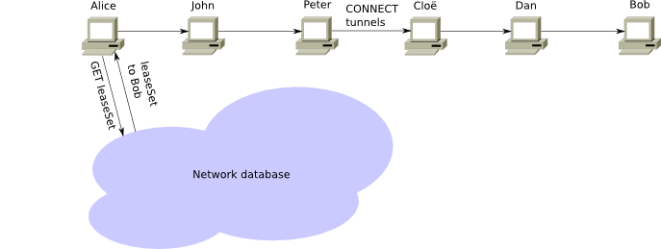
Establishing a Connection

Slide 30
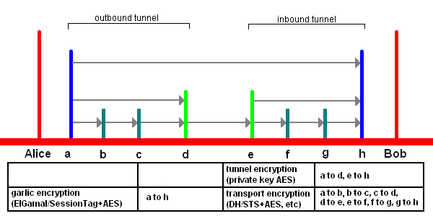
Encryption View

Slide 31
Comparison: Tor vs. I2P
TCP vs. UDP
Directory Server vs. NetDB (P2P)
Separation of Nodes and Clients vs. Everyone Routes Traffic
Exit Nodes vs. Outproxies
Circuits vs. Tunnels

Slide 32
Questions/Comments?
Credit and resources:
  This presentation is a modification of https://www.cse.unr.edu/~mgunes/cpe401/cpe401sp11/student/tor.ppt
  https://www.eff.org/torchallenge/what-is-tor.html
  https://en.wikipedia.org/wiki/Nothing_to_hide_argument
  https://scholarship.law.gwu.edu/cgi/viewcontent.cgi?article=1159&context=faculty_publications
  https://support.mozilla.org/en-US/kb/connection-settings-firefox?as=u&utm_source=inproduct
  https://en.wikipedia.org/wiki/Facebookcorewwwi.onion
  https://en.wikipedia.org/wiki/On_the_Internet,_nobody_knows_you%27re_a_dog

