Slide 1

RedditRank
Predicting the Success of a Reddit Post
Murtaza Latif Andrew Wang
Notes:
Introduce the project, murt and andrew
describe what Reddit is, subreddit, posts
talk about popularity of Reddit

Slide 2

What makes a post popular?
Notes:
Narrow focus to askreddit
Askreddit has posts that are only titles which are questions directed to the general population

Slide 3
Which movie quote stuck with you?
What role do you play at family gatherings?
- u/DenzellMayers 11/24/2019
- u/skabonk 11/22/2019
Notes:
first question 21.3K
second question 143

Slide 4
Which movie quote has always stuck with you?
Predicting
popularity
is hard
- u/_TheTrashPanda 08/15/2019
Notes:
even humans cant predict popularity?
5 score

Slide 5

score = upvotes - downvotes
title ~ text only questions
context
serious replies only?
nsfw content?
what time?
what day?
Notes:
Quickly, what's score?
what context goes into a post

Slide 6
Your
Post
Scores
Neural Net Training
Titles
Model
Model
Context
Predicted Score

Slide 7

Popular?

Slide 8
Data Collection

Slide 9
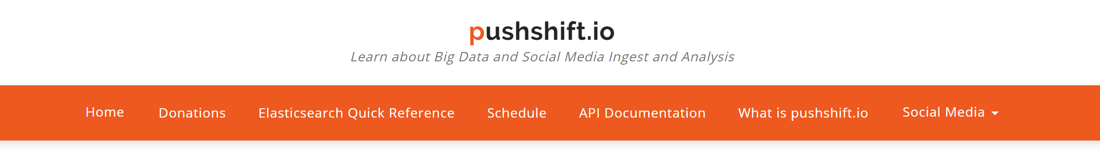


PRAW
Python Reddit API Wrapper
import requests
“GET” -> api/?subreddit=AskReddit&score={score}&...
100 +
0 - 99
100 +
Notes:
Not using PRAW because of collection limitation
Pushshift io allows unlimited collection
-> pushshift queries allow balanced datasets

Slide 10
Sample Title I have 4000$ with 394129 cows
sample title
i have 4000$ with 394129 cows
sample title
i have 1000 dollars with 100000 cows
31
192
123
212
.
.
.
. . .
title.lower()
title.fix_numbers()
?
?
?
?
.
.
Ents abacemen deliate compon inclarbolds objeffleecter atoria

Slide 11

serious_flair = 1
created_utc = 1574729083
hour[19] = 1
hour = 19
hour = [0, 0, …, 1, …, 0, 0]
weekday = 0
weekday = [1, 0, 0, 0, 0, 0, 0]
over_18 = 0

Slide 12
C:\Users\redditrank
$ python datamanger.py clean raw_dataset.csv
Filtered out 3775 posts.
Frequencies of clean post scores:
0 50000
1 50000
2 50000
3 47830
4 32893
Balanced dataset to 32893 samples per class.

Slide 13
C:\Users\redditrank
$ python datamanger.py split clean_dataset.csv
Splitting dataset…
file | train.csv | valid.csv | test.csv | overfit.csv
--------+-----------+-----------+----------+------------
Samples | | | |
per | 21052 | 5263 | 5263 | 1315
class | | | |

Slide 14
C:\Users\redditrank
$ python datamanger.py stats clean_dataset.csv
Value frequencies per hour:
9 12124
10 12011
17 11980
...
Value frequencies per weekday:
Wed 42366
Tue 42099
...
Average title length: 76.10

Slide 15
Model

Slide 16
0 - 99
0 - 1
0
100 +
2 - 499
1 - 9
500 +
10 - 99
100 - 999
1000 +
2
3
5

Slide 17
Context
Titles
GloVe Embedding
Text Neural Network?
MLP
Prediction
Class
ADAM Optimizer
Cross Entropy Loss

Slide 18
Baseline1: Averaging
Context
Embedded Vectors
Average Vectors
MLP

Slide 19
Average | epochs | batchsize | embedding dimension | First Layer Neurons
2 Classes | 100 | 5000 | 100 | 64
3 Classes | 100 | 5000 | 100 | 128
5 Classes | 100 | 5000 | 100 | 128

Slide 20
Our Model: CNN
Conv. Layers
Max
Singles
Pool
Batch Norm
Dropout
Embedded Vectors
Pairs
Pool
MLP
Triples
Pool
Quads
Pool

Slide 21
Our Model: MLP
First Layer
(300)
Leaky
ReLu
Batch
Norm.
Dropout
Second Layer
(100)
Leaky
ReLu
Batch
Norm.
Dropout
Final Layer
(1-5)
Neural Net Output

Slide 22
CNN | epochs | batchsize | embedding dimension | Conv. Dropout | MLP1 Dropout | MLP2 Dropout
2 Classes | 35 | 5000 | 100 | 0.1 | 0.5 | 0.5
3 Classes | 100 | 5000 | 100 | 0.1 | 0.5 | 0.5
5 Classes | 100 | 5000 | 100 | 0.1 | 0.5 | 0.5
Conv1 Kernels | Conv2 Kernels | Conv3 Kernels | Conv4 Kernels | MLP1 Neurons | MLP2 Neurons
300 | 200 | 100 | 100 | 300 | 100
300 | 200 | 200 | 100 | 300 | 100
700 | 600 | 400 | 300 | 300 | 100

Slide 23
Results & Discussion

Slide 24
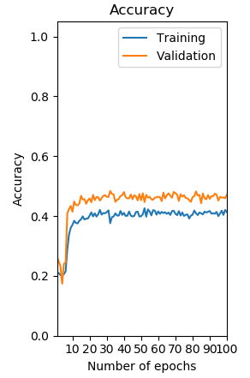
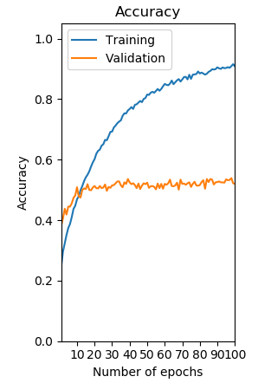
Baseline
CNN
Quinary Classifier
Random Guess Accuracy | 20.00%
Baseline Test Accuracy | 38.63%
CNN Test Accuracy | 48.77%

Slide 25
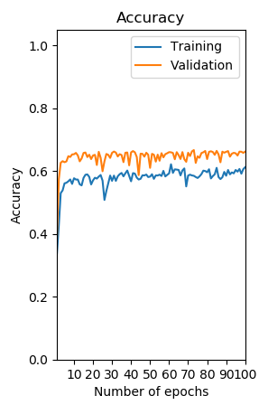
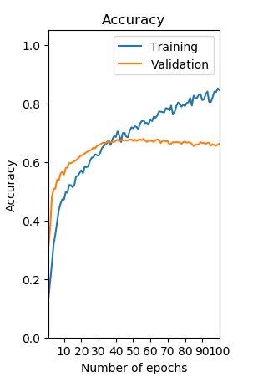
Baseline
CNN
Ternary Classifier
Random Guess Accuracy | 33.33%
Baseline Test Accuracy | 52.01%
CNN Test Accuracy | 53.48%

Slide 26
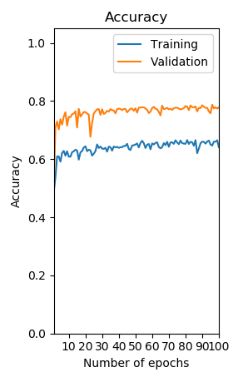
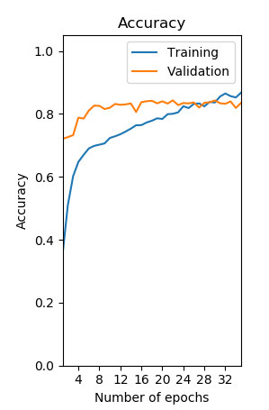
Baseline
CNN
Binary Classifier
Random Guess Accuracy | 50.00%
Baseline Test Accuracy | 66.28%
CNN Test Accuracy | 73.66%

Slide 27
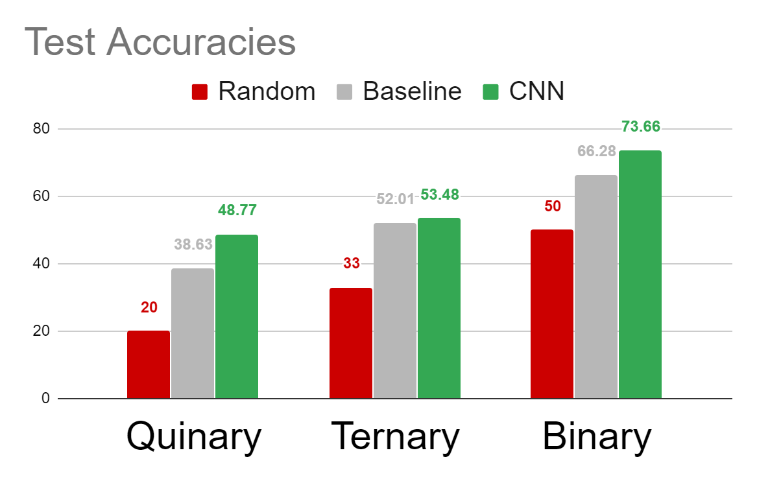

Slide 28
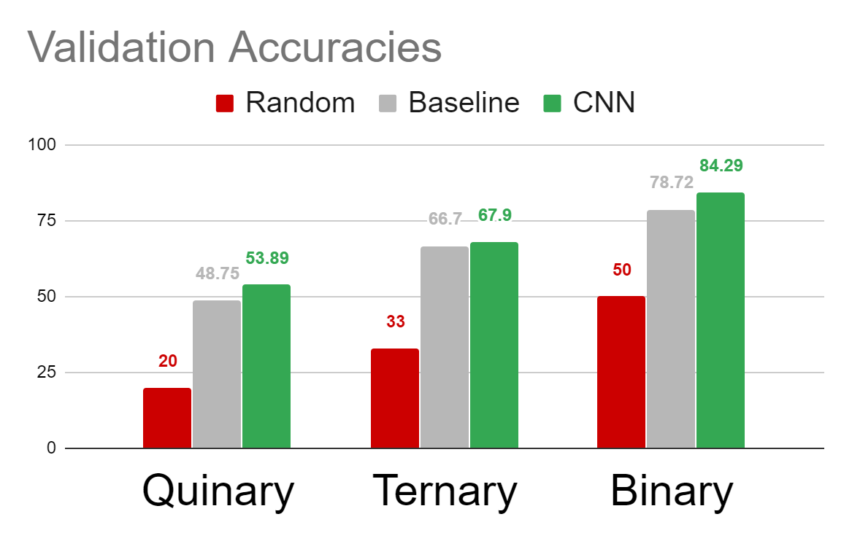

Slide 29
Binary Confusion
 | Truth Low | Truth High
Prediction Low | 13104 | 5113
Prediction High | 4389 | 13466
Recall = 72.48%

Slide 30
Ternary Confusion
 | Truth Low | Truth Average | Truth High
Prediction Low | 4173 | 1066 | 541
Prediction Average | 890 | 3352 | 1189
Prediction High | 411 | 914 | 3279
True "High" Rate = 65.46%

Slide 31
Quinary Confusion
 | Truth Zero | Truth Low | Truth Average | Truth High | Truth Viral
Prediction Zero | 1981 | 311 | 163 | 899 | 136
Prediction Low | 1410 | 1966 | 731 | 501 | 611
Prediction Average | 550 | 851 | 3370 | 309 | 442
Prediction High | 636 | 1324 | 506 | 2566 | 605
Prediction Viral | 281 | 620 | 133 | 1283 | 3053
True "High/Viral" Rate = 51.16%

Slide 32


Slide 33
