Slide 1

RedditRank Proposal
Predicting the Success of a Reddit Post
Andrew Wang
Murtaza Latif

Slide 2
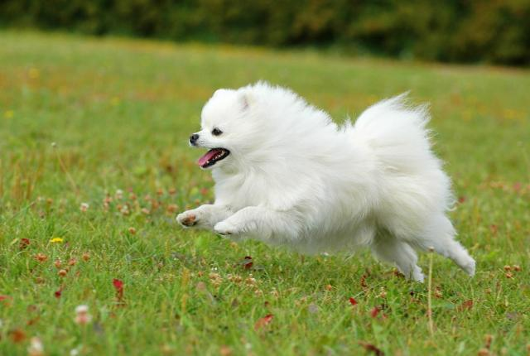
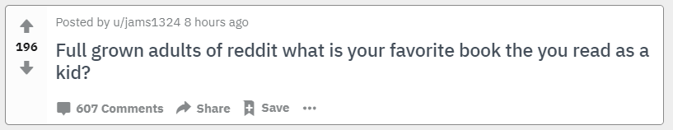
NN
NN
RedditRank
NN

Slide 3
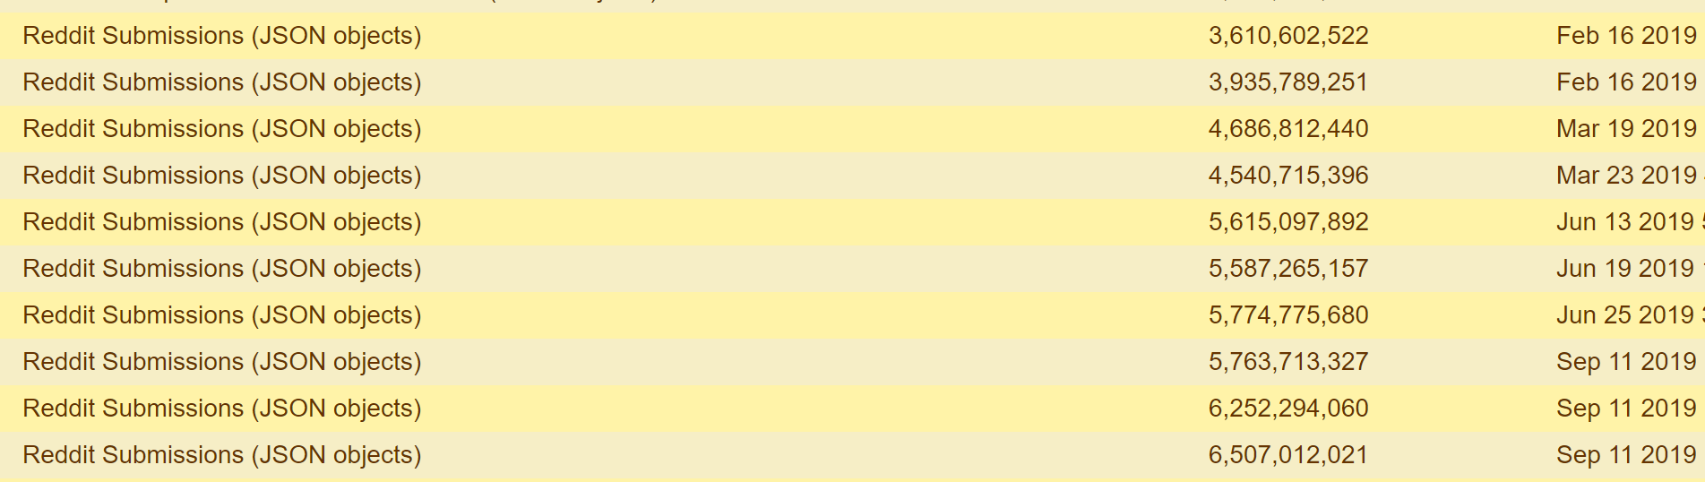

2. Data Collection and Processing
user: “jams1324”
title: “Full grown adults of reddit…”
comments: 607
score: 196
age: 8 hours ago
⋮
Label
Younger than 2 days

Slide 4
Text Architectures
Frequency
Vectors
NN
B1
A cat is a red cat.
"a" | "is" | "cat" | "red"
2 | 1 | 2 | 1
Text
CNN
NN
B2
Tokenized
Text
RNN
NN
AO

Slide 5
Text & Image Architectures
Frequency
Vectors
NN
B1
Text
CNN
NN
B2
Tokenized
Text
RNN
NN
AO
Processed
Images
CNN
Images

Slide 6
Risks
RNN can take too long to train
Truncate titles
Downsize images
Lack of words in word vector dictionary
Find & replace
Omit the input

Slide 7
Objectives by Progress Report Time
Data collection and processing methods complete
Baseline models created and functional

