Slide 1
Presenting:
Group 6:
Mahjabin Rahman ( 011 151 129)
Muhammad Farhan Tanvir (011 153 054 )
Nabila Tabassum (011 161 046)
Murtoza Ahmed (011 153 043)
Prodip Asha (011 161 027)

Slide 2
Table Of Contents:
Introduction
Overview of the Project
Tangible Outcome(User Interphase)
Dataset
Flowchart
Efficiency
Conclusion
Work distribution

Slide 3
Group name :(Group-6) Supervisor Dr. Mohammad Nurul Huda Designation : Professor (United International University)

Slide 4

Topic: Bangla Speech Recognition

Slide 5
Overview
Automated Speech recognition
Vocal frequency to text conversion
Only Bangla
Consequently offline version
Tangible outcome – A web based figure

Slide 6
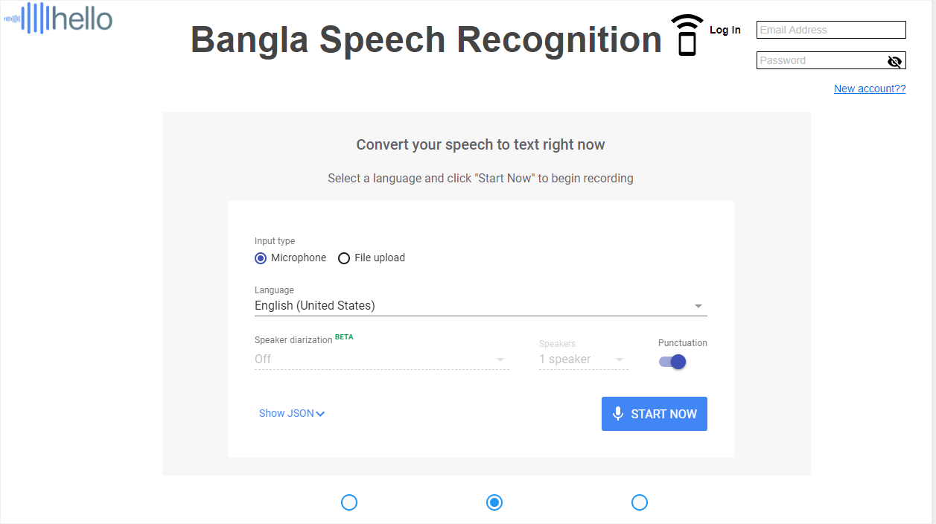
Tangible Outcome(User Interphase)

Slide 7
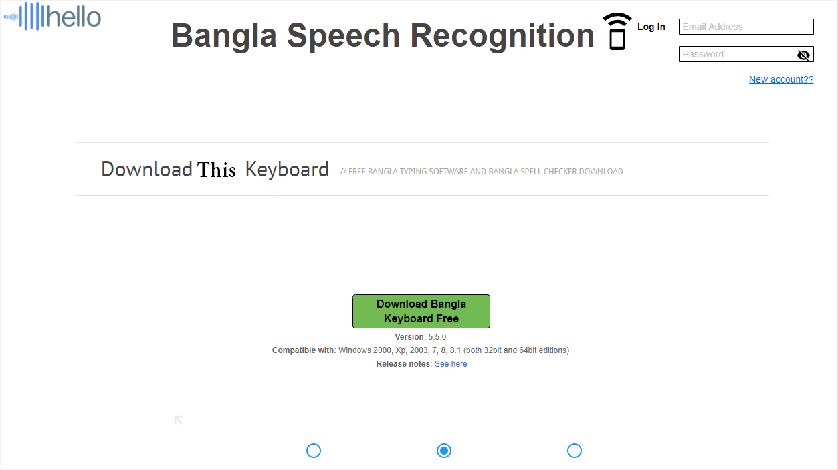
Tangible Outcome(User Interphase)

Slide 8
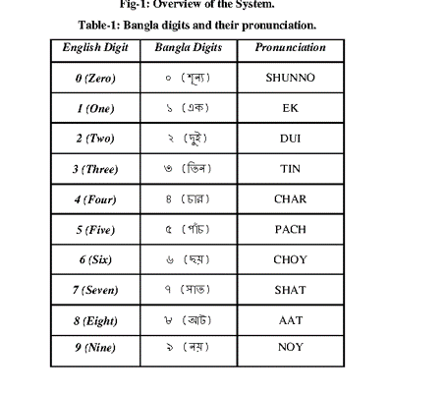
Dataset

Slide 9
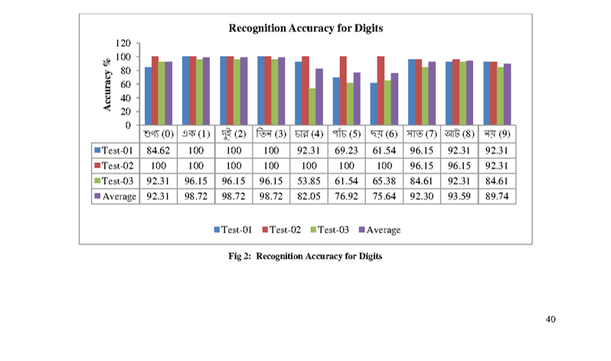
Digit Accuracy

Slide 10
Speech Recognition
Speaker recognition
Recognizing who is speaking
Frequencies
Recognizing what is being said

Slide 11
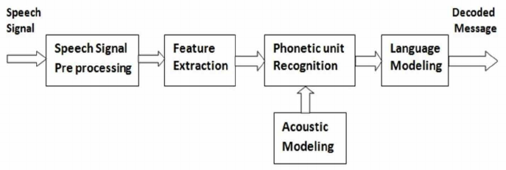
Flowchart

Slide 12
The technique of the voice recognition
Get data from microphone port as packet.
Filter data and remove noise.
Dictionary matching.
Grammar checking.
Output sentence as a packet form.

Slide 13
Efficiency
People With Disabilities
Less Educated People
Get rid of long annoyance texting.
Organization- Reduce cost and error.
Lower Operational Cost
Bangla Speech Recognition can replace touch-ton dialing resulting in the ability to target customer that speak Bengali .

Slide 14
Conclusion
Bangla speech recognition will involve the ability to match voice pattern against a provided or acquired vocabulary
It will use to make control.
It will has an acceptable accuracy , but better accuracy implies less speed.
Although it won’t be an unique idea ,it will help for some less educated , physically not fitted people who can speak in Bengali.
Although it has some limitation , it can perform better by its configaration within its limitation.

Slide 15
Work distribution
Name | ID | Responsibility
Mahjabin Rahman | 011 151 129 | Documentation, User Interphase.
Muhammad Farhan Tanvir | 011 153 054 | CMU Sphinx,Dataset Research.
Murtoza Ahmed | 011 153 043 | CMU Sphinx, Progress Video.
Nabila Tabassum Naureen | 011 161 046 | CMU Sphinx, Research paper.
Prodip Asha | 011 161 027 | CMU Sphnix, Source paper

Slide 16


