Slide 1
PICT, Pune
Expressive English Text-to-Speech Synthesis system
Under guidance of:
Prof. G. P. Potdar
By:
Pranjal Bhor (4116)
Prathamesh Dharangutte (4125)
Vaibhav Chaudhari (4120)
Murtaza Raja (4147)

Slide 2
Previous Attempts
Adobe PDF reader: Closed source emotion devoid TTS
engine
Ivona TTS: Monotonic with robotic toning
(https://www.ivona.com/)
Jovie: Open source but without focus on emotions of
the text
(http://www.kde.org/applications/utilities/jovie)

Slide 3
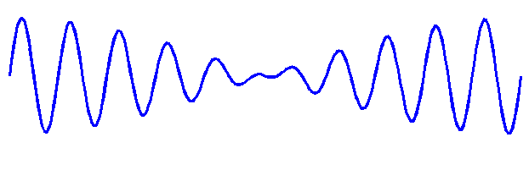

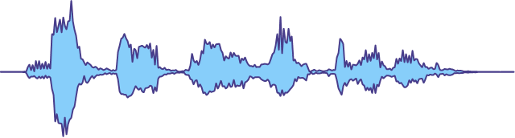

Our Approach
Monotonic Speech
Generator
Expressive Speech
Generator
English Text Input
Emotion Classifier
Expressive Speech Output

Slide 4
Divide and Conquer Strategy

Slide 5

DIPEX 2017

