Slide 1
Expressive English Text-to-Speech Synthesis system
Guided By : Dr. G. P. Potdar
Vaibhav Chaudhari B120054254
Prathamesh Dharangutte B120054267
Murtaza Raja B120054367
Pranjal Bhor B120054399

Slide 2
Motivation
Monotonic audio output by in-built TTS of PDF readers
Dis-satisfactory emotional aspects of existing TTS engines
Very few existing TTS engines, understand text before giving output with emotional aspects

Slide 3
Existing TTS systems
Text-to-speech Engines | Drawbacks
Adobe PDF reader | Closed source and emotionless audio
Ivona TTS | Monotonic with robotic toning https://www.ivona.com/
Jovie | Open source but without focus on emotions of the text http://www.kde.org/applications/utilities/jovie

Slide 4
Problem Statement
Develop a software that reads a text or PDF file containing English sentences such that 5 basic emotions (joy, sadness, anger, surprise and neutral) are identified and reflected in the audio which it generates.

Slide 5
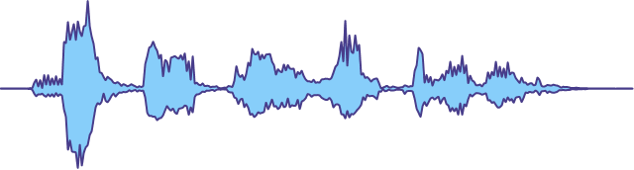


Our Approach
Expressive Speech
Generator
English Text Input
Expressive Speech Output
Emotion Classifier

Slide 6
Divide & Conquer Strategy

Slide 7
Emotion Detection
Challenges
Knowledge Based
English sentences can be constructed in many different ways.
Difficult to understand human intention from the sentence.
Scarce availability of dataset.
Deep Learning
Our Approach

Slide 8
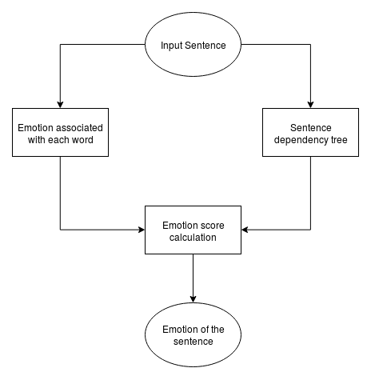
Emotion Detection
Challenges
Knowledge Based
Deep Learning
Our Approach
Knowledge Based approach (acc. 46%)

Slide 9
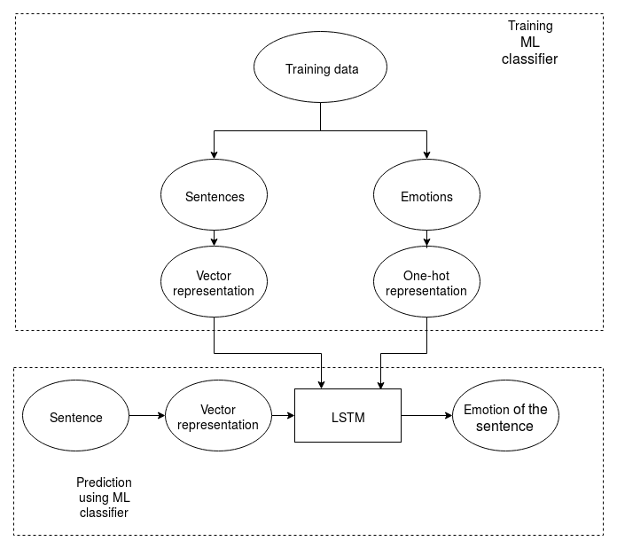
Emotion Detection
Challenges
Knowledge Based
Deep Learning
Our Approach
Machine Learning approach (acc. 82%)

Slide 10
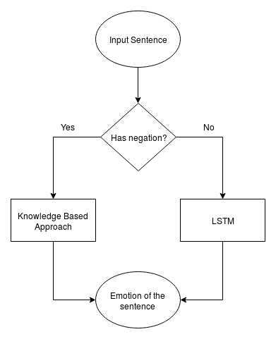
Emotion Detection
Challenges
Knowledge Based
Deep Learning
Our Approach
Our Approach (acc. 86%)

Slide 11
Affective Audio Synthesis
Challenges
Voice Building
Voice building requires large amount of quality audio.
Incorporating different accents is difficult.
Affective audio generated is afar from natural human speech.
TTS System

Slide 12
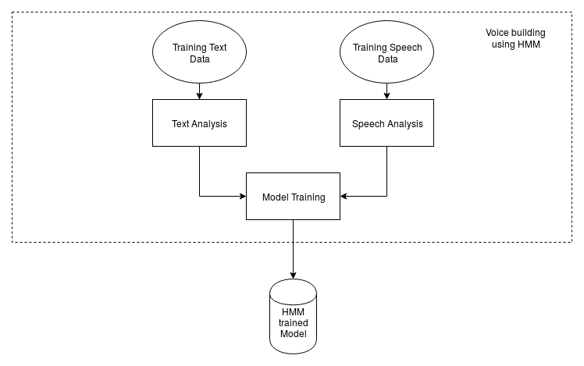
Affective Audio Synthesis
Challenges
Voice Building
TTS System
Voice Building using Hidden Markov Modelling (HMM)

Slide 13
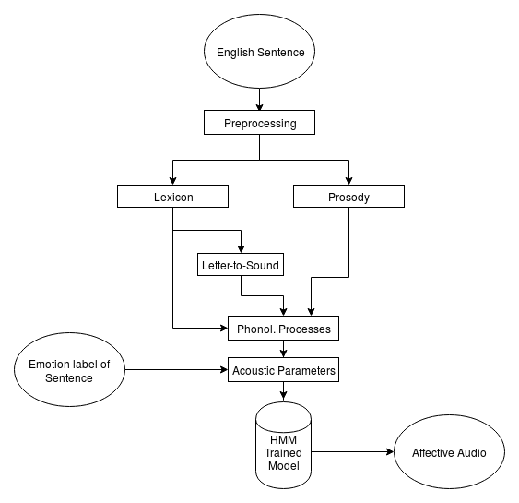
Affective Audio Synthesis
Challenges
Voice Building
TTS System
Text-to-Speech System Structure

Slide 14
Demonstration

Slide 15
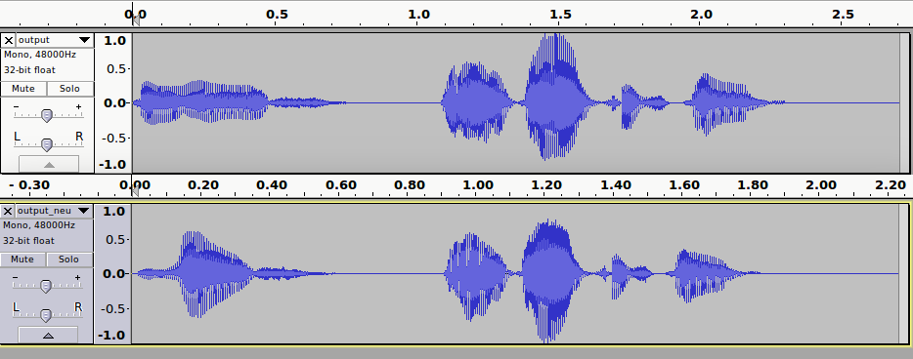
Sad vs. Neutral Audio Waveforms
Sad
Neutral

Slide 16
Applications
PDF reader plug-in especially for listening to novels and stories.
Automatic generation of audio books.
Automatic Text-to-Speech generation in video games.

Slide 17
Thank You

