Slide 1
Presentation
Expressive English Text-to-Speech Synthesis system
Under guidance of:
Prof. G. P. Potdar
By:
Pranjal Bhor (4116)
Prathamesh Dharangutte (4125)
Vaibhav Chaudhari (4120)
Murtaza Raja (4147)

Slide 2
Problem
Monotonic audio output by in-built PDF readers’ TTS
Unsatisfactory emotional aspects of existing TTS engines
Very few existing TTS engines, understands text before giving output with emotional aspects

Slide 3
Previous Attempts
Adobe PDF reader: Closed source emotion devoid TTS
engine
Ivona TTS: Monotonic with robotic toning
(https://www.ivona.com/)
Jovie: Open source but without focus on emotions of
the text
(http://www.kde.org/applications/utilities/jovie)

Slide 4
Problem Statement
Develop a software program that reads a text file containing English sentences such that the emotions in the sentences are reflected in the audio.

Slide 5
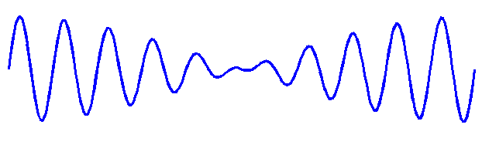

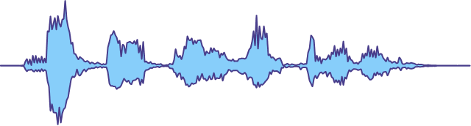

Our Approach
Monotonic Speech
Generator
Expressive Speech
Generator
English Text Input
Emotion Classifier
Expressive Speech Output

Slide 6
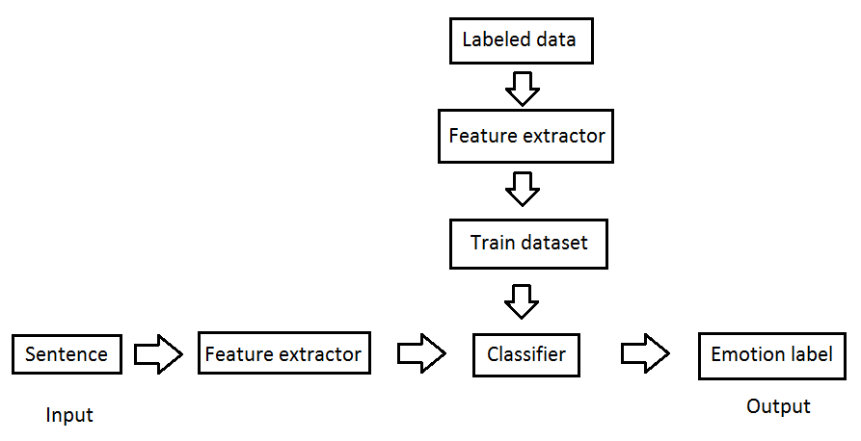
Classfication of emotions

Slide 7
Divide and Conquer Strategy

Slide 8
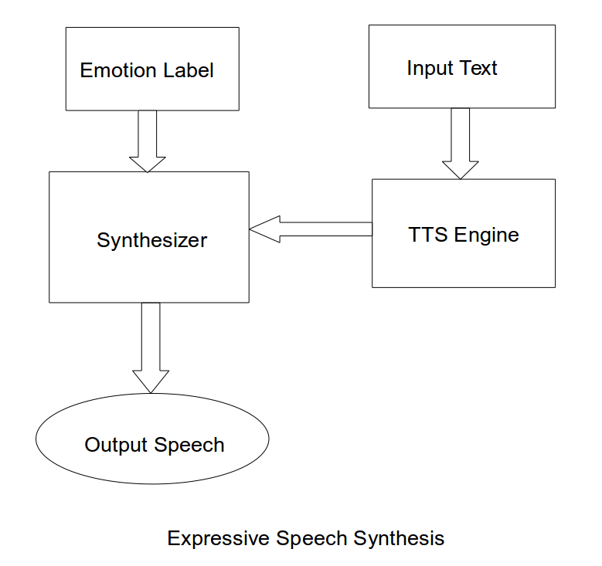
Audio Processing

Slide 9
Applications
PDF reader plug-in especially for listening to novels and stories
Automatic Generation of audio books
Automatic Text-to-speech generation in video games

Slide 10
Tools and Technologies
1. Python 2.7
2. SciKit library
3. NLTK library
4. HMM-based Speech Synthesizer
5. eSpeak TTS

Slide 11
References
1. Vanmassenhove, Eva, João P. Cabral, and Fasih Haider. "Prediction of emotions from text using sentiment analysis for expressive speech synthesis." 9th ISCA Speech Synthesis Workshop, Sunnyvale, USA, Septemper. 2016.
2. Alm, Cecilia Ovesdotter, Dan Roth, and Richard Sproat. “Emotions from text: machine learning for text-based emotion prediction.” Proceedings of the conference on human language technology and empirical methods in natural language processing. Association for Computational Linguistics, 2005
3. Chaffer, Saumaya, and Diana Inkpen. “Using a heterogeneous dataset for emotion analysis in text.” Canadian Conference on Artificial Intelligence. Springer Berlin Heidelberg, 2011

Slide 12
References
4. Schlunz, Georg Isaac. “Advanced natural language processing for improved prosody in text-to-speech synthesis/GI Schlunz. Diss. North-West University, 2014
5. Bowles Tristan, and Sandra Pauletto. "Emotions in the voice: humanising a robotic voice." Proceedings of the 7th Sound and Music Computing Conference, Barcelona, Spain. 2010
6. Pierre-Yves Oudeyer. “The production and recognition of emotions in speech: features and algorithms.” International Journal of Human-Computer Studies, 2003

Slide 13
References
8. Shaikh, Mostafa Al Masun, Antonio Rui Ferreira Rebordao, and Keikichi Hirose. “Improving TTS synthesis for emotional expressivity by a prosodic parameterization of affect based on linguistic analysis.” Proceedings of the 5th International Conference on Speech Prosody (SP5), 2010
9. Ian McLoughlin, “Applied speech and audio processing with Matlab examples”, First Edition, 2009

Slide 14

DIPEX 2017

Slide 15


