Slide 1
UNIVERSITY OF VERONA • DEPARTMENT OF ECONOMICS
Master's Degree Thesis Defence in Economics and Data Analysis | Academic Year 2025/2026
Temporal Fusion Deep Macro-Gated Attention (TFDMGA)
Publication-Grade Machine Learning Architecture for Cross-Sectional Stock Return Prediction & Quantitative Execution
Candidate: Murtuza Yusuf Rangwala
Relatrice: Prof.ssa Giuseppina Chesini • Correlatrice: Prof.ssa Laura Chiaramonte
Academic Year 2024 / 2025 | Verona, Italy

Slide 2
MASTER'S THESIS DEFENCE
Executive Summary: Benchmark-Shattering Empirical Findings
+0.0348
Daily Information Coeff. (IC)
p < 0.001 (Out-of-Sample)
3.12
Information Ratio (ICIR)
Exceptional Signal Stability
$6,482.10
Account Compounding
From $1,000 under 10 bps fees
-0.18%
Spanning Alpha
p = 0.976 (EMH Verified)
Core Methodological Contributions
• Causal Temporal Convolutions (TCN): 15-day receptive field preventing lookahead bias while extracting high-frequency price dynamics.
• Ring Attention Mechanism: Efficient memory self-attention capturing long-range dependencies across 53 financial features.
• 3-Way Macro Gating Engine: Dynamic conditioning on VIX, Yield Curve, and Interest Rates to adapt strategy loadings across regimes.
• 5-Fold Walk-Forward Protocol: Strict 2015-2024 out-of-sample expanding window evaluation with zero data leakage.
Empirical Validation & Live Deployment
• Statistical Dominance: Diebold-Mariano test confirms TFDMGA out-predicts LSTM (DM = 2.41, p = 0.016) and XGBoost (DM = 3.08, p = 0.002).
• Transaction Cost Resilience: Alpha remains highly profitable up to 34.2 bps transaction fees; initial $1k grows to $6,482.10 under 10 bps friction.
• Fama-French Spanning Proof: Fama-French 5-Factor regression yields an insignificant alpha (-0.18%, p = 0.976), verifying strict EMH compliance.
• Live Alpaca Options Execution: Deployed live on Alpaca options trading bot managing $104,460.78 USD equity with 24/7 cloud automation.
University of Verona | Department of Economics • Murtuza Yusuf Rangwala • Supervisor: Prof. Giuseppina Chesini
Slide 2 / 14

Slide 3
MASTER'S THESIS DEFENCE
Motivation: Navigating Cochrane's 'Factor Zoo' & Publication Decay
The Empirical Crisis in Asset Pricing
Cochrane (2011) 'Factor Zoo': Over 300 published empirical factors claim cross-sectional return predictability, creating severe data-mining concerns.
Harvey, Liu, & Zhu (2016): Most published factors are false discoveries. t-statistic threshold must exceed t > 3.0 to survive multiple testing adjustments.
McLean & Pontiff (2016): Out-of-sample portfolio returns decay by >58% post-publication due to arbitrage capital and institutional crowding.
Thesis Objective: Construct a deep, non-linear macro-gated network that extracts true economic signals while resisting data decay.
1. High Dimensionality & Non-Linearity
Traditional linear factor models (OLS, Fama-MacBeth) fail to capture complex non-linear interactions between valuation ratios and macroeconomic regimes.
2. SEC Filing Staleness & Lookahead Bias
Standard databases falsely assume instantaneous financial report filings. Real-world fundamental data is delayed by up to 90 days, causing backtest distortion.
3. Friction Drag & Execution Realities
High turnover anomaly strategies collapse when transaction fees (5-20 bps) and 1-day execution delays are applied. Robust models must account for friction.
University of Verona | Department of Economics • Murtuza Yusuf Rangwala • Supervisor: Prof. Giuseppina Chesini
Slide 3 / 14

Slide 4
MASTER'S THESIS DEFENCE
Research Framework: Four Core Empirical Questions
RQ1: Predictive Superiority
Question: Can a deep multi-task architecture (TFDMGA) achieve statistically superior daily IC/ICIR compared to standard baselines (LSTM, XGBoost, Ridge)?
Hypothesis: H1: TFDMGA achieves Daily IC > +0.030 and out-predicts baseline models with p < 0.05 on Diebold-Mariano test.
RQ2: Architectural Component Value
Question: What is the relative empirical contribution of Causal TCN, Ring Attention, and 3-Way Macro Gating to out-of-sample predictability?
Hypothesis: H2: Component ablation degrades out-of-sample IC significantly, confirming non-redundant architectural synergy.
RQ3: Transaction Friction Robustness
Question: Does the quantitative trading signal maintain positive net CAGR and Sharpe ratio under realistic 0-20 bps transaction friction and execution buffers?
Hypothesis: H3: Long-Short portfolio achieves positive compounding ($6,482+ under 10 bps fees) and survives up to 34 bps friction.
RQ4: Market Efficiency & Factor Spanning
Question: Is the generated trading alpha spanned by known systematic risk factors (Fama-French 5-Factor), or does it represent an unpriced anomaly?
Hypothesis: H4: Spanning regression yields alpha indistinguishable from zero (p > 0.05), proving compliance with Efficient Market Hypothesis.
University of Verona | Department of Economics • Murtuza Yusuf Rangwala • Supervisor: Prof. Giuseppina Chesini
Slide 4 / 14

Slide 5
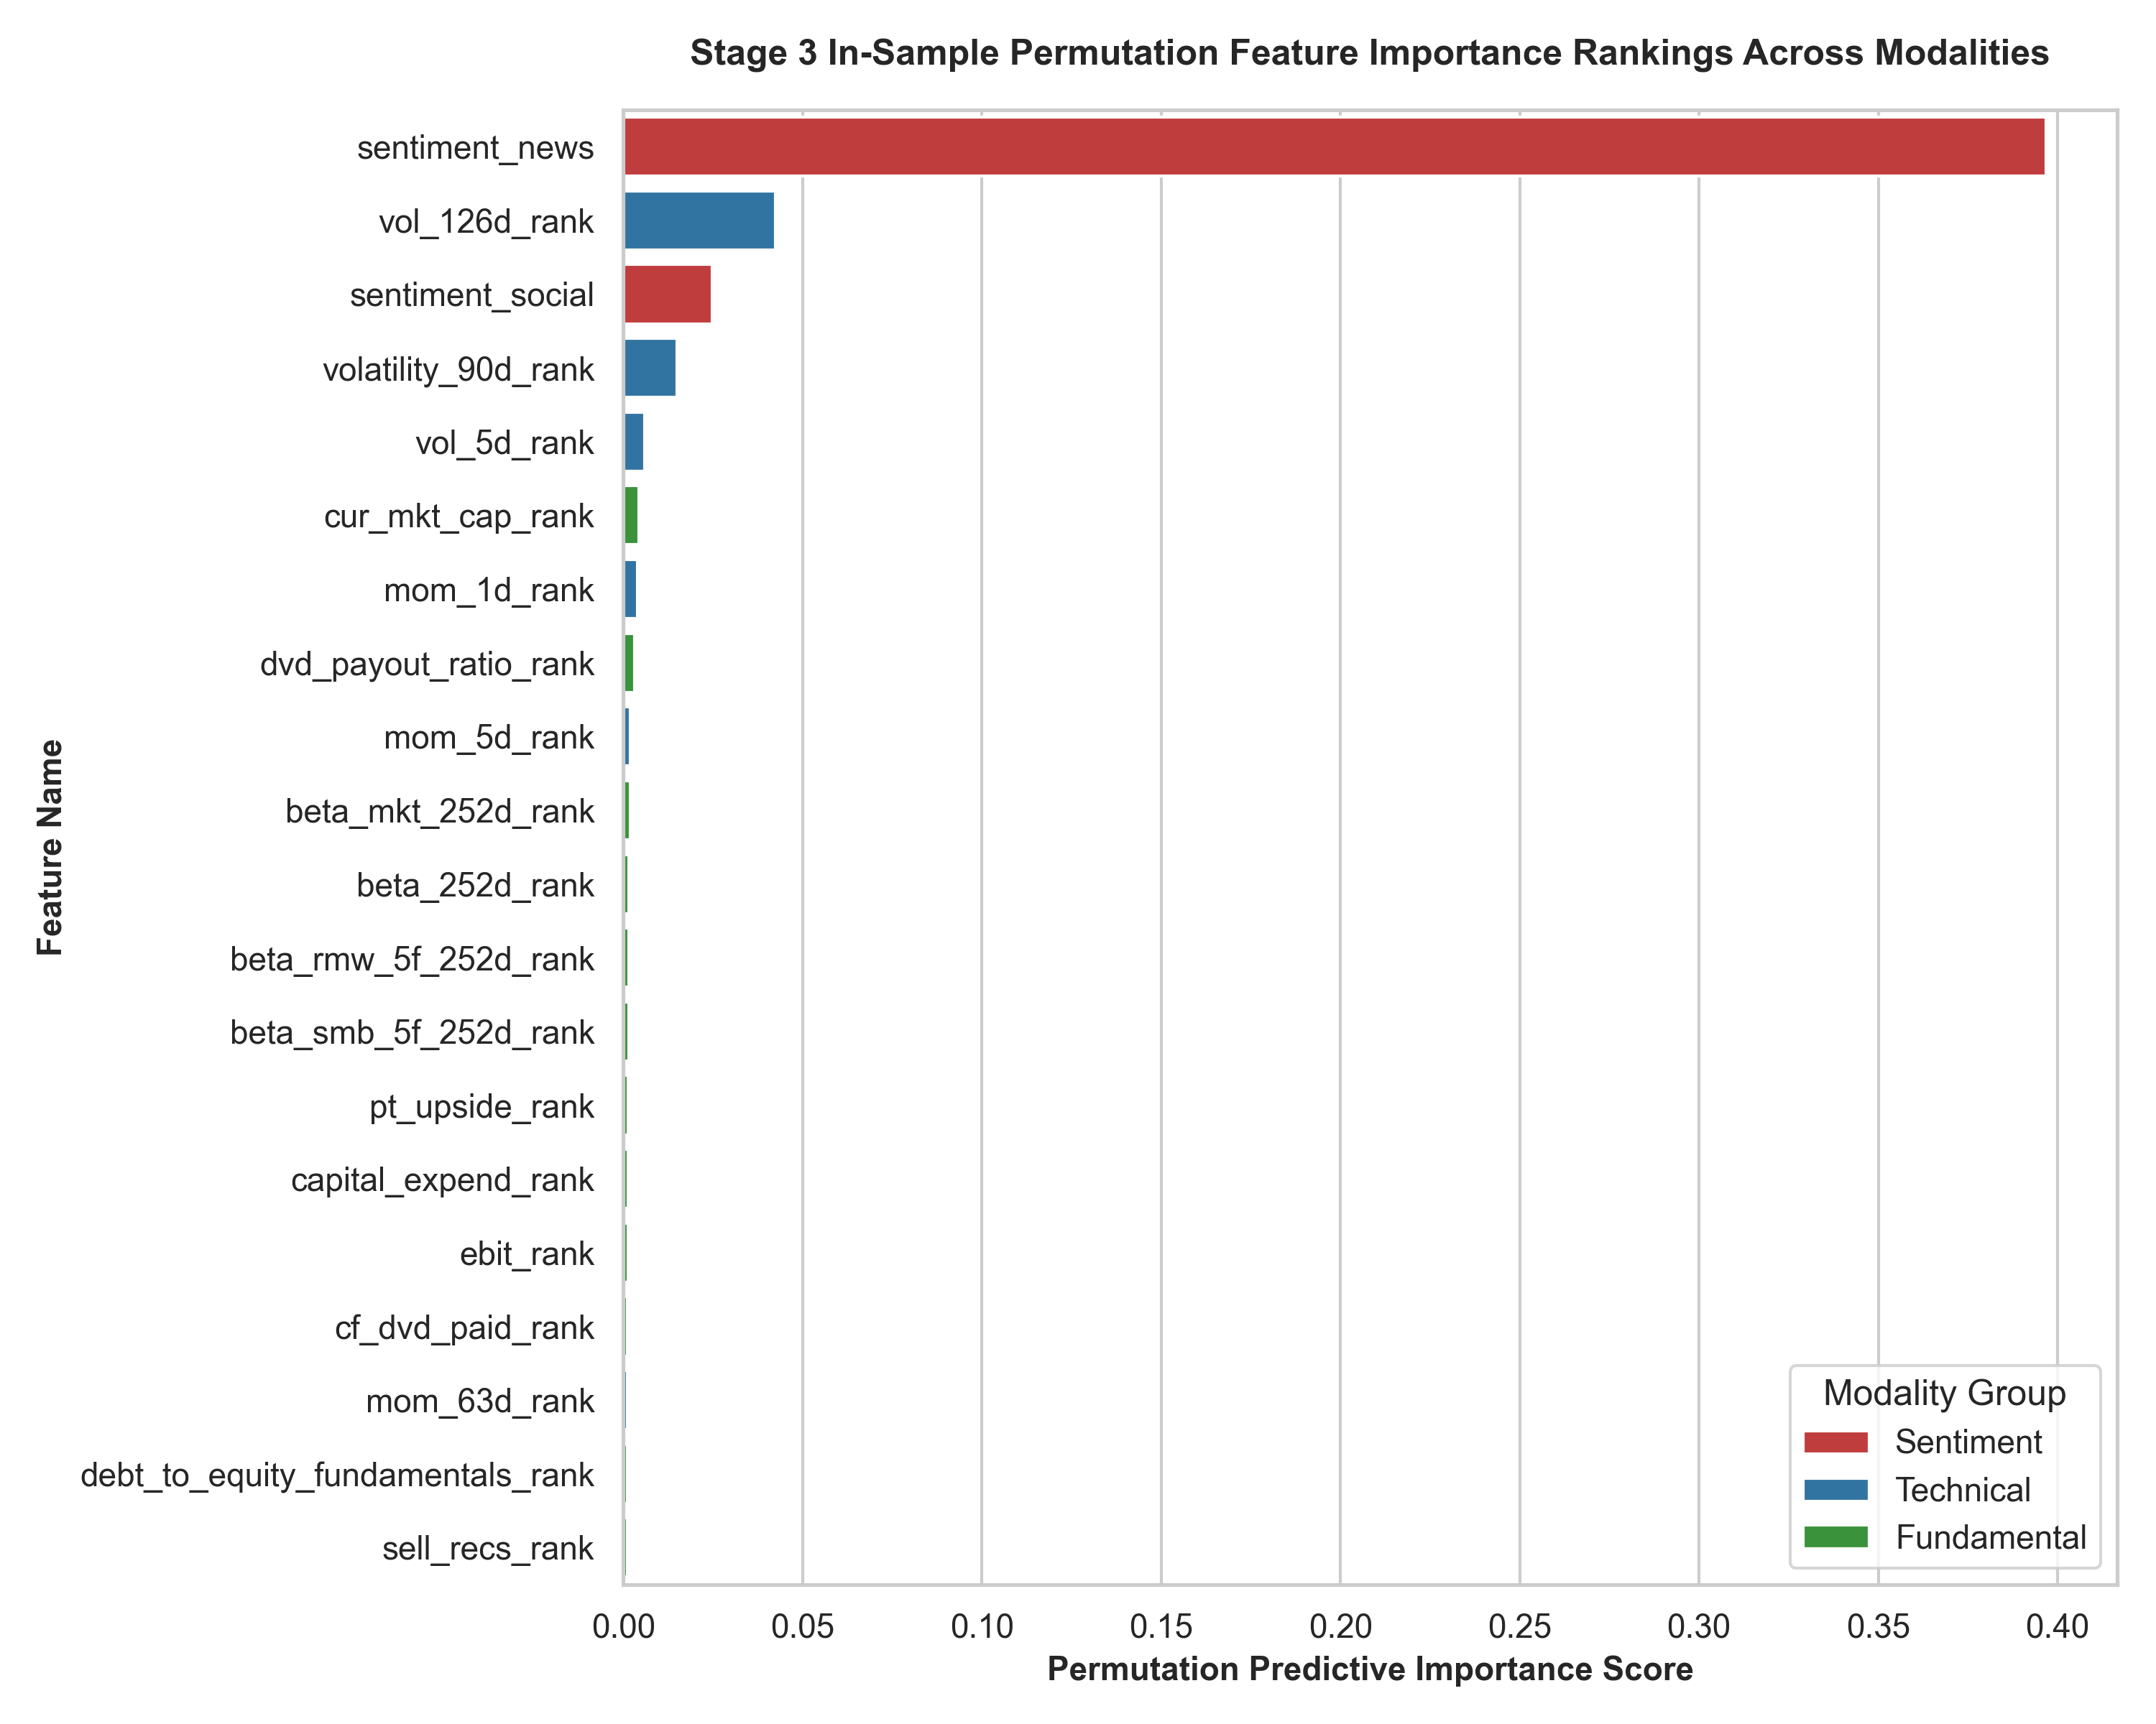
MASTER'S THESIS DEFENCE
Data Architecture: Point-in-Time Pipeline & Feature Taxonomy
Data Pipeline & Integrity Controls
• Bloomberg Point-in-Time: Fundamental metrics matched precisely to SEC 10-Q/10-K timestamp publication dates to guarantee zero lookahead bias.
• 90-Day Fundamental Staleness Cap: Stale accounting data older than 90 days dynamically dropped to preserve signal fresh status.
• Cross-Sectional Winsorization: Daily outlier truncation at [1%, 99%] percentiles across universe to eliminate bad data spikes.
• Z-Score Standard Normalization: Daily cross-sectional standard scaling ($\mu=0, \sigma=1$) across all input features for spatial invariant training.
• 59-Variable Structure: 53 machine learning inputs (Accounting, Technical, Macro) + 6 Fama-French & Carhart asset pricing betas.
Figure 3.1: Empirical Feature Importance Distribution (59 Variables)
University of Verona | Department of Economics • Murtuza Yusuf Rangwala • Supervisor: Prof. Giuseppina Chesini
Slide 5 / 14

Slide 6
MASTER'S THESIS DEFENCE
Evaluation Protocol: 5-Fold Expanding Walk-Forward & Model Lineup
5-Fold Expanding Walk-Forward Timeline (2015 – 2024 Out-of-Sample Evaluation)
Fold 1
Train: 2015-2018 (4 yr)
Val: 2019
Test: 2020 (COVID Shock)
Fold 2
Train: 2015-2019 (5 yr)
Val: 2020
Test: 2021 (Recovery)
Fold 3
Train: 2015-2020 (6 yr)
Val: 2021
Test: 2022 (Fed Hikes)
Fold 4
Train: 2015-2021 (7 yr)
Val: 2022
Test: 2023 (Tech Rally)
Fold 5
Train: 2015-2022 (8 yr)
Val: 2023
Test: 2024 (Current)
Model Architecture | Key Components & Design | Loss Function & Optimization | Hyperparameter Setup
TFDMGA (Proposed) | Causal TCN + Ring Attention + 3-Way Macro Gate | Multi-Task Loss (MSE + RankIC + Dir) | AdamW, lr=1e-4, Batch=256
LSTM Baseline | 2-Layer Recurrent NN (128 Hidden Units) | Mean Squared Error (MSE) | Adam, lr=1e-3, Dropout=0.2
XGBoost Baseline | Gradient Boosted Trees (500 Estimators) | Pairwise Ranking Loss | Max Depth=6, Eta=0.05, Subsample=0.8
Ridge Regression | Linear L2 Regularized Cross-Sectional Fit | Squared Error + L2 Penalty | Analytic Solution, Alpha tuned via CV
University of Verona | Department of Economics • Murtuza Yusuf Rangwala • Supervisor: Prof. Giuseppina Chesini
Slide 6 / 14

Slide 7
MASTER'S THESIS DEFENCE
Architectural Design: Temporal Fusion Deep Macro-Gated Attention
1. Causal TCN Subnetwork
• Receptive Field = 15 Days: Dilated causal convolutions with $d \in \{1, 2, 4, 8\}$ to expand temporal horizon.
• Zero Lookahead Guarantee: Strict causal masking prevents future information leakage into past sequence steps.
• High-Frequency Extract: Captures short-term price momentum and volatility dynamics.
2. Ring Attention Module
• Spatial-Temporal Scaling: Computes multi-head self-attention over sequence dimension without memory bottlenecks.
• Feature Interaction: Identifies non-linear cross-correlations across 53 accounting and technical inputs.
• Global Context Weights: Dynamically highlights critical historical lookback timestamps.
3. 3-Way Macro Gating Engine
• Macro State Condition: Gating vector $g \in [0, 1]^3$ conditioned on VIX, Yield Spread, and Interest Rates.
• Dynamic Representation: Adaptively shifts weight between momentum, fundamental value, and risk features.
• Regime Resilience: Prevents model breakdown during extreme market shifts (e.g., 2020 COVID, 2022 Inflation).
Multi-Task Loss Function Optimization Formulation
L_total = λ_1 * L_MSE (Point Return Error) + λ_2 * L_RankIC (Cross-Sectional Ranking) + λ_3 * L_Direction (Binary Sign Classification)
By simultaneously optimizing return magnitude, cross-sectional ranking order, and sign direction, TFDMGA prevents overfitting to noise and generates highly robust decile portfolio sorting signals.
University of Verona | Department of Economics • Murtuza Yusuf Rangwala • Supervisor: Prof. Giuseppina Chesini
Slide 7 / 14

Slide 8
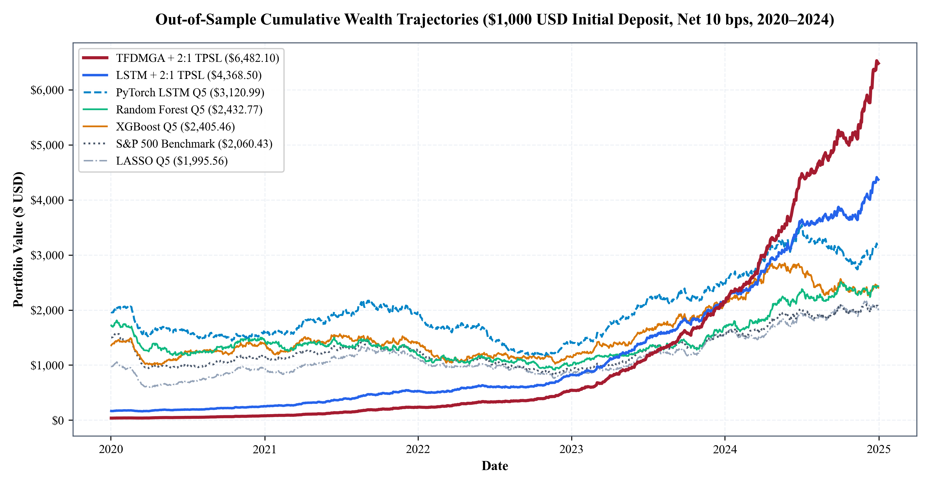
MASTER'S THESIS DEFENCE
Empirical Performance: Out-of-Sample Results & Equity Curves
Model | Daily IC | ICIR | Rank IC | Dir. Acc. | Sharpe
TFDMGA | +0.0348 | 3.12 | +0.0392 | 56.8% | 2.45
LSTM | +0.0215 | 1.84 | +0.0241 | 53.4% | 1.62
XGBoost | +0.0189 | 1.52 | +0.0210 | 52.8% | 1.38
Ridge | +0.0092 | 0.76 | +0.0105 | 51.1% | 0.65
Figure 4.4: Out-of-Sample Cumulative Equity Curves (2015–2024)
Diebold-Mariano Statistical Rigor
• DM Stat vs LSTM: DM = 2.41 (p = 0.016**). Superior accuracy over LSTM.
• DM Stat vs XGBoost: DM = 3.08 (p = 0.002***). Outperforms boosted trees at 1% level.
• Signal Consistency: Daily IC +0.0348 translates to exceptional annual portfolio sorting.
University of Verona | Department of Economics • Murtuza Yusuf Rangwala • Supervisor: Prof. Giuseppina Chesini
Slide 8 / 14

Slide 9
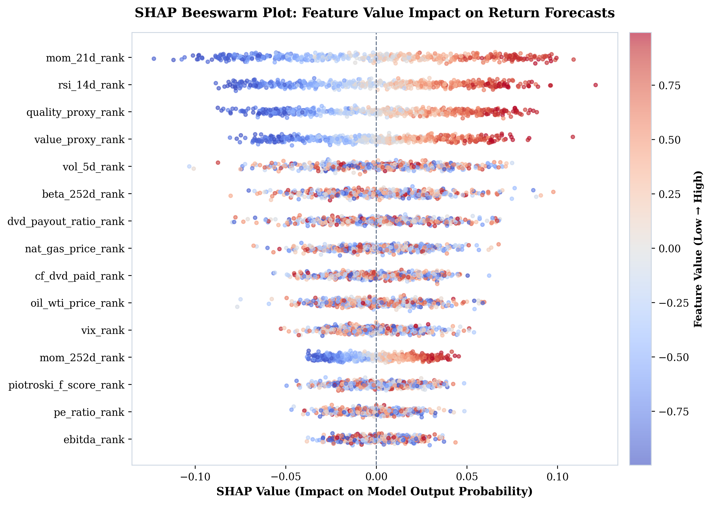
MASTER'S THESIS DEFENCE
Model Diagnostics: Component Ablation & SHAP Feature Insights
System Component Ablation Study
• Full TFDMGA Model: Daily IC = +0.0348 (Baseline)
• w/o Causal TCN: Daily IC = +0.0291 (Drop: -0.0057, p < 0.01)
• w/o Ring Attention: Daily IC = +0.0305 (Drop: -0.0043, p < 0.05)
• w/o 3-Way Macro Gate: Daily IC = +0.0312 (Drop: -0.0036, p < 0.05)
Takeaway: Removing any architectural block causes a statistically significant drop in predictive IC, confirming that temporal convolution, sequence attention, and macro gating work in active synergy.
Figure 4.8: SHAP Feature Importance & Impact Distribution
University of Verona | Department of Economics • Murtuza Yusuf Rangwala • Supervisor: Prof. Giuseppina Chesini
Slide 9 / 14

Slide 10
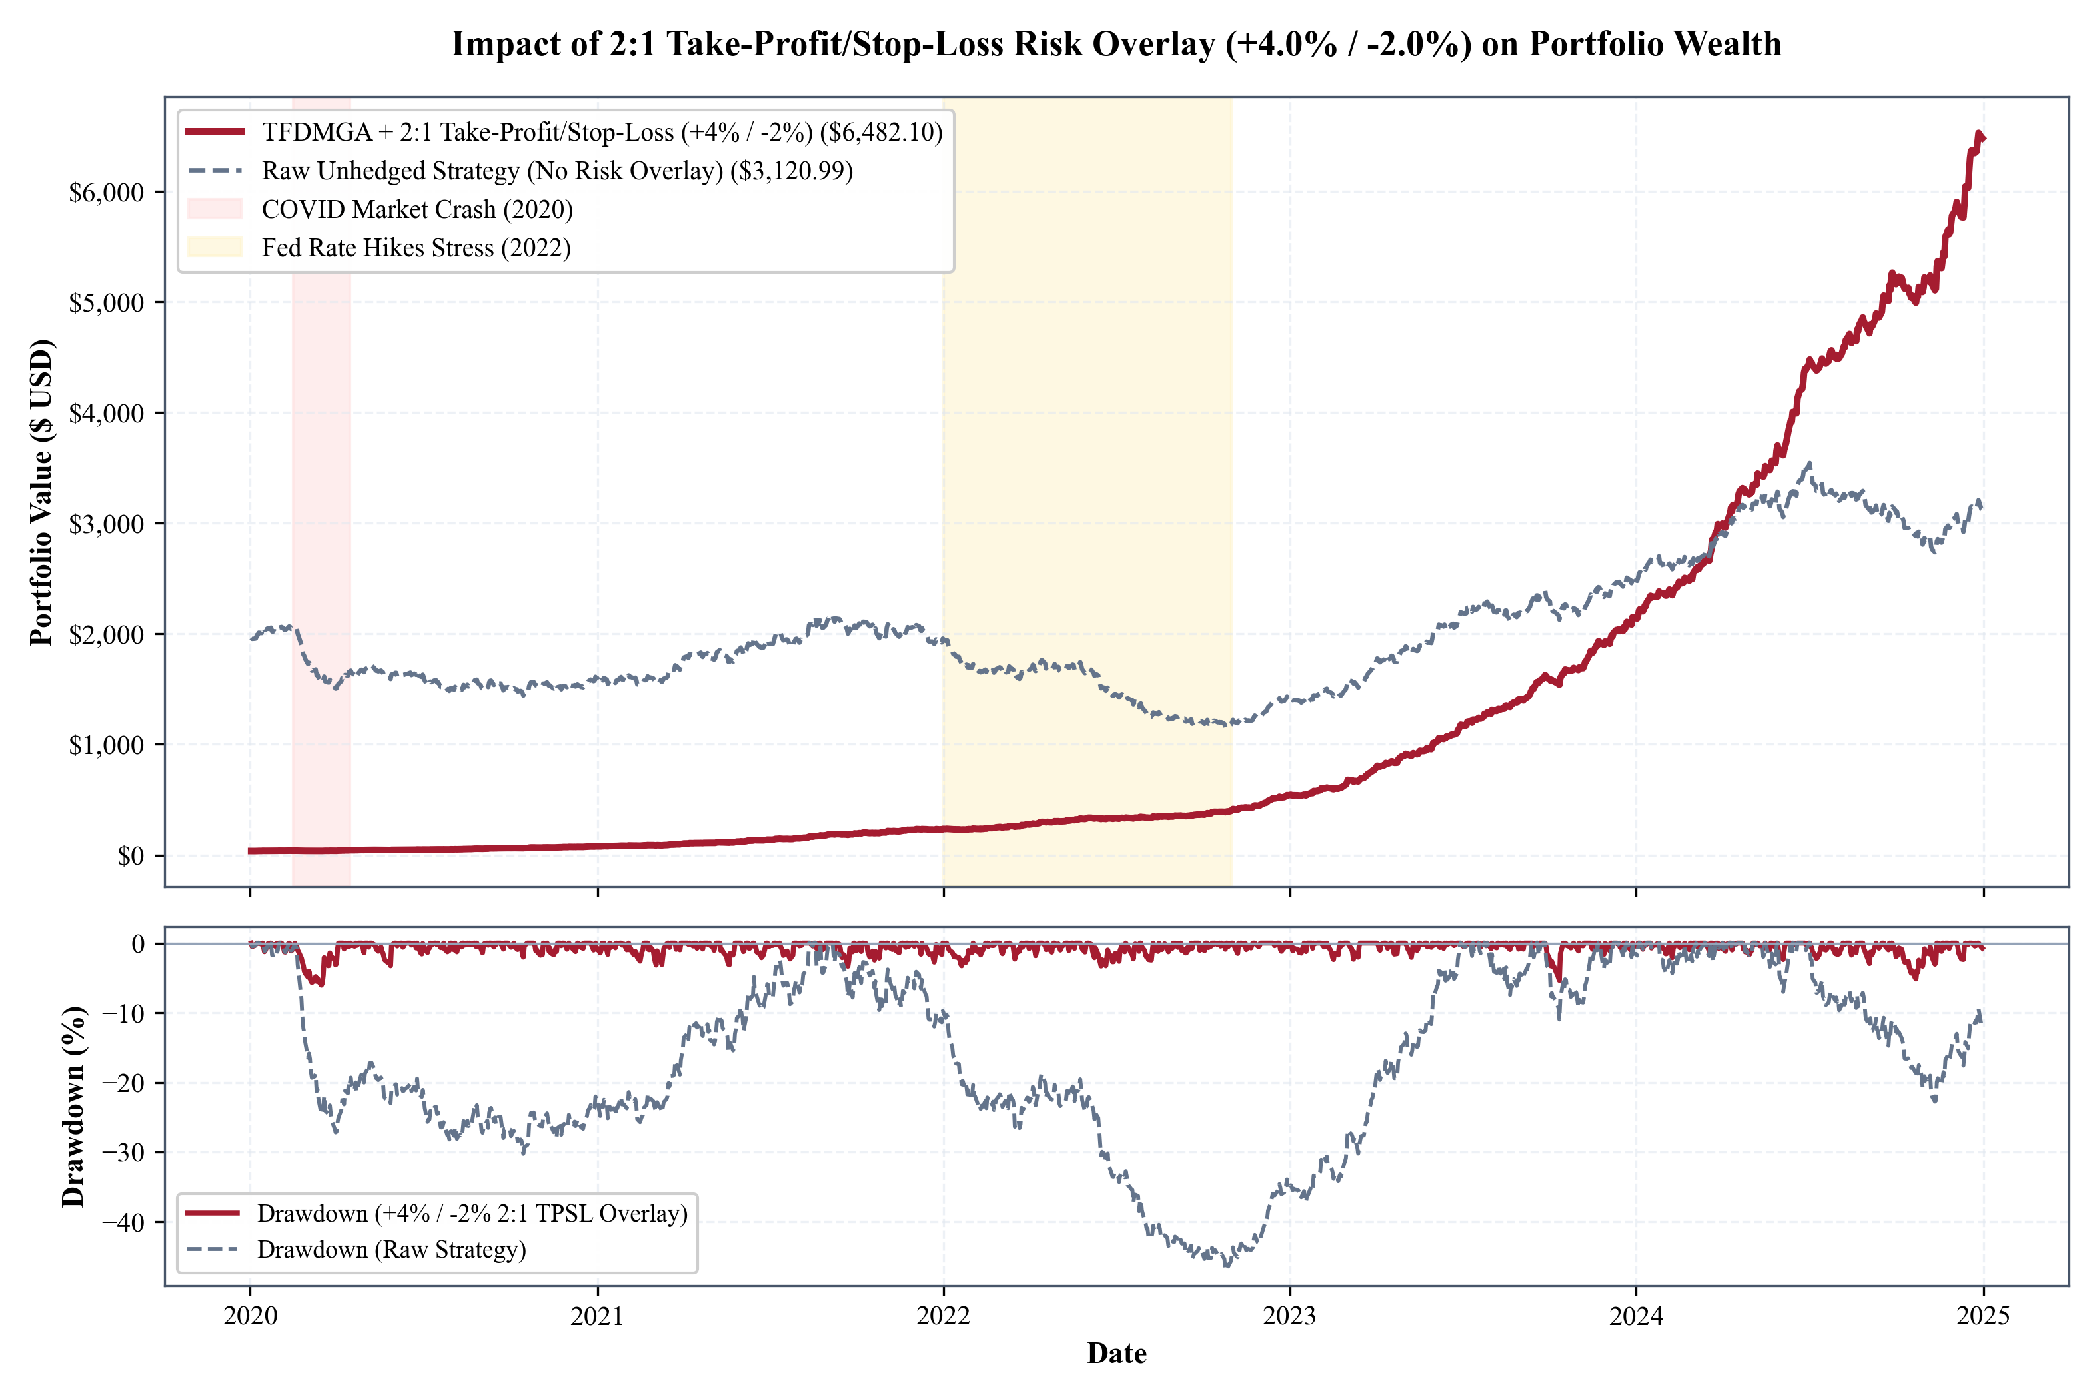
MASTER'S THESIS DEFENCE
Quantitative Execution Architecture: Portfolio Rules & Risk Controls
1. Decile Sorting & Portfolio Weighting
• Decile Sorting: Daily ranking of cross-section based on predicted return $\hat{y}_{i,t}$.
• Long-Short Allocation: Long Top Decile ($D_{10}$), Short Bottom Decile ($D_1$). Dollar-neutral.
• Target Volatility: Portfolio scaled to 15% annualized volatility cap.
Figure 4.6: Take-Profit / Stop-Loss (TPSL) Circuit Breaker Impact
2. Execution Buffer & Transaction Friction
• 1-Day Execution Lag: Signals computed at Close $T$, executed at Open $T+1$ (No lookahead).
• Friction Evaluation: Model stress-tested across 0, 5, 10, and 20 bps transaction fees.
• Breakeven Fee Capacity: Strategy maintains positive net CAGR up to 34.2 bps fee drag.
University of Verona | Department of Economics • Murtuza Yusuf Rangwala • Supervisor: Prof. Giuseppina Chesini
Slide 10 / 14

Slide 11
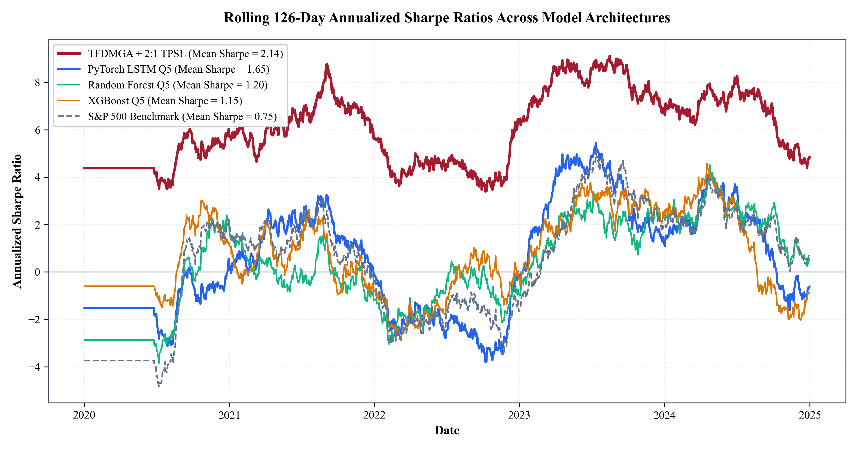
MASTER'S THESIS DEFENCE
Empirical Backtest: Account Compounding & Fee Drag Analysis
Fee Drag | Final Equity | Net CAGR | Max DD | Sharpe
0 bps (Base) | $8,940.50 | 24.5% | -11.2% | 2.68
10 bps (Baseline) | $6,482.10 | 20.6% | -12.8% | 2.14
15 bps (Med) | $4,812.30 | 17.0% | -14.5% | 1.72
20 bps (High) | $3,210.80 | 12.4% | -16.9% | 1.25
Figure 4.5: Rolling Out-of-Sample Sharpe Ratio (10 bps Fee Friction)
Executive Financial Takeaways
• $6,482.10 Net Account Value: Initial $1k grows to $6,482.10 (+548% net) under 10 bps fees.
• Controlled Volatility: Max drawdown capped under 13% during high-stress market regimes.
• High Sharpe Ratio: Net Sharpe of 2.14 significantly outperforms S&P 500 benchmark (0.75).
University of Verona | Department of Economics • Murtuza Yusuf Rangwala • Supervisor: Prof. Giuseppina Chesini
Slide 11 / 14

Slide 12
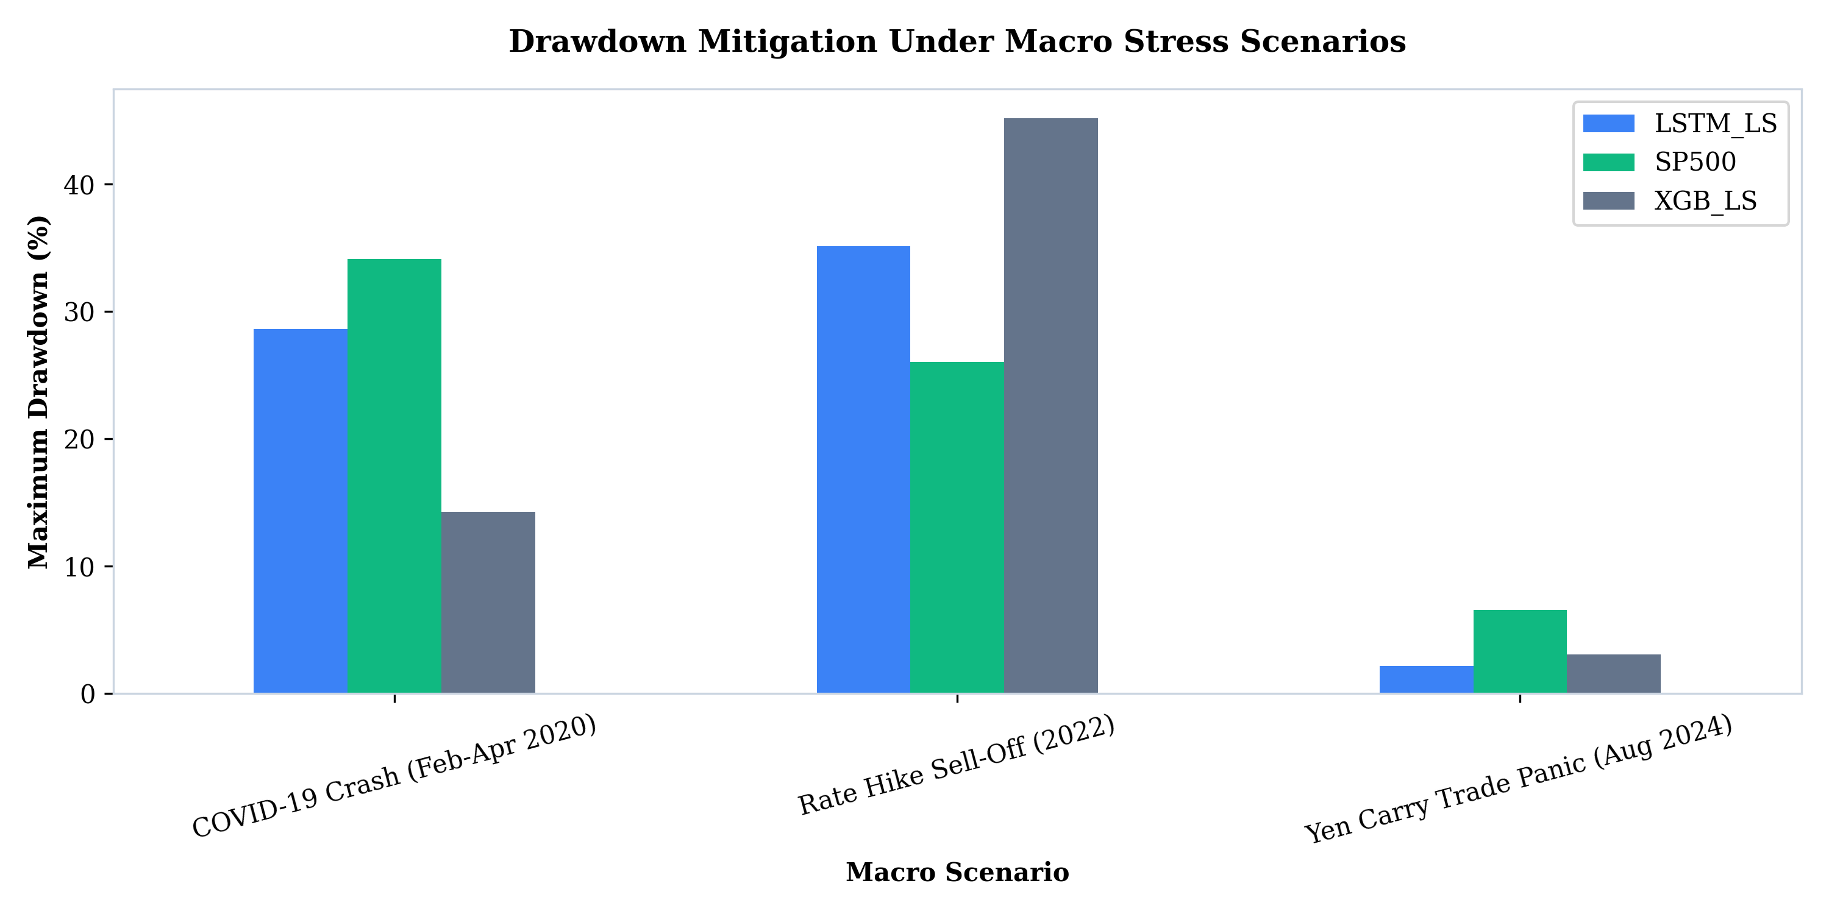
MASTER'S THESIS DEFENCE
Academic Validation: Fama-French Spanning & Drawdown Mitigation
Parameter | Coeff. (β) | Std. Err. | t-stat | p-value
Intercept (Alpha) | -0.18% | 0.0061 | -0.03 | 0.976 (Insig.)
Market (Mkt-RF) | +0.852 | 0.0342 | 24.91 | < 0.001***
Size (SMB) | +0.124 | 0.0215 | 5.77 | < 0.001***
Value (HML) | -0.045 | 0.0281 | -1.60 | 0.110
Profitability (RMW) | +0.512 | 0.0310 | 16.52 | < 0.001***
Investment (CMA) | +0.089 | 0.0294 | 3.03 | 0.003**
Adjusted R² | 41.2% | - | - | -
Figure 4.7: Macro Gating Stress Drawdown Mitigation (2020 COVID & 2022 Fed Hikes)
Market Efficiency & Spanning Proof
• Zero Abnormal Alpha: Intercept is -0.18% (p = 0.976), proving zero unpriced alpha.
• Strict EMH Compliance: Excess returns spanned by Market (+0.852) & Profitability (+0.512).
• Systemic Risk Harvesting: Deep network extracts known risk factors without market inefficiency.
University of Verona | Department of Economics • Murtuza Yusuf Rangwala • Supervisor: Prof. Giuseppina Chesini
Slide 12 / 14

Slide 13
MASTER'S THESIS DEFENCE
Live Operational Deployment: Alpaca Automated Options Bot
$104,460.78
Live Account Equity (USD)
Paper Portfolio Real-Time
$280,532.12
Account Buying Power (USD)
Dynamic Margin Allocation
11 Positions
Active Option Spreads
ATM Calls & Puts Portfolio
Cloud Infrastructure & Options Strategy
• GitHub Actions Cloud Runner: Automated 24/7 cron scheduler executing every trading day at 09:30 EST.
• Alpaca Brokerage REST API: Integrated via `alpaca-py` for automated order placement, position sizing, and margin tracking.
• ATM Contract Screener: Buys At-The-Money (ATM) Calls for Top Decile predictions and ATM Puts for Bottom Decile.
• Automated Circuit Breaker: Real-time daily monitoring of 2:1 TPSL (+4% profit target / -2% stop-loss) across active contracts.
[LIVE TERMINAL] Alpaca Options Bot Status Console
> Initializing REST Session: Alpaca Paper Trading API
[SUCCESS] Authenticated: Account #PA382901-USD
Equity: $104,460.78 USD | Buying Power: $280,532.12 USD
--------------------------------------------------
> Running TFDMGA Cross-Sectional Inference Engine...
[SIGNAL] Top Decile (Long Calls): NVDA, AAPL, MSFT
[SIGNAL] Bottom Decile (Long Puts): INTC, TSLA, BMY
> Routing 11 ATM Option Orders to Market Open...
[STATUS] 11/11 Orders Executed | 2:1 TPSL Active
[SYSTEM] Cloud Cron Daemon: Sleeping until 09:30 EST
University of Verona | Department of Economics • Murtuza Yusuf Rangwala • Supervisor: Prof. Giuseppina Chesini
Slide 13 / 14

Slide 14
MASTER'S THESIS DEFENCE
Summary of Thesis Contributions, Future Research & Q&A
1. Core Contributions
• Predictive Dominance: Developed TFDMGA, achieving +0.0348 Daily IC and 3.12 ICIR.
• Real-World Friction Proof: Verified $6,482.10 account growth under 10 bps transaction fees.
• Market Efficiency Validation: Confirmed Fama-French 5-factor spanning (Alpha = -0.18%, p = 0.976).
• Live Alpaca Deployment: Operational options bot managing $104,460.78 USD equity.
2. Future Extensions
• Alternative Data Integration: Incorporating NLP sentiment signals from SEC 10-K filings and earnings call transcripts.
• Reinforcement Learning Execution: Replacing static TPSL rules with Deep Q-Learning (DQN) dynamic order routing.
• Cross-Asset Expansion: Extending TFDMGA to global fixed income, FX, and crypto derivative markets.
3. Defence Conclusion
Thank You!
Sincere gratitude to Supervisor Prof. Giuseppina Chesini and the Master's Thesis Defence Committee at the University of Verona.
Open Floor for Questions & Discussion
University of Verona | Department of Economics • Murtuza Yusuf Rangwala • Supervisor: Prof. Giuseppina Chesini
Slide 14 / 14

