Slide 1
MACHINE LEARNING Algorithms

Slide 2
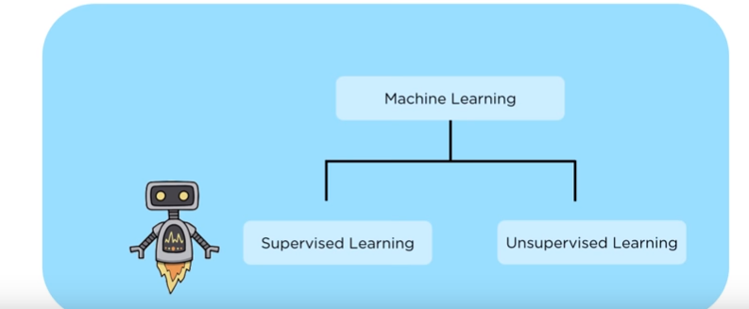

Slide 3
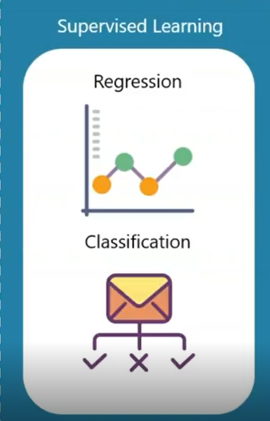
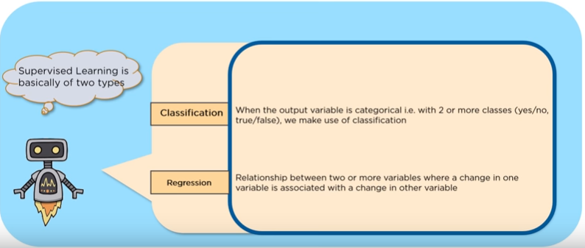

Slide 4
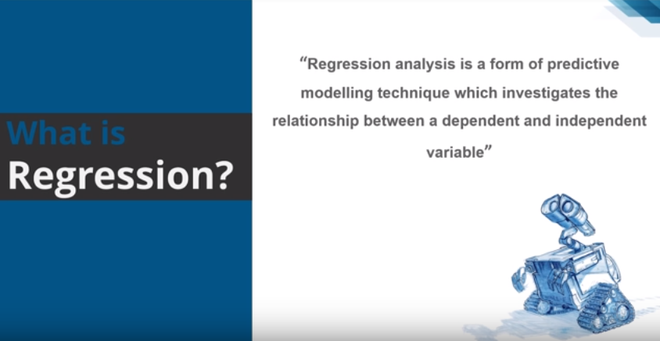

Slide 5
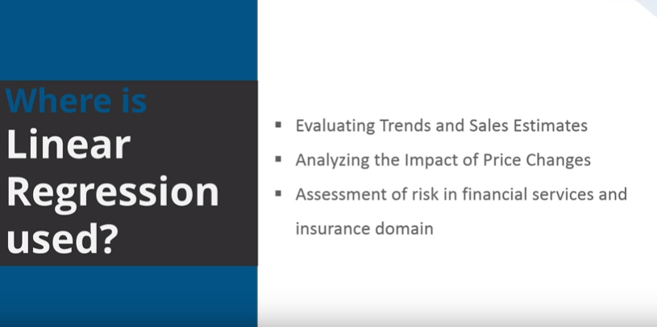

Slide 6
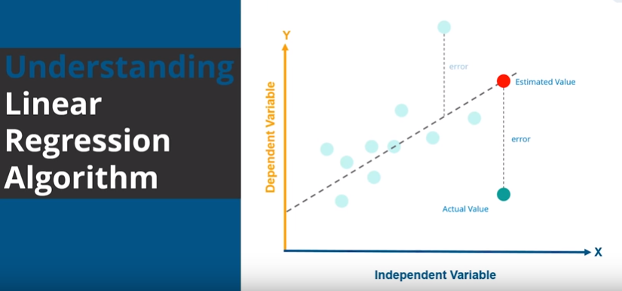

Slide 7
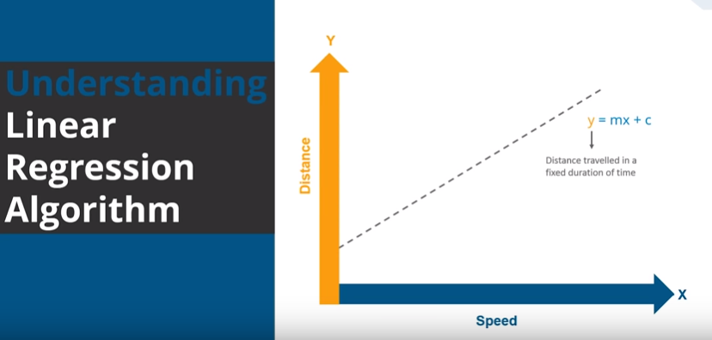
T

Slide 8
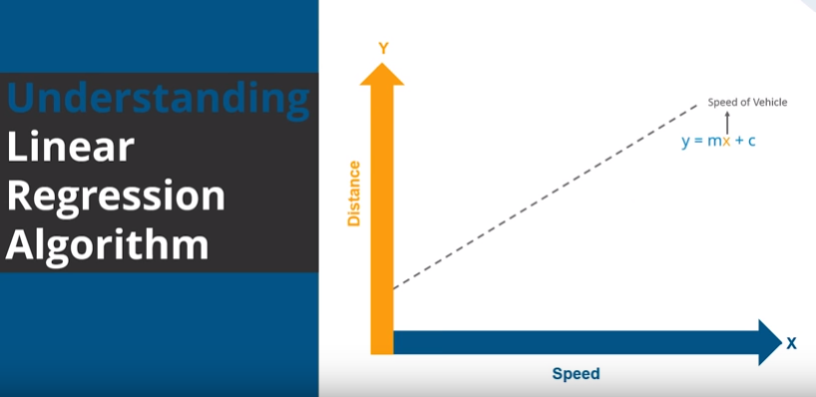

Slide 9
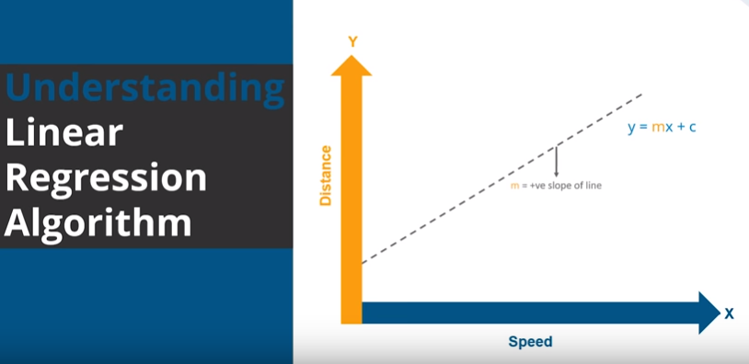

Slide 10
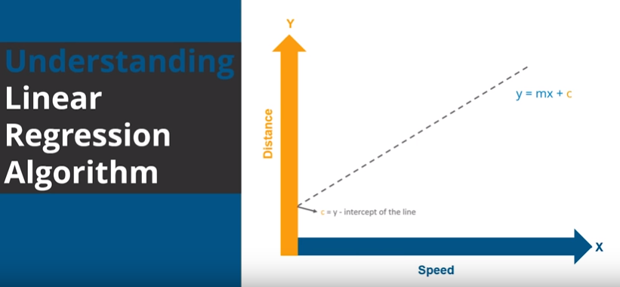

Slide 11
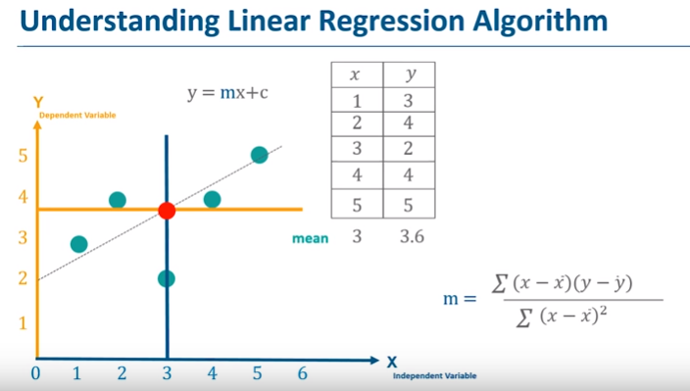

Slide 12
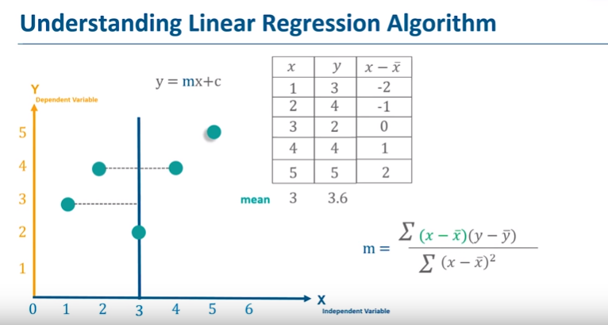

Slide 13
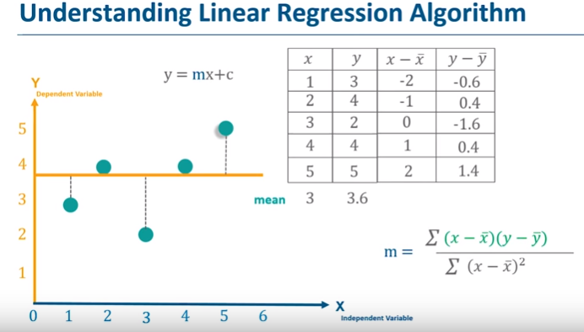

Slide 14
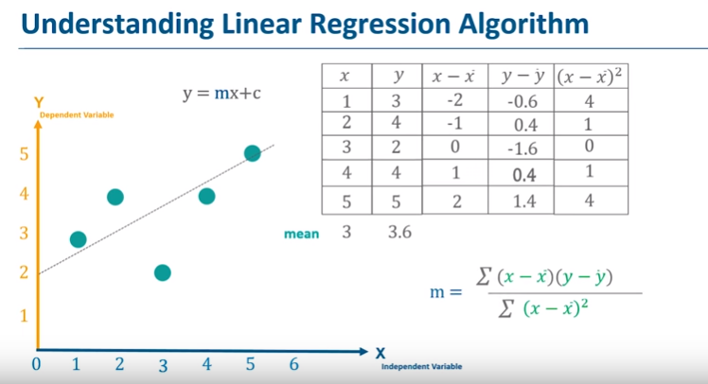

Slide 15
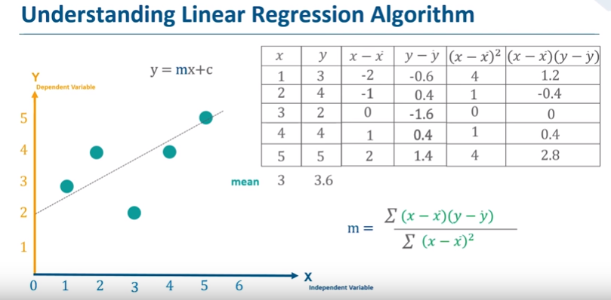

Slide 16
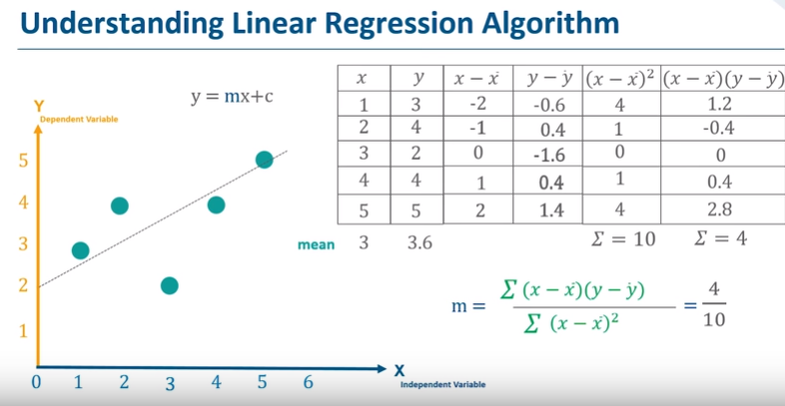

Slide 17
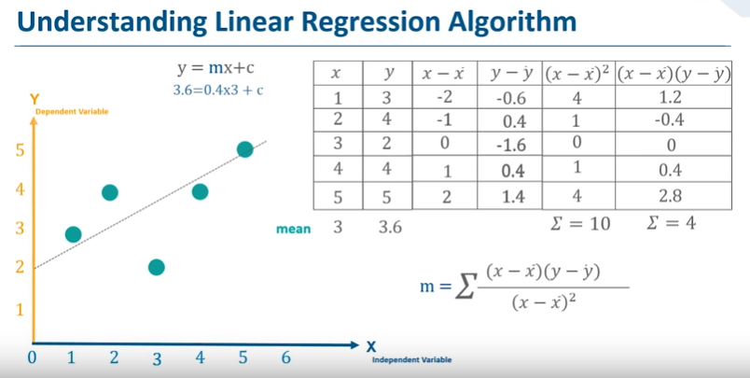

Slide 18
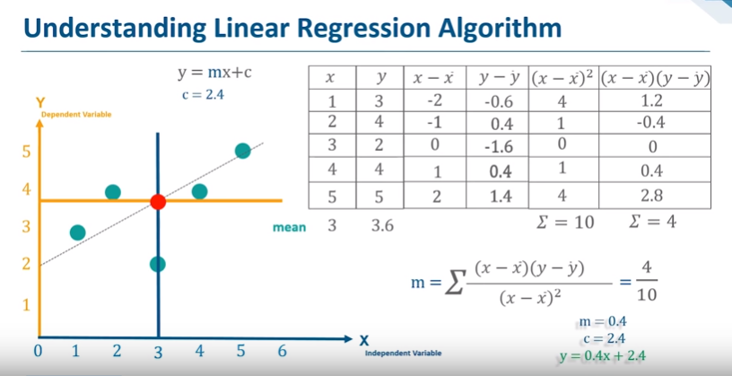

Slide 19
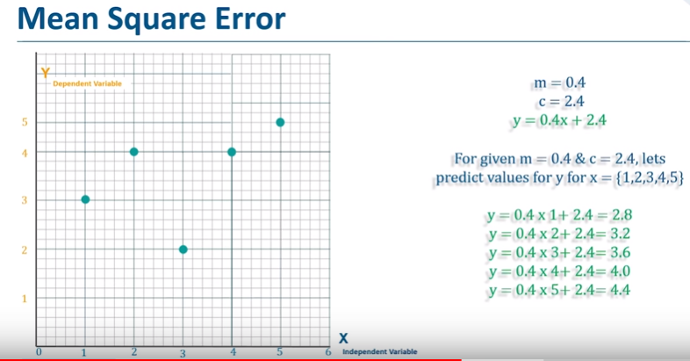

Slide 20
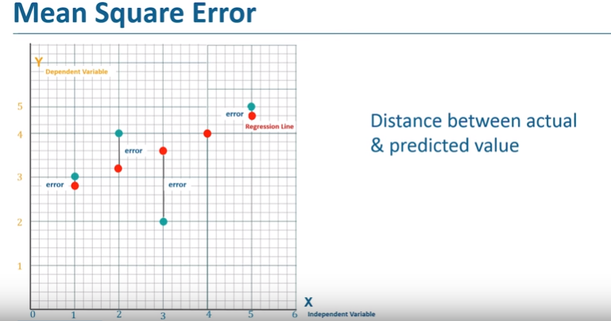

Slide 21


Slide 22
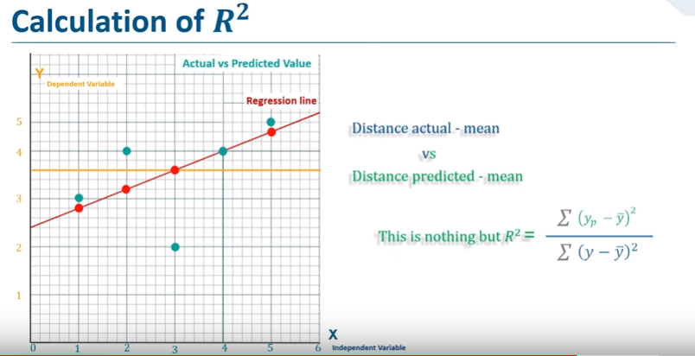

Slide 23
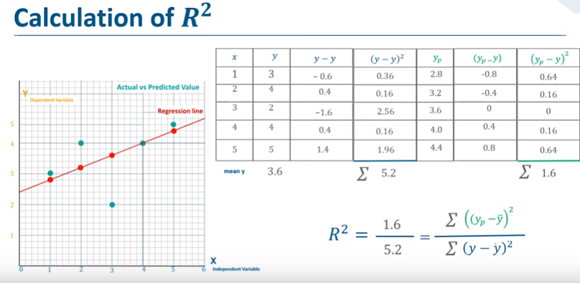

Slide 24
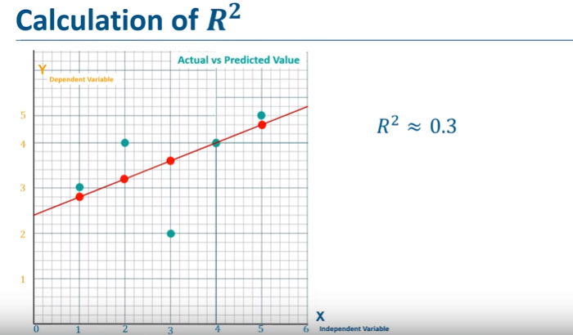

Slide 25
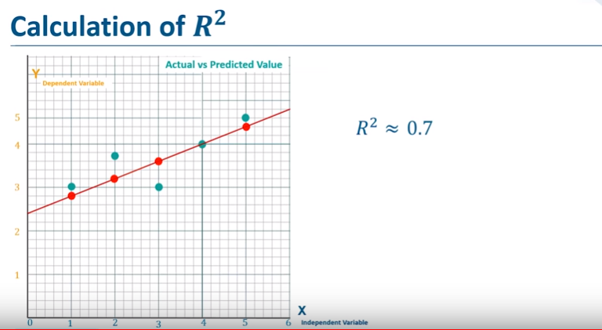
Machine learning

Slide 26
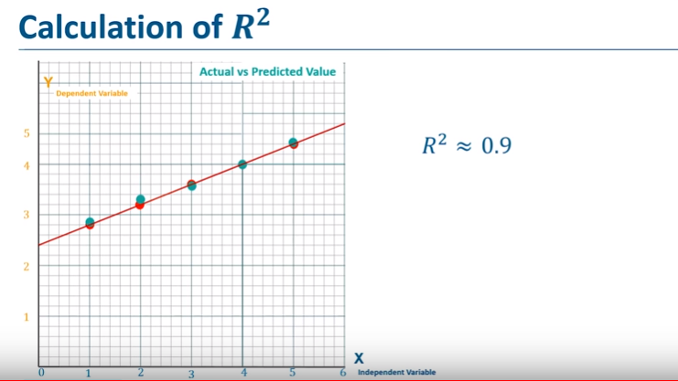

Slide 27
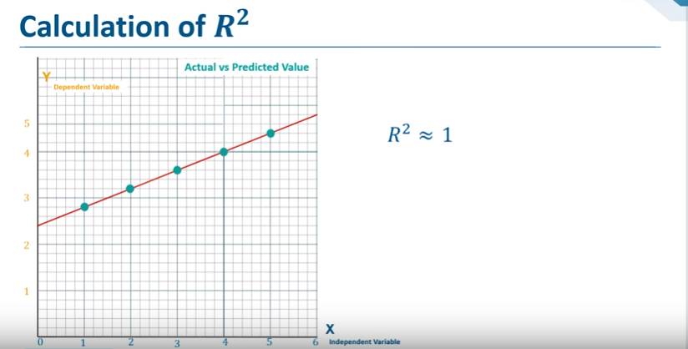
Types Of Machine Learning

Slide 28
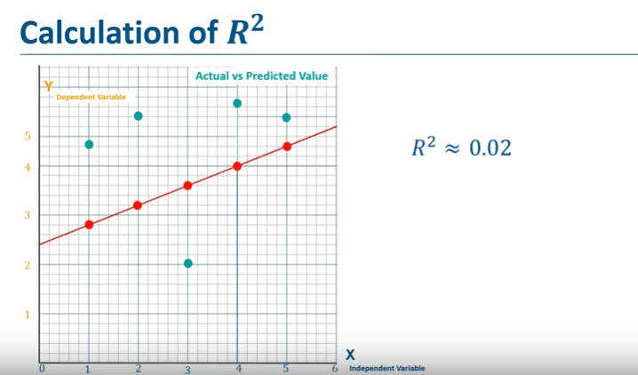

Slide 29
ABOUT US
Our Services:
Meter reading
Meter Accuracy Testing
Data Analytics

Slide 30
ABOUT US
Products:
Common Meter Reading Instrument
Reference Standard Meter
GPS Time Server
DLMS AMR Solutions
Stator Protection Systems
Converters
Multifunction meter
Feeder Remote Terminal Unit (FRTU).

Slide 31

TRAININGS @ SANDS
Industry Tour
Hands-on workshop
Internship/ In-plant Training
Value added Course
Job Assured Training
Final year Projects
Faculty Development Programme
Engineering Services

Slide 32
Thank you
+91 8754546090
training@sandsindia.com
www.sandscerebro.com
More Details

