Slide 1
MACHINE LEARNING WITH PYTHON

Slide 2
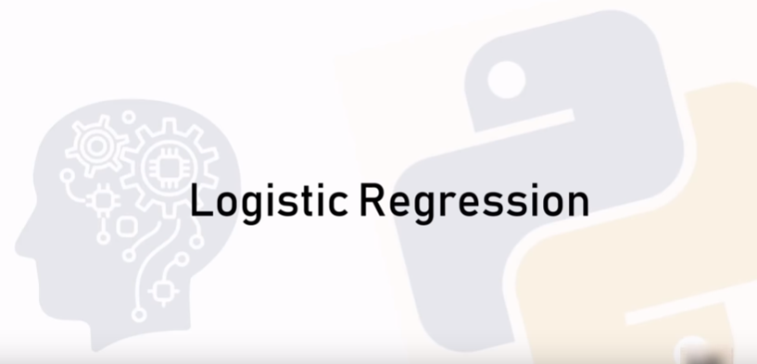

Slide 3
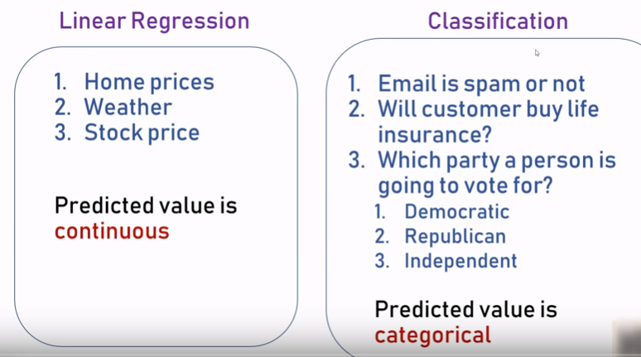

Slide 4
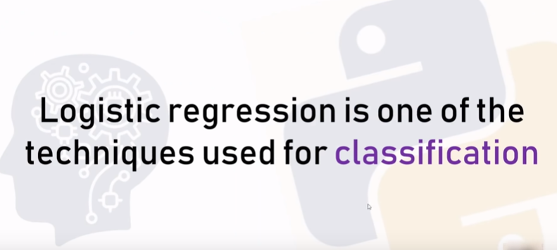

Slide 5
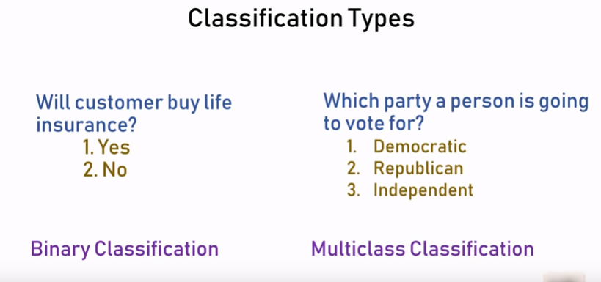

Slide 6
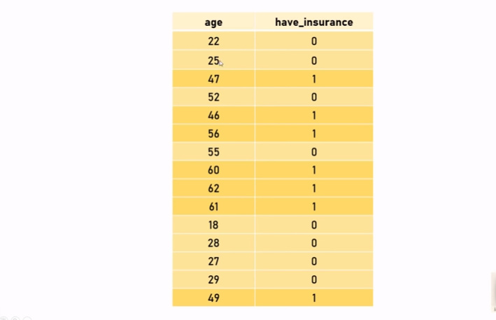

Slide 7
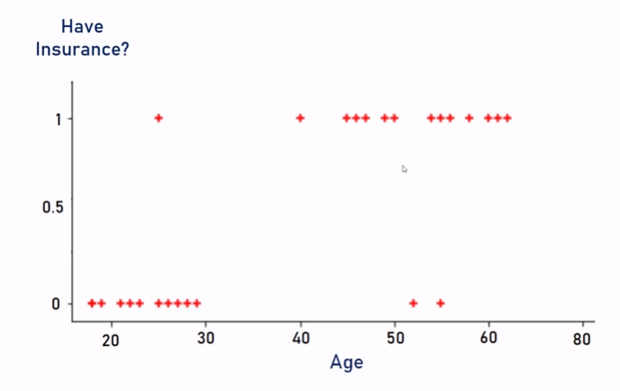

Slide 8
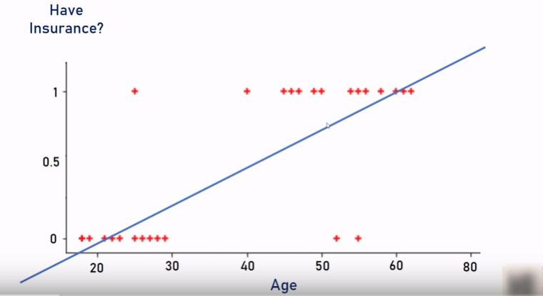
T

Slide 9
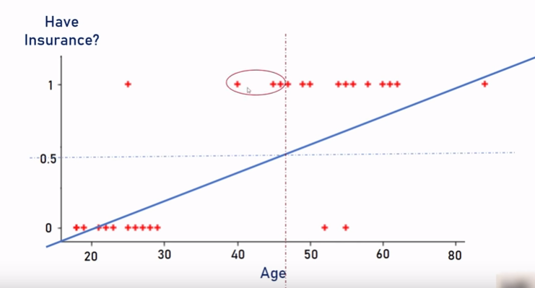

Slide 10
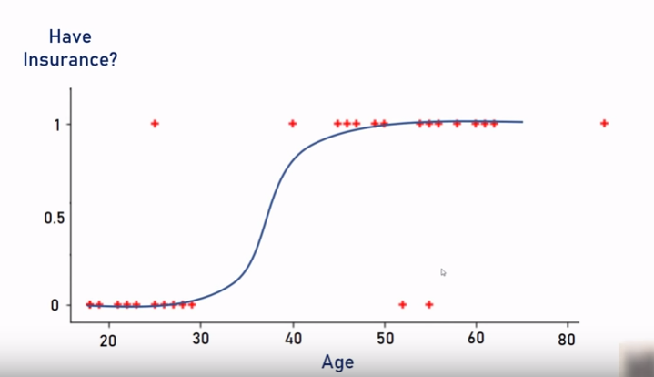

Slide 11
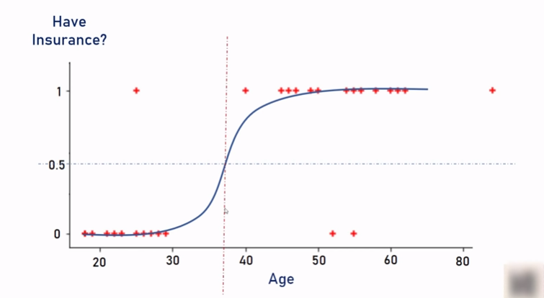

Slide 12
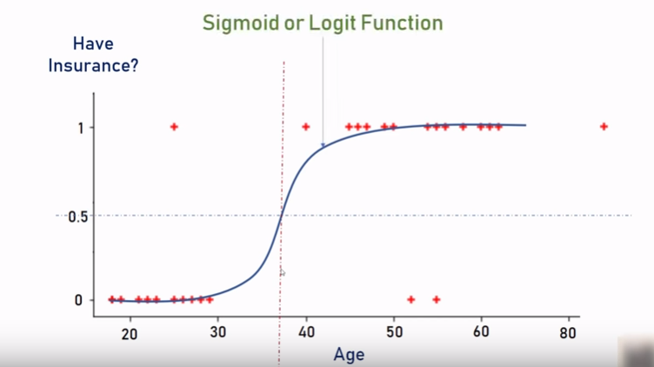

Slide 13
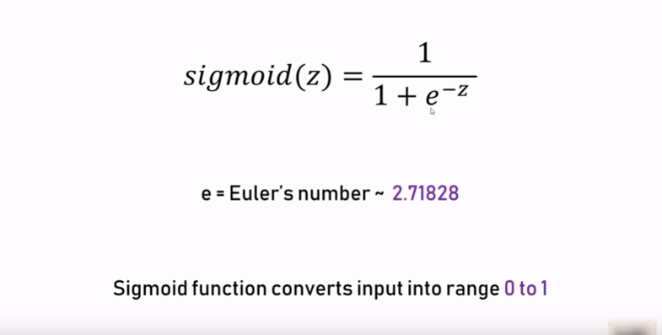

Slide 14
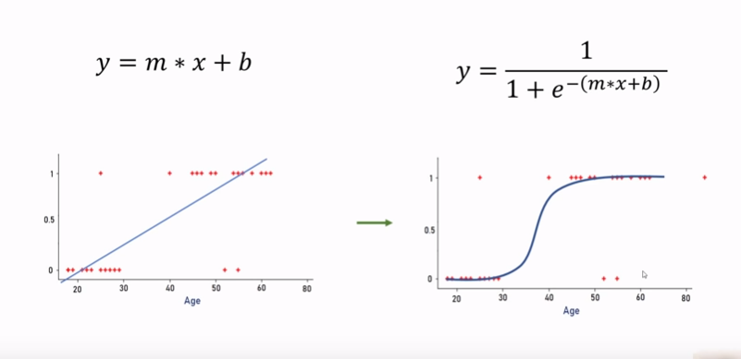

Slide 15
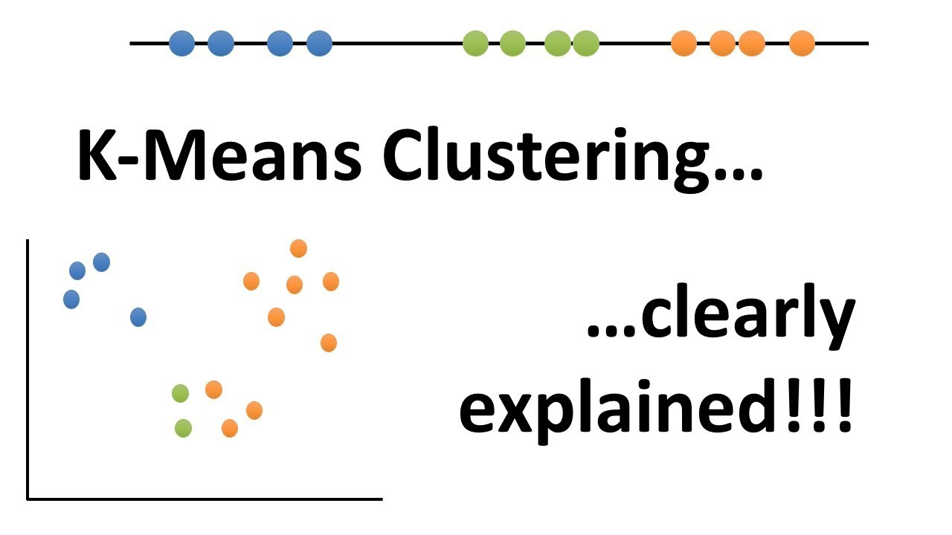

Slide 16
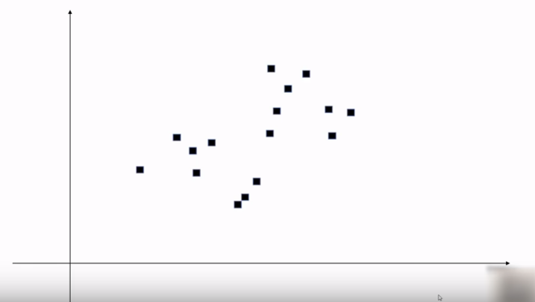

Slide 17
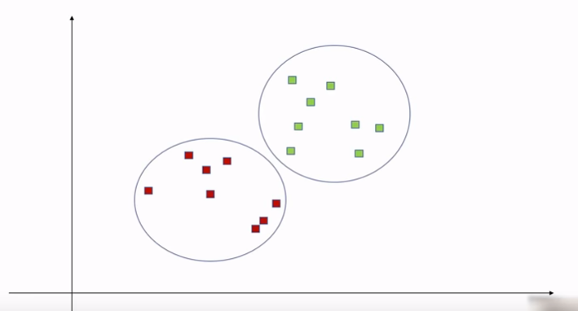

Slide 18
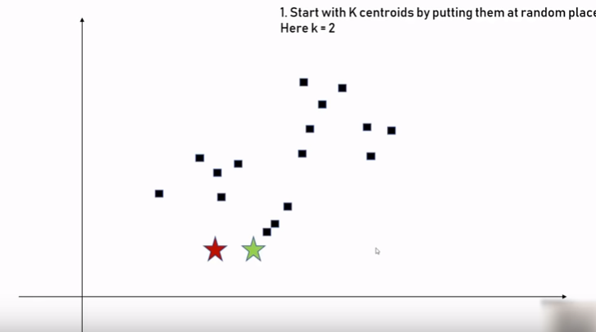

Slide 19
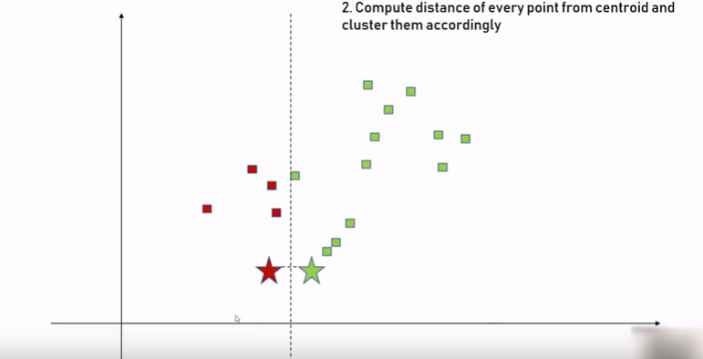

Slide 20
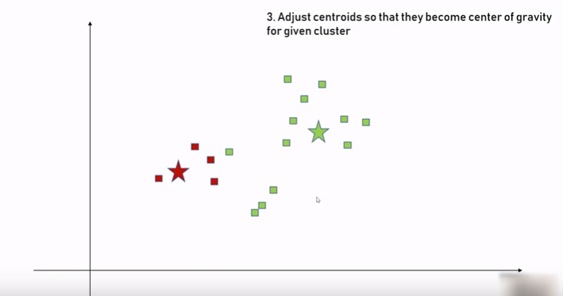

Slide 21
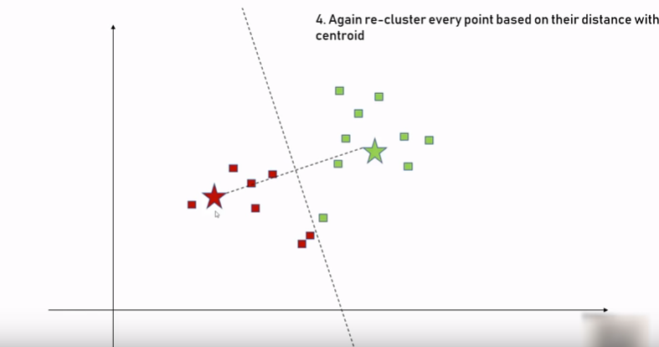

Slide 22
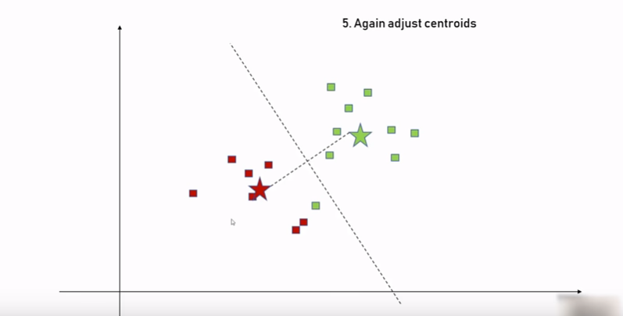

Slide 23
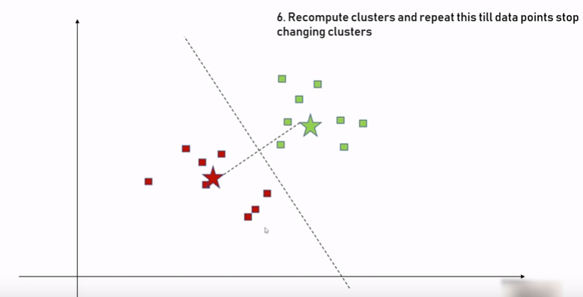

Slide 24
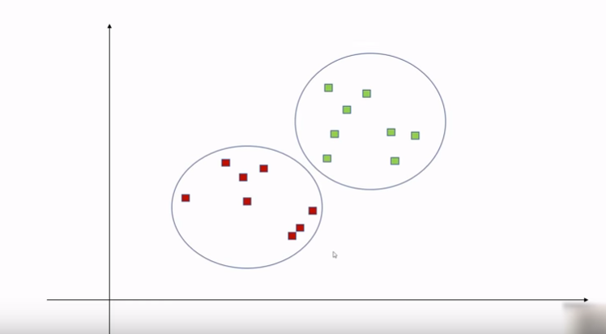

Slide 25
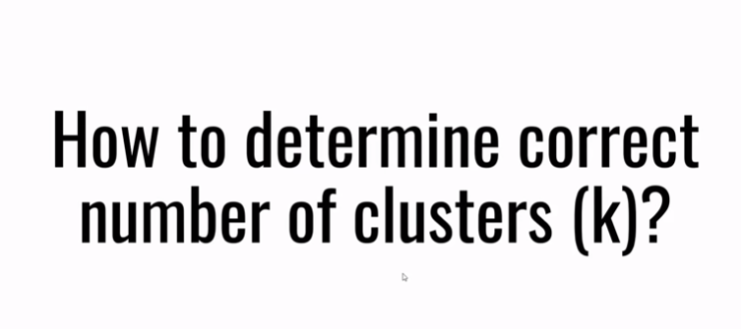

Slide 26
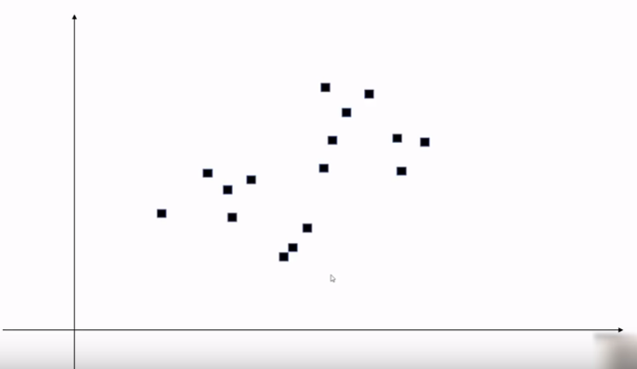
Machine learning

Slide 27
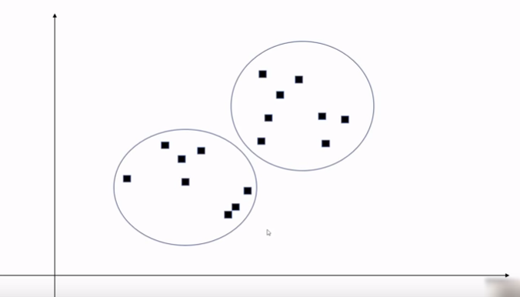

Slide 28
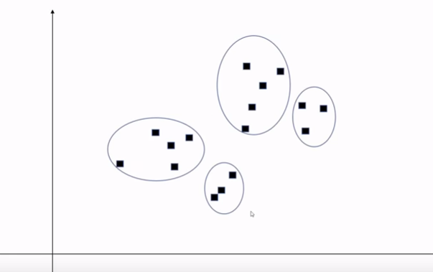
Types Of Machine Learning

Slide 29
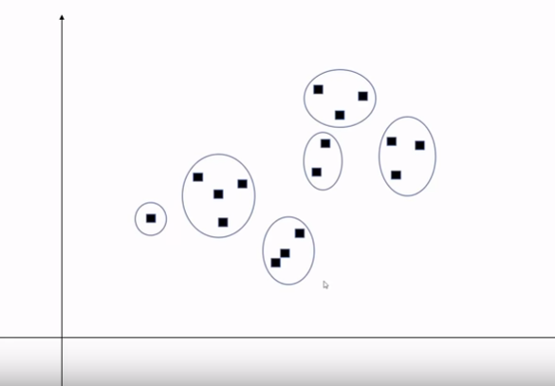

Slide 30
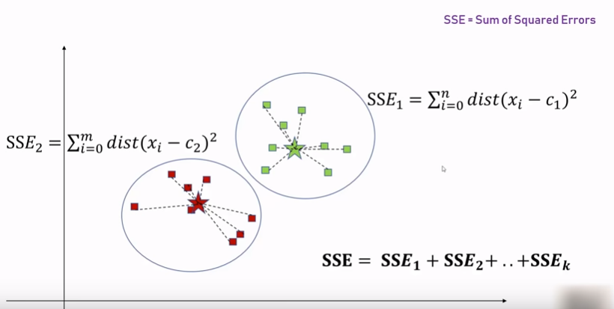

Slide 31
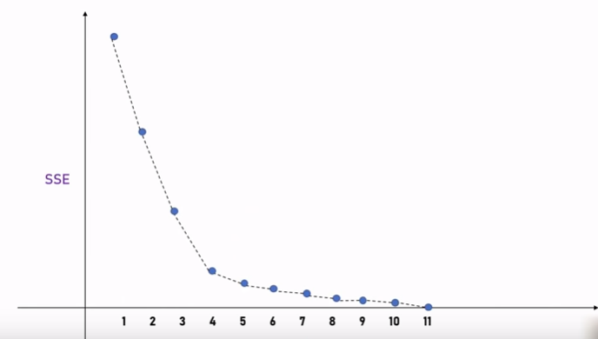

Slide 32
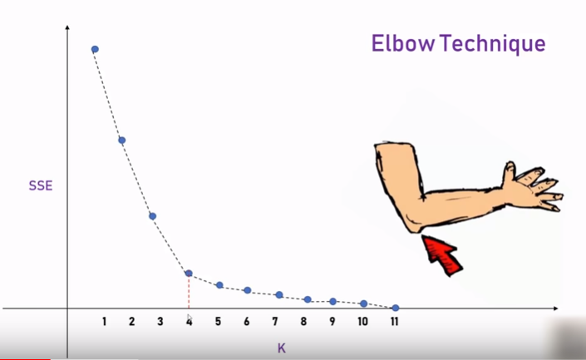
Types of SUPERVSED LEARNING

Slide 33
ABOUT US
Our Services:
Meter reading
Meter Accuracy Testing
Data Analytics

Slide 34
ABOUT US
Products:
Common Meter Reading Instrument
Reference Standard Meter
GPS Time Server
DLMS AMR Solutions
Stator Protection Systems
Converters
Multifunction meter
Feeder Remote Terminal Unit (FRTU).

Slide 35

TRAININGS @ SANDS
Industry Tour
Hands-on workshop
Internship/ In-plant Training
Value added Course
Job Assured Training
Final year Projects
Faculty Development Programme
Engineering Services

Slide 36
Thank you
+91 8754546090
training@sandsindia.com
www.sandscerebro.com
More Details

