Slide 1

Battery Management System(BMS)
Gurram Bhanu Prakash Murugan S Mentored By Dr. Paul Braineard

Slide 2
What is Battery Management System?
A Battery Management System (BMS) is an embedded system designed to monitor, control, and protect a rechargeable battery pack. It ensures safe operation, longevity, and efficiency by managing voltage, current, temperature, and balancing individual cells in a battery pack.
BMS usually includes:
Monitoring the battery.
Providing battery protection.
Estimating the battery’s operational state.
Continually optimizing battery performance.
Reporting operational status to external devices.

Slide 3
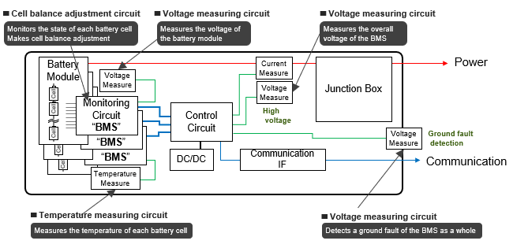
Configuration of the BMS

Slide 4
Monitoring the Battery:- A BMS continuously tracks key parameters to ensure the battery is operating safely and efficiently. It typically monitors:
Voltage of each cell and the overall battery pack.
Current during charging and discharging cycles.
Temperature to prevent overheating or cold damage.
Charge Cycles to track battery aging and usage patterns.
Providing Battery Protection:-The BMS acts as a safety system that protects the battery from harmful conditions, such as:
Overcharging – Prevents charging beyond the safe limit to avoid thermal runaway.
Over-discharging – Stops excessive discharge, which could permanently damage the battery.
Overcurrent & Short Circuit Protection – Detects excessive current and disconnects the load to prevent damage.
Thermal Protection – Shuts down or limits operations if the battery gets too hot or too cold.

Slide 5
Estimating the Battery’s Operational State:- The BMS calculates key battery parameters in real-time using embedded algorithms:
State of Charge (SoC): How much charge is left (%) in the battery.
State of Health (SoH): How much the battery has degraded over time.
State of Power (SoP): The battery’s ability to deliver power at a given moment.
Continually Optimizing Battery Performance:- A BMS improves battery efficiency and lifespan through;
Cell Balancing: Ensuring all cells in a multi-cell battery pack maintain equal charge levels.
Passive Balancing: Uses resistors to drain extra charge from higher-voltage cells.
Active Balancing: Transfers energy between cells for efficient balancing.
Charge Cycle Optimization: Adjusts charging behavior to reduce stress on the battery.

Slide 6
Reporting Operational Status to External Devices:-
The BMS communicates Battery data to external systems, such as:
Electric Vehicles (EVs) → Sends battery status to the vehicle's ECU.
Smart Energy Systems → Connects with IoT devices via I2C, CAN Bus, UART, or Bluetooth.
Power Banks & Laptops → Displays battery level on an LCD or LED indicator.

Slide 7
Configuration of Battery
Here, the term “Battery” implies the entire pack. Battery is assembly of battery cells, electrically organized in a row x column matrix configuration to enable delivery of targeted range of voltage and current for a duration of time against expected load scenarios. There are different types of battery cells based on their shapes. They are:
Cylindrical cells.
Prismatic cells.
Pouch cells.
Tesla,Lucid,Rivian using cylindrical cells for their High power, better cooling features whereas VW,BYD,BMW use prismatic cells because they are Compact, Cost-effective.

Slide 8
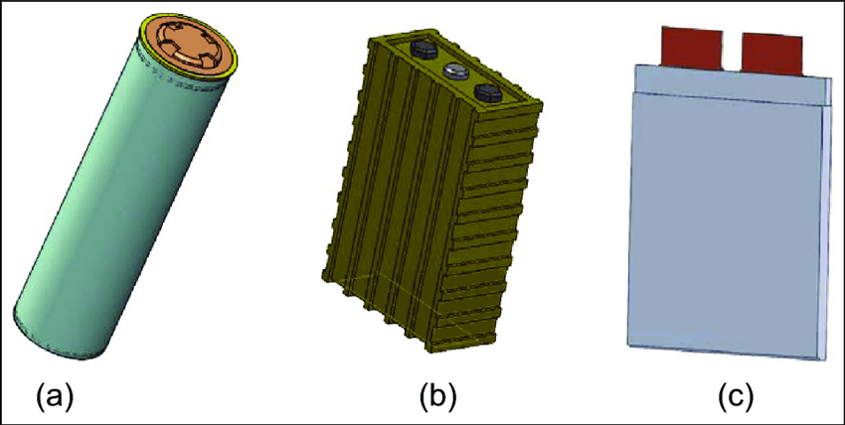
Classification of CELLS
Cylindrical cells.
Prismatic cells.
Pouch cells.

Slide 9
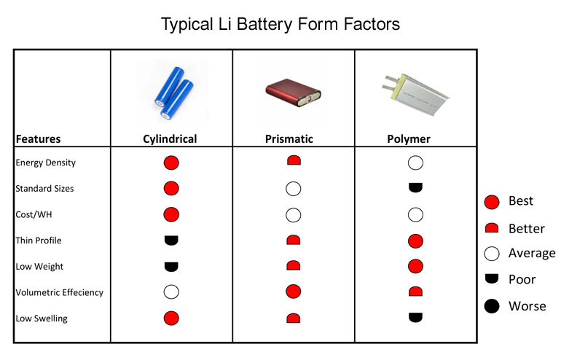

Slide 10
A Battery Management System (BMS) has many critical features, but two of the most essential ones are Battery Pack Protection Management and Capacity Management. Battery pack protection management ensures safe operation and prevents damage to the battery. It consists of two key arenas:
Electrical Protection.
Thermal Protection.
Electrical Management Protection:- Prevents damage caused by overvoltage, undervoltage, overcurrent, and short circuits by ensuring the battery operates within its SOA(Safe Operating Area). It consists of two areas, they are:
Electrical Management Protection: Current:- Monitors battery pack current to prevent unsafe conditions. Overcurrent protection ensures short circuits don’t damage cells. Peak current monitoring allows short-term high current but prevents sustained overuse.
Electrical Management Protection: Voltage:- Keeps battery voltage within SOA for safety and longevity. Prevents overvoltage by reducing or stopping charging near upper limits. Prevents undervoltage by reducing power loads when voltage is low.

Slide 11
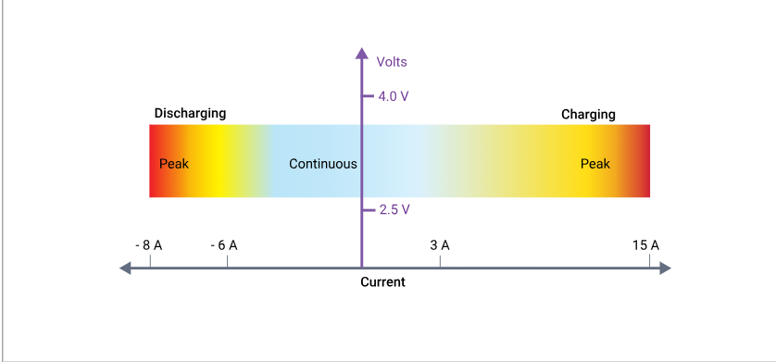
Electrical Management Protection
Safe Operating Area(SOA) of typical Li-ion cell:

Slide 12
Thermal Management Protection: Temperature:-
Temperature Impact on Lithium-Ion Batteries-
Low Temperatures:
Reduces battery capacity as chemical reactions slow down.
Charging below 0°C (32°F) is dangerous due to the risk of lithium plating on the anode, which causes:
Permanent capacity loss
Higher risk of failure under vibration or stress.
High Temperatures:
Reduces battery performance and lifespan.
Example: A 10°C rise (from 20°C to 30°C) can cause up to 20% performance loss.
If charging/discharging occurs at 45°C (113°F), efficiency loss can reach 50%.
Excess heat leads to premature aging and degradation, especially in fast-charging scenarios.

Slide 13
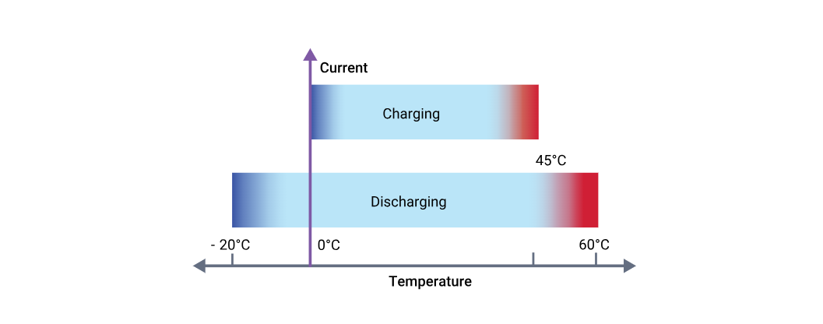
Importance of Thermal Management:-
Prevents capacity loss at low temperatures.
Protects against degradation at high temperatures.
Ensures optimal performance and extends battery lifespan.

Slide 14
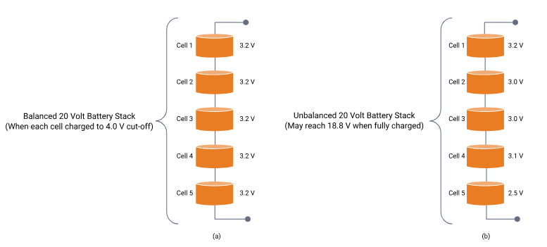
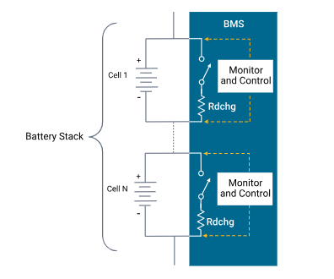
Capacity Management
Impact of Cell Imbalance on Battery Pack
🔹 Unbalanced Pack (a):
Weakest cell limits overall capacity.
Leads to energy loss and inefficiency.
🔹 Balanced Pack (b):
All cells reach limits simultaneously.
Maximizes usable capacity and battery life.
🔹 Key Takeaway: A Battery Management System (BMS) ensures balance, improving efficiency and longevity.

Slide 15
Literature Survey
R. R. Kumar, C. Bharatiraja, K. Udhayakumar, S. Devakirubakaran, K. S. Sekar and L. Mihet-Popa, "Advances in Batteries, Battery Modeling, Battery Management System, Battery Thermal Management, SOC, SOH, and Charge/Discharge Characteristics in EV Applications," in IEEE Access, vol. 11, pp. 105761-105809, 2023, doi: 10.1109/ACCESS.2023.3318121.
M. Brandl et al., "Batteries and battery management systems for electric vehicles," 2012 Design, Automation & Test in Europe Conference & Exhibition (DATE), Dresden, Germany, 2012, pp. 971-976, doi: 10.1109/DATE.2012.6176637.
M. Senthilkumar, K. P. Suresh, T. G. Sekar and C. Pazhanimuthu, "Efficient Battery Monitoring System for E-Vehicles," 2021 7th International Conference on Advanced Computing and Communication Systems (ICACCS), Coimbatore, India, 2021, pp. 833-836, doi: 10.1109/ICACCS51430.2021.9442038.

Slide 16
Summary
A Battery Management System (BMS) is an embedded system that monitors, controls, and protects a rechargeable battery pack to ensure safe operation, longevity, and efficiency. It performs key functions such as:
Monitoring: Tracks voltage, current, temperature, and charge cycles.
Protection: Prevents overcharging, over-discharging, overcurrent, short circuits, and thermal issues.
State Estimation: Calculates State of Charge (SoC), State of Health (SoH), and State of Power (SoP).
Performance Optimization: Uses cell balancing (active and passive) and charge cycle optimization.
Communication: Reports battery data to external systems like EVs, smart energy systems, and portable electronics.
Batteries consist of multiple cells arranged in a matrix configuration, categorized into cylindrical, prismatic, and pouch cells, each with its advantages. The BMS ensures battery safety through electrical protection (voltage, current limits) and thermal management to prevent performance degradation at extreme temperatures.

Slide 17
Conclusion
A well-designed BMS is crucial for maintaining the efficiency, safety, and longevity of battery packs in various applications, including electric vehicles, energy storage systems, and consumer electronics. It optimizes battery performance through monitoring, protection mechanisms, and balancing strategies, ensuring reliable and sustainable energy storage solutions. Proper thermal and electrical management further enhances battery lifespan and prevents critical failures, making BMS an essential component of modern battery technology.

Slide 18
Future Implementation
Fault Detection in the cells of the battery.
Prototype.

Slide 19
Thank You

