Slide 1
Demystifying Microarray Analysis

Slide 2
Table of Contents
01
02
03
04
What is Microarray Analysis
Microarray Analysis Method
Microarray Analysis Example
Takeaways

Slide 3
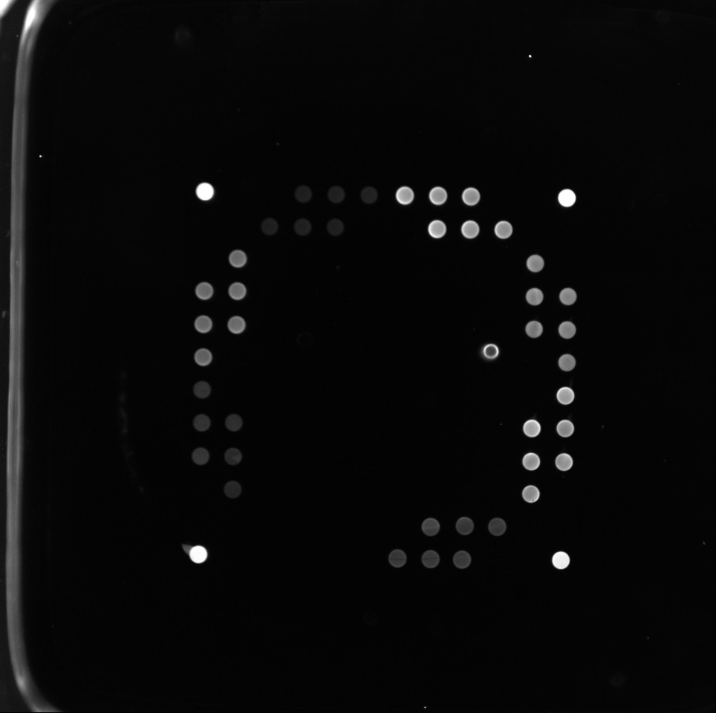
What is Microarray Analysis

Slide 4
Method
Scanning Image
Noise Reduction
Edge Detection
Hough Circle
Intensity Collection
Statistical Analysis

Slide 5
Scanning Image

Slide 6
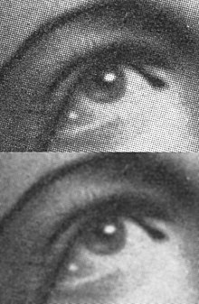
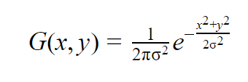
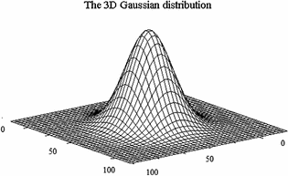
Noise Reduction-Gaussian Filter

Slide 7
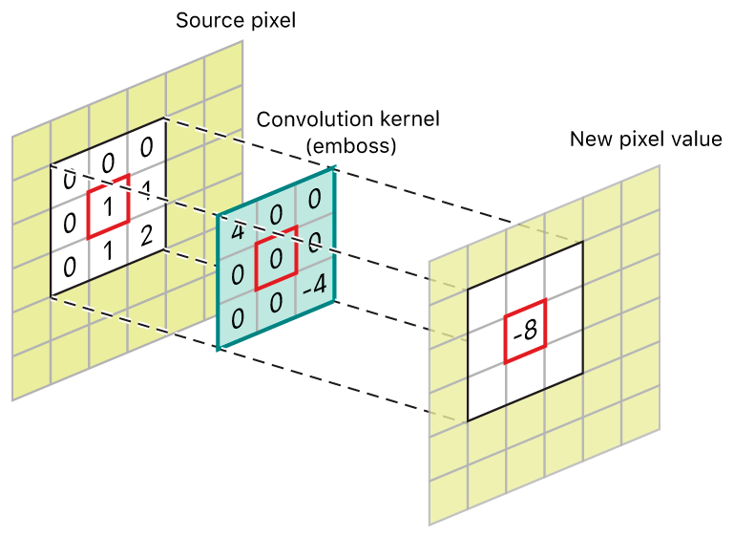
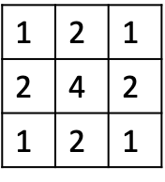
Noise Reduction-Gaussian Filter

Slide 8
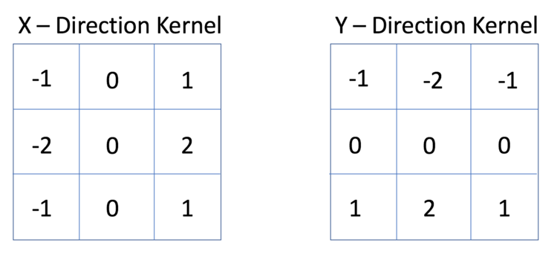
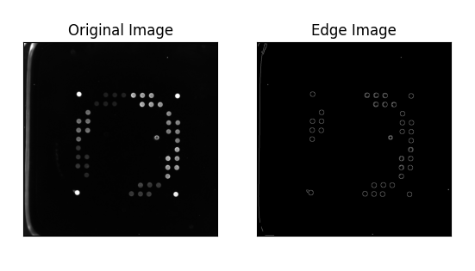
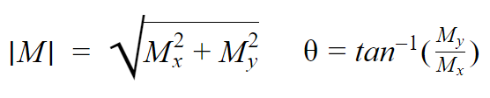
Edge Detection-Sobel Kernel
Notes:
Amplified edges

Slide 9
Method
Scanning Image
Noise Reduction
Edge Detection
Hough Circle
Intensity Collection
Statistical Analysis

Slide 10

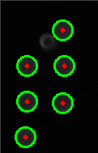
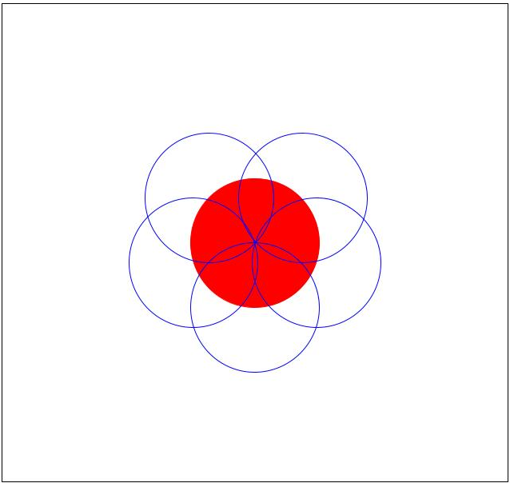
Hough Circle Application

Slide 11

Intensity Collection
Sample number | Intensities of Q1
1 | 104
2 | 103
3 | 104
4 | 101
5 | 103
6 | 97
7 | 96
8 | 95
9 | 93
10 | 97
11 | 104
12 | 101
13 | 105
14 | 100
15 | 104

Slide 12
Statistical Analysis
Sample use case:
Determining whether the observed reaction belongs in a known family of reactions.
Example:
Antibody level is comparable to the levels in patients who have had a Covid infection.

Slide 13
Method
Scanning Image
Noise Reduction
Edge Detection
Hough Circle
Intensity Collection
Statistical Analysis

Slide 14
Next Steps
Future Goals
Potential Research
Integrate individual scripts into one unified application
Broadening the use case beyond antibody testing
Develop a graphical user interface

