Slide 1
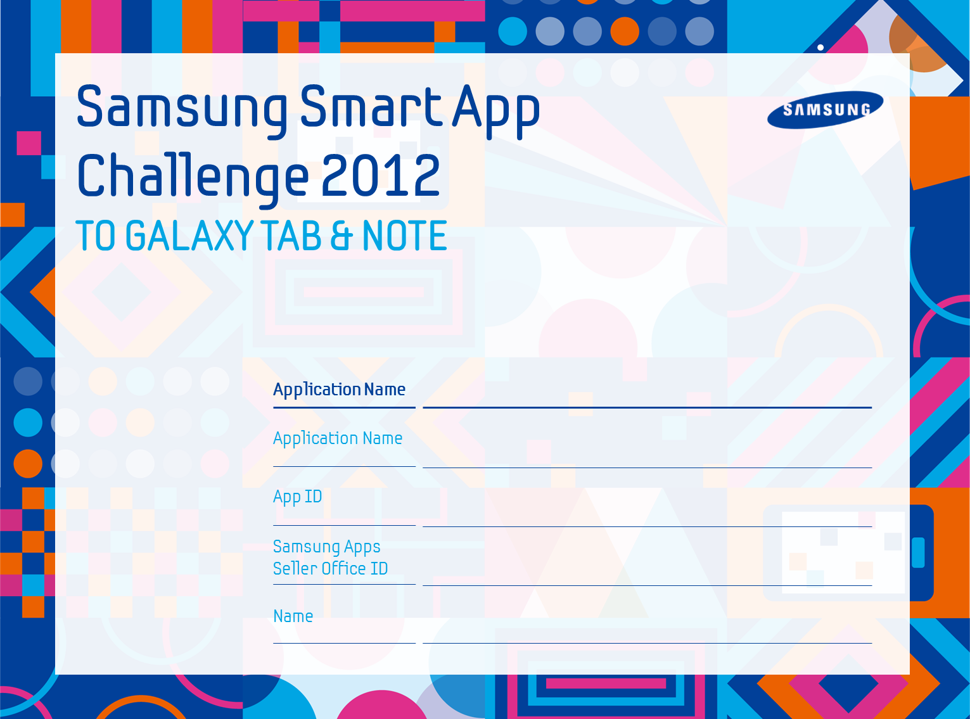
Bees
com.bees
m.bhantooa@btinternet.com
Destiny Technologies

Slide 2
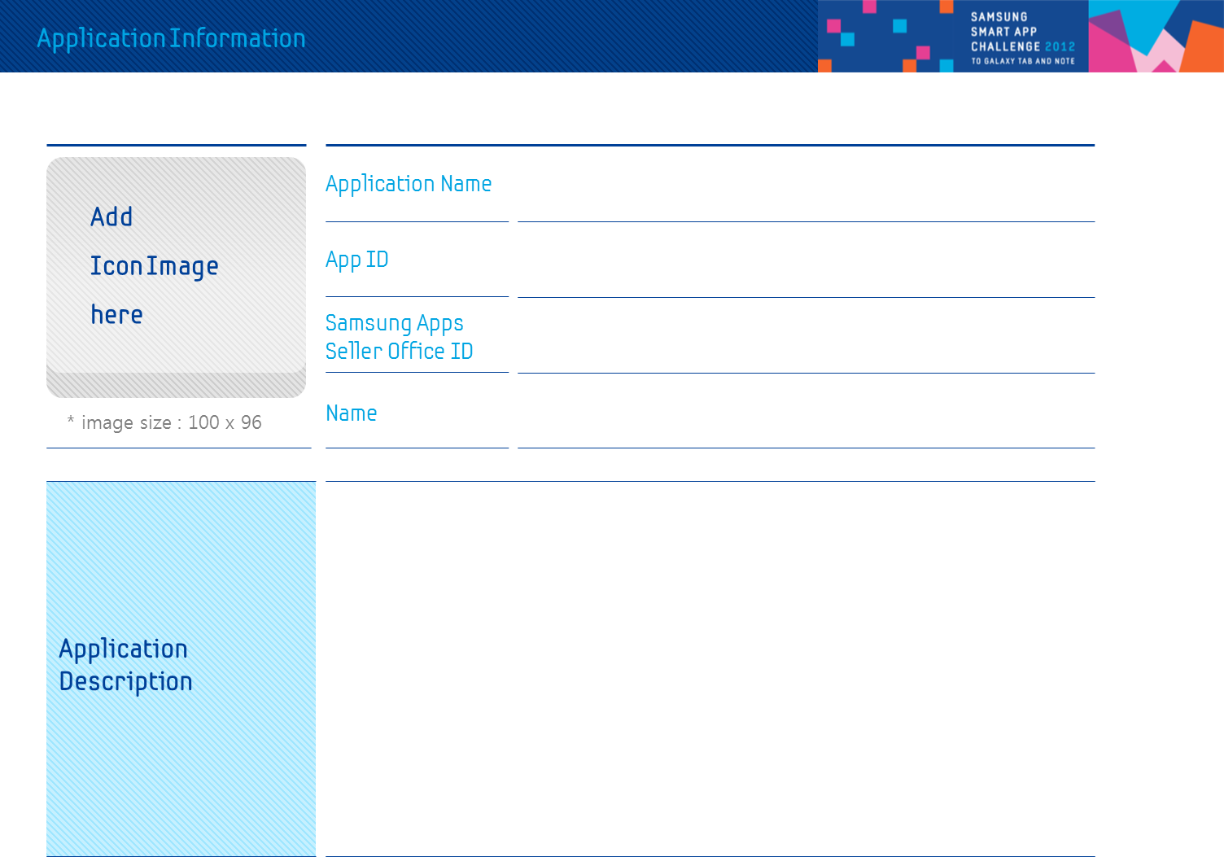

Bees
com.bees
m.bhantooa@btinternet.com
Destiny Technologies
Bees is a location aware application that locates a user and tells him what events are happening around him. Event are fetched from the industry leader Eventful. The user’s geolocation and other search filters are applied and a rich set of events are pulled back. Those events are then precisely laid on a map which form part of the application’s home screen. To get more information about a certain event the user can simply tap an event and go to the list screen. There he can add the event to the device’s calendar, share the event using share intents or make a door to door journey to the event’s location.
To narrow down searches that are relevant to a user he can edit the search filters on the list screen. Filters include date, category, sorting algorithm and proximity radius of search. Events returned are usually in hundreds and as such all results are paginated in batches of 30. The user can navigate to the next page by using the download more button.

Slide 3
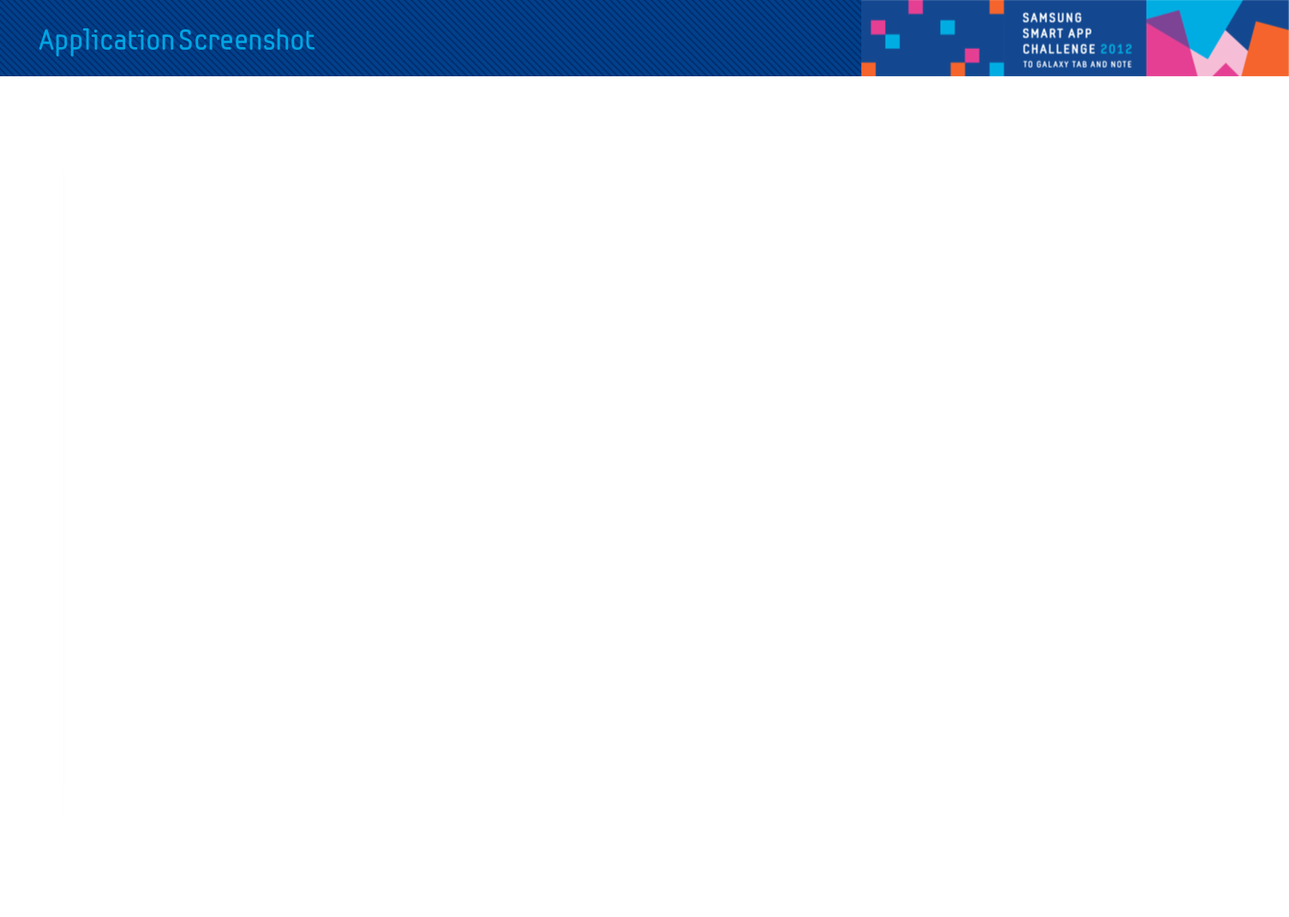
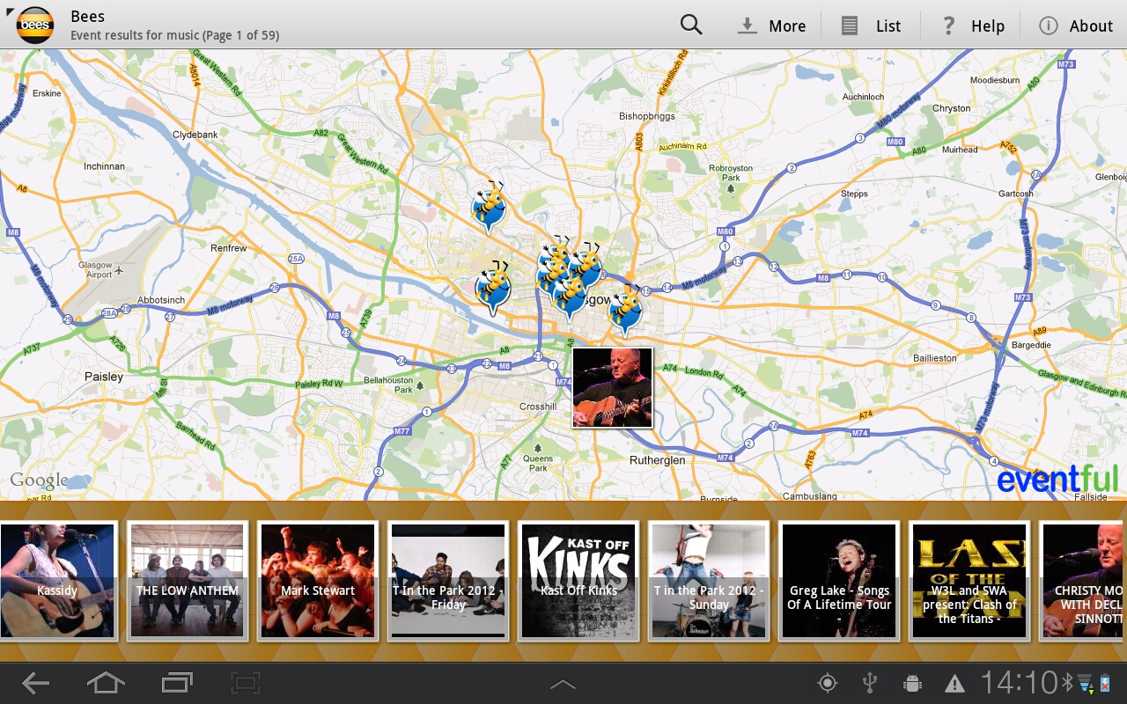
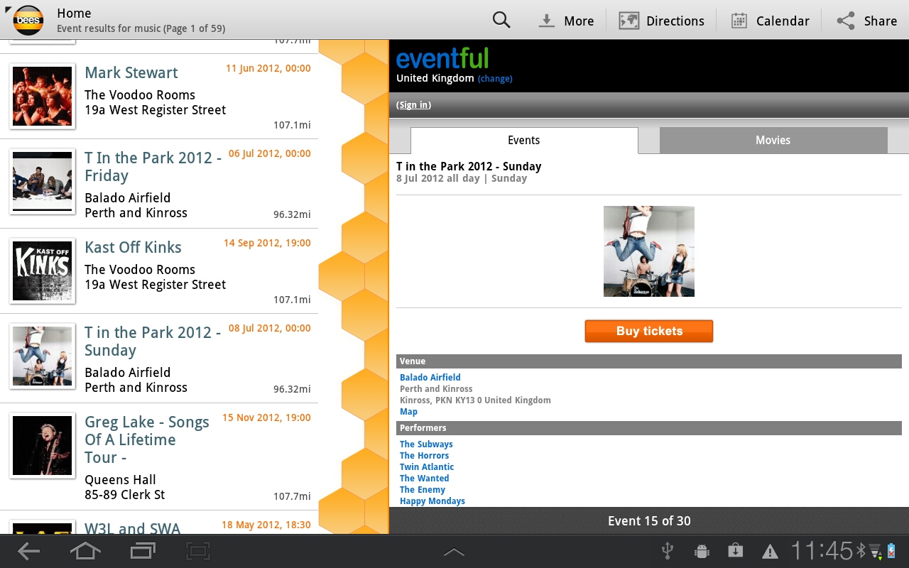
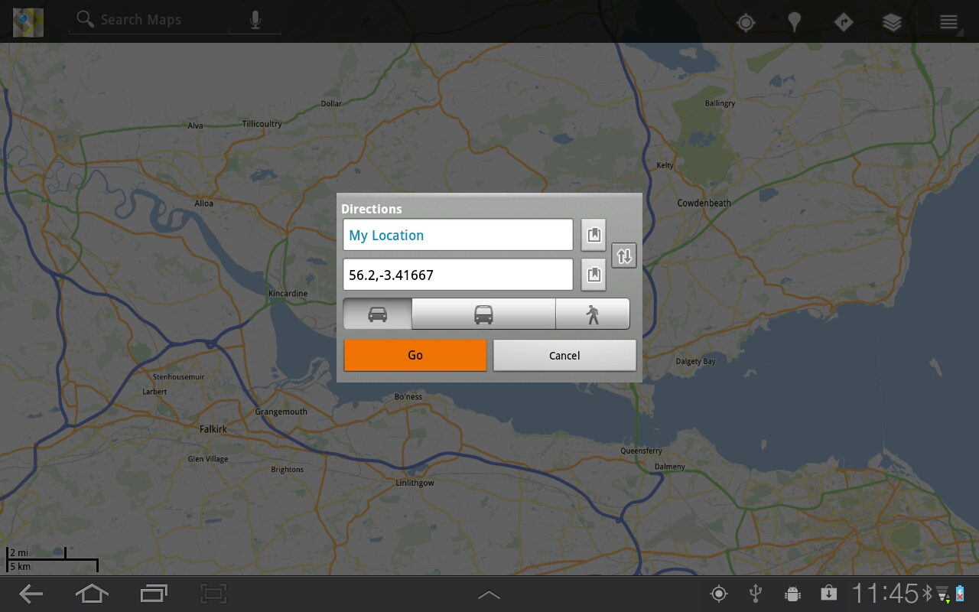
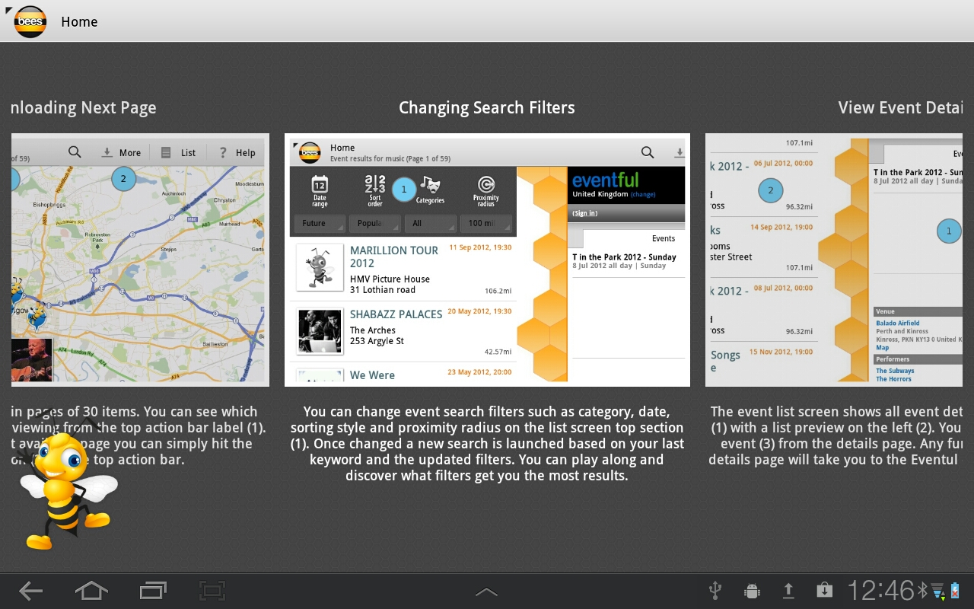

Slide 4
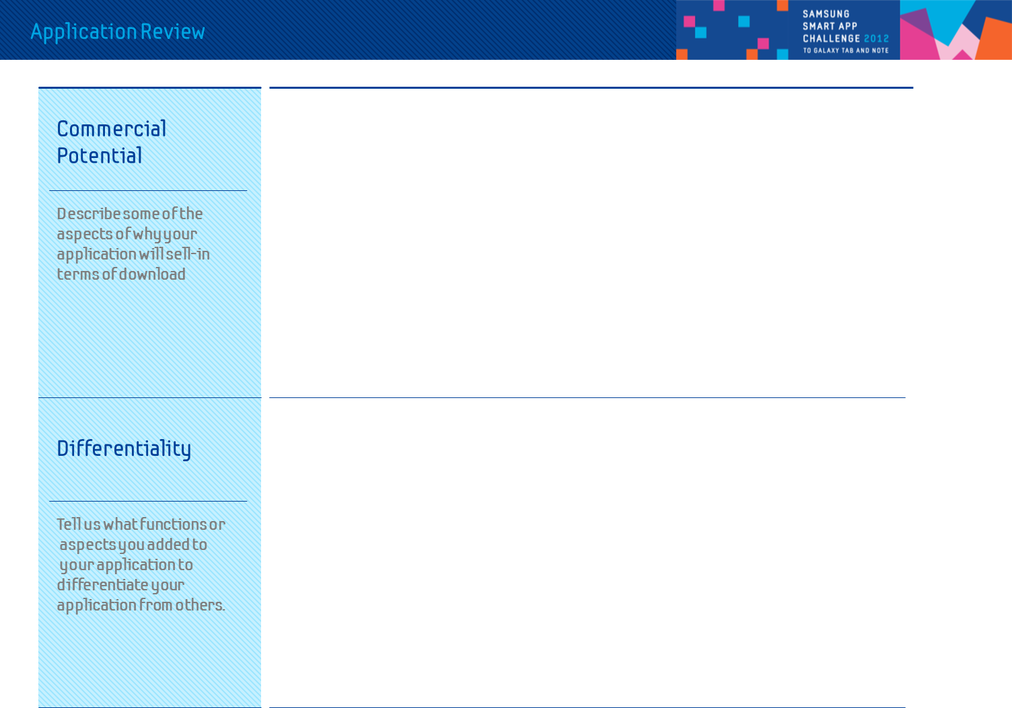
Application gives relevant event information to the user. Being location aware it can quickly pull out events that affects the immediate vicinity of the user. Bees is fun and easy to use. The events data is rich and complete as opposed to other event providers. The map view brings all the events into context and the user gets a bird’s eye view of everything interesting happening around him. Eventful data covers the whole of Europe and America and as such the target market for the application sales is huge.
Bees is one of it’s kind in the tablet applications. It is precise, targeted and easy to use. The user has an array of options to play around with events such as saving, sharing and navigating to.
Differentiality

Slide 5
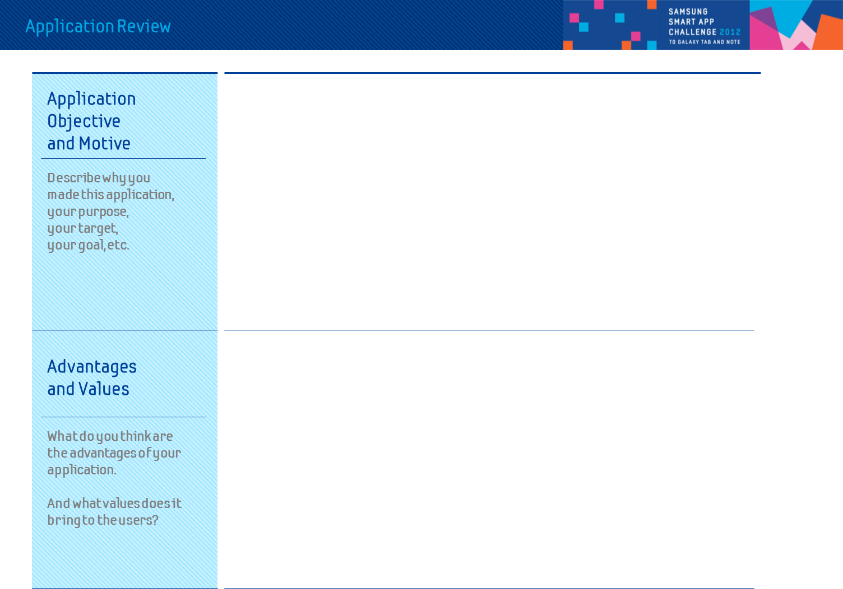
Application Objective and Motive
Advantages and Values

Slide 6
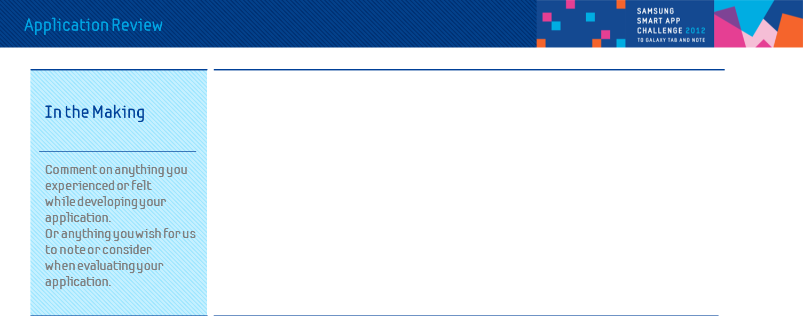
In the Making

Slide 7
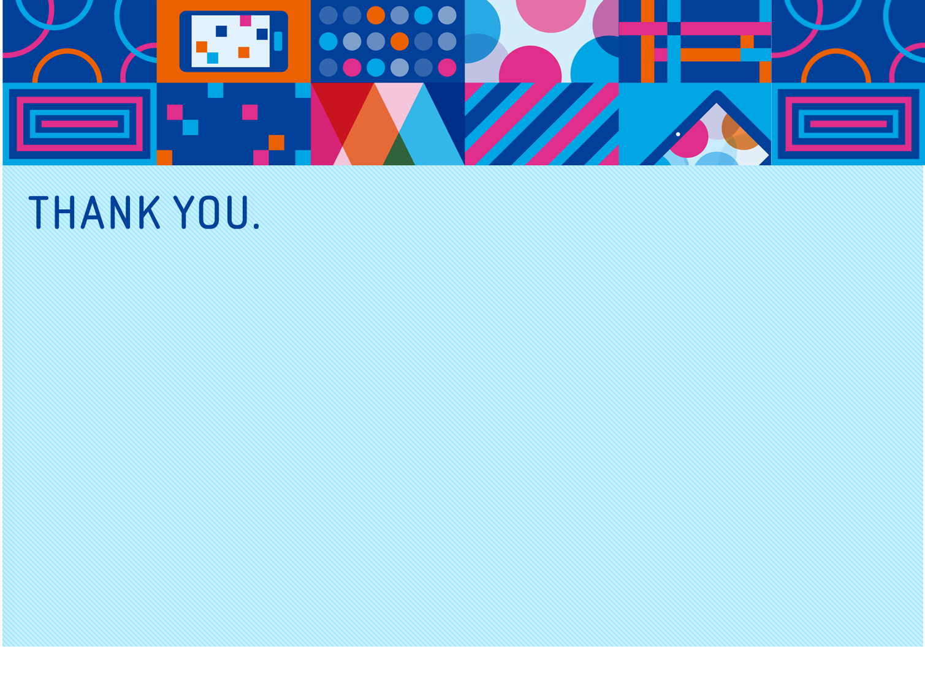
Notes:
This is all I have today.
Samsung Apps cannot guarantee you that we will help you to become suddenly profitable, but we can guarantee you that we will support you to make you to be a global player with our marketing support.
Samsung Apps is of a new gateway to the globe and we want to build up the long-term relationship with sellers, so we promise that once developers decide to be Samsung Apps sellers, we will do our best to brighten our sellers! Yes, We Can!!!
Thank you.

