Slide 1


Application Name | inBloom (Java App)
Category | Utilities & Productivity
Author | Murvin Bhantooa
Location | Falkirk, United Kingdom
Application Description | inBloom is a Java application specially ported for the Asha Competition organised by Nokia. It is a multi-lingual theme-able application that helps women and girls through their menstrual cycle. It’s original touch and type version has already attracted over 30 000 downloads on the Nokia market place. It comes with a smart colour coded calendar that gives a quick glance of the current cycle’s fertile days, ovulation day and period days. With the calculation based on the user’s own settings inBloom modifies it’s view to be precise and relevant to the user’s physiological attributes. Physical and emotional entries can be made for each calendar day and all information are stored for future references and chart plotting. With it’s subtle name, effectiveness and appealing themes inBloom is the perfect helper and confidant for women.

Slide 2
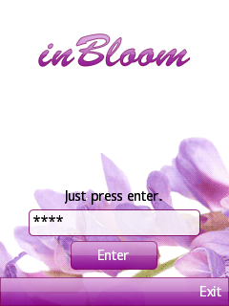
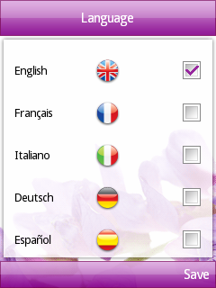
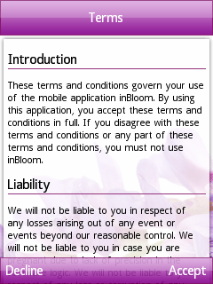
inBloom starts
inBloom starts up by presenting the user with a login screen. If it is a first launch or the user has not reset the default password in settings any password or none will work when enter is pressed. On first launch the user can then select her favorite language and then only the terms and conditions screen is shown. When those terms are accepted the user is finally taken to the application’s main screen.

Slide 3
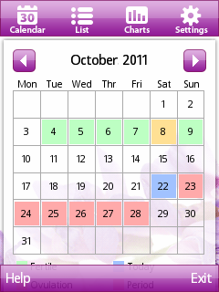
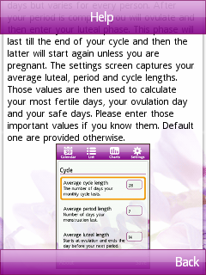
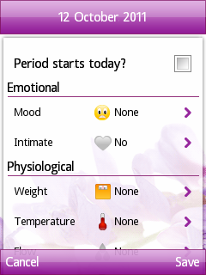
inBloom tabbed screens
The main starting screen is the calendar screen. The different cycle stages are colour coded with green days being fertile days, red ones when the user is having her period and the yellow one is the ovulation day. Those days are initially calculated by assuming the current day being the user’s first day of her cycle. All values required for those calculations can of course be edited in the settings screen. The left option shows up the help screens so the user can get more accustomed to the whole design and purpose of inBloom. Selecting a day brings up the entry screen.

Slide 4
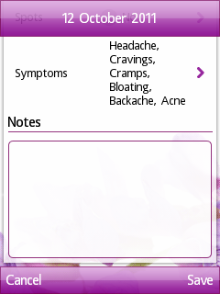
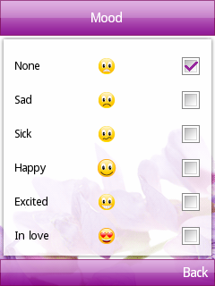
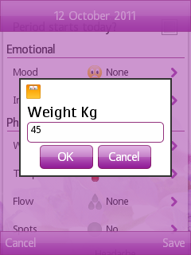
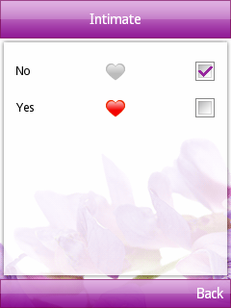
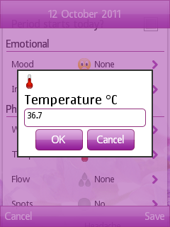
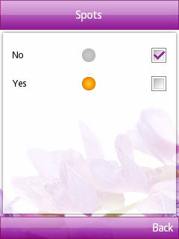
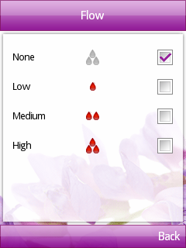
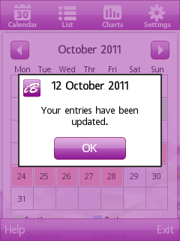
Multiple entries supported
The entry screen is the place where the user can enter all her essential attributes for the day. She can reset her cycle calculations by selecting the top checkbox. This screen holds elements for weight, temperature, symptoms, mood, intimacy, spotting and flow level. After all wanted elements are entered the user can save all by selection the save option.

Slide 5
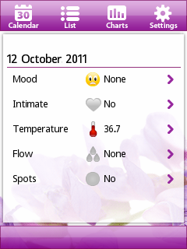
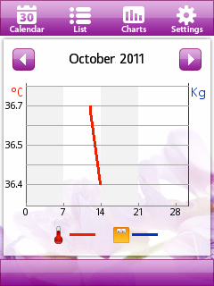
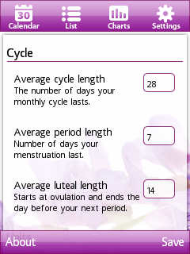
Other tabbed screens
inBloom offers 3 other tabs aside the calendar screen. The list tab shows all the entries ever made by the user on a list. Entries are separated by dates. The charts screen plots the entered weight and temperature for every month and the settings screen allows the user to reset cycle variables such as cycle length, period length and luteal length. Weight and temperature units can also be altered. The user can also change the language or inBloom’s theme.

Slide 6
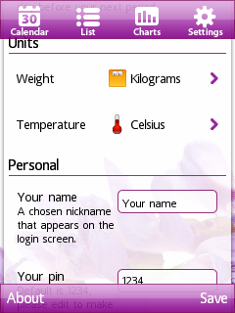
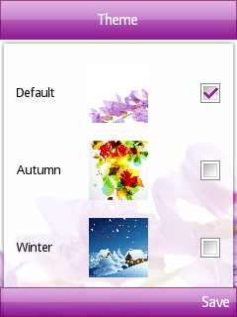
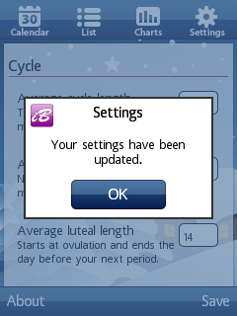
Themes
inBloom comes built in with 3 different themes, the default, autumn and winter theme. The user can change the look and feel of her application at any time. All colour and images are changed to match the selected theme. After all settings are set the save option stores the changes permanently.

Slide 7
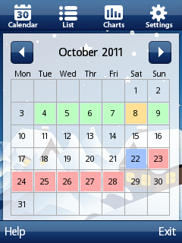
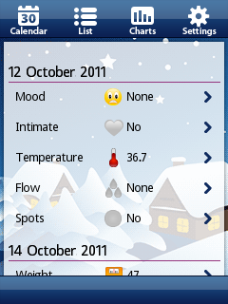
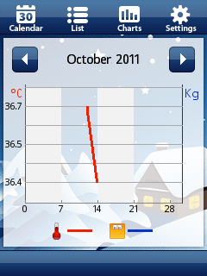
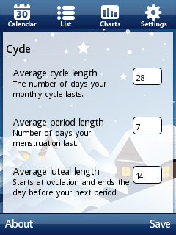
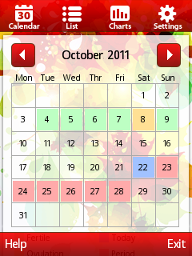
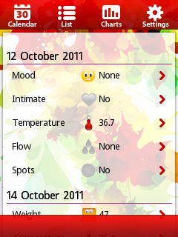
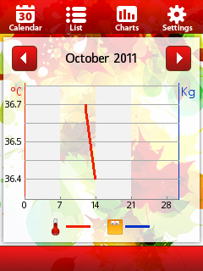
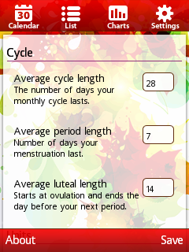
Themes
inBloom comes built in with 3 different themes, the default, autumn and winter theme. The user can change the look and feel of her application at any time. All colour and images are changed to match the selected theme. After all settings are set the save option stores the changes permanently.

Slide 8
inBloom is built for?
Application Objective and Motive | Allow easy capture of daily menstruation related physical and emotional symptoms. Allow later viewing and editing of entered values so they can be corrected if required. View a quick and easy visualisation of the current cycle’s phase and forecasted fertile, period and ovulation days. Calculate and forecast all future cycle dates based on entered cycle start and settings configuration values. Allow physical entries such as weight and temperature to be plotted against calendar days for a given month so the general trend and progression can be clearly analysed. Allow user to edit all menstrual attributes such as cycle length, luteal length and period length. Those values vary for every individual and sometimes also vary over time. Support multiple languages so that users downloading from other countries do not have to translate to understand how the application functions and how beneficial it is. Allow the application to be theme-able with multiple themes built in. Those themes can be changed as per the user’s mood. This ensures the application always looks fresh and dynamic.

Slide 9
And then..
Future enhancements | In-Bloom.co.uk/forum is an online forum where women can share and discuss everything related to period and menstruation. The next release would be to have the forum as a screen in the application itself. Then a registered user will be able to view all her threads and interact with the online forum on the go with inBloom. Many more themes! inBloom currently supports 3 themes. The default, autumn and winter one. A lot more themes will be added to this list to make the application even more attractive. inBloom already supports five languages (English, French, Italian, German and Spanish). More language packs will be added such as Hindi and Chinese so that those markets can also be targeted. More charts! inBloom currently supports the plotting of weight and temperature. The next release will also have many more attributes, both physical and emotional, that can be plotted against calendar days. A professional web site that reflects the quality and attention to detail that inBloom possesses. The site would also be a link to the forum.

