Slide 1
NETWORK SNIFFER
Muhammad Ismail Ramzan (20i-0941)
Muhammad Usman Shahid (20i-1797)
Musaab Imran (20i-1794)

Slide 2
Contents
Introduction
Motivation
Demo
Network sniffing
Filters
Attack detection
Security analysis

Slide 3
1.INTRODUCTION

Slide 4
Initial Approach:
Making of proxy server
Using as MITM
Reasons for not opting
Using SCAPY library

Slide 5
2.MOTIVATION

Slide 6
3.DEMO

Slide 7
4.NETWORK SNIFFING

Slide 8
4. NETWORK SNIFFING
HTTP request
HTTP response
Protocols

Slide 9
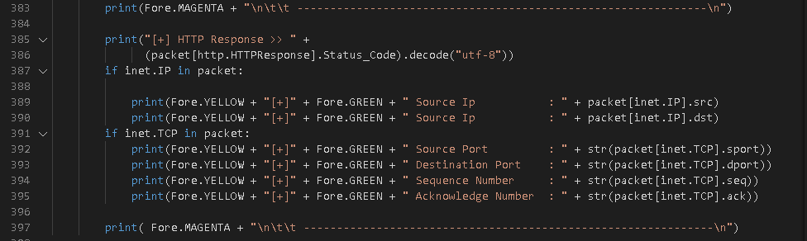
HTTP REQUEST

Slide 10
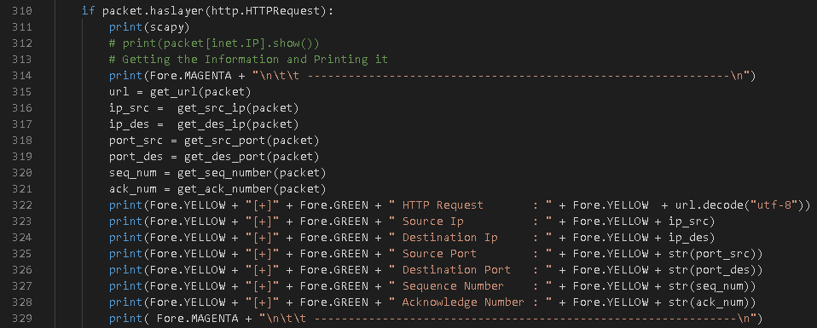
HTTP RESPONSE

Slide 11
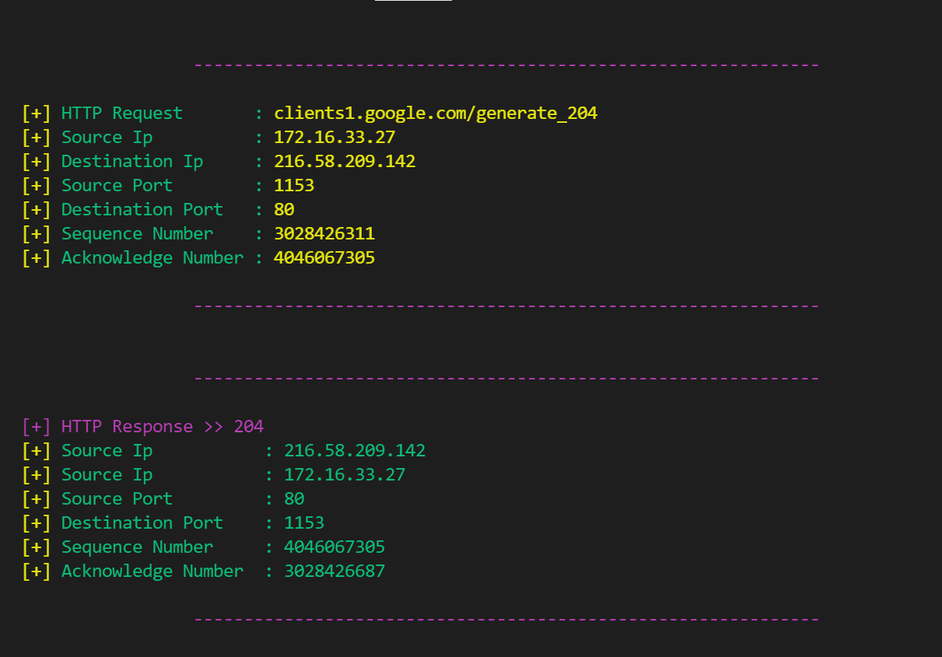
HTTP REQUEST

Slide 12
5.FILTERS

Slide 13
5.FILTERS
Port number
Port range
TCP
UDP
ICMP
Combinations

Slide 14
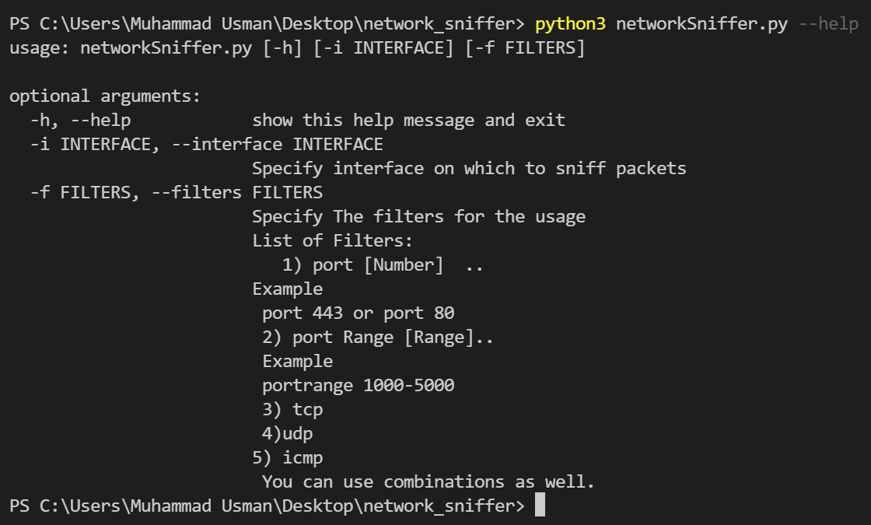
--HELP

Slide 15
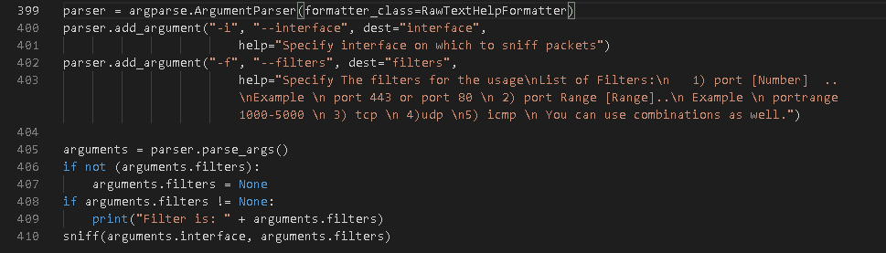

Slide 16
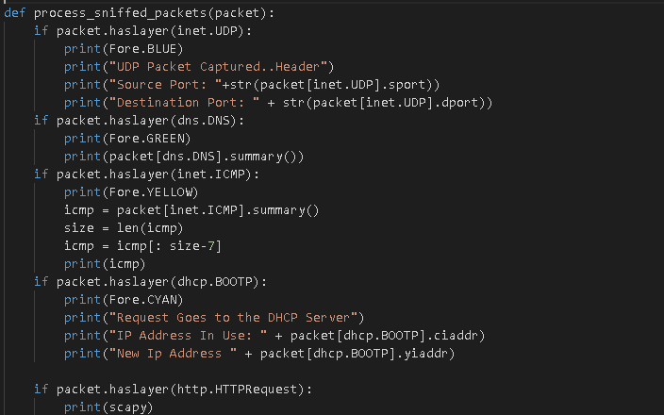

Slide 17
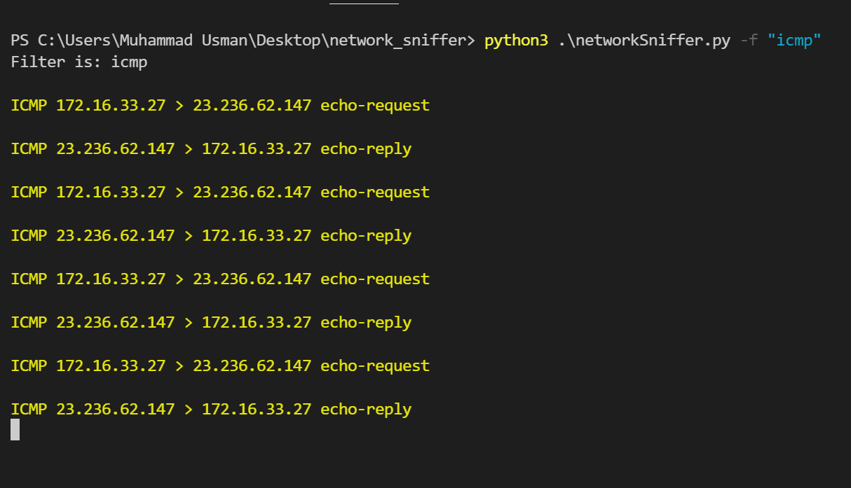

Slide 18
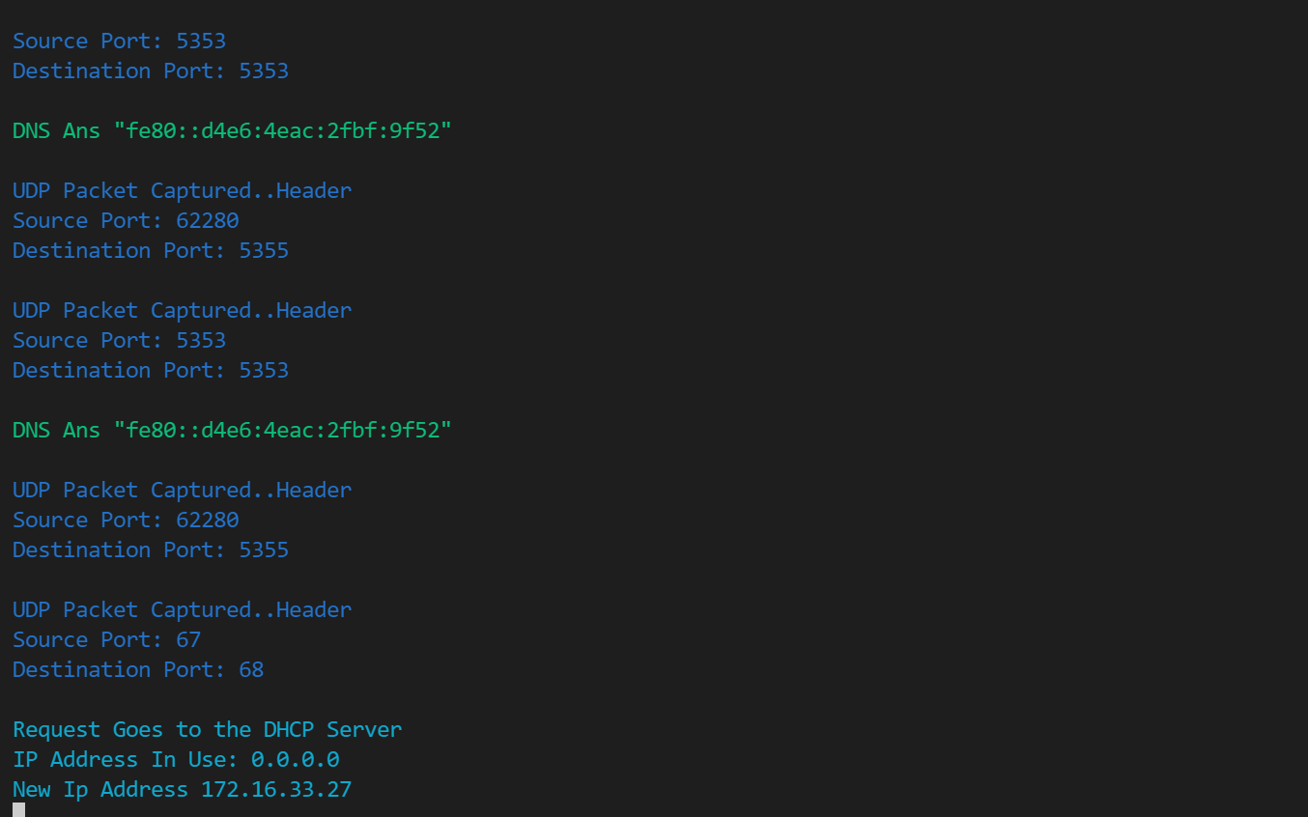

Slide 19
6.ATTACK DETECTION

Slide 20
6.ATTACK DETECTION
Credential harvester
HTML injection
SQL injection
XSS / JS injection
XXE injection
Command injection
XSLT injection

Slide 21
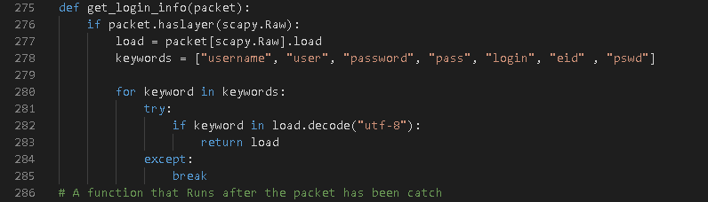
CRDENTIAL HARVESTER
Credential harvester
HTML injection
SQL injection
XSS / JS injection
XXE injection
XPATH injection
Command injection
XSLT injection

Slide 22
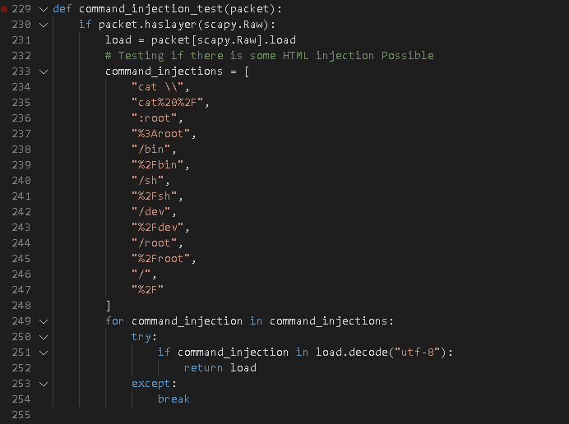
ATTACK’S DETECTION
Credential harvester
HTML injection
SQL injection
XSS / JS injection
XXE injection
XPATH injection
Command injection
XSLT injection

Slide 23
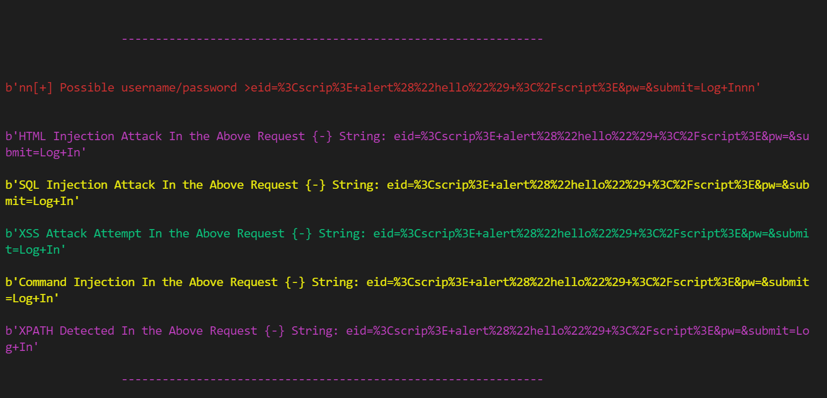

Slide 24
7.SECURITY ANALYSIS

Slide 25
7.SECURITY ANALYSIS
Strengths:
Detects malicious input
Shows the packet having credential
Different protocols identification
Weakness:
It doesn’t sniff HTTPS

Slide 26
7.SECURITY ANALYSIS
Concepts:
Network basics
Network security
Web attacks

Slide 27
ANY QUESTIONS?

Slide 28
Thank You

