Slide 1
Onto Learn Reloaded: A Graph-Based Algorithm for Taxonomy Induction

Slide 2
SYED BAQIR ABBAS
Ontology
Taxonomy learning
Approaches
Taxonomy learning workflow

Slide 3
ONTOLOGY
Formal Ontology
Prototype-based Ontology
Lexical/terminological Ontology

Slide 4
TAXONOMY LEARNING
1. Selection of upper nodes
2. Solving different issues
3. Proposal of novel algorithm
4. Evaluation of hypernym relation
5.Taxonomy-building overflow completed

Slide 5
APPROACH
Rule based Approach
Distributional Approach

Slide 6
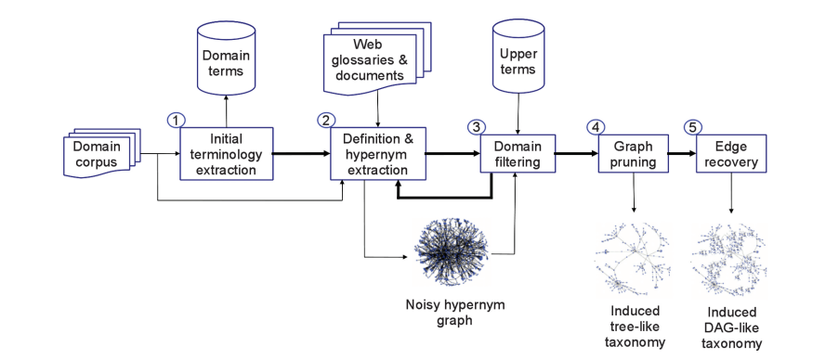
Onto learn RELOADED TAXONOMY LEARNING WORKFLOW

Slide 7
MUHAMMAD USMAN SHAHID
Initial term extraction
Hypernym extraction
Domain filtering

Slide 8
Initial term extraction
Term Extractor tool
T(0) initial domain terminology
T(0) includes both single- and multi-word expressions
Gnoisy = (Vnoisy, Enoisy) for each term in T(0).
Sentence s=t1,t2,t3…..tn
V={t1,t2,t3….tn}
E= {(t1,t2),(t2,t3)…tn-1,tn}

Slide 9
Definition and hypernym extraction
Example:
In computer science, a pixel]DF [is]VF [a dot]GF [that is part of a computer image]REST.
The DEFINIENDUM field (DF): this part of the definition includes the definiendum (that is, the word being defined) and its modifiers (e.g., pixel”). Definiendum is also the <TARGET> string.
The DEFINITOR field (VF): which includes the verb phrase used to introduce the definition (e.g., “is”).
The DEFINIENS field (GF): which includes the genus phrase (usually including the hypernym, e.g., “a dot”).
The REST field (RF): which includes additional clauses that further specify the differentia of the definiendum with respect to its genus (e.g., “that is part of a computer image”).

Slide 10
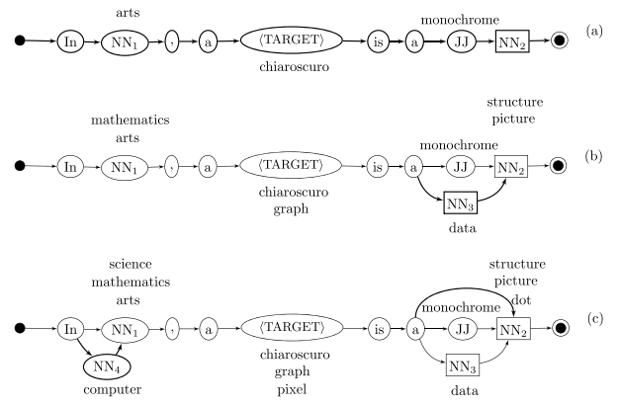



Definition and hypernym extraction
Sentence s=t1,t2,t3,….tn

Slide 11


Creation of hypernym graph
Bd(t) is the bag of content words in the definition candidate d(t) .
D is given by the union of the initial terminology T(0) and the set of single words of the terms in T(0) that can be found as nouns in WordNet.
Domain Weight(d(t)) ≥ θ
θ =0.38 is empirically tuned threshold
d(t)= definition candidate
Set of terms T(i+1) is given by the hypernyms of the current set of terms T(i) excluding those terms that were already processed during previous iterations of the algorithm.
Difference of Union of all the hypernyms terms from all the terms of previous iterations.

Slide 12
MUHAMMAD Ismail Ramzan
Graph Pruning
Edge Recovery
Complexity

Slide 13
Graph pruning
Graph Trimming
Edge Weighting
Optimal Branching
Pruning Recovery
Semantic reconnection step
Reconnection step by lexical inclusion
Decomposition step

Slide 14


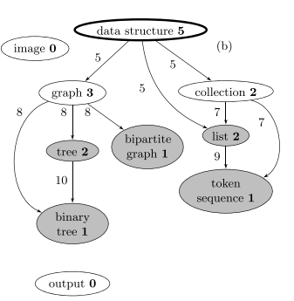
B. Edge weighting
By the first formula we are calculating sum of the weights of the path.
Sum of weight of the path from data structure till binary tree is 11.
Second formula assigns the edges weight.
T(data structure, list)
= { data structure → list, data structure → collection → list }
whose weights are 7 (w(data structure) + w(list))
and 9 (w(data structure) + w(collection) + w(list)),
respectively

Slide 15
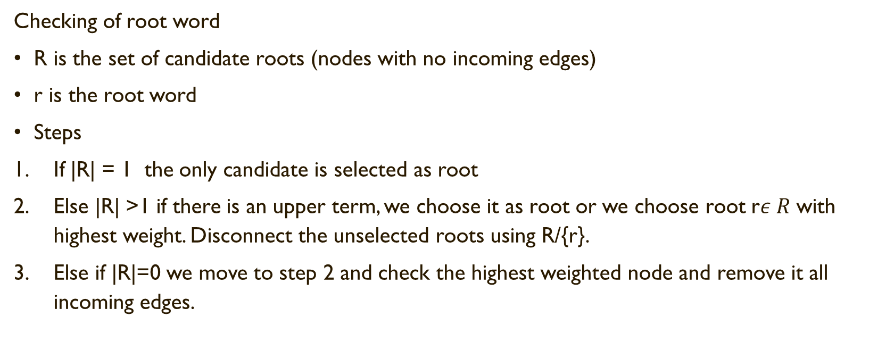
C. Optimal branching
Checking of root word
R is the set of candidate roots (nodes with no incoming edges)
r is the root word
Steps
If |R| = 1 the only candidate is selected as root
Else |R| >1 if there is an upper term, we choose it as root or we choose root r$ε R$ with highest weight. Disconnect the unselected roots using R/{r}.
Else if |R|=0 we move to step 2 and check the highest weighted node and remove it all incoming edges.

Slide 16
Cont.….
Contraction phase
Select entering edge with highest weight.
If no cycle go to expansion phase
Modify weights using :
w(h, k) = w(h, v) + (w(x(v), v) − minv(w(x(v), v)))
Replacement of edges to break the cycle
Go to step 2 with contracted graph

Slide 17
Cont.….
Expansion phase
Using the redefined weights, we use the node with the highest weight and remove the incoming edge in that node to break the cycle.
This process is done by the famous Chu-Liu/Edmond algorithm.
This algorithm costs us O(m.log2n)
* O(n) = hypernym edge cost

Slide 18
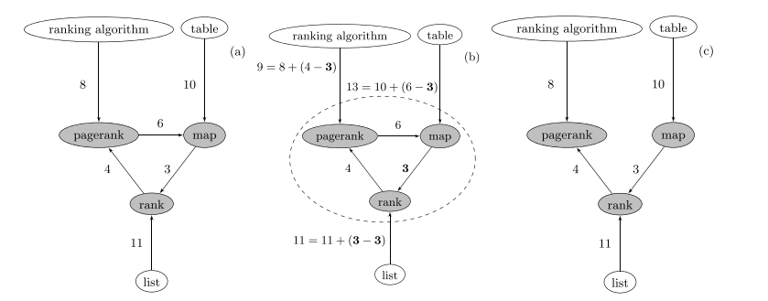
a. Graph with cycle.
b. Redefining weights.
c. Removing the ingoing edge of highest weighted node to break the cycle.

Slide 19
Musaab imran
Evaluation:
Experimental set-up
Evaluation against gold standard
Manual evaluation

Slide 20
Assessing the quality of taxonomy:
Evaluation against gold standard.
Manual evaluation by domain experts.
Structural evaluation.
Application driven evaluation.

Slide 21
1. Experimental setup
1. Domains
a. Word net
b. MeSH
2. Definition harvesting
3. Terminology
a. Term Extractor tool
4. Upper terms
a. Word net
b. MeSH
Algorithm versions and structural statistics
a. TREE
b. DAG [1,3]
c. DAG [0,99]

Slide 22
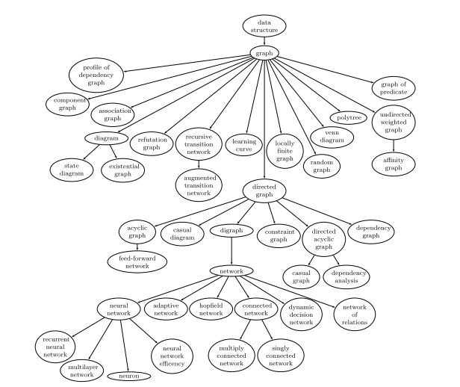





ERRORS
Slide Tite
Meaning are used:
“Neuron is a neural network”
Overspecializations
“Network is a graph”

Slide 23
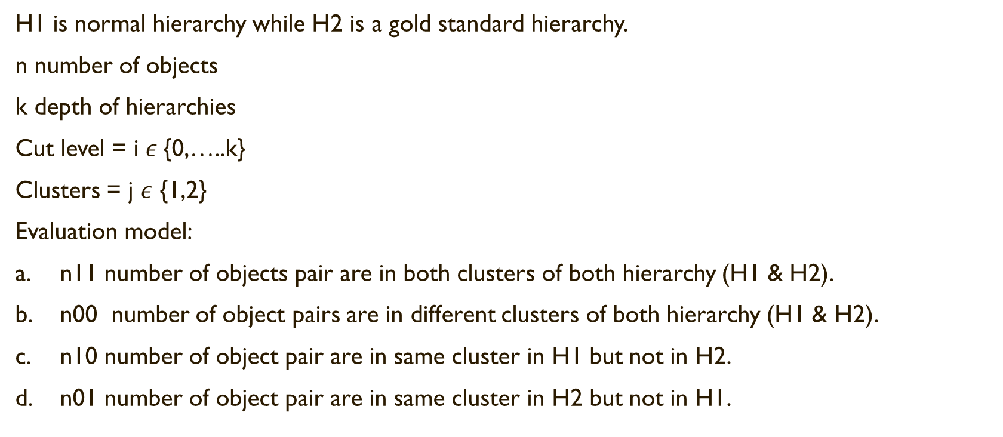
2. Evaluation against gold standard
H1 is normal hierarchy while H2 is a gold standard hierarchy.
n number of objects
k depth of hierarchies
Cut level = i $ε${0,…..k}
Clusters = j $ε$ {1,2}
Evaluation model:
n11 number of objects pair are in both clusters of both hierarchy (H1 & H2).
n00 number of object pairs are in different clusters of both hierarchy (H1 & H2).
n10 number of object pair are in same cluster in H1 but not in H2.
n01 number of object pair are in same cluster in H2 but not in H1.

Slide 24
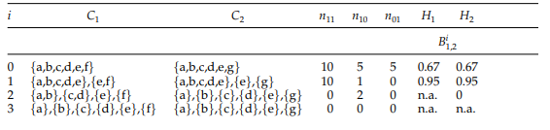

Application of evaluation method
B shows that both H1 and H2 are learned hierarchies.
C1 and C2 are the clusters.
n is number of objects .

Slide 25
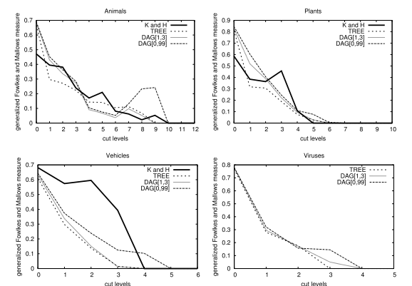







Gold standard evaluation

Slide 26
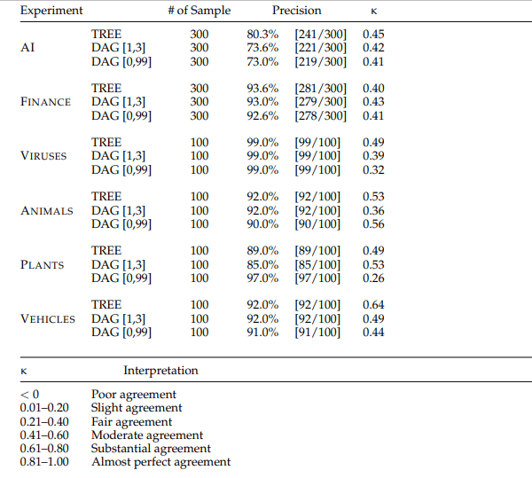
3. Manual evaluation
Hypernym evaluation:

Slide 27
structural assessment

Slide 28
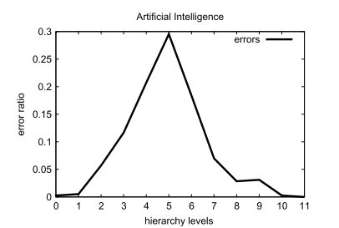
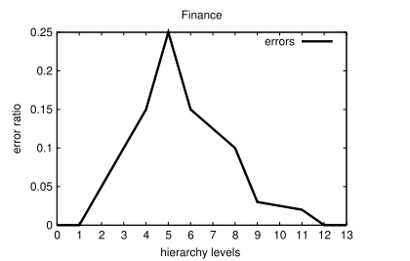


errors
1. Ambiguity

Slide 29
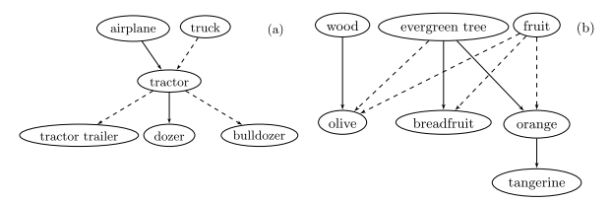
Errors
2. Systematic polysemy:

Slide 30
Errors
3. Low quality of definitions
4. Hypernym is a clause
5. Lack of appropriate definitional pattern
6. Wrong hypernym string

Slide 31
Conclusion (implementation plan)

Slide 32
Implementation plan
STEPS:
Sentences or definitions as input .
Algorithm for building taxonomy.
Use of tools to extract upper terms then root words as hypernyms and then domain.
Defining of hypernym and domain.
Then we cope up with the issues of ambiguity, complexity, multiplicity of hypernyms.
Creation of hypernym graphs.
Pruning of graphs
Contraction and extraction phase

Slide 33
Cont.….
STEPS:
Edge recovery
using of python code to recover the edge that were eliminated in the optimization of graph.
Evaluating of the graph .
11. Applying 3 experiment of TREE, DAG[1,3], DAG[0,99] on 6 taxonomies to check the result.
Comparing the result with the gold standard K & H.
Studying of graphs .
Checking for different errors.
Checking of hierarchy at different levels to check the pattern of hierarchy.
Output will the full taxonomy of the given respective input.

Slide 34
Cont.….
Python will be used:
Graph pruning
Optimization of graph
Weight calculation and edge removal
Edge recovery
Graphing the hypernym graph and hierarchy for extensive values
Applying different test on different taxonomies
Checking with gold standard
Calculating coverage, depth and precision of hierarchies
Checking of systematic polysemy problems

Slide 35
Cont.….
Libraries:
Matplotlib: Plots graphs easily on all applications
Seaborn: Versatile library based on matplotlib that allows comparison between multiple variables.
Ggplot: Produces domain-specific visualizations
Bokeh: Preferred libraries for real-time streaming and data.
Plotly: Allows very interactive graphs
Numpy for mathematics especially matrices

Slide 36
Thank you

