Slide 1

E-Learn learning management system

Slide 2
E-Learn
an application or web-based technology used to plan, implement a specific learning process,

Slide 3


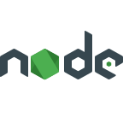

Used technologies
mongodb
Node js
express js
Joi validation
B
bcrypt

Slide 4
architecture
The MVC architecture pattern was used in developing this project.
The mvc architecture is designed as a way for developers to structure their files to section so they are readable and easy to maintain.
- Model: data layer.
- View: presentation layer.
- Controller: logic layer.

Slide 5
DEMO

