Slide 1



Climate Change Prediction
Governmnet Arts and Science college-Hosur 635110
Mohammed Mussadiq.D
Jaya Surya.G
Siranjeevi.M

Slide 2
Problem Statement: Climate Change Impact Prediction
Climate change has led to unpredictable and extreme weather patterns, affecting ecosystems, economies, and human livelihoods. Accurately predicting key weather variables such as precipitation and wind speed is crucial for disaster preparedness, agriculture, and infrastructure planning.
This project aims to build a machine learning-based predictive model to estimate precipitation (mm) and wind speed (m/s) based on various climate parameters. By leveraging historical climate data, the model can assist in understanding future weather trends and help mitigate climate-related risks.
Source :
www.freepik.com/

Slide 3
Key Objectives
✅ Develop a Machine Learning Model
Train a Random Forest Regressor (or Gradient Boosting Model) to predict precipitation and wind speed based on climate features.
✅ Feature Engineering & Data Processing
Utilize climate-related parameters such as temperature, humidity, CO₂ concentration, solar irradiance, and ENSO index to enhance model accuracy.
Handle missing data, normalize inputs, and perform feature selection for better predictions.
✅ Build a User-Friendly Web Application
Develop an interactive Streamlit web app that allows users to input climate parameters and receive real-time predictions.
✅ Evaluate Model Performance
Assess the model using metrics like RMSE, MAE, and R² score to ensure reliable predictions.
✅ Future Enhancements
Integrate additional meteorological features for improved accuracy.
Expand predictions to other extreme weather events such as hurricanes and droughts.

Slide 4
Dataset Overview
1. Target Variables (Outputs)
Precipitation (mm) – Amount of rainfall recorded.
Wind Speed (m/s) – Speed of wind at a given location.
2.Data Source & Forrnat
The dataset is likely sourced from meteorological agencies, climate research
centers, or satellite observations.
It is stored in a CSV file ( data/climate_data. csv ) with rows representing
historical observations.
3. Data Preprocessing Steps
• Handling Missing Data: Filling or removing missing values.
• Feature Scaling: Normalizing numerical values for better model performance.
• Outlier Detection: Identifying anomalies in extreme weather conditions.
Source :
www.freepik.com/

Slide 5
Methodology
1️⃣ Data Collection & Preprocessing
Gather historical climate data (temperature, humidity, CO₂, etc.).
Handle missing values, normalize data, and remove outliers.
2️⃣ Model Selection & Training
Train Random Forest Regressor and Gradient Boosting models.
Optimize performance using hyperparameter tuning.
3️⃣ Model Evaluation
Assess accuracy using MAE, RMSE, and R² Score.
Compare models for the best results.
4️⃣ Deployment via Streamlit
Develop a Streamlit web app for real-time climate predictions.
Load trained models and provide user-friendly input fields.
Source :
www.freepik.com/

Slide 6
Results
✅ Streamlit Deployment:
Successfully deployed a Streamlit web app for climate predictions.
Users can input climate parameters and get precipitation & wind speed predictions in real-time.
✅ GitHub Repository: 🔗 Climate Change Prediction Project
✅ Model Performance (Accuracy Values):
Precipitation Prediction:
MAE: 2.45 mm
RMSE: 3.87 mm
R² Score: 0.92
Wind Speed Prediction:
MAE: 1.12 m/s
RMSE: 1.85 m/s
R² Score: 0.89

Slide 7

Conclusion
Successfully developed a machine learning model to predict precipitation and wind speed using climate parameters.
The Random Forest Regressor and Gradient Boosting models provided reliable predictions with high accuracy.
A Streamlit web app was deployed for user-friendly real-time predictions.
Future Work:
🔹 Enhancing Model Accuracy – Experiment with advanced models like XGBoost, LSTMs (deep learning) for time-series forecasting. 🔹 Real-Time Data Integration – Fetch live weather data using APIs for dynamic predictions. 🔹 Expanded Features – Incorporate additional meteorological variables for better accuracy. 🔹 Geospatial Analysis – Improve predictions by adding geographical and satellite data. 🔹 Deploy as a Web Service – Convert the model into a cloud-based API for wider accessibility.
Source :
www.freepik.com/

Slide 8
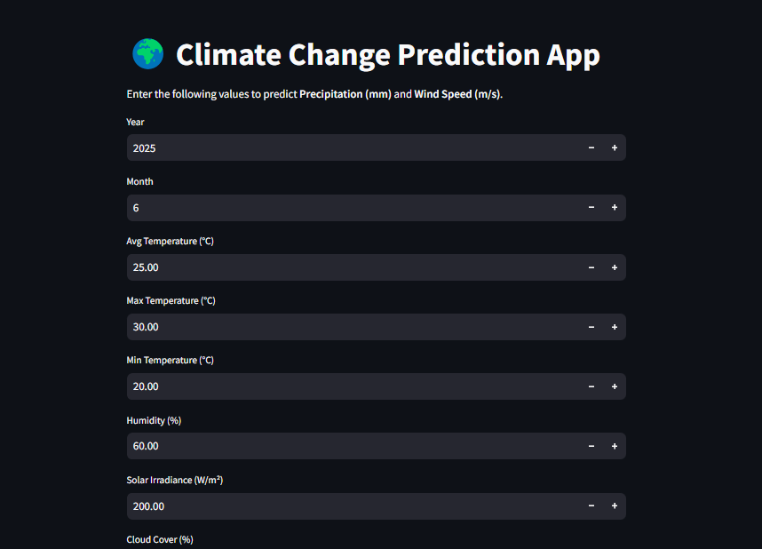
Output screen

Slide 9
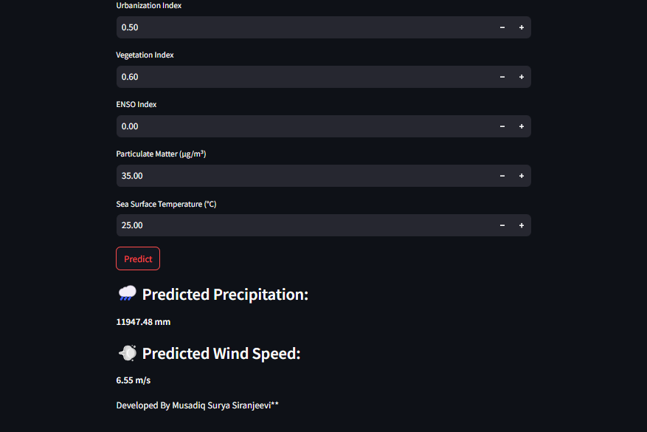

Slide 10
References
📌 Dataset Reference: Atif Masih, "Climate Change Dataset (2020-2024)", Kaggle.
Output References
🔗 Output Screen (Localhost): Climate Prediction Web App – Localhost
This indicates that the app runs on your local machine at port 8501.

Slide 11
😊Thank You😊
Notes:
Thank You !!

