Slide 1
Getting into Linux Kernel Development after 30 years
Muhammad Usma Anjum <usama.anjum@collabora.com>
Notes:
Introduction
Summary:
* options

Slide 2
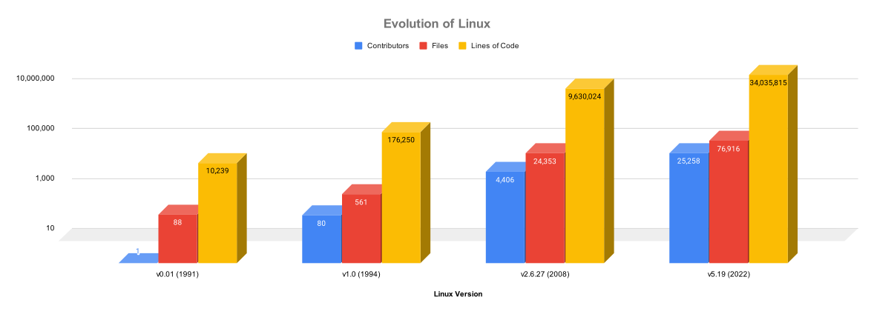
Evolution of Linux in 30 years
Notes:
- More than 30 years of development
- Kernel + hardware already complex
- R&D happening all the time
- Used almost everywhere
- Security and trust on open source

Slide 3
Who does develop Linux Kernel?
Companies
  Vendors – Intel, Samsung
  Users – Google, Amazon
  Consultancies
Researchers and Students
Hobbyists
Notes:
Companies use Linux in their products
Servers / laptops
Other device??
Printers routers
Hobbyist use Linux in what ???
Using linux on their laptop and hardware isn’t supported
Resercher and students examples
Source code is avialable, security analysis
New algorithms
Inaria

Slide 4
Difficulties
Very few and outdated documentation
Code keeps changing at accelerated rate
Some components were designed 10-20 years ago
Notes:
Block layer, hard disks have evolved

Slide 5
Hello World Course
LFD103: A Beginner's Guide to Linux Kernel Development
  Development process
  Configuring the development environment
  Building and installing the kernel
  Preparing and sending the first patch
  Testing and debugging

Slide 6
Other Free Courses
Beginner level and general information courses
  LFS101x: Introduction to Linux
  LFD102: A Beginner’s Guide to Open Source Software Development Training
  LFD107x: Open Source Software Development: Linux for Developers Training
  LFD108x: Linux Tools for Software Development Training
  LFD109x: Git for Distributed Software Development Training

Slide 7
Courses and Trainings
Linux Foundation’s paid instructor-led courses
  LFD420 - Linux Kernel Internals and Development
  LFD430 - Developing Linux Device Drivers
  LFD435 - Developing Embedded Linux Device Drivers
  LFD440 - Linux Kernel Debugging and Security
  LFD450 - Embedded Linux Development
Shubhra Kar Linux Foundation Training (LiFT) Scholarship for studying ONE free course

Slide 8
Linux Kernel Mentorship Program
LFX Mentorship
  Bug fixing
  Developing feature
DIY exercises in the application process
Work with mentor for 3 months
Learn to collaborate with the community
Notes:
Become linux kernel maintainer
Full time / Part time

Slide 9
Outreachy Internship
For groups underrepresented in tech
Contribute to a project during the application phase
Work on the project with mentor
Full time only
Notes:
women and other diverse people

Slide 10
The Eudyptula Challenge
Series of 20 challenges solved through mail
  Setting up the development environment
  Sending the first patch upstream
  Develop different module
  Kernel development
Not accepting applicants now
Can still be attempted on personal level
Notes:
(google search the challange and find the questions)

Slide 11
Help from others
#kernelnewbies IRC channel on oftc server
kernelnewbies@kernelnewbies.org mailing list
kernelnewbies.org has several useful blogs
  First Kernel Patch blog post
  Patch Philosophy blog post
Join mailing list http://vger.kernel.org/vger-lists.html
  Be polite and don’t take things personally

Slide 12
Blogs and Talks
LWN.net is computing webzine
Different kernel developers have blogs
  https://planet.kernel.org
The recordings of conference presentation and talks
  Linux Plumbers
  OSS Summit

Slide 13
LF Live: Mentorship Series
Virtual mentoring series
Provides expert knowledge and valuable interactive discussions
  “Best Practices to Getting Your Patches Accepted” by Greg Kroah-Hartman
  “Rust for Linux: Writing Safe Abstractions & Drivers” by Miguel Ojeda
  “An Introduction to Linux Tracing and its Concepts” by Elena Zannoni
  “Fuzzing Linux Kernel” by Andrey Konovalov

Slide 14
Code and documentation
Kernel has some documentation on some components
  Linux Device Drivers by Jonathan Corbet, Alessandro Rubini, and Greg Kroah-Hartman (v2.6.10)
Reading the code can be done to learn about the component
Writing the code
Notes:
* explain getting a baord and actully wriitng some code..

Slide 15
Contribute to the Kernel
Fix checkpatch warnings
Fix bugs reported by static analyzers
  Sparse
  Smatch
  Coverity
Fix bugs reported by dynamic analyzers
  Syzbot

Slide 16
Newbies → Full time Developers
Upstream contributions → Full time job
Outreachy Internship → Full time job
LF Mentorship Internship → Full time job
Close source experience → Courses, Scholarships, Upstream Patches → Full time job
Notes:
Upstream contributions → Collabora
Outreachy Internship → Microsoft
LF Mentorship Internship → Canonical → Intel
Close source experience → Courses and Scholarships → Collabora

Slide 17
We are hiring col.la/careers

Slide 18
Thank you!

Slide 19
We are hiring col.la/careers

