Slide 1
Git
Set
Go
Notes:
Notes here

Slide 2


Slide 3
Git’s Amicable Features
Almost every operation is local
Integrity by hashing

Slide 4
Bash!
ls --all
ls -a
cd mentor; grep abc ; ls;
man git
man git-commit
Aliases: export nuc4=’cd /var/mentor/nuc4-source’

Slide 5
Git Model
Notes:
Notes here

Slide 6
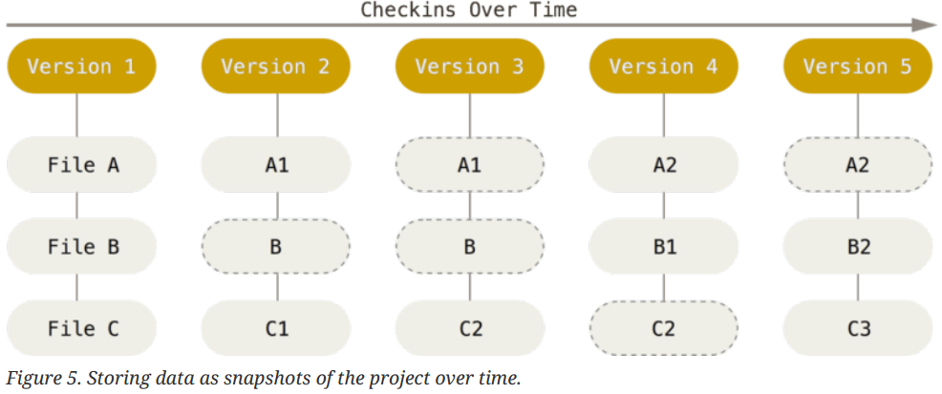
Snapshots

Slide 7
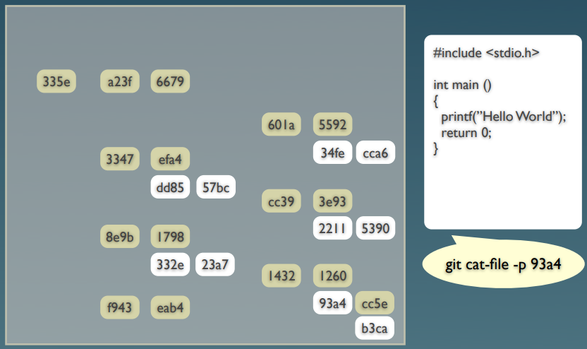
Git Repository

Slide 8
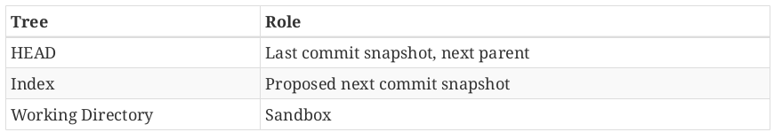
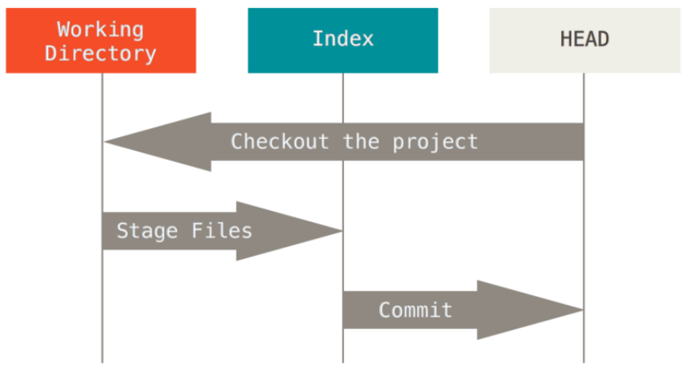
The Three Trees

Slide 9
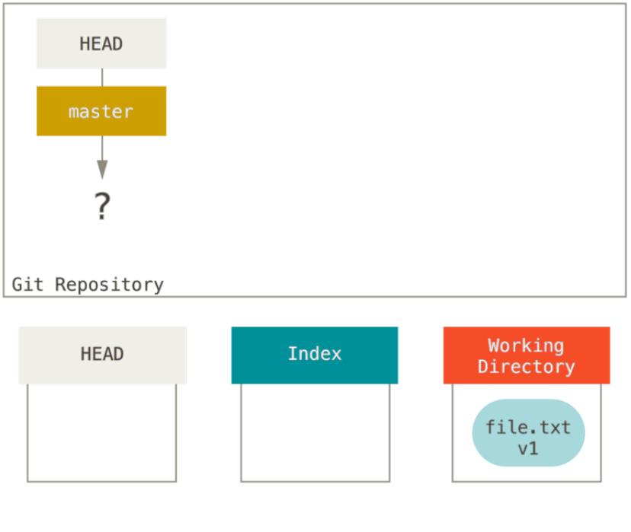
The Three Trees

Slide 10
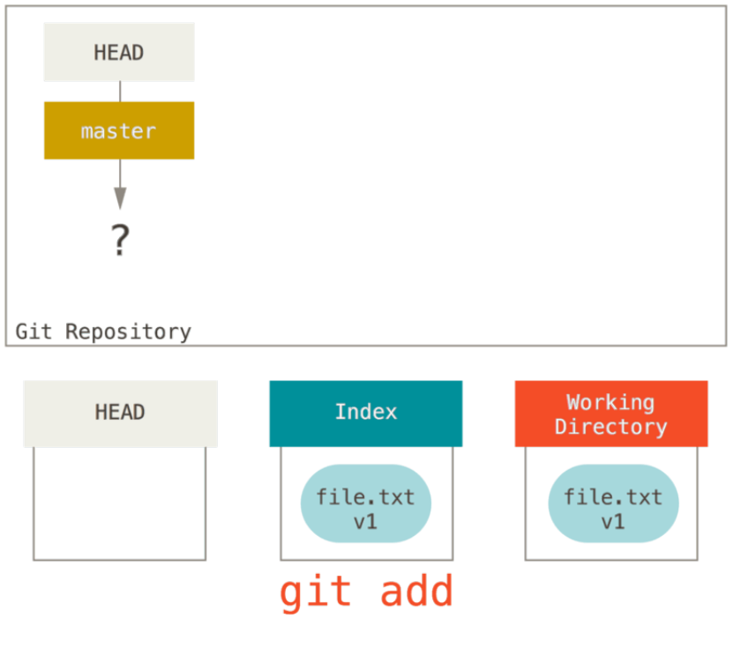
The Three Trees

Slide 11
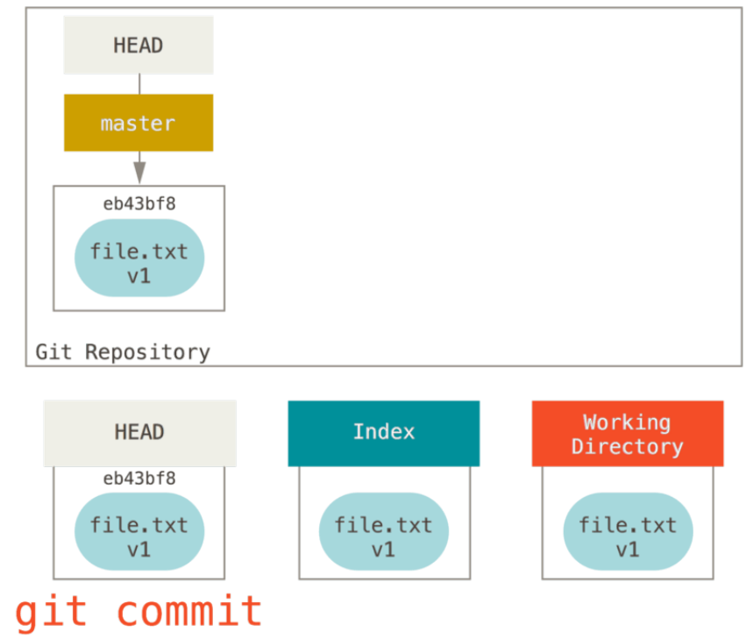
The Three Trees

Slide 12
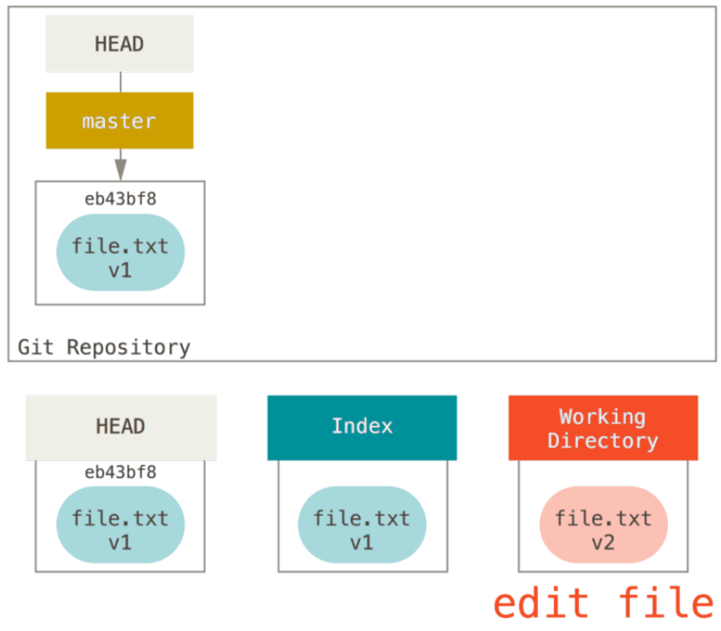
The Three Trees

Slide 13
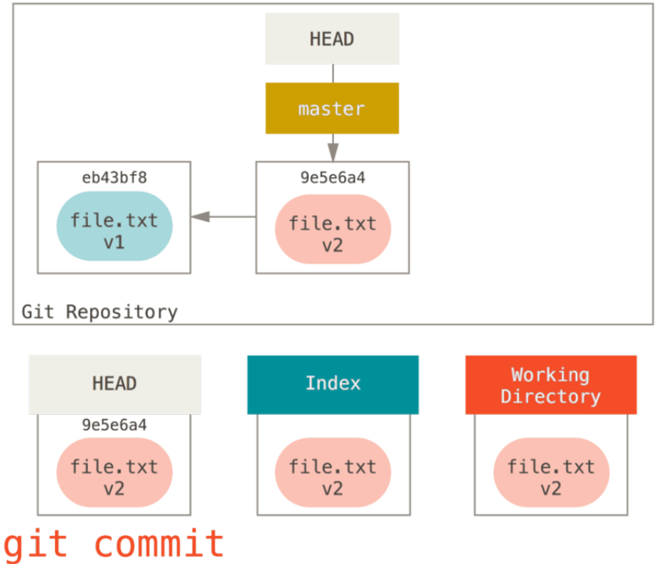
The Three Trees

Slide 14
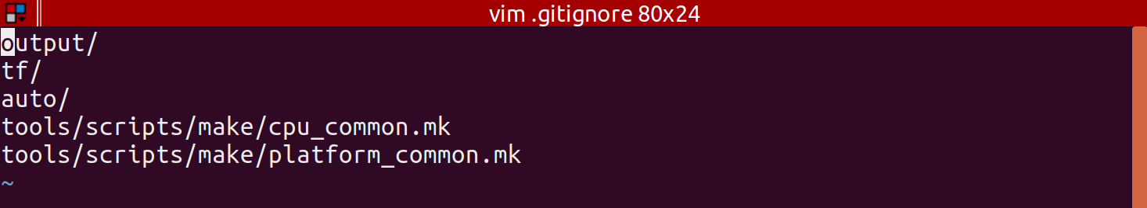
Ignore Useless Files
.gitignore file
  Specify blob patterns of files to be ignored

Slide 15
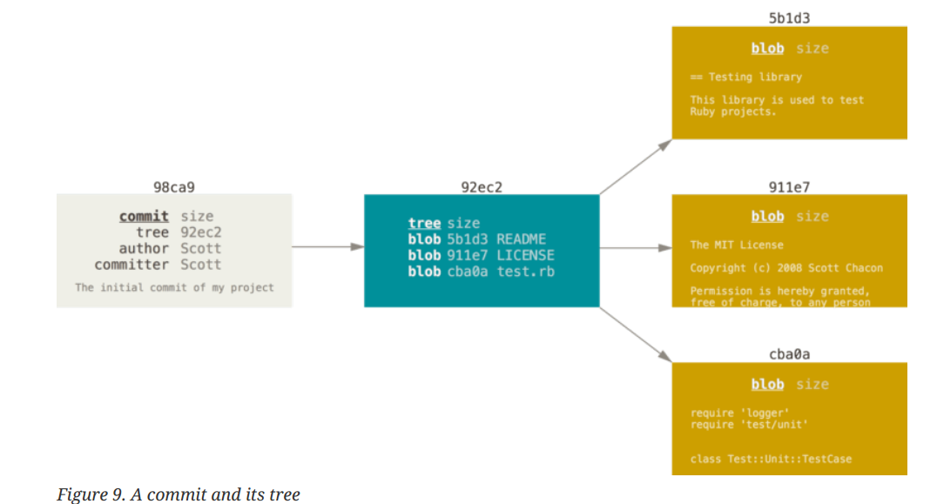
Branching

Slide 16
Basic Commands
Notes:
Notes here

Slide 17
First Repo
git clone https://abc.com/repo.git
git checkout <branch>
git checkout -- <file>
git checkout <branch> -- <file>

Slide 18
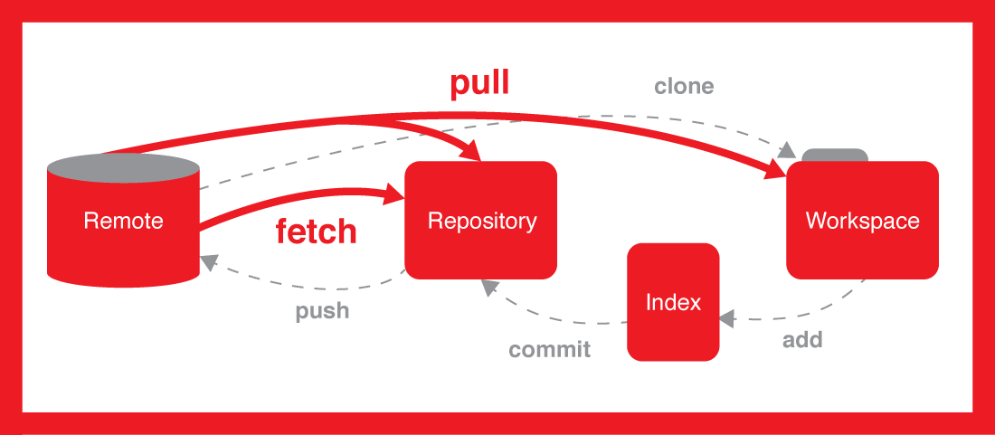
Basics
git fetch
git pull
git add <file / directory>
git commit
git commit -m “<commit_message>”
git push

Slide 19
Basics
git diff (un-tracked changes)
git diff --staged (tracked changes)
git rm --cached file.c
git mv file_from file_to (file movements aren’t tracked otherwise)

Slide 20
Status Log Blame
git status
git status -s
git log
git log --pretty=oneline
git log --pretty=format: “<format letters>”
git log --since=2.weeks
git blame <file path>

Slide 21
Aliases
Git aliases
  git config --global alias.unstage “reset HEAD --”
  git unstage fileA

Slide 22
Configuration
Global vs Local
git config --global user.name “johnwick”
git config --global user.email jhonwick@me.c
git config --global core.editor <Path to editor>
git config --global difftool “BC4”
git config --global credential.helper 'cache --timeout=300'
git config --global help.autocorrect 50

Slide 23
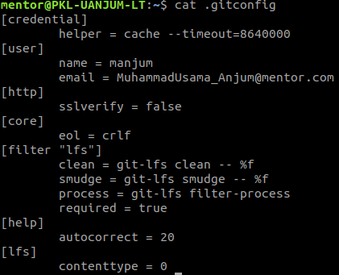
Global .gitconfig Example

Slide 24
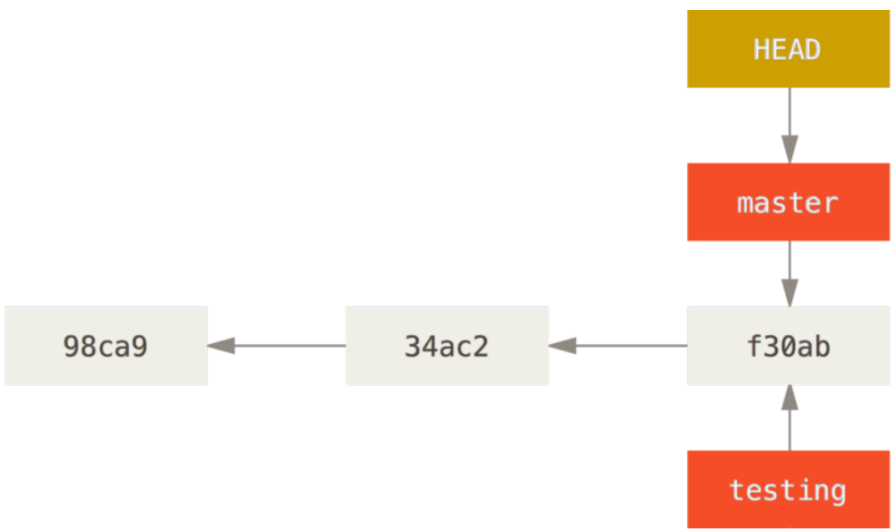
Creating a Local Branch
git branch testing and git checkout testing
OR
git checkout -b testing

Slide 25
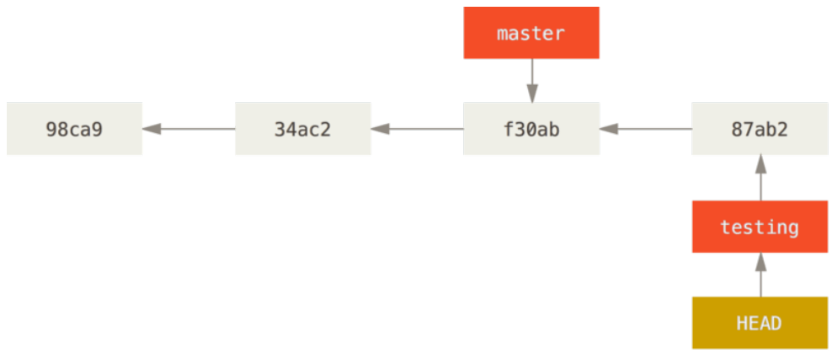
HEAD branch moves forward
git commit -a -m “Removed USB bug”

Slide 26
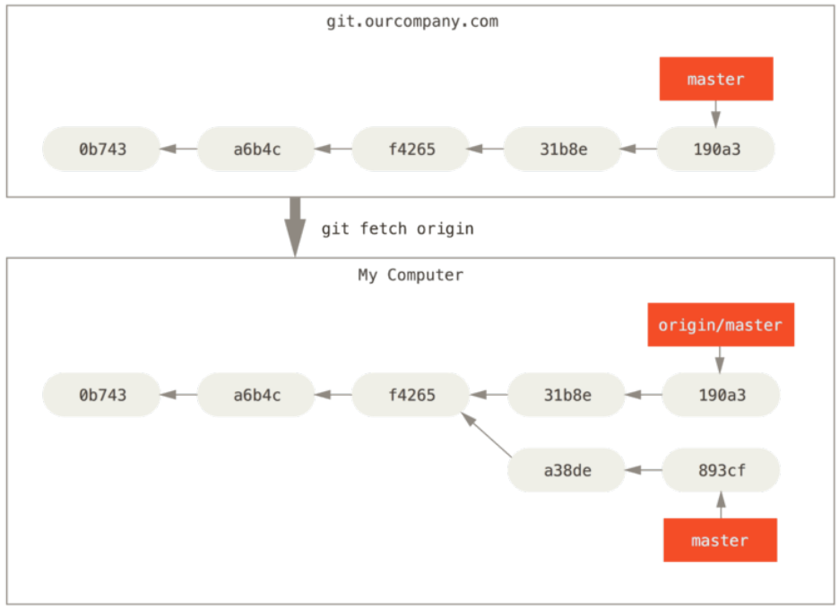
Different branches at remote and local

Slide 27
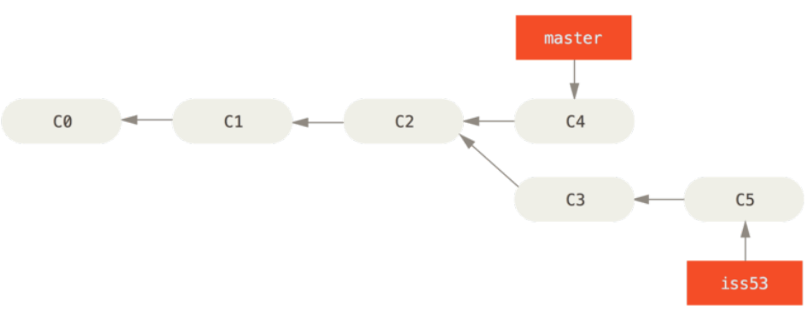
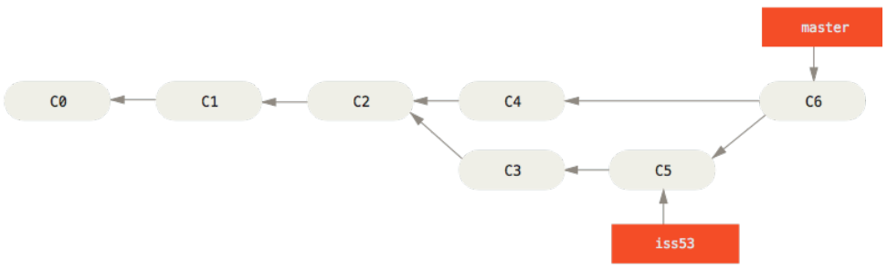
Merging

Slide 28
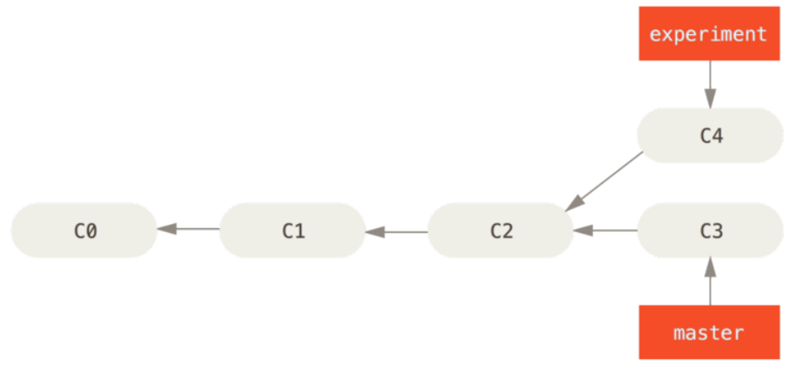
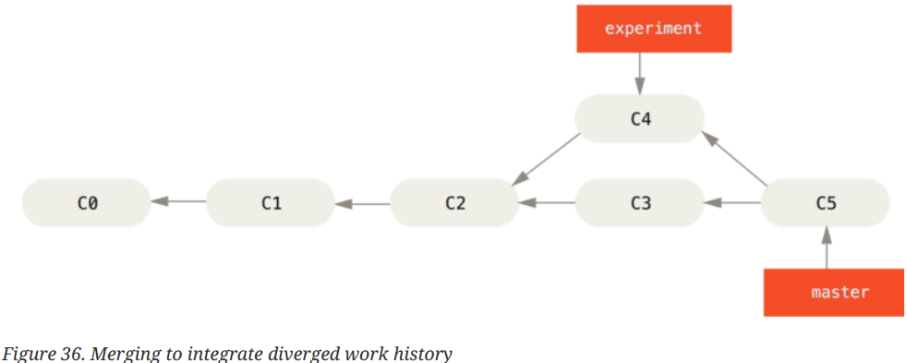
Merging(git merge <master>)

Slide 29
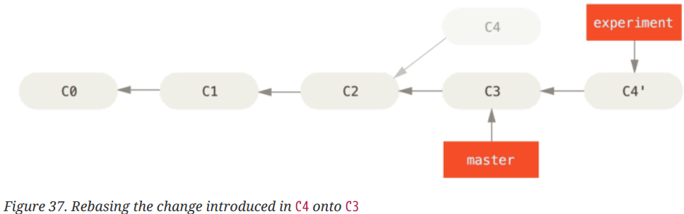
Rebasing (git rebase <branch>)

Slide 30
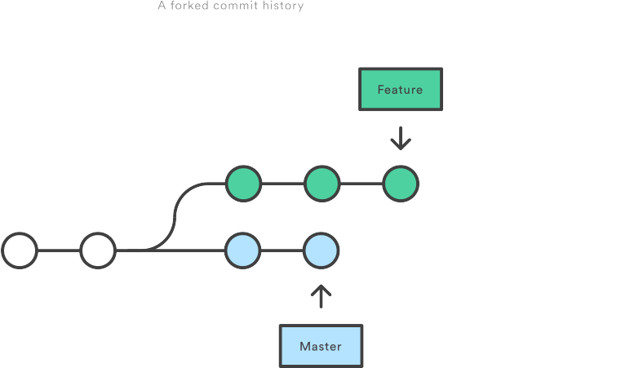
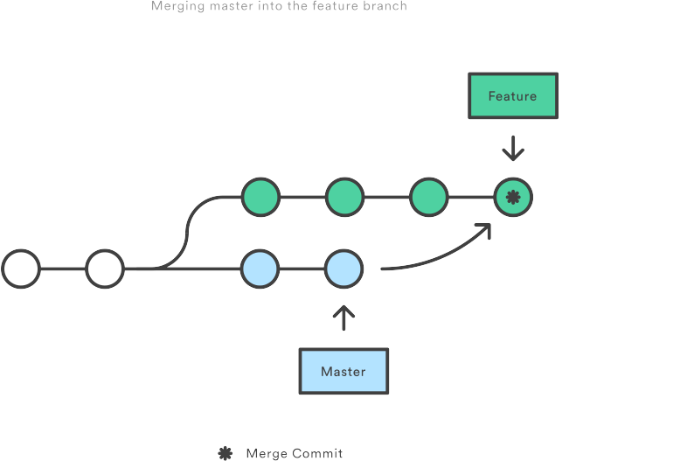
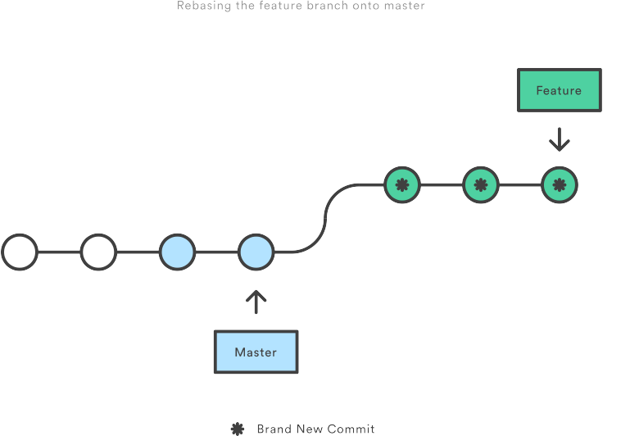
Merging vs Rebasing

Slide 31
Fast-Forwarding vs
Non-Fast-Forwarding

Slide 32
After merging / rebasing should I do sanity testing again?

Slide 33
Deleting Branches
Deleting Local Branch
  git branch -d <branch>
  git branch -D <branch> (if branch isn’t merged)
Deleting Remote branch
  git push origin --delete <branch>
  git push origin :<branch>

Slide 34
Ideal commit message
[<JIRA project key>-<JIRA issue number>] <Title text>
<Details>
[NUC4-5901] Instrumented availability time of main peripherals.
This changeset is adding the instrumentation for the availability time of main peripherals; ethernet, usb host, usb function, sdio and serial.
Commits which fix spacing etc should be squashed into previous commit

Slide 35
Advanced
Notes:
Notes here

Slide 36
Advanced
Ancestry References - “^” = parent or “~” = parent
  git show HEAD^
  git show HEAD~4
Untracked local files/folders removal
  git clean -n -d -f

Slide 37
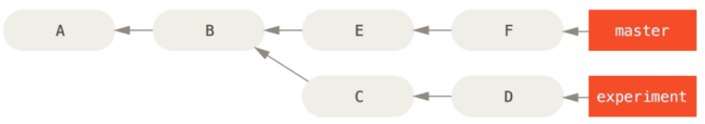
Git Ranges - Double Dot
What is in experiment that hasn’t been merged into master?
git log master..experiment
D
C
git log experiment..master
F
E
In the same way diff can also be seen
  git diff master..experiment

Slide 38
Git Ranges - Triple Dot
Which commits are different in both branches?
git log master...experiment
F
E
D
C

Slide 39
Misc
Interactive Staging
  git add -i
  then follow the steps :D
Stashing
  git stash
  git stash pop
  git stash list
  git stash apply stash@{2}
  git stash --include-untracked
  git stash branch <branch>

Slide 40
Search inside git
git grep sabre_lite
git log --grep=<pattern>

Slide 41
Rewriting History
Change last commit
  git commit --amend
Change multiple commit messages
  git rebase -i HEAD~3
  (squash, drop, edit, reword, change order of commits)

Slide 42
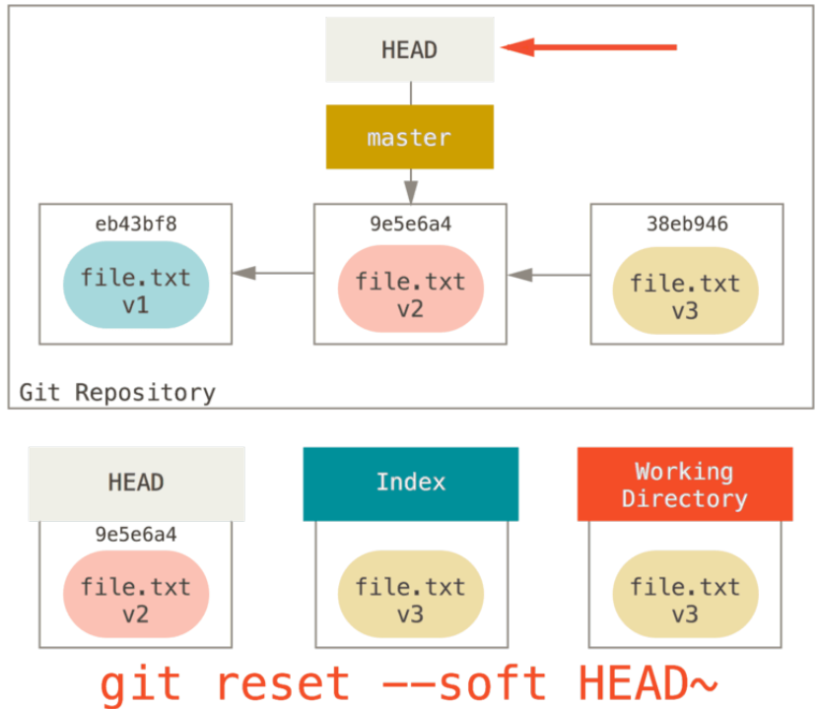
The Role of Reset

Slide 43
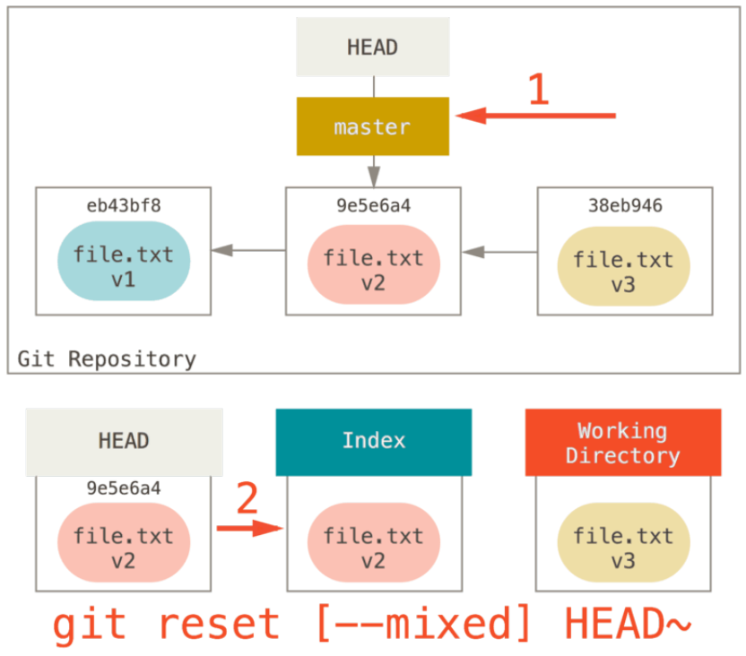
The Role of Reset

Slide 44
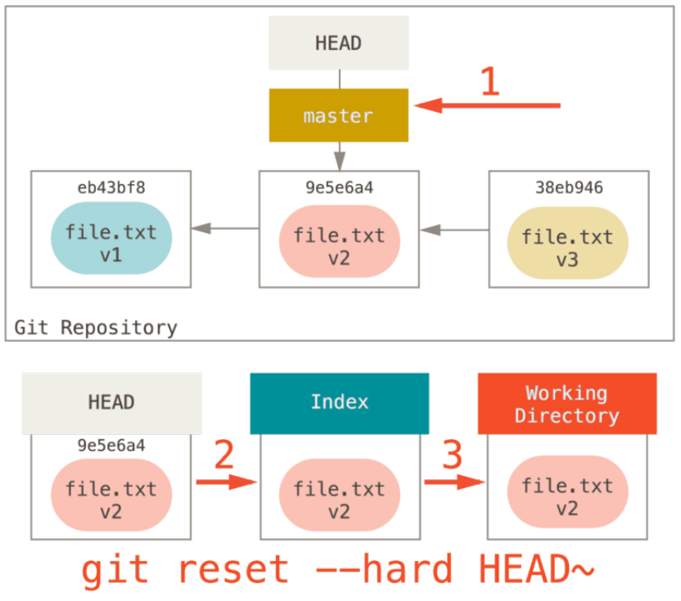
The Role of Reset

Slide 45
Conflicts removal
git <merge/rebase> master
Conflicts!!!
  <<<<<<< HEAD
  INT I = 10;
  =======
  INT J;
  >>>>>>> new_branch_to_merge_later
Remove conflicts
git add <file which had conflicts>
git <merge/rebase> --continue OR (--abort)

Slide 46
Conflicts Avoidance
Conflicts Removal
  git config --global rerere.enabled true

Slide 47
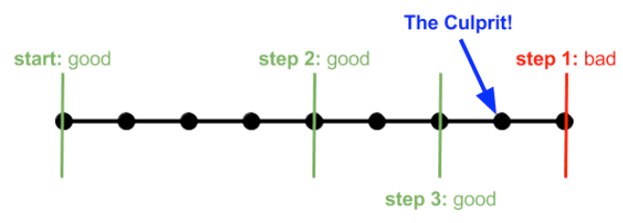
Finding Malicious Commit
git bisect start
git bisect bad <hash>
git bisect good <hash>
git bisect skip
git bisect reset

Slide 48
Git Sub-Modules
git submodule add https://mentor.com/tf.git
git push origin master
git clone https://mentor.com/nuc4.git
git submodule init

Slide 49
Advanced Git Config
git config --global credential.helper <cache/wincred>
git config --global core.autocrlf <true/false/input>
git config --global core.whitespace trailing-space,-space-before-tab,indent-with-non-tab,tab-in-indent,cr-at-eol,tabwidth=4
git config --global help.autocorrect 20 (2 seconds)

Slide 50
Advanced Commands
Reverse Commit
  git revert <commit-hash>
Bring commit from some other branch into yours
  git cherry-pick <commit-hash>

Slide 51
Advanced Commands
What to do if destructive operation gets wrong!!
  git reflog
Garbage collection!!
  git gc

Slide 52

DIY
Git Hooks
  pre-commit
  pre-receive
  post-commit
  post-receive
Client Side Hooks / Server Side Hooks
.git/hooks/

Slide 53
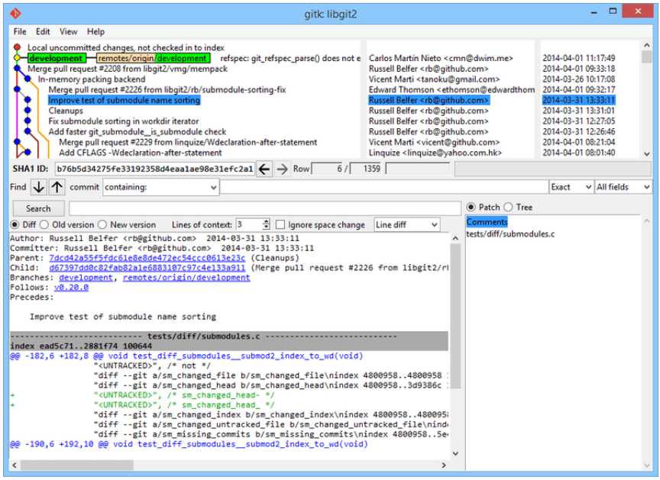
GUI
gitk

Slide 54
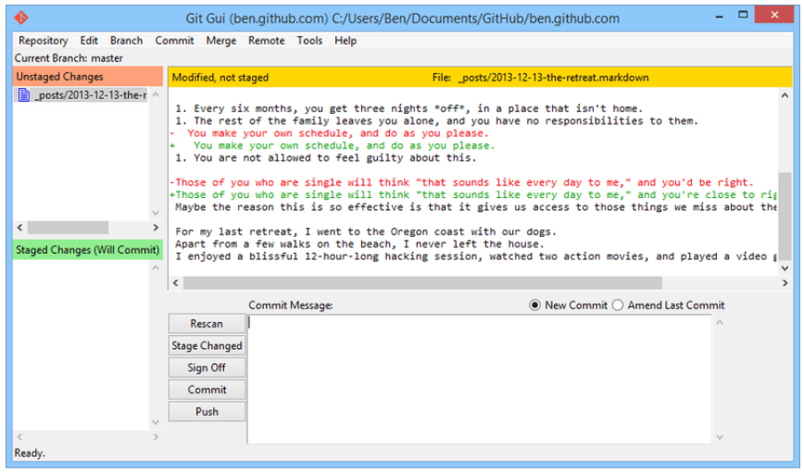
GUI
git gui

Slide 55
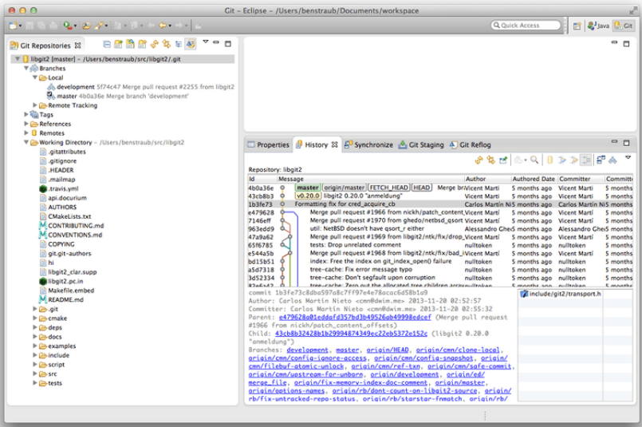
Ecclipse

Slide 56
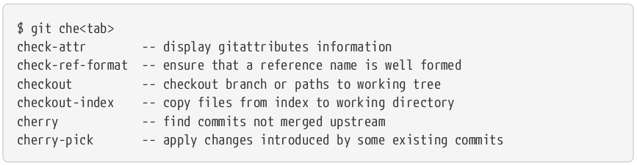
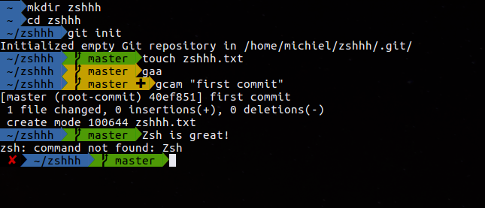
Git in ZSH

Slide 57
Recommendations
A PR will contain only the one logical change or one bug
No one will comment and ask for cosmetic changes instead of approving logical change-set
Another PR can be created under same issue or a generic issue to fix the cosmetic changes
All commits present in a PR must be squashed into one with one consolidated detailed commit message

Slide 58
Thank you!
Notes:
Notes here

