Slide 1
From Automated Builds to Tests:
Enabling new trees in KernelCI
(Hands-on)
Muhammad Usma Anjum <usama.anjum@collabora.com>
Notes:
Introduction
Summary:
* options

Slide 2
KernelCI
A collaborative CI framework to improve Linux kernel stability and testing efficiency.
Challenges in Kernel Development:
  Complexity of the Linux kernel
  Increasing hardware and platform diversity
  Frequent regressions during upstreaming
KernelCI’s Solution:
  Collaborative, open-source CI system
  Focused on kernel stability and long-term maintenance
Notes:
Companies use Linux in their products
Servers / laptops
Other device??
Printers routers
Hobbyist use Linux in what ???
Using linux on their laptop and hardware isn’t supported
Resercher and students examples
Source code is avialable, security analysis
New algorithms
Inaria

Slide 3
Key Features of KernelCI
Comprehensive Testing Framework:
  220+ build configurations
  Extensive test suites: kselftest, kunit, rt-tests, LTP, etc.
Automation:
  Builds, tests, and regression detection across platforms
Web Dashboard:
  Analyze results, track regressions, and generate custom reports
Collaboration:
  YAML-based configuration for easy customization
Notes:
Companies use Linux in their products
Servers / laptops
Other device??
Printers routers
Hobbyist use Linux in what ???
Using linux on their laptop and hardware isn’t supported
Resercher and students examples
Source code is avialable, security analysis
New algorithms
Inaria

Slide 4
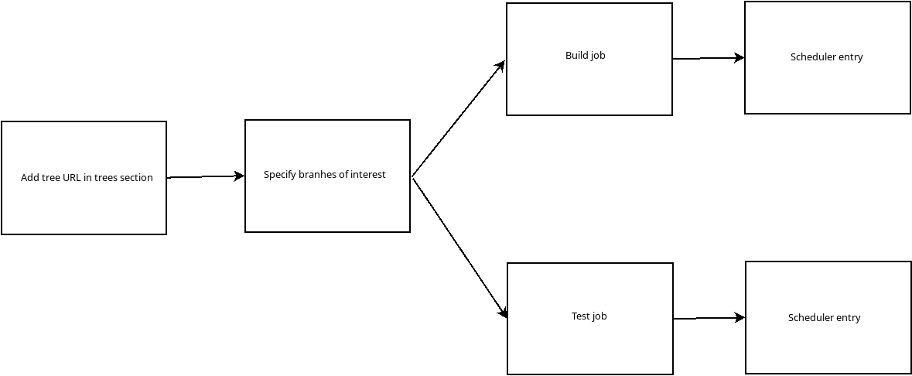
Adding tree

Slide 5
Adding Your Tree to KernelCI
Add entry to the pipeline configuration file [1] in trees section
trees:
<tree-name>:
url: "<tree-url>"

Slide 6
Specify different branches
Specify branches of interest in build_config file:
build_configs:
amlogic:
tree: amlogic
branch: 'branch0'
amlogic:
tree: amlogic
branch: 'branch1'

Slide 7
Build job
<kbuild-job-name>:
template: <job-template>
kind: kbuild
image: <docker-image-name>
params:
arch: <architecture>
compiler: <compiler-name>
cross_compile: <compiler-prefix>
dtbs_check: <dtb-check-enabled>
defconfig: <defconfig-name>
fragments:
- <fragment-name>

Slide 8
Test job or test
<test-job-name>:
template: <template-name>
kind: <kind of job, either 'job' or 'test'>
params:
nfsroot: <rootfs-url>
collections: <name-of-suite>
job_timeout: <timeout>
kcidb_test_suite: <kcidb-mapping>

Slide 9
Rules for jobs
rules:
min_version:
version: <kernel-version>
patchlevel: <kernel-patch_level>
max_version:
version: <kernel-version>
patchlevel: <kernel-patch_level>
tree:
- <tree-name>
- !<tree-name2>
- <tree-name3>:<branch-name>
branch:
- <branch-name>

Slide 10
Scheduler Entry
scheduler:
- job: <kbuild-job-name>
event: <API-pubsub-event>
runtime:
name: <runtime-name>
- job: <test-job-name>
event: <API-pubsub-event>
runtime:
type: <runtime-type>
name: <runtime-name>
platforms:
- <device-type>

Slide 11
Example Build Job: Definition
kbuild-gcc-12-arm64-preempt_rt_chromebook:
<<: *kbuild-gcc-12-arm64-job
params:
<<: *kbuild-gcc-12-arm64-params
fragments:
- 'preempt_rt'
- 'arm64-chromebook'
defconfig: defconfig
rules:
tree:
- 'stable-rt'

Slide 12
Example Build Job: Scheduler Entry
- job: kbuild-gcc-12-arm64-preempt_rt_chromebook
event: &checkout-event
channel: node
kind: checkout
state: available
runtime:
name: k8s-all

Slide 13
Example Test Job: Definition
kselftest-dt:
template: generic.jinja2
kind: job
params:
test_method: kselftest
nfsroot: 'http://storage.kernelci.org/images/rootfs/debian/bookworm-kselftest/20240221.0/{debarch}'
collections: dt
job_timeout: 10
rules:
min_version:
version: 6
patchlevel: 7
kcidb_test_suite: kselftest.dt

Slide 14
Example Test Job: Scheduler Entry
- job: kselftest-dt
event: *kbuild-gcc-12-arm64-node-event
runtime:
type: lava
name: lava-collabora
platforms:
- bcm2711-rpi-4-b

Slide 15
Templates (continued)
- test:
timeout:
minutes: {{ job_timeout }}
definitions:
- from: inline
repository:
metadata:
format: Lava-Test Test Definition 1.0
name: timesync-off
description: Disable systemd time sync services
run:
steps:
- systemctl stop systemd-timesyncd || true
name: timesync-off
path: inline/timesync-off.yaml

Slide 16
Templates
- repository: https://github.com/kernelci/test-definitions.git
from: git
revision: kernelci.org
path: automated/linux/kselftest/kselftest.yaml
name: '{{ node.name }}'
parameters:
TESTPROG_URL: '{{ node.artifacts.kselftest_tar_gz }}'
SKIPFILE: /dev/null
TST_CMDFILES: '{{ collections }}'
TST_CASENAME: '{{ tests }}'
SKIP_INSTALL: True
ENV: '{{ env }}'

Slide 17
Lava Job Description
Example definition: https://lava.collabora.dev/scheduler/job/16725918/definition

Slide 18
Writing a selftest
https://github.com/kernelci/kernelci-pipeline/blob/main/config/pipeline.yaml

Slide 19
Thank you!

