Slide 1
Adding feature to MM
Muhammad Usma Anjum <usama.anjum@collabora.com>
Notes:
Introduction
Summary:
* options

Slide 2
Soft-Dirty PTE (Page Table Entry) flag
Software flag only
Keeps track of which pages have been written to since the last clear operation
  Clear soft-dirty bits from the task's PTEs.
  Read soft-dirty bits from the PTEs.
Historically it has been used in the CRIU project
Notes:
Companies use Linux in their products
Servers / laptops
Other device??
Printers routers
Hobbyist use Linux in what ???
Using linux on their laptop and hardware isn’t supported
Resercher and students examples
Source code is avialable, security analysis
New algorithms
Inaria

Slide 3
Soft-Dirty PTE (Page Table Entry) flag
A region may get de-allocated and new memory can appear at the same address space with same soft-dirty flags
Soft-dirty flag got introduced at the VMA (Virtual Memory Area) level as well
Now internally Soft-dirty PTE flag isn’t just the PTE flag. Is it?
  Soft-dirty flag in the VMA
  Soft-dirty flag in the PTE
  If any of these two flags is set, the page is soft-dirty.
Notes:
Companies use Linux in their products
Servers / laptops
Other device??
Printers routers
Hobbyist use Linux in what ???
Using linux on their laptop and hardware isn’t supported
Resercher and students examples
Source code is avialable, security analysis
New algorithms
Inaria

Slide 4
Soft-Dirty PTE flag
VMAs having the same flags are merged together
VMAs having all the same flags, but different soft-dirty flag will not merge. There is possibility that the maximum vma limit is reached (/proc/sys/vm/max_map_count).
Short-term-solution: Ignore the soft-dirty flag while deciding if the VMAs should be merged
Side-effect: A non-soft-dirty VMA can become soft-dirty out of the blue
  Expecting 5 dirty pages from a total of 10, but got all the 10 dirty. (There wasn’t any use case at that time)
Notes:
Companies use Linux in their products
Servers / laptops
Other device??
Printers routers
Hobbyist use Linux in what ???
Using linux on their laptop and hardware isn’t supported
Resercher and students examples
Source code is avialable, security analysis
New algorithms
Inaria

Slide 5
GetWriteWatch() Windows Syscall
Get and/or Clear the page addresses which have been written to
It has some special sementics that the syscall returns after finding X dirty pages from total of N pages
Linux doesn’t support:
  Clearing of soft-dirty flag on a region of memory
  Getting and clearing atomically isn’t possible

Slide 6
Lets design a Sycall in Linux
A generic syscall which can be used to watch or clear the flags in the PTEs
long process_memwatch(int pidfd, unsigned long start, int len, unsigned int flags,
  void *vec, int vec_len);
  Split the VMA and clear it (but merging happens)
  Lets ignore the VMA dirtiness with a flag

Slide 7
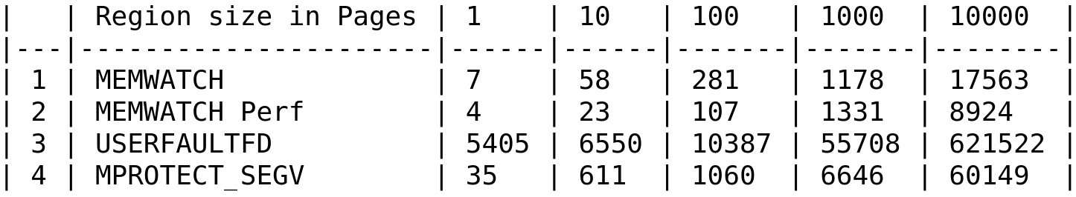
Benchmarking with other possible methods
It is more about correctness than the performance

Slide 8
The memwatch() syscall
Not much interest from the community.
Feedback: Maybe an IOCTL is better?

Slide 9
Lets make a IOCTL in Linux
Feedback: The interface isn’t generic enough. Add the support of following to make it useful for the CRIU project:
  Get the status of more flags (is file, is present, is swapped)
  Filtering support

Slide 10
Lets make a IOCTL in Linux
The IOCTL is getting accepted. But deciding the soft-dirtiness only on the PTEs is buggy. It can be reproduced using the mprotect.
Why this happened? As the soft-dirtiness wasn’t dependent only on the PTEs for a long time,
    the core memory management code considers PTE flag irrespective of the VMA dirtiness flag
    the other kernel code doesn’t care about PTE flag if the VMA dirtiness flag is set.

Slide 11
Feedback
Factor out that from your patch set for now
Find a way to handle this cleanly, for example, not merging VMAs that differ in soft-dirty flags
Notes:
Block layer, hard disks have evolved

Slide 12
VMA merging
VMA merging can be reworked for soft-dirty feature correctness
  It cannot be done after 8 years because of regression
  Feedback from original developer of the soft-dirty feature: The way softdirty has been implemented in the first place is to reach the minimum needs for dirty page tracking. More precise tracking (such as partial cleanup of memory region) will require at least other structures to remember which part of vma is cleared and which one is dirty after their merge. And I don't think this is possible to implement without extending vma structure itself (which is big enough already).

Slide 13
Problems while development
The development takes lots of effort in development and testing.
Lack of reviews and feedback on the MM mailing list and IRC
The original feature developers are very busy and aren’t involved even in the version 6. One veteran involved dev has said that he’ll look at it maybe before or after Chrismas.

Slide 14
In-progress work
Re-work the VMA dirtiness
  Keep a record that which part of the VMA is soft-dirty possibly in list initially
  Do all of this effort without the promise that the change in the VMA will be accepted as the VMA size is considered critical.

Slide 15
Thank you!

