Slide 1
Adding Functionality to make Windows games run faster on Linux
Muhammad Usma Anjum <usama.anjum@collabora.com>
Notes:
Introduction
Summary:
* options

Slide 2

2 years at Collabora
5+ years of development experience
Interests in core kernel
70+ patches in Upstream
Really enjoying Bilbao

Slide 3
GetWriteWatch() Windows API
Get and/or Reset the write tracking state
Operation on any size of memory area
Returns after finding X dirty pages from total of N pages (X < N)
API is relatively widely used on Windows
  Implementing copy-on-write mechanisms
  Security, intrusion and debugger detection
  Garbage collectors

Slide 4
ResetWriteWatch() Windows API
Resets the write-tracking state for a region of memory

Slide 5
CRIU uses Soft-Dirty Flag
CRIU freezes processes to pre-dump their memory
It doesn’t have the accurate information about pages to the moment of dumping them

Slide 6
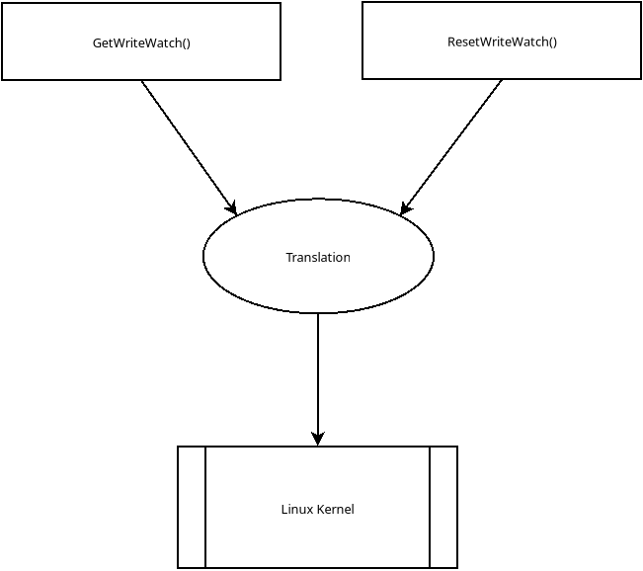
Translation

Slide 7
Using mprotect() + SIGSEGV
Write protect the memory with mprotect()
Register SIGSEGV handler to catch segmentation faults
In the handler
  Unprotect the page and do the bookkeeping
Other than being very slow, it doesn’t fulfill all the use cases
  Write protected memory isn’t desired by some software layers like Vulkan drivers

Slide 8
Using Userfaultfd()
Initialize a userfault file descriptor (userfaultfd)
Register memory region with userfaultfd
Poll the descriptor for UFFD_PAGEFAULT_FLAG_WP fault messages
Clear the fault and Do the bookkeeping
Even slower than mprotect() + SIGSEGV

Slide 9
Are they useful?
Traveling of signals or messages between kernel and userspace
Too much slow to be useful in high performance demanding applications like games

Slide 10
Memory Management Concepts
Page tables are used to map virtual to physical addresses
Page table entry (PTE) holds the mapping
  Page Frame Number, Protection bits, Status flags
Virtual Memory Area (VMA) is used to keep track of process’s memory mappings
Page Fault (PF) is an exception which is raised when page isn’t present or page is protected
TLB cache stores the recent virtual to physical address

Slide 11
Soft-Dirty PTE (Page Table Entry) flag
Software only status flag in PTE
The writeable bit of PTE is cleared. Soft-Dirty flag is set when Page Fault occurs
Keeps track of which pages have been written to since the last clear operation
  Read soft-dirty flags of desired pages from pagemap file
  Clear soft-dirty flag from all the PTEs of the task
Notes:
Companies use Linux in their products
Servers / laptops
Other device??
Printers routers
Hobbyist use Linux in what ???
Using linux on their laptop and hardware isn’t supported
Resercher and students examples
Source code is avialable, security analysis
New algorithms
Inaria

Slide 12
Soft-Dirty VMA flag
A region may get de-allocated and new memory can appear at the same address space with same soft-dirty flags
Soft-dirty flag got introduced at the VMA (Virtual Memory Area) level as well named as VM_SOFTDIRTY
Soft-Dirty PTE flag is set regardless of VM_SOFTDIRTY
Now internally Soft-dirty PTE flag isn’t just the PTE flag. Is it?
  Soft-dirty flag in the PTE
  Soft-dirty flag in the VMA
  If any of these two flags are set, the page is soft-dirty.
Notes:
Companies use Linux in their products
Servers / laptops
Other device??
Printers routers
Hobbyist use Linux in what ???
Using linux on their laptop and hardware isn’t supported
Resercher and students examples
Source code is avialable, security analysis
New algorithms
Inaria

Slide 13
Kernel’s Internal Activity Affecting Soft-Dirty Flag
VMAs having the same flags are merged together
VMAs having all the same flags, but different soft-dirty flag will not merge. There is possibility that the maximum vma limit is reached (/proc/sys/vm/max_map_count).
Notes:
Companies use Linux in their products
Servers / laptops
Other device??
Printers routers
Hobbyist use Linux in what ???
Using linux on their laptop and hardware isn’t supported
Resercher and students examples
Source code is avialable, security analysis
New algorithms
Inaria

Slide 14
Kernel’s Internal Activity Affecting Soft-Dirty PTE
Short-term-solution: Ignore the soft-dirty flag while deciding if the VMAs should be merged
Side-effect: A non-soft-dirty VMA can become soft-dirty out of the blue
  Expecting 5 soft dirty pages from a total of 10 pages memory, but got all the 10
Notes:
Companies use Linux in their products
Servers / laptops
Other device??
Printers routers
Hobbyist use Linux in what ???
Using linux on their laptop and hardware isn’t supported
Resercher and students examples
Source code is avialable, security analysis
New algorithms
Inaria

Slide 15
Short-comings of Soft-Dirty Flag
It is not accurate
Soft-Dirty flag on a part of memory region cannot be cleared
Atomic get and clear opeartion isn’t present
Notes:
Companies use Linux in their products
Servers / laptops
Other device??
Printers routers
Hobbyist use Linux in what ???
Using linux on their laptop and hardware isn’t supported
Resercher and students examples
Source code is avialable, security analysis
New algorithms
Inaria

Slide 16
Add IOCTL based on Soft-Dirty Flag
Implement Clear operation on a region of memory
Implement atomic GET+CLEAR operation
Ignore Soft-Dirty flag (VM_SOFTDIRTY) on VMA

Slide 17
Add IOCTL based on Soft-Dirty Flag
The prototype was working until some patch related to mprotect() stopped setting the SOFT_DIRTY flag when VM_SOFTDIRTY was set
We argued that it is changing functionality
The users weren’t affected by this patch, so nobody listened to us

Slide 18
1. Lets fix Soft-Dirty Functionality
While soft-dirty feature creation there was a bug
The newly created VMA wasn’t getting merged into older VMA because of wrongfully setting VM_SOFTDIRTY flag on new VMA
The issue wasn’t identified correctly
Started ignoring the soft-dirty flag for VMA merging decision
Feedback: Sorry, it’ll cause regressions now.

Slide 19
2. Lets fix Soft-Dirty functionality
Add a linked list in VMA struct to keep track of which part of VMA is soft-dirty and which isn’t
Feedback: This would increase the memory usage per VMA struct by 8 bytes and 32 bytes per entry in linked-list

Slide 20
UFFD_FEATURE_WP_ASYNC for Userfaultfd
Userfaultfd uses _PAGE_UFFD_WP PTE flag to Write-Protect the page
Add Asynchronous WP mode in userfaultfd UFFD_FEATURE_WP_ASYNC
Resolve the Page Fault from kernel instead
A page is considered dirty (written) if it isn’t write protected
  Dirty = !(is_page_written)
Notes:
Companies use Linux in their products
Servers / laptops
Other device??
Printers routers
Hobbyist use Linux in what ???
Using linux on their laptop and hardware isn’t supported
Resercher and students examples
Source code is avialable, security analysis
New algorithms
Inaria

Slide 21
UFFD_FEATURE_WP_UNPOPULATED for Userfaultfd
Write protection on empty pages isn’t recorded
Add feature to remember the write-proctection for empty pages
Notes:
Companies use Linux in their products
Servers / laptops
Other device??
Printers routers
Hobbyist use Linux in what ???
Using linux on their laptop and hardware isn’t supported
Resercher and students examples
Source code is avialable, security analysis
New algorithms
Inaria

Slide 22
Update PAGEMAP_SCAN IOCTL
Use userfaultfd WP flag in place of soft-dirty flag
The input of IOCTL is given in struct pm_scan_arg
Implement the scaning for all memory types:
  Pages
  Huge Pages
  HugeTLB
  Holes
Notes:
Companies use Linux in their products
Servers / laptops
Other device??
Printers routers
Hobbyist use Linux in what ???
Using linux on their laptop and hardware isn’t supported
Resercher and students examples
Source code is avialable, security analysis
New algorithms
Inaria

Slide 23
Supported operations
Scan the address range and get the memory ranges matching the provided criteria. This is performed when the output buffer is specified.
PM_SCAN_WP_MATCHING write protects the pages of interest.
PM_SCAN_CHECK_WPASYNC aborts the operation if non-Async WP pages are found
Notes:
Companies use Linux in their products
Servers / laptops
Other device??
Printers routers
Hobbyist use Linux in what ???
Using linux on their laptop and hardware isn’t supported
Resercher and students examples
Source code is avialable, security analysis
New algorithms
Inaria

Slide 24
CRIU Developers Requested
Compacted output memory buffer
More PTE flags support in initial patches themselves
Filtering support
Notes:
Block layer, hard disks have evolved

Slide 25
Return compacted data to user
Return data to user in form of ranges instead of address
Return the flags with each address range
Would return less data from kernel to user on average
Notes:
Companies use Linux in their products
Servers / laptops
Other device??
Printers routers
Hobbyist use Linux in what ???
Using linux on their laptop and hardware isn’t supported
Resercher and students examples
Source code is avialable, security analysis
New algorithms
Inaria

Slide 26
Supported PTE flags
PAGE_IS_WPALLOWED: Page has async-write-protection enabled
PAGE_IS_WRITTEN: Page has been written-to
PAGE_IS_FILE: Page is file backed
PAGE_IS_PRESENT: Page is present in the memory
PAGE_IS_SWAPPED: Page is in swapped
PAGE_IS_PFNZERO: Page has zero PFN
PAGE_IS_HUGE: Page is THP or Hugetlb backed
Notes:
Companies use Linux in their products
Servers / laptops
Other device??
Printers routers
Hobbyist use Linux in what ???
Using linux on their laptop and hardware isn’t supported
Resercher and students examples
Source code is avialable, security analysis
New algorithms
Inaria

Slide 27
Add filtering support
category_mask: Skip pages for which any category doesn't match
category_inverted: PAGE_IS_* categories which values match if 0 instead of 1
category_anyof_mask: Skip pages for which no category matches
return_mask: PAGE_IS_* categories that are to be reported in page_region
Notes:
Companies use Linux in their products
Servers / laptops
Other device??
Printers routers
Hobbyist use Linux in what ???
Using linux on their laptop and hardware isn’t supported
Resercher and students examples
Source code is avialable, security analysis
New algorithms
Inaria

Slide 28
Add more flexibility and documentation
Size of input struct is specified in size
max_pages is optionally specified to find X pages from region of N pages (X < N)
Address where the scan stopped is specified in walk_end
Notes:
Companies use Linux in their products
Servers / laptops
Other device??
Printers routers
Hobbyist use Linux in what ???
Using linux on their laptop and hardware isn’t supported
Resercher and students examples
Source code is avialable, security analysis
New algorithms
Inaria

Slide 29
Performance Improvements
The initial versions had bad performance
There were multiple passes to make code more simpler
The performance was improved over time
  Reduce the internal temporary usage to 12 kB as data cannot be copied to user buffer from inside the mm lock. Why?
  Reduce the number of iterations of page walks
  Add functions to WP the pages and flush TLB only once
Notes:
Companies use Linux in their products
Servers / laptops
Other device??
Printers routers
Hobbyist use Linux in what ???
Using linux on their laptop and hardware isn’t supported
Resercher and students examples
Source code is avialable, security analysis
New algorithms
Inaria

Slide 30
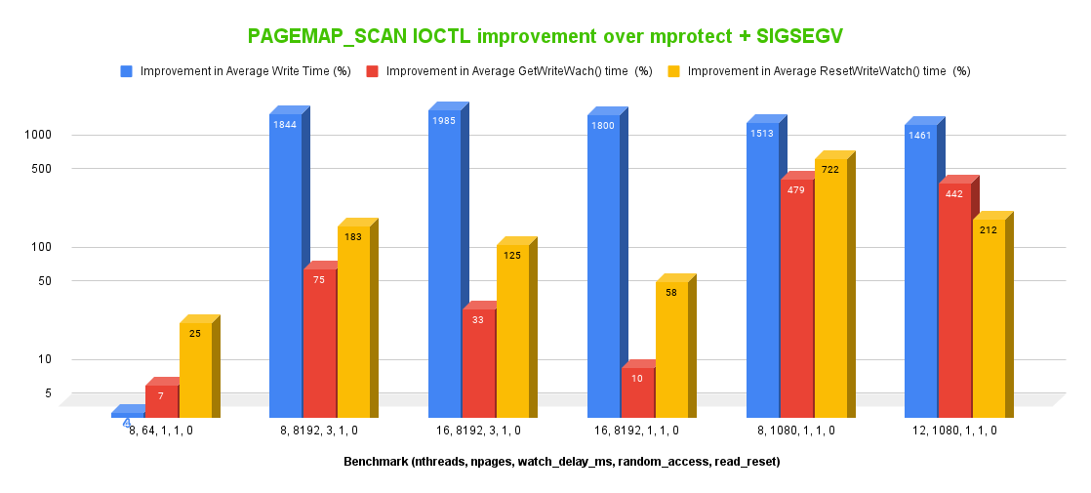
Benchmark

Slide 31
Current State
Patches are at v33
Multiple upstream developers have reviewed
Waiting for reply from maintainer from 4 weeks
Hoping for good news at any time now

Slide 32
Usages of Write Watches
A lot of games are known to use write watches
  Streets of Rage
  Red Dead Redemption 2

Slide 33
Problems while development
The development and testing takes a lots of effort
The original feature developers are long gone
Lack of timely reviews/feedback on the MM mailing list and IRC

Slide 34
Documentation and Testing
Documentation has been added in patch series
100+ kselftests been written
Through testing has been done by using it in WINE
TODO: Man page updates for Userfaultfd and PAGEMAP_SCAN IOCTL

Slide 35
Thank you!

