Slide 1
Power Measurements
Muhammad Usma Anjum <usama.anjum@collabora.com>
Notes:
Introduction
Summary:
* options

Slide 2
Attributes to be measured
C-States residency
P-States residency
Power consumed by CPU package
Number of Context Switches
Notes:
Companies use Linux in their products
Servers / laptops
Other device??
Printers routers
Hobbyist use Linux in what ???
Using linux on their laptop and hardware isn’t supported
Resercher and students examples
Source code is avialable, security analysis
New algorithms
Inaria

Slide 3
C-States
C-states are power-saving modes at different levels.
Higher C-state = deeper sleep, more power saved, longer wake-up time.
C-states save power, but aggressive management affects responsiveness due to transition time.
Use cpupower to measure C-State residency
  `cpupower monitor -c <app>`

Slide 4
P-States
P-states are different combination of frequency and voltage at which a CPU can operate.
Each P-state corresponds to different clock speed.
Higher P-state, more power consumption and more performance.
Governors pick P-State based on Load history, Response time, and even thermal conditions.
  Performance, Powersave, Ondemand and Schedutil

Slide 5
Power consumed by CPU Package
RAPL (Running Average Power Limit) allows real-time monitoring at various levels of the CPU hierarchy, such as the package, cores, and memory.
RAPL counters are accessed by perf.
Available events: `perf list | grep power/energy`
Use with perf stat
  `perf stat -I 1000 -e power/energy-pkg/`

Slide 6
Number of the Context Switches
Number of times tasks were scheduled
Key to understanding scheduler behavior
  `trace-cmd record -e sched_wakeup`
  `trace-cmd report | `grep "sched_wakeup"`

Slide 7
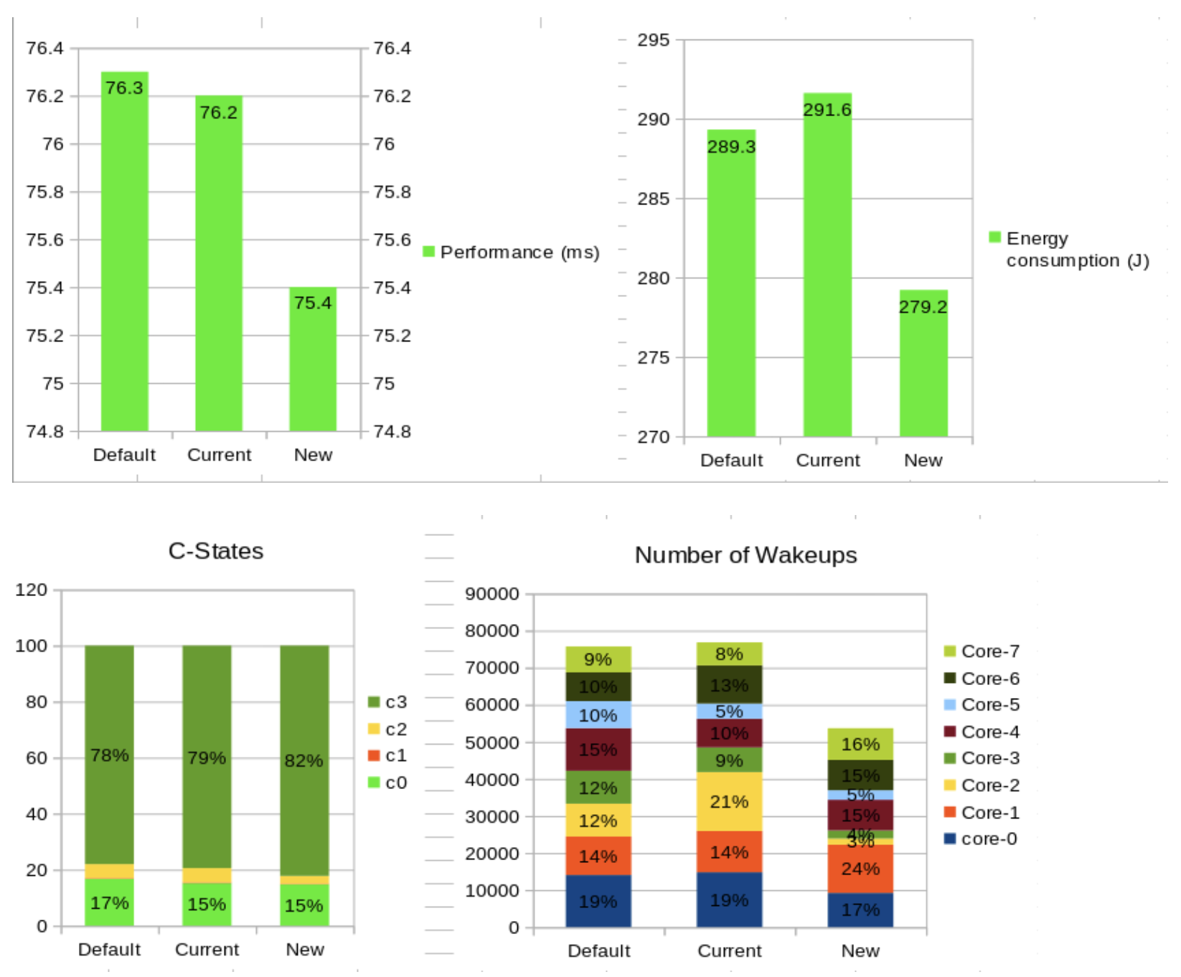
Some benchmarks

Slide 8
Thank you!

