Slide 1

→ 1. CAMPUS TRANSIT CRISIS & SOLUTION
UNIVERSITY OF ILORIN · SWEP GROUP H
ENGINEERING EXHIBITION 2026
→ 2. FULL-STACK SYSTEM ARCHITECTURE
SMART CASHLESS
CAMPUS TRANSIT.
A smart bus payment and tracking system using tap cards and phone scans
→ 3. ESP32 VALIDATOR POD
→ 4. OFFLINE RESILIENCE
→ 5. AUTOMATED PAYSTACK WALLET SYSTEM
DEFENSE DEMO · OCT 2026
→ 6. TECHNICAL BENCHMARK & LIVE DEMO

Slide 2
02
THE CAMPUS TRANSIT CRISIS
PROBLEM & VALUE PROPOSITION
EXISTING BOTTLENECK
The Friction of Cash on Campus
Over 30,000 university students rely on campus shuttle buses daily. Physical cash payments cause severe cash-change shortages, delayed boarding queues, fare dispute friction, and untracked driver revenue leakages.
The Hyperion Solution: A unified digital wallet where students can buy Ride Points (e.g. 1 Ride Point = ₦250). Students authenticate via physical student ID card or dynamic driver QR code for instantaneous, cashless boarding.
12 MIN
QUEUE DELAY ELIMINATED
Sub-second tap-and-go boarding accelerates passenger entry by over 80% compared to cash handling.
100%
AUDITED REVENUE RECONCILIATION
All transactions sync to university administrative consoles with zero physical cash leakage.

Slide 3
03
FULL-STACK ARCHITECTURE
HARDWARE-SOFTWARE CO-DESIGN
LAYER 01 | CLIENT APP
Student Mobile App
The daily passenger app for students to quickly generate QR boarding passes, view transaction logs, view wallet balances, and top up funds.
TECH: REACT NATIVE · EXPO · TAILWIND
LAYER 02 | EDGE IoT
Smart Bus Scanner Pod
The physical scanner mounted inside the bus. It instantly reads student ID cards or phone taps, shows instant approval on its screen, and signals boarding access.
TECH: C++ · ESP-IDF · FREERTOS · PN532
LAYER 03 | BACKEND API
Central Cloud Server
The secure brain connecting everything. It instantly verifies rides, processes fare deductions, and syncs data between mobile apps and bus scanners in milliseconds.
TECH: NODE.JS · TYPESCRIPT · MONGOOSE
LAYER 04 | FINTECH & FLEET
Payments & Admin Hub
Provides each student with their own dedicated bank account for easy bank transfers, while giving managers real-time bus tracking and revenue insights.
TECH: PAYSTACK WEBHOOKS · MONGODB ATLAS

Slide 4
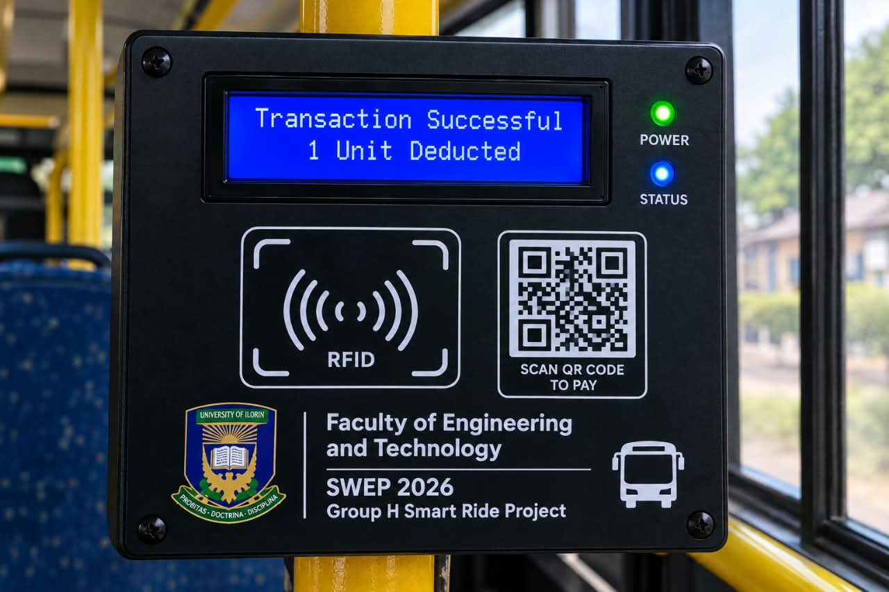
04
BUS SCANNER POD
PHYSICAL PROTOTYPE
ONBOARD EMBEDDED SYSTEM
Passenger Entry Validator
Mounted right at the bus door so drivers never have to handle cash or pass around phones. Students simply tap their smart student ID card or scan with their phone for instant entry.
Main Controller: ESP32 Chip (Handles Wi-Fi, Bluetooth & Logic)
Card Reader: High-Speed RFID & Phone Tap Sensor
Display Screen: Mini OLED Screen (Shows Fare & Balance)
Device Security: Encrypted Access Key (Prevents Tampering)
PROTOTYPE: ONBOARD SCANNER UNIT

Slide 5
05
OFFLINE RELIABILITY
WORKS WITHOUT INTERNET
01
Network Outage Detection
If the bus drives into an area with poor network coverage or dead zones, the scanner automatically switches to offline mode without interrupting boarding.
AUTOMATIC SWITCH
02
Internal Memory Verification
The scanner stores an encrypted list of valid student passes directly on its internal memory, verifying card taps in less than 50 milliseconds.
INSTANT VERIFICATION
03
Accurate Clock Timestamping
A battery-powered backup clock records the exact time and sequence of every ride to prevent duplicate taps or record tampering.
SECURE LOGGING
04
Automatic Cloud Sync
As soon as internet connection is restored, the scanner automatically uploads all saved offline rides to the server to update balances seamlessly.
BACKGROUND SYNC

Slide 6
06
PAYMENTS & TOP-UPS
SEAMLESS WALLET SYSTEM
SIMPLE BANK TRANSFER TOP-UP
Students can transfer any amount (e.g. ₦1,000 → 4 ride points) using any banking app, USSD code, OPay, or PalmPay.
₦250
= 1 RIDE POINT
INSTANT WALLET CREDIT
Secure automated payment alerts credit student wallets within 2 seconds, safely converting every naira into usable ride points.
Dedicated Bank Account
Every student gets a unique, permanent virtual bank account number linked directly to their student profile.
CAMPUS CASH BOOTH ALTERNATIVE
An on-campus service desk allows designated university staff to credit student cards with cash whenever needed.

Slide 7
07
SYSTEM COMPARISON
WHY HYPERION WINS
KEY FEATURE | CASH / PAPER TICKETS | REGULAR RIDE APPS | STANDARD POS MACHINES | HYPERION TRANSIT
Boarding Speed | Slow (15 – 30 seconds) | Moderate (8 – 15 seconds) | Slow (10 – 20 seconds) | Instant (< 0.5s Card/QR Tap)
Offline Capability | Unmonitored cash | Fails with poor signal | Fails with poor signal | Works Offline & Syncs Later
Bus Hardware | None | None (phone only) | Generic bank POS | Custom Scanner & Embedded IoT
Automated Fares | Manual change issues | Manual card/in-app flow | Bank network dependent | Instant Sub-Second RFID & QR
Revenue Accounting | Frequent cash loss (>20%) | App-only rides | Delayed settlements | 100% Real-Time & Audited

Slide 8
08
SPEED & PERFORMANCE
SPEED TEST RESULTS
Response Speed Breakdown
< 0.2s
AVERAGE TAP VERIFICATION
Passengers can tap and step right in without waiting for slow loading screens.
1. OFFLINE CARD TAP (45MS — INSTANT)
45ms
2. ONLINE CARD TAP (180MS — BLAZING FAST)
180ms
3. PHONE QR CODE SCAN (420MS — UNDER HALF A SECOND)
99.98%
TRANSACTION RELIABILITY
Built-in safety checks ensure students are never charged twice for the same ride.
420ms
4. BANK TRANSFER WALLET UPDATE (1.2S — NEAR-INSTANT)
1.2s

Slide 9
09
LIVE EXHIBITION DEMO
STEP-BY-STEP WALKTHROUGH
DEMO STAGE 01 | CARD TAP
Card Tap Boarding
Tap the student card on the bus scanner. The screen immediately displays "₦250 Deducted | 4 Pts Remaining", beeps, and lights up green.
INSTANT PASSENGER VALIDATION
DEMO STAGE 02 | PHONE QR
Phone QR Boarding
Open the student app and scan the driver's QR code. The fare is deducted immediately with no need to type in a PIN or password.
SMARTPHONE BOARDING PASS
DEMO STAGE 03 | BANK TOP-UP
Real-Time Bank Deposit
Send ₦500 from a commercial bank app to the student's personal account number. The wallet automatically updates with 2 ride points in seconds.
AUTOMATED PAYMENT PROCESSING
DEMO STAGE 04 | ADMIN DASHBOARD
Manager Control Screen
The manager's laptop dashboard shows live boarding telemetry, bus locations, ride history, and automated revenue totals in real time.
LIVE FLEET & REVENUE OVERVIEW

Slide 10
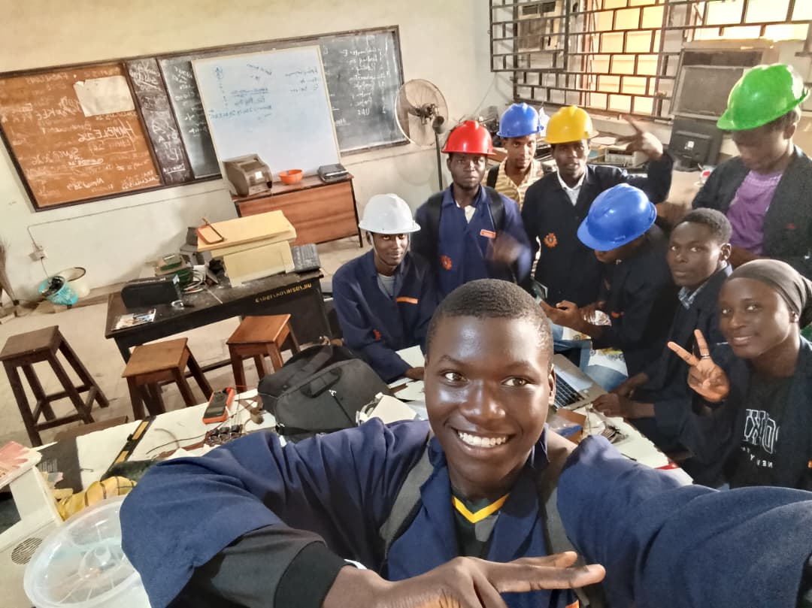
HYPERION SYSTEMS
Project Team & Attribution
Exhibition: SWEP 200 Group H (2026)
Institution: University of Ilorin, Nigeria
Repository: github.com/musamusakannike/hyperion
CONCLUSION
Smart.
Cashless.
Connected.
Hyperion delivers a reliable, fast, and easy-to-use campus transit system engineered specifically for Nigerian university environments.
SWEP 200 · UNIVERSITY OF ILORIN
ENGINEERING DEMO
GROUP H © 2026

