Slide 1
SASS/SCSS
Responsive Web Design
18.10.2021

Slide 2
2 different approaches
Using Custom Mixin Method
Using Media Queries with
Components/Layouts

Slide 3
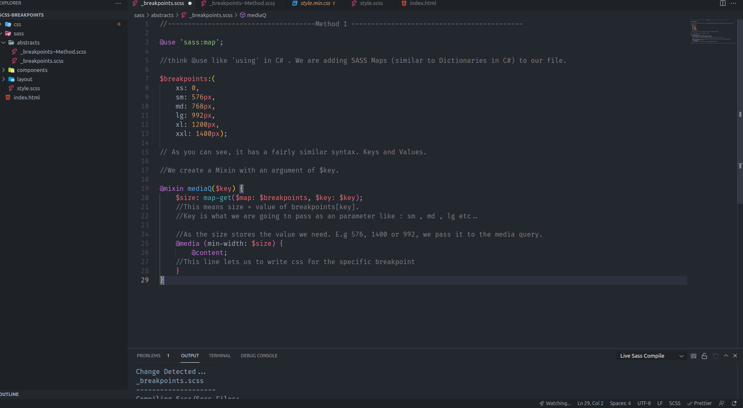
Lorem
Ipsum Dolor
Id volutpat lacus laoreet non curabitur gravida arcu. Felis bibendum ut tristique et egestas quis ipsum suspendisse. Quam viverra orci sagittis eu. Risus commodo viverra maecenas accumsan lacus. Sit amet est placerat in egestas. Semper auctor neque vitae tempus quam pellentesque

Slide 4
So what happens with Method 1 ?
Creating Custom Mixin
First we create a list/map to store our breakpoints
On Line 19, we create a custom mixin with the parameter of $key.
$key is what we are going to pass(e.g: sm , md , lg);
Map
But in order to use the Map ‘data structure’ in SASS/SCSS , we need to add it . So at the top of our file , we write: @use ‘sass:map’
Map-Get
With this method , we get the value at the given key. E.G md(key) : 768px(value)
SCSS Map structure
Maps in SCSS are pretty simple. They use key&value concept. Like Dictionaries in C#.
@content
@content lets us to dynamically write css whenever we call the custom mixin.

Slide 5
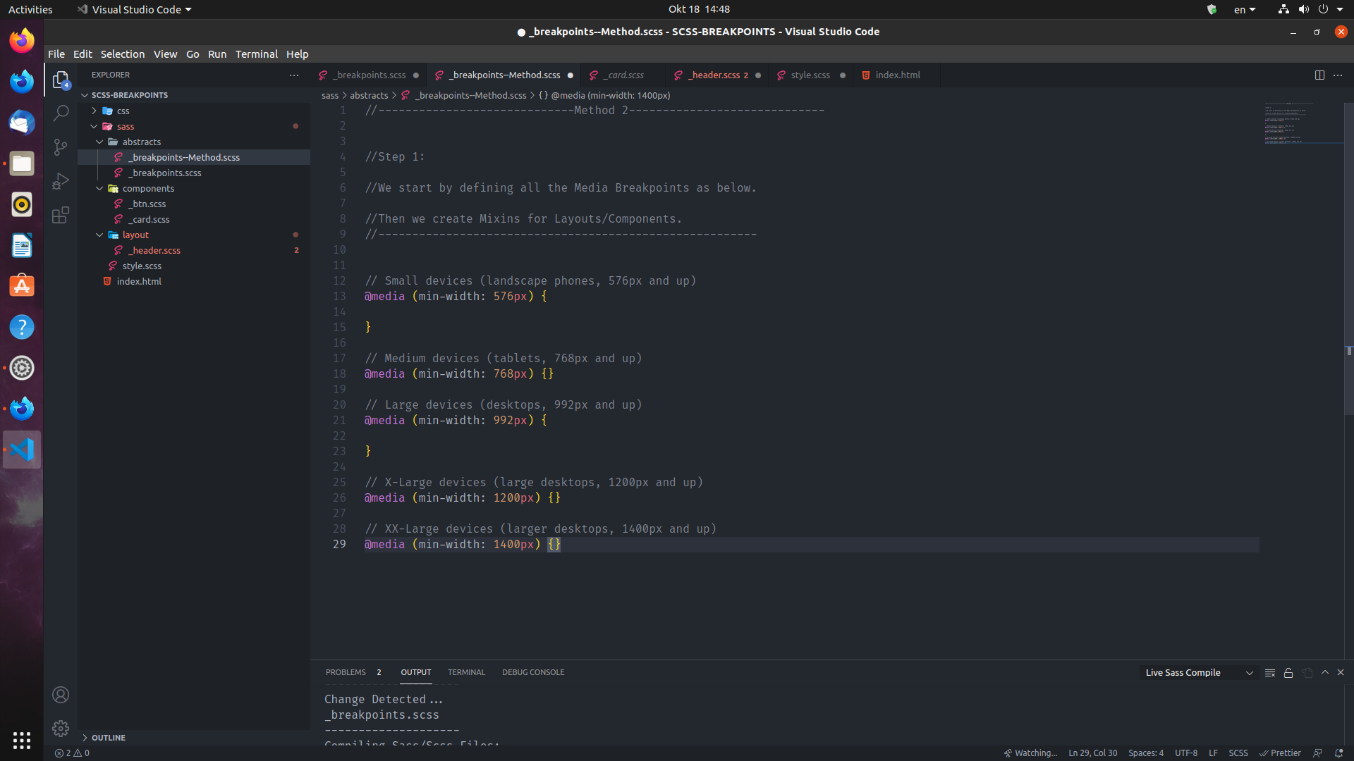

Slide 6
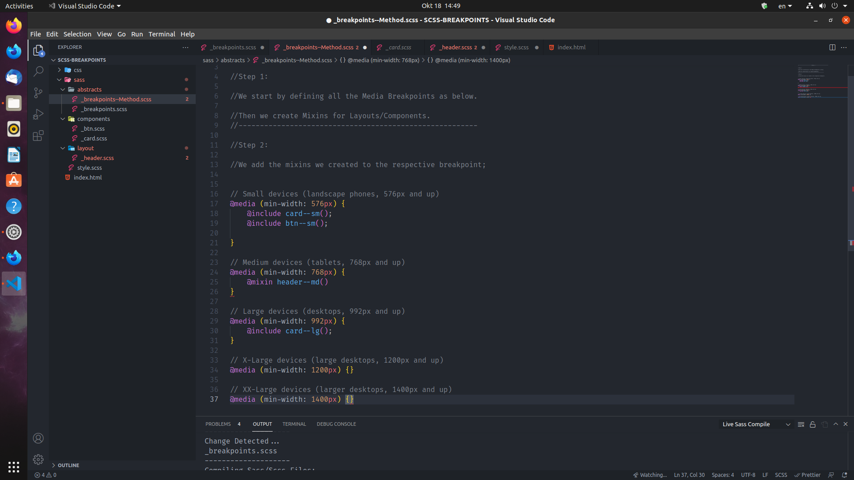

Slide 7
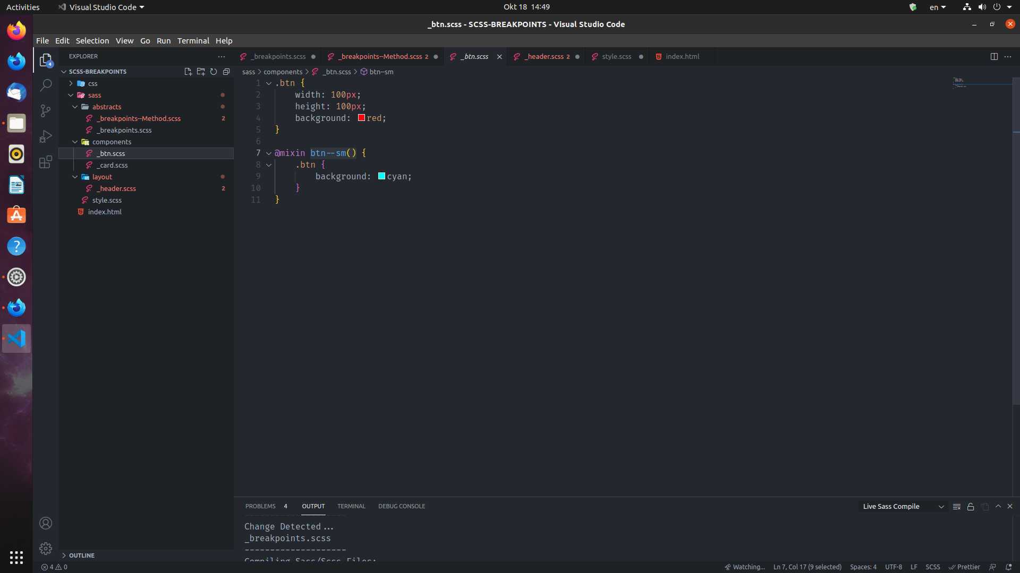

Slide 8
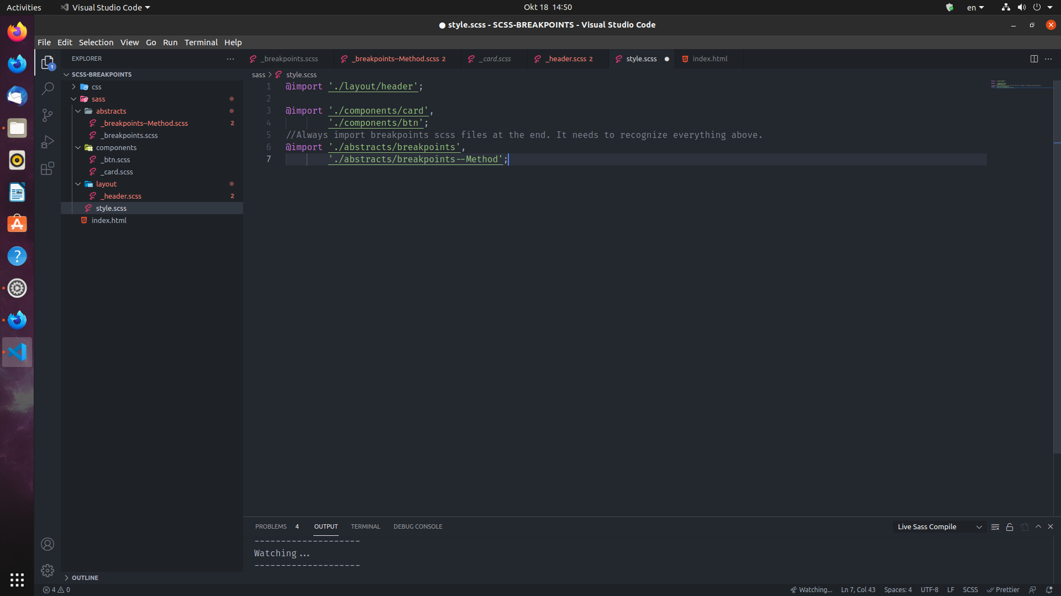

Slide 9
01
03
Media Queries
Creating Mixins
We create Media Queries like in slide 5.
Shown in slide 7, we create mixins in the respective Component or Layout file.
02
04
We Add Mixins
Main SCSS
Shown in Slide 6, we add the mixins we created for .btn, .card, header elements
The order of importing partials matters!
Always add Breakpoint files at the end. So it recognizes everything above.

Slide 10
So which method to choose?
Method 1
Method 2
Great for small projects.
Provides a fast development + your media queries are separated for each element.
Best for the big projects.
provides a more complex and neat design. It removes the duplication of media queries.
and it provides a compact , easy to read environment.

