Slide 1
Climate Change Overview
Generated by AI Presentation Maker

Slide 2
What is Climate Change
Climate change occurs when the Earth's average temperature rises due to increased levels of greenhouse gases in the atmosphere.
The most significant cause is human activity, particularly burning fossil fuels such as coal, oil, and gas for energy and transportation.
Renewable energy sources like solar and wind power can replace fossil fuels and reduce emissions, mitigating climate change.
Reducing energy consumption and adopting sustainable land use practices are also crucial steps in addressing the issue of climate change.

Slide 3
Key Causes
Burning fossil fuels releases carbon dioxide, a major contributor to global warming.
Transitioning to renewable energy sources can significantly reduce greenhouse gas emissions.
Reducing energy consumption and using efficient technologies is another key solution.
Implementing policies that promote renewable energy and energy efficiency are crucial actions.
Implementing sustainable land use practices can also help mitigate the effects of climate change.

Slide 4
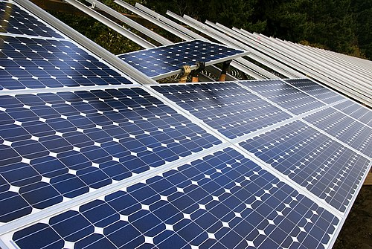
Solutions
Implementing solar panels or wind turbines to generate electricity from clean sources.
Investing in renewable energy technologies like hydroelectric power, geothermal, and biomass.
Encouraging the use of electric vehicles and promoting public transportation alternatives.
Transitioning to carbon capture and storage technologies to reduce emissions from fossil fuel combustion.
Supporting policies that promote sustainable land use practices, reforestation, and climate-resilient infrastructure.

