Slide 1
Climate Change Overview
Generated by AI Presentation Maker

Slide 2
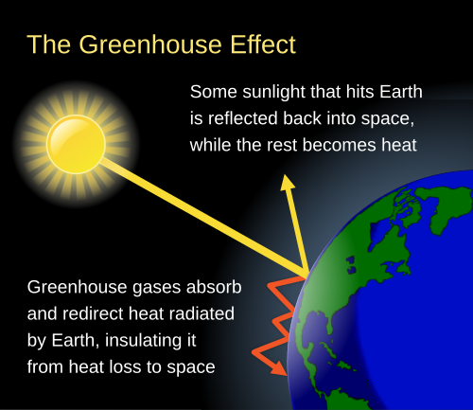
What is Climate Change
Greenhouse gases, such as carbon dioxide and methane, trap heat in the atmosphere.
Burning fossil fuels, like coal, oil, and gas, releases these gases into the air.
Deforestation and land-use changes also contribute to increased greenhouse gas emissions.
The increasing levels of greenhouse gases in the atmosphere lead to rising global temperatures.

Slide 3
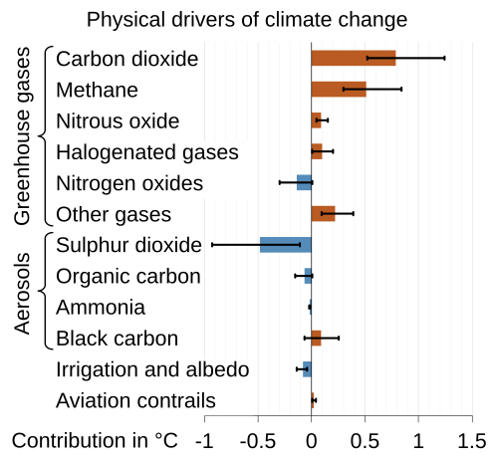
Key Causes
Burning of fossil fuels releases carbon dioxide, a major contributor to climate change.
Transitioning to renewable energy sources such as solar and wind power can significantly reduce emissions.

Slide 4
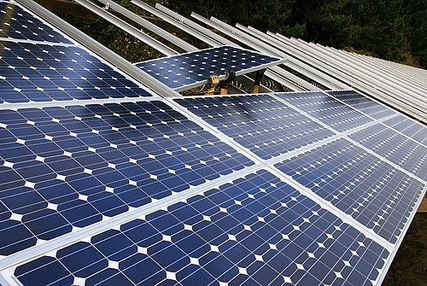
Solutions
Transition to renewable energy sources, such as solar and wind power.
Invest in energy efficiency measures at home and in businesses to reduce energy consumption.
Implement policies that phase out fossil fuels and promote cleaner transportation options.
Educate consumers about the benefits of renewable energy and encourage sustainable practices.

