Slide 1

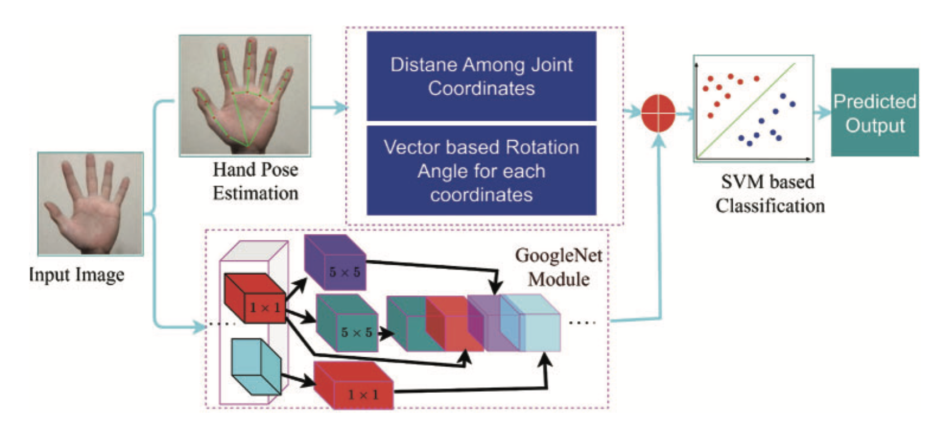
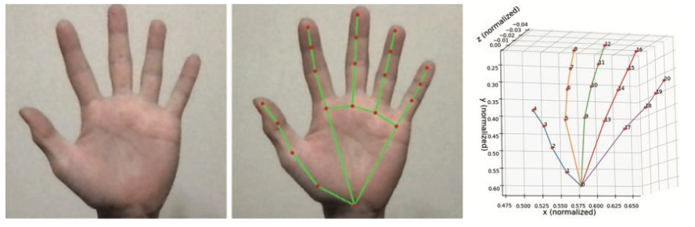
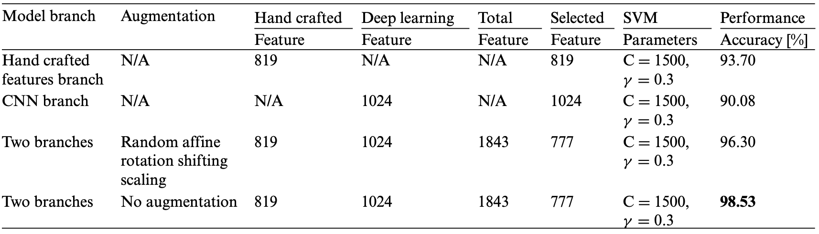

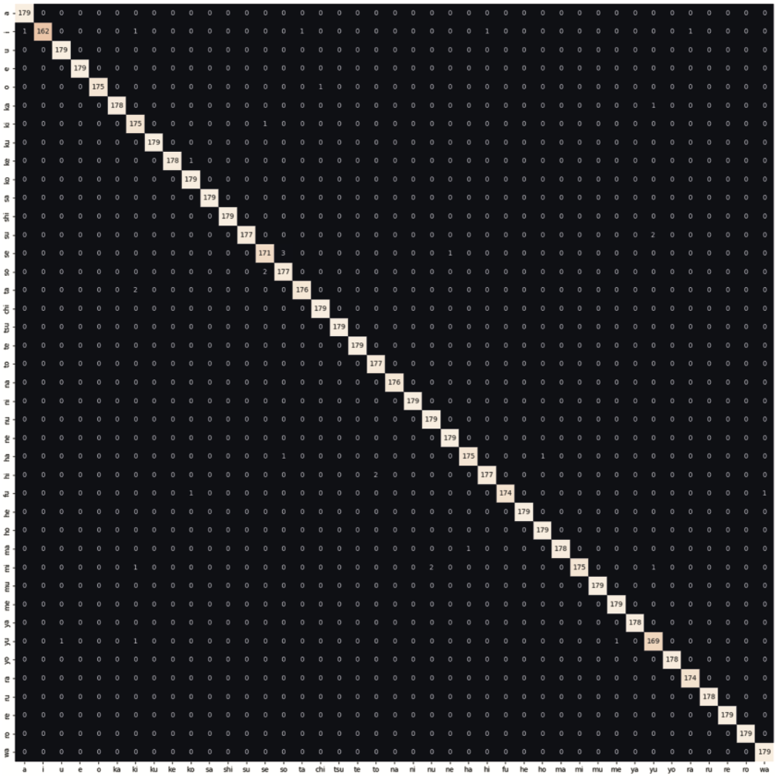

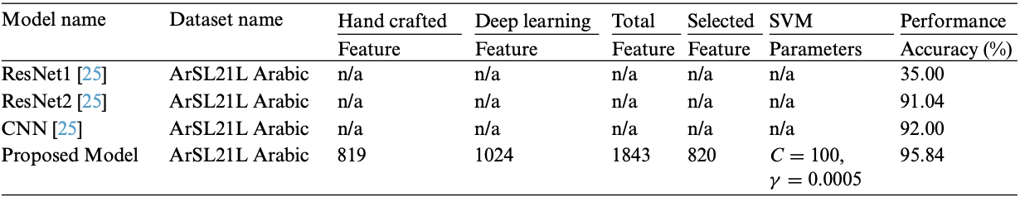
Japanese Sign Language Recognition by Combining Joint Skeleton-Based Handcrafted and Pixel-Based Deep Learning Features with Machine Learning Classification
PATTERN PROCESSING LAB, SCHOOL OF COMPUTER SCIENCE AND ENGINEERING, UNIVERSITY OF AIZU
INTRODUCTION
Japanese Sign Language (JSL) plays a pivotal role in enabling communication for the Deaf and hard-of-hearing communities in Japan[1]. Approximately 340,000 individuals rely on this visual-based language for their daily interactions [2]. Among them, 80,000 deaf communities use JSL to establish their communication to express their daily basic needs, thoughts, expressions, and requirements [3]. However, learning JSL presents considerable challenges, both for the Deaf community and for non-deaf individuals, primarily due to its complexity. Many people have used a human language translator to establish communication between the deaf and non-deaf communities. However, it is difficult to find human sign language translators costly. Furthermore, in the context of the COVID-19 pandemic, the demand for touchless communication interfaces has grown, underlining the urgency of developing reliable JSL recognition technologies. Therefore, there is a growing demand for non-contact input interfaces that allow users to input data without touching their hands.
In this study, we propose an innovative approach to JSL recognition that capitalizes on the strengths of joint skeleton-based handcrafted features and pixel-based Convolutional Neural Network (CNN) features. We introduce an innovative fusion approach that enhances both accuracy and robustness, contributing to the state-of-the-art in sign language recognition.
METHODOLOGY
Figure 1 demonstrates the proposed method architecture. In the study, we revolved around the fusion of pixel-based deep-learning features and joint skeleton-based handcrafted features for JSL recognition. To begin, we extracted joint skeleton-based features from sign language gestures, capturing intricate details of hand and body movements. These features were crucial in capturing the nuances of JSL articulation and expression. Concurrently, we harnessed the power of CNNs to extract pixel-based features from video frames containing sign language gestures. The fusion of these two distinct branch feature sets took place at multiple levels within our JSL recognition system. By combining joint skeleton-based features with pixel-based CNN features, we aimed to create a holistic and robust representation of sign language gestures. After concatenating the feature, we fed it into the feature reduction approach to select the effective features by discarding the less relevant features. Finally, we employed SVM with various kernel functions for the classification.
Estimation Skeleton Joint Coordinates
Figure 1: Proposed method architecture
Mediapipe estimates hand joints using a machine-learning model that analyzes input data from a single RGB camera. The model first detects the presence of a hand in the camera image and then estimates the 3D position of the hand joints. In the first branch, we used Mediapipe to extract the hand joint skeleton from the JSL hand gesture RGB dataset.
Feature Selection and Classification
We got 819 features from the hand-crafted first stream and 1024 from the deep learning-based second stream. After concatenating the two streams, we got 1843 features in total. We used a popular method for feature selection, namely the Boruta algorithm, which leverages the power of Random Forest to identify the most relevant features for a given problem.
After selecting the potential features using the Boruta algorithm approach, we employed the conventional machine learning model SVM with various kernel approaches for recognition and prediction. In the study, we used several kernel functions, such as polynomial, radial basis function, and sigmoid functions, aiming to transform the data into a higher-dimensional space to make it more separable.
Skeleton-Based Feature Extraction
In the study, after extracting the 21 joint coordinates by including x, y, and z coordinates, we capture the hand-crafted features to avoid the hand position- related limitations.
Distance Based Feature Extraction
To extract features unaffected by the hand’s position in the image, distances between the 21 coordinates were calculated. This resulted in 190 features being obtained from each image. Using the distances between these joints, the same position can be expected even if the position of the hand changes.
Angle-Based Feature Extraction
The feature value of how much the hand is tilted was calculated by calculating the direction vectors between the coordinates of each joint and then determining how much each vector was tilted from the XYZ direction. These features can increase the recognition rate of signs with the same shape but with different meanings depending on the inclination of the hand, such as the Japanese Sign Language characters for (na), (ni), (ma), and (mi). The angle between the vectors was calculated by taking Cos values from the two space vectors and using the direction vector and the vectors in the x, y, and z-axis directions.
RESULT
Table 1 shows the accuracy score of the proposed model for JSL (Japanese Sign Language Dataset).
As shown in Table, we conducted experiments with various configurations and conditions, last row condition which used the combined stream but without augmentation, achieving a remarkable accuracy of 98.53%.
Right figure shows the confusion matrix for the proposed JSL dataset. Various labels manifest high precision rates coupled with near-perfect recall, indicating a propensity not only to predict positives correctly but also to effectively capture nearly all actual positive instances effectively.
The table 2 shows the accuracy and state-of-the-art comparison of proposed model on ArSL21L Arabic dataset . Our proposed model achieved the 95.84% accuracy, and outperformed than state-of-the-art works.
Table 1: Performance results proposed with the lab JSL dataset
GoogleNet Features
Fig. Confusion matrix for our lab JSL dataset
In the second stream, we extracted deep learning features using the pre-trained GoogleNet model from the RGB images in the JSL dataset. We did this by removing the final classification layers and keeping the feature extraction layers intact. Pass each image through the modified model, and the output from one of the intermediate layers can be considered as the extracted features. We used the output of the GoogleNet architecture as a feature of the second stream, and the feature dimension is 1024, which is concatenated with the handcrafted feature to produce the final feature.
Table 2: Performance results proposed with the public Arabic dataset and state-of-the-art comparison.
References
[1] Cabinet Office Japan (2023). White paper on persons with disabilities 2023. https://www8.cao.go.jp/ shougai/english/annualreport/2023/pdf/index.pdf (accessed on 08/06/2023).
[2] Ministry of Health, Labour and Welfare, Japan (2018). Survey on difficulties in living. https://www. mhlw.go.jp/toukei/list/dl/ (accessed on 08/06/2023).
[3] Kobayashi, H., Ishikawa, T., Watanabe, H. (2019). Classification of japanese signed character with pose estimation and machine learning. IEICE General ConferenceProceedings of the Conference on Information and Systems, Hiroshima, Japan.
Cite: Jungpil. Shin, Md. Al Mehedi Hasan, Abu. Saleh. Musa. Miah, Kota. Suzuki, and Koki. Hirooka " Japanese Sign Language Recognition by Combining Joint Skeleton-Based Handcrafted and Pixel-Based Deep Learning Features with Machine Learning Classification," in CMES, 2023, doi:10.32604/cmes.2023.046334

