Slide 1


Android 101 - Developer Workshop
6th October, 2012

Slide 2

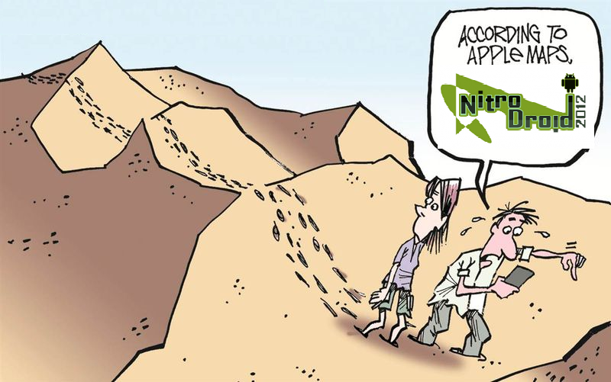
Thank You for not using iOS 6 Maps

Slide 3
Goals of Workshop
Help you understand what Android is
Try out some Android APIs via Android Eclipse Projects
Build a simple Application (Quotes)
Build enough enthusiasm for you to take your next leap into Android Programming

Slide 4
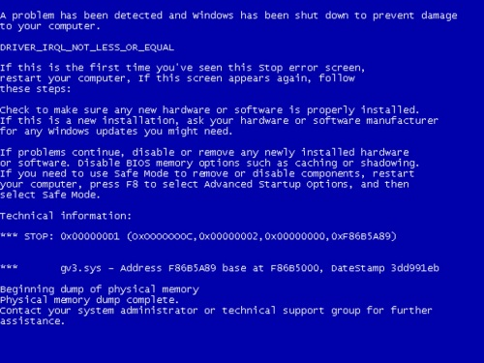

Course Requirements
Basic working knowledge of HTML, JavaScript and CSS
Use a Text Editor or any other IDE of your preference to write all code samples
We shall run all examples on various browsers

Slide 5
Participant Requirements
Basic working knowledge of Java or any other OOP language
Eclipse IDE
Android SDK and Tools
We shall run all examples on the Android Emulator
A device is important to have but not necessary for this course

Slide 6
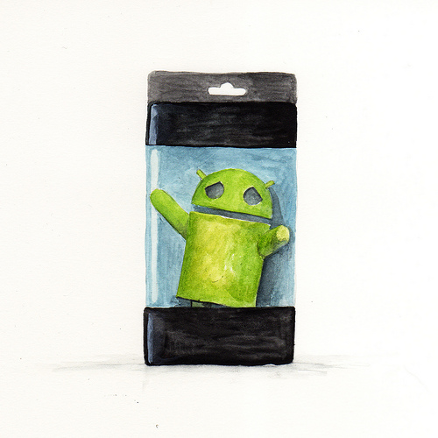


What is Android ?

Slide 7
What is Android?
A software stack for mobile devices
Includes Linux Kernel, OS Middleware, Application Framework & Applications.
Provides SDK for developers
From Google
Open Source and provided to Handset manufacturers
http://www.android.com
http://developer.android.com

Slide 8
Android - History
OS Version | Name | API Level | Date
Beta, 1.0 , 1.1 | - | -, 1 , 2 | Nov 2007, Sep 2008, Feb 2009
1.5 | Cupcake | 3 | April 2009
1.6 | Donut | 4 | September 2009
2.1 | Eclair | 7 | October 2009
2.2 | Froyo | 8 | May 2010
2.3 | Gingerbread | 10 | December 2010
3.0 | Honeycomb | 11 | February 2011
3.1.x, 3.2 | Honeycomb | 12,13
4.0, 4.0.1, 4.0.2 | Icecream Sandwich | 14 | October 2011
4.0.3, 4.0.4 | Icecream Sandwich | 15 | December 2011
4.1 | JellyBean | 16 | June 2012

Slide 9
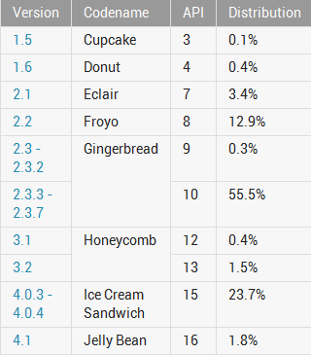
Android Device Dashboard
~ 72%
~ 25%
October 1, 2012 : http://developer.android.com/resources/dashboard/platform-versions.html

Slide 10
Android Features
Handset Layouts, Multiple Languages
Storage
Connectivity
Messaging
Media Support
Hardware support
Cameras, touch screens, GPS, accelerometer, etc.
Reuse of Data
Reuse of Functionality

Slide 11
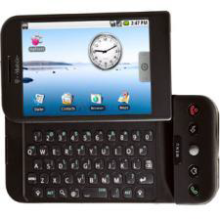
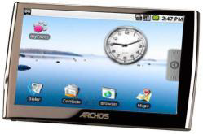
Why Android?
Android has garnered more than 50% of the current market share in Smartphone
Android by its nature is available across various devices (Phone, Tablet, TV, Navigation Devices, etc)
Robust Ecosystem : 300+ Hardware/Software partners
Open Source (http://git.android.com)
Good set of Developer Tools
25 Billion+ Downloads

Slide 12
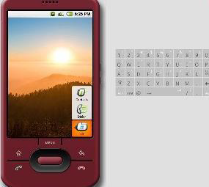



Android Developer Tools
Java SDK
Eclipse
Android SDK
Android Emulator
Command Line Tools
Documentation + Samples
Platform Libraries
Android Development Tools (ADT) for Eclipse (Recommended to begin with)

Slide 13

Development Environment Setup

Slide 14
Tools Needed
Java SDK
http://www.oracle.com/technetwork/java/javase/downloads/index.html
Eclipse
http://www.eclipse.org/downloads
Android SDK
http://developer.android.com/sdk/index.html
Android Development Tools (ADT) for Eclipse
http://developer.android.com/sdk/eclipse-adt.html (Recommended to begin with)

Slide 15
Android Virtual Device
SDK includes an Emulator - a virtual mobile device
Emulator helps your test your applications without a physical device
It mirrors the System Image and functionality as closely as possible
You need to create an Android Virtual Device for the Android OS that you wish to target. E.g. 2.2, 2.3, 3.x, 4.x

Slide 16
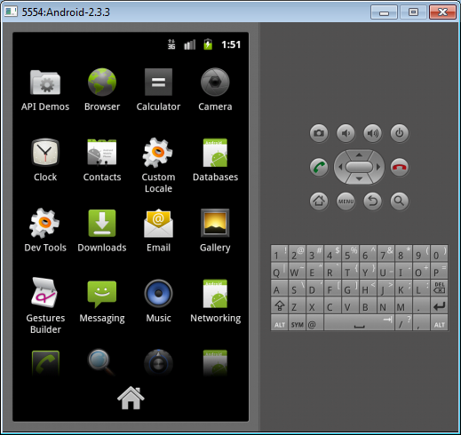
Android Emulator
Mimics a Normal Android Device
Use it to get familiar with the functions

Slide 17

Your First Android App

Slide 18
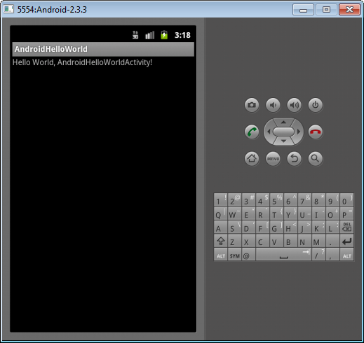
Hello World In Android

Slide 19
Steps to First Hello World
Development Environment !
Create the AVD and start the Device
Use Eclipse to create the Android Project
Code, Code, Code
Run the Application either the AVD or a real device

Slide 20
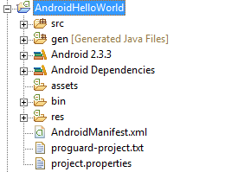
Project Structure

Slide 21
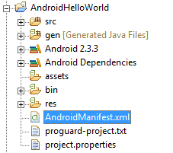
Android Manifest XML
Describes the Application
Activities and other components
Application Name
Application Version
Permissions
Android SDK Version

Slide 22
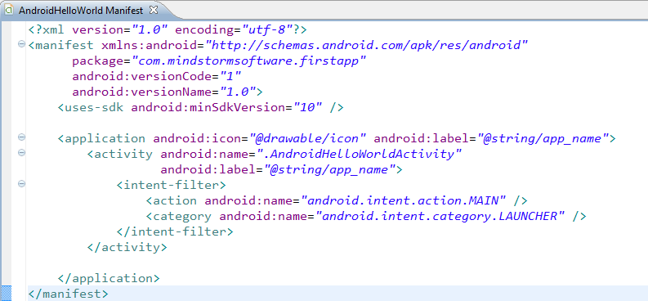
Android Manifest XML

Slide 23

Project Structure - Source
Contains all the Java Source files

Slide 24
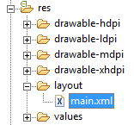
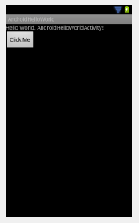
Project Structure - Layout
Defines how the User Interface is laid out.

Slide 25
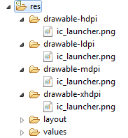

Project Structure – Image Resources
Define Image Resources for different resolutions
The runtime takes care of using the right image
If not present, it scales it accordingly.

Slide 26
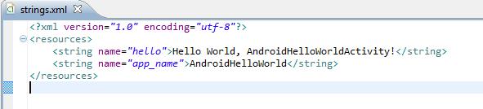
Project Structure – strings.xml
Externalize all String values
strings.xml is just one kind of resource you can put
Other examples are:
colors.xml
dimens.xml
arrays.xml

Slide 27
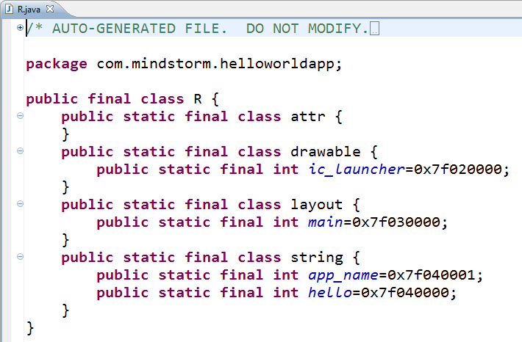
Project Structure – R.java file
Compiled version of all your resources
Can reference them from XML file or even from Java source file
Compiled and weaved into your code

Slide 28

Hands On Exercise
Hands On Exercise : ex01 – Hello World.doc
Hello World
Check List
Developer Tools are setup
Android Virtual Device has been created

Slide 29
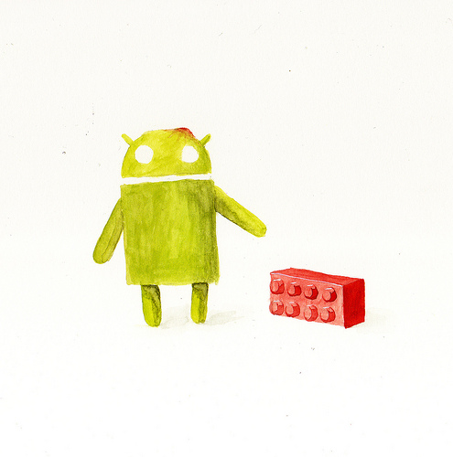

Android Building Blocks

Slide 30
Building Blocks
Important to understand what an Android Application is made up of
Android defines few buildings blocks that make up an application
Activity
Manifest File
Resources
Content Provider
Broadcast Receiver
Service

Slide 31
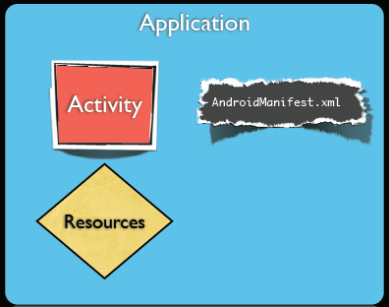
Android Application - Minimal
You need 3 things at least
Activity
Android Manifest XML
Resources

Slide 32
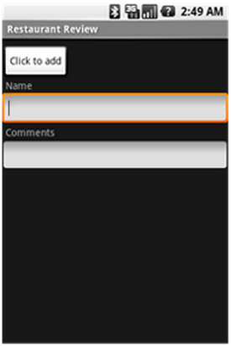
Android Activity
Most Basic Building Block
It is a Screen that users can interact with
Example: Filling out a text field, dialing a number, etc.
An Activity is typically written by extending the Activity class.
You can implement the call back methods to get notified of Activity life cycle (onCreate(), onDestroy(), etc)

Slide 33
Android Activity
Creating an Activity
Extend the Activity class
Implement the following method
onCreate() : In this method, you can specify the layout (UI) for the activity and write any other initialization functions

Slide 34
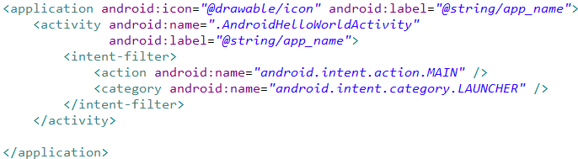
Android Activity
An Application can have one or more Activities
One Activity is designated as the Main Activity that is launched when the Application Starts

Slide 35
Android Activity – User Interface
An Activity can implement its User Interface by defining a XML file.
The User Interface will consist of ViewGroups (Layout) and Views.
You can set the View by calling the setContentView() method in the onCreate() method of the Activity
Pass the layout in the onCreate()

Slide 36
Android UI
Android supports
Description of UI in XML
Programming UI creation
Design Principle : Separate the UI Design from Behaviour (Event Handling e.g. Click)
Views
ViewGroups

Slide 37
Android UI - Views
View
Basic Unit of UI
Base class for all widgets
Examples : TextField, Button, etc.

Slide 38
Android UI - ViewGroup
ViewGroup serves as the base class for “Layouts”
Layout
Allows to group Views
Lay them out in various architectural ways
Tabular
Linear
Relative
Layouts can be nested to create complex screens

Slide 39
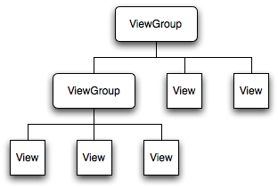
Android UI – ViewGroup + View

Slide 40
Android UI – View Types
Android supports variety of views that help capture various kinds of user input
What kind of data + User Experience
Button
EditText
TextView
ImageButton
CheckBox
RadioButton, RadioGroup
ToggleButton
SeekBar
ProgressBar

Slide 41
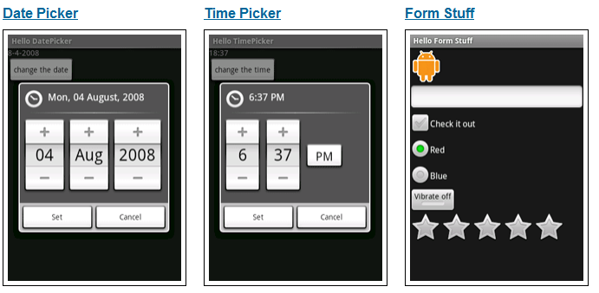
Android UI – Basic Views

Slide 42
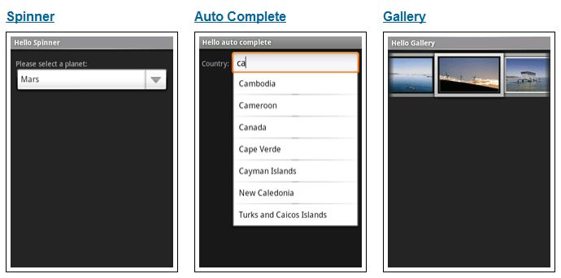
Android UI – Basic Views

Slide 43




Android UI – View Declaration
XML
Common attributes
Id , text , layout_width, layout_height
Various other fields

Slide 44
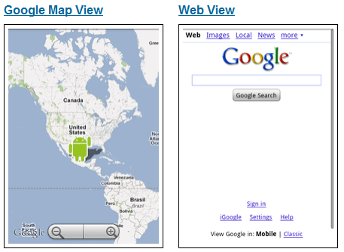
Android UI – Basic Views

Slide 45
Android UI – View Declaration
XML
Common attributes
Id , text , layout_width, layout_height
Various other fields

Slide 46
Android UI – Event Handling
Pattern for working with Widgets
Get the instance to the view
findViewById(R.id.<viewid>)
Set up Event Handlers
Example : onClick
Provide Event Handler implementation
Study the Java class for different methods and events that you can handle on the Widgets

Slide 47
Android UI – Layout
Layout – Recommended way is to define the Viewgroup hierarchy in an XML file
Different Layouts are supported. Common ones are:
LinearLayout
Framework
TableLayout
RelativeLayout
Other ViewGroups: Gallery, GridView, ScrollView, TabHost, etc.

Slide 48
Android UI – Linear Layout
Is a ViewGroup
Displays Child View Elements in a linear fashion
Linear = One After Another
Orientation attribute
Horizontal
Vertical

Slide 49
Android UI – Linear Layout
Linear Layout
Button
Text View
Edit Text
Text View
Edit Text

Slide 50
Android UI – Linear Layout
<LinearLayout xmlns:android="http://schemas.android.com/apk/res/android" android:orientation="vertical" android:layout_width="fill_parent" android:layout_height="fill_parent">
<Button …. /> <TextView ….. /> <EditText …./> <TextView …./>
<EditText …./>
</LinearLayout>

Slide 51
Hands On Exercise
Hands On Exercise
ex02.docx – View and Layout Basics

Slide 52
Multiple Activities

Slide 53
Multiple Activities
You can define more than one Activity in an Application
Think of : Activity ←→ User Screen
You can launch an Activity from within an Activity
MainActivity
SignInActivity
Please click button below to sign in first
User Name
onClick
Begin
Password
Start SignInActivity
Sign In

Slide 54
Android - Intent
An Intent can be loosely termed as what you want to do.
Examples:
Start a particular Activity
Send Email
Send SMS
View URL
Intents : Explicit and Implicit

Slide 55
Android – Explicit Intent
Explicit Intent
Start Activity 2
You need to know the class for Activity 2
For e.g. if you have a screen (Activity 1) which has one button saying “Begin”
On clicking “Begin”, you want to display another form (start Activity) where the user enters userid/password

Slide 56
Android – Explicit Intent
Intent intent = new Intent(this, SignInActivity.class); startActivity(intent);
MainActivity
SignInActivity
Please click button below to sign in first
User Name
onClick
Begin
Password
Start SignInActivity
Sign In

Slide 57
Android - Intent
An Intent can be loosely termed as what you want to do.
Examples:
Start a particular Activity
Send Email
Send SMS
View URL
Intents : Explicit and Implicit

Slide 58
Android – Explicit Intent
Explicit Intent
Start Activity 2
You need to know the class for Activity 2
For e.g. if you have a screen (Activity 1) which has one button saying “Begin”
On clicking “Login”, you want to display another form (start Activity) where the user enters userid/password

Slide 59
Android – Explicit Intent
Intent intent = new Intent(this, SignInActivity.class); startActivity(intent);
MainActivity
SignInActivity
Please click button below to sign in first
User Name
onClick
Begin
Password
Start SignInActivity
Sign In

Slide 60
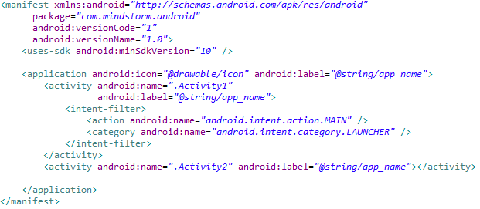
Android Activity - Manifest
All Activities need to be defined in the Android Manifest XML file

Slide 61
Android – Implicit Intent
Android supports various standard activties that are commonly clubbed under Implicit Intent
Examples:
Send Email
Send SMS
Dial / Call a number
View a web page
View a Map
Launch Camera
Share Content
Android will look at all applications that are capable of handling the Intent and then it will launch that

Slide 62
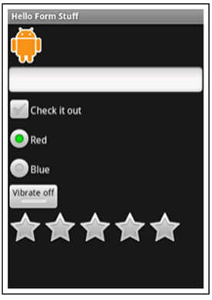
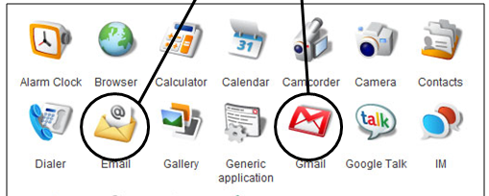
Android – Implicit Intent
I have 2 Apps for you
Intention : Send Email
SMS
Mail
Web

Slide 63
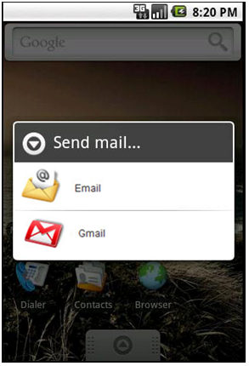
Android – Implicit Intent
I have 2 Apps for you
Intention : Send Email
SMS
Mail
Web

Slide 64
Android – Implicit Intents - 1
To Launch a Browser
Intent i = new
Intent(android.content.Intent.ACTION_VIEW,
Uri.parse("http://www.amazon.com"));
startActivity(i);

Slide 65
Android – Implicit Intents - 2
Built In Intent (ACTION_DIAL)
This will show the Dial Screen but not start calling
Intent i = new Intent (android.content.Intent.ACTION_DIAL,
Uri.parse("tel:+9810020011"));
startActivity(i);

Slide 66
Android – Implicit Intents - 3
Built In Intent (ACTION_CALL)
This will start calling the number
Requires the following permission: <uses-permission android:name="android.permission.CALL_PHONE">
Intent i = new Intent (android.content.Intent.ACTION_CALL,
Uri.parse("tel:+9810020011"));
startActivity(i);

Slide 67
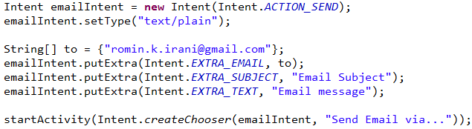
Android – Send Email

Slide 68
Android – Send SMS
Intent i = new Intent(android.content.Intent.ACTION_VIEW);
i.putExtra("address", “9821111111;9822211111");
i.putExtra("sms_body", "Hello");
i.setType("vnd.android-dir/mms-sms");
startActivity(i);

Slide 69
Hands On Exercise
Hands On Exercise
ex03.docx -- Multiple Activities
ex04.docx -- Built In Intents

Slide 70
Building a Complete Android Application

Slide 71
Quotes Application
Functional Specifications
Displays Random Quotes
User can share quotes via SMS
Future Extensions
User can view quotes by category
User can mark some quotes as favourites

Slide 72
Quotes Application
Android Features to be used
Activities [Multiple Screens]
Layouts for all activities [LinearLayout]
Built in Intents
Launch SMS App to share Quote via SMS
Launch Email App to share Quote via Email
File based database to store quotes

Slide 73
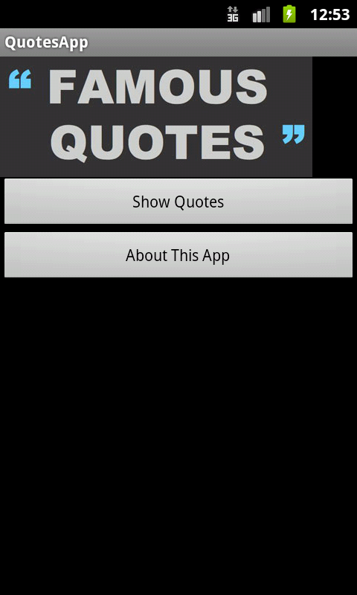
Quotes App in Action
QuoteActivity – Shows Main Menu

Slide 74
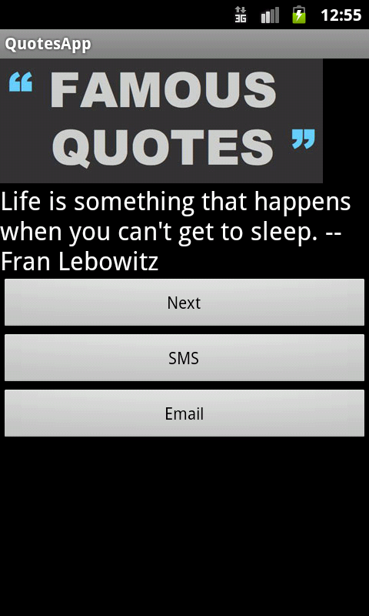
Quotes App in Action
Show Quotes retrieves a quote from Database

Slide 75
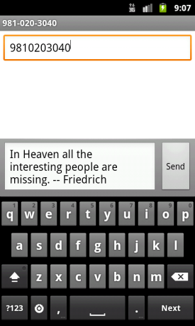
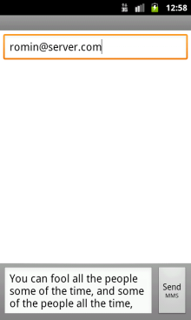
Quotes App in Action
Show Quote Activity – Other Functions
JSON File
Retrieves another random quote from database and displays it
Launches SMS App on phone to share this quote
Launches Email App on phone to share this quote

Slide 76
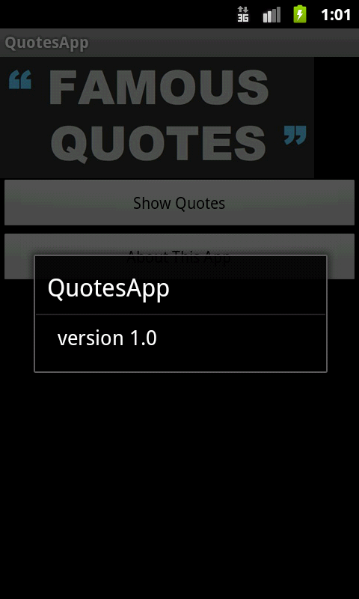
Quotes App in Action
About App – Displays a Dialog box

Slide 77
Quotes App – Step by Step
Quotes App – Step 1 - Navigation
Quotes App – Step 2
Random Quotes
Share a Quote via SMS
Share a Quote via Email
Future - Quotes App – Step 3 - Favourites
Future - Quotes App – Step 4 – Category Quotes

Slide 78


Android Marketplace

Slide 79
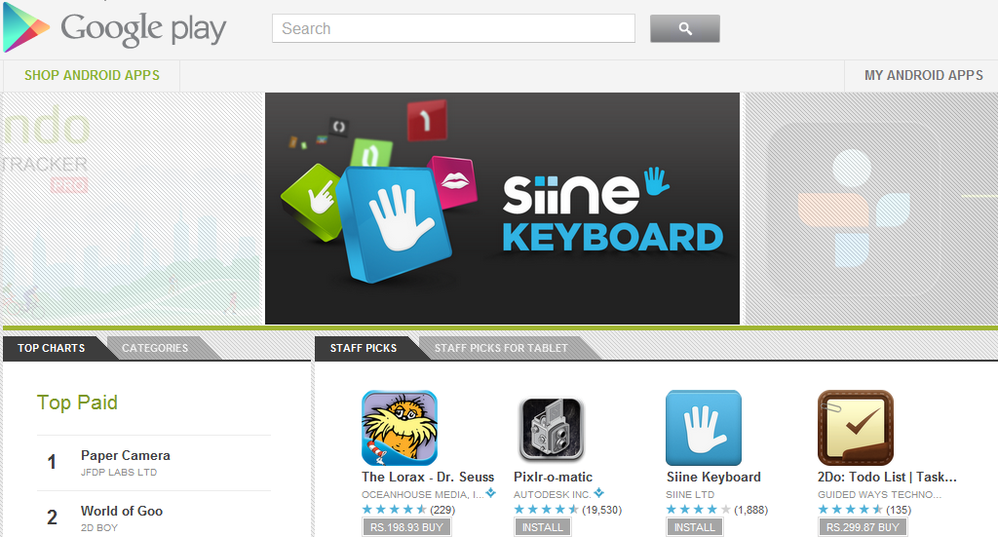
Android Marketplace (Google Play)
http://play.google.com

Slide 80
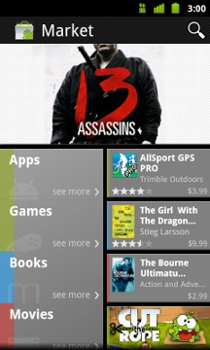
Android Marketplace
Web application + Android Application
Single Marketplace for eBooks, Music, Movies and Android Applications
Filters out the above categories if services are not available in particular country
Publisher Account
Google Account
Free Apps and Paid Apps (30% commission)
Selling a Paid App currently not available for India
Download Free Apps
Download Paid Apps
$25 Registration Fee
Application Approval - Immediate

Slide 81
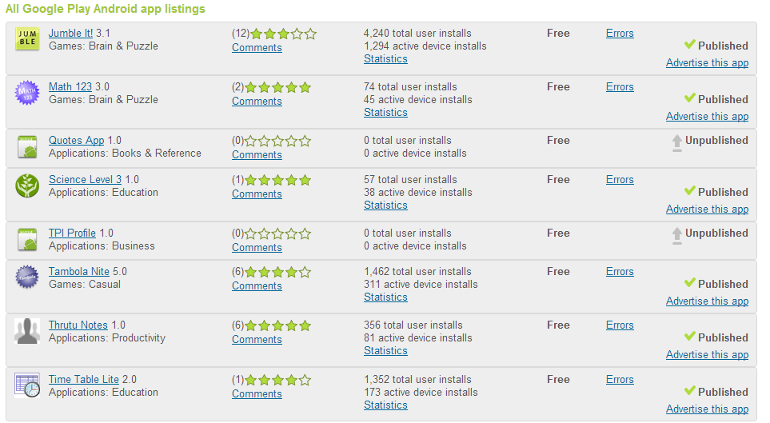
Android Marketplace
For the Publisher – Login and visit https://play.google.com/apps/publish/Home

Slide 82
Build the APK – Short Check List
Test Your Application
Review your AndroidManifest.xml file
Permissions (<uses-permission>)
Icon and Label
Application Version
API Level : <uses-sdk>, minSDKVersion, targetSDKVersion
Other Filters : <supports-screens>, etc
http://developer.android.com/guide/appendix/market-filters.html
Compile Your Application
Export Signed Application (.APK)

Slide 83
Build the APK
APK = Android Application Package
File Format to distribute and install software on Android OS
Android Marketplace allows only signed APKs
APK = Archive File
META-INF directory
res
AndroidManifest.xml
classes.dex
resources.arsc

Slide 84
Android Marketplace - Publish
Upload the APK
Provide 2 screenshots
Provide 1 High Resolution Image Icon (512 x 512)
Title , Description, Recent Changes
Application Type
Category
Contact Details

Slide 85
Android APIs
We have seen just a fraction of what Android phones can do
APIs for
Media
Networking
Location Based Programming (GPS, Maps)
Storage (File, Database)
Rich UI Widgets

Slide 86


Next Steps
Go back and absorb the material
Look at the examples again
Github: https://github.com/rominirani/Nitrodroid-2012-Android101-Workshop
Android Developer http://developer.android.com
Android Training http://developer.android.com/training
Get the Google Play Account…
… unleash your Apps
All The Best !

Slide 87


Q & A
Website : http://www.mindstormsoftware.com
Email : romin.irani@mindstormsoftware.com
Twitter: iRomin
2-Day Android, HTML5 and Cloud Computing Hands-on Developer Courses

