Slide 1
Parallel NMS-SIFT for
Content-Based Image Retrieval
Why more threads didn't help, and what did
Musa Waghu | Senior research project in parallel processing
Notes:
This project asked whether splitting images into tiles and processing them in parallel could speed up SIFT feature extraction for image retrieval. The short answer: not with threads, because of Python's GIL. With processes, yes: 6.65 times faster.

Slide 2
The project in four numbers
1.4%
1.0
6.65×
−7.9%
average gain from 16 threaded tiles over 4 in 2023: not significant
CPU cores actually busy with threads, on an 8-core CPU
speedup with processes at 16 tiles, the fix
keypoints lost at tile borders with 16 tiles
Notes:
Four numbers tell the story. The 2023 experiment found almost no difference. Measuring CPU use showed why: threads only ever kept one core busy. Switching to processes gave a 6.65x speedup. And splitting images has a cost: keypoints are lost at tile borders.

Slide 3
Background: image retrieval and SIFT
Part 1
Notes:
Some background on content-based image retrieval and the SIFT algorithm.

Slide 4


Why content-based image retrieval
Text-based (TBIR)
Content-based (CBIR)
Experts tag images by hand
Slow to annotate
Tags are subjective and inconsistent
Query with an image, compare visual features
No manual labelling
Cost: feature extraction for every image
97 zettabytes of data were created in 2022 [1]. Feature extraction speed decides whether CBIR scales.
Notes:
Text-based retrieval depends on people tagging images, which is slow and subjective. Content-based retrieval compares the images themselves, but every image has to go through feature extraction, which is computationally heavy. With data volumes like 97 zettabytes a year, speed is the bottleneck.

Slide 5
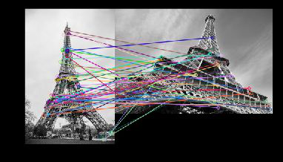
SIFT: keypoints that survive scale and rotation
1
Scale-space extrema
Gaussian pyramid, Difference of Gaussians
2
Keypoint localisation
Reject low contrast and edges
3
Orientation
Dominant gradient direction
4
Descriptor
128-d gradient histogram
SIFT matches the same landmark across scale and viewpoint (Lowe, 1999 [4])
Notes:
SIFT works in four stages: find extrema across scales using Differences of Gaussians, refine them and reject weak or edge points, assign an orientation, and build a 128-dimensional descriptor. The result is keypoints that can be matched even when scale and viewpoint change.

Slide 6
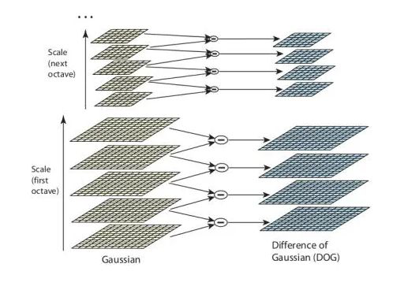
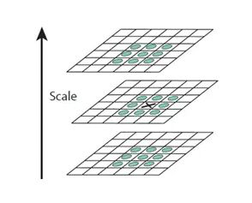
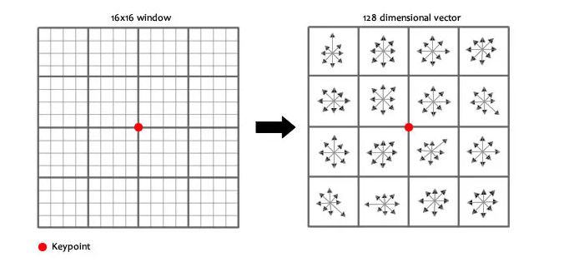
Inside SIFT
Difference of Gaussians across scales
Each pixel checked against 26 neighbours
16×16 window becomes a 128-d descriptor
Notes:
The DoG pyramid approximates the Laplacian of Gaussian at several scales. A pixel is a candidate keypoint if it is larger or smaller than all 26 neighbours in space and scale. The descriptor is a 4 by 4 grid of 8-bin gradient histograms. All of this is pixel-by-pixel work, which in this implementation means Python loops.

Slide 7
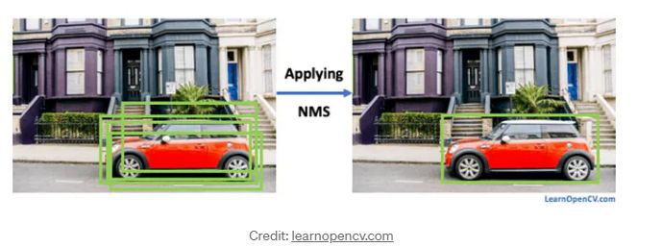
NMS-SIFT: keep the strongest keypoint nearby
Sort keypoints by response strength
Drop any keypoint within 10 px of a stronger one
Fewer, more distinctive keypoints for matching
Non-maximum suppression is borrowed from object detection, where it removes overlapping boxes [5].
NMS in object detection. Image credit: learnopencv.com
Notes:
NMS-SIFT adds non-maximum suppression: keypoints are sorted by strength and anything within 10 pixels of a stronger keypoint is dropped. The idea comes from object detection, where it removes overlapping bounding boxes.

Slide 8
The 2023 study
Part 2
Notes:
The original experiment and its result.

Slide 9
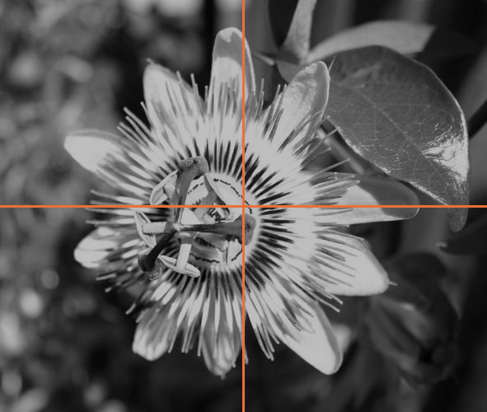
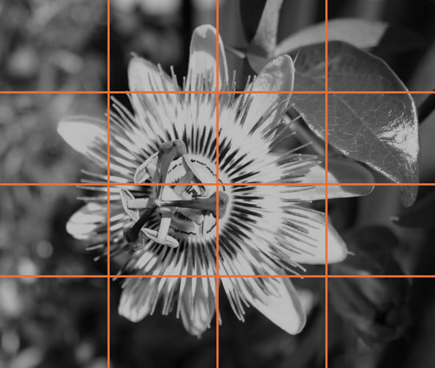
Hypothesis: more tiles, more threads, faster
Hypothesis
SIFT's work is local, so each tile can be processed on its own thread. Splitting into 16 tiles should be faster than 4.
4 tiles, 4 threads
16 tiles, 16 threads
Notes:
SIFT works on local neighbourhoods, so an image can be cut into tiles and each tile processed independently. The hypothesis was that 16 tiles, each on its own thread, would beat 4 tiles.

Slide 10



Experimental setup
Dataset
Hardware
Code
Oxford 102 Category Flowers [6]: the first 50 images
AMD Ryzen 7 3700X, 8 cores / 16 threads. The 2026 rerun used the same CPU model.
Pure-Python NMS-SIFT by S. Jadhav and Dr. J. Korah, with tiling and threading added
Notes:
The dataset is the Oxford 102 Flowers set, the first 50 images. The CPU is an 8-core Ryzen 7 3700X, and the rerun used the same CPU model, so the times are directly comparable.

Slide 11
2023 result: no significant improvement
24 / 36
images faster with 16 tiles, the rest slower
+1.4%
average gain: not significant
−5%
keypoints with 16 tiles vs 4
Notes:
This is the 2023 result: 4-tile vs 16-tile threaded times for each image. 16 tiles won on 24 of 36 images, by 1.4 percent on average. Not significant. 16 tiles also produced about 5 percent fewer keypoints. The question became: why didn't threading help?

Slide 12
Diagnosis: why threads didn't help
Part 3
Notes:
Why the threads didn't speed anything up.

Slide 13
The culprit: Python's Global Interpreter Lock
4 threads (GIL)
4 processes
Thread 1
Process 1
Thread 2
Process 2
Thread 3
Process 3
Thread 4
Process 4
time →
time →
Only one thread runs Python at a time. They take turns on one core.
Each process has its own interpreter and its own GIL, so all four run at once.
Notes:
CPython has a Global Interpreter Lock: only one thread can execute Python bytecode at a time. Threads help with I/O, but this SIFT code is nested Python loops, so the threads just take turns on a single core. Processes each have their own interpreter and GIL, so they really run in parallel.

Slide 14
Measured: threads kept exactly one core busy
How it's measured
Each worker records its own CPU time. Total CPU time ÷ wall-clock time = cores busy. Above 8 means SMT siblings are in use.
Notes:
This makes the GIL visible. Each worker records the CPU time its own thread used. Divide total CPU time by wall time and you get how many cores were busy. Threads with the GIL: exactly 1.0, the same as serial. Processes and no-GIL threads: over 9 at 16 tiles.

Slide 15
The fix: processes, and Python without the GIL
Part 4
Notes:
Rerunning the experiment with a proper control and the fix.

Slide 16
Rerun: same images, seven configurations
Configuration | What it tests
Serial, whole image | Baseline
Serial, 4 / 16 tiles | New control: tiling with no parallelism
Threads, 4 / 16 tiles | The 2023 method
Processes, 4 / 16 tiles | The fix: one interpreter per worker
No-GIL threads (3.14t) | Python's new free-threaded build
Same images as 2023?
36 / 36 16-tile keypoint counts match the slides exactly
44 / 50 4-tile counts match; the rest are within 2 keypoints
Every parallel run must give keypoints identical to serial on the same tiles.
Notes:
The rerun adds a control: the same tiles processed one at a time. That separates the effect of tiling from the effect of parallelism. Keypoint counts reproduce the 2023 slides, which confirms it's the same images and the same algorithm.

Slide 17
Processes: 6.65× faster at 16 tiles
Threads (GIL)
1.04× / 1.13×: only the tiling effect
Processes
3.42× / 6.65×
16 beats 4
With real parallelism, the 2023 hypothesis holds
Notes:
Geometric-mean speedup over 50 images. Threads with the GIL get 1.04x and 1.13x, and serial code on the same tiles gets the same, so that small gain is from tiling, not threading. Processes get 3.4x at 4 tiles and 6.65x at 16. With real parallelism, 16 tiles do beat 4, so the original idea was right; the GIL was the problem.

Slide 18
Every image, same story
Notes:
The same pattern holds on all 50 images: threaded runs track the serial time, while processes and no-GIL threads finish in about a sixth of the time.

Slide 19
Processing time per version
Version | Mean per image | Fastest / slowest | All 50 images
Serial, whole image | 71.5 s | 42.3 / 118.1 s | 59.6 min
Serial, 4 tiles | 67.9 s | 39.6 / 107.2 s | 56.6 min
Serial, 16 tiles | 62.5 s | 36.1 / 98.3 s | 52.1 min
Threads (GIL), 4 tiles | 68.5 s | 40.2 / 107.9 s | 57.1 min
Threads (GIL), 16 tiles | 63.3 s | 36.7 / 100.8 s | 52.7 min
Processes, 4 tiles | 20.9 s | 13.1 / 34.6 s | 17.5 min
Processes, 16 tiles | 10.6 s | 7.5 / 16.2 s | 8.8 min
No-GIL: serial, whole image | 79.5 s | 47.8 / 127.9 s | 66.2 min
No-GIL: threads, 4 tiles | 24.1 s | 15.0 / 39.2 s | 20.1 min
No-GIL: threads, 16 tiles | 13.5 s | 9.2 / 22.0 s | 11.3 min
Wall-clock time to extract keypoints and descriptors. Other rows: Python 3.14 with the GIL. No-GIL: free-threaded 3.14t.
Notes:
The actual times behind the speedups. Serial takes about 72 seconds per image, an hour for all 50. Threads with the GIL barely change that. Processes bring it down to about 11 seconds per image, under 9 minutes for the whole set. No-GIL threads land at 13.5 seconds, even though the free-threaded interpreter is about 11 percent slower single-threaded.

Slide 20
Python 3.14 without the GIL: threads finally scale
5.82×
+11%
0
No-GIL threads at 16 tiles (3.30× at 4), close to processes
Slower single-threaded: the cost of a thread-safe interpreter
OpenCV builds for free-threaded Python. I reimplemented 4 calls in NumPy
PEP 703 made the GIL optional [7]. For this workload it already works, though libraries are still catching up.
Notes:
Python 3.14 officially supports a free-threaded build with no GIL. Plain threads then reach 5.8x at 16 tiles, close to processes. The interpreter is about 11 percent slower single-threaded, which explains most of the gap. The catch today is the ecosystem: OpenCV has no free-threaded build, so I reimplemented the four OpenCV calls SIFT needs in NumPy.

Slide 21
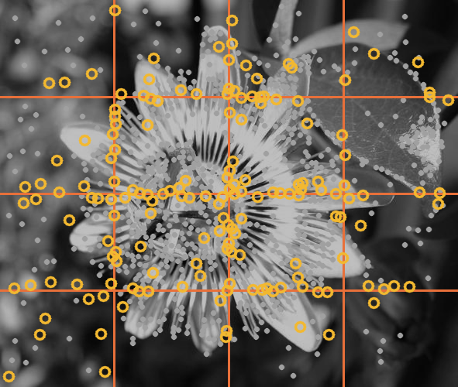
The hidden cost: keypoints lost at tile borders
Tiling | Keypoints | Lost
Whole image | 1,290 | n/a
4 tiles | 1,251 | −3.1%
16 tiles | 1,191 | −7.9%
Each tile skips a 5-pixel border
Descriptor windows are clipped at the cut
Worst image loses 12.1% at 16 tiles
Image 1, 16 tiles. Gold rings: whole-image keypoints with no 16-tile match nearby. They cluster along the cuts.
Notes:
Splitting the image isn't free. Each tile is processed as if it were a whole image, so a strip along every cut gets no keypoints. 4 tiles lose 3 percent of keypoints and 16 tiles lose 8 percent on average, up to 12 percent. That is also why serial code on 16 tiles is slightly faster: less descriptor work.

Slide 22



Bugs found while rebuilding
Ordering race
Pickling error
Matching crash
Threads saved results as they finished (e.g. 3, 1, 0, 2), but merging assumed order 0 to 3. Keypoints could land in the wrong quadrant.
cv2.KeyPoint can't be pickled, which blocks saving results and multiprocessing. Fixed by passing plain tuples.
The retrieval step passed the wrong image shape to perspectiveTransform.
Notes:
Rebuilding the code turned up three bugs. The most interesting is a race: each thread appended its result when it finished, but the merge assumed submission order, so keypoints could be shifted into the wrong quadrant. Timings and counts weren't affected.

Slide 23
Conclusions and future work
Part 5
Notes:
What I learned and what I'd do next.

Slide 24
Conclusions
1
The GIL, not the idea, sank 2023
Pure-Python loops on threads never used more than one core.
2
The small 2023 gain came from tiling
Fewer keypoints meant less work, at the cost of accuracy.
3
Real parallelism works
Processes: 6.65×. No-GIL threads: 5.82×. 16 tiles beat 4.
Notes:
Three conclusions. The 2023 null result was caused by the GIL, not by the tiling idea. The small gain 16 tiles showed came from losing keypoints, not from parallelism. And with real parallelism, either processes or Python without the GIL, the speedup is large and 16 tiles do beat 4.

Slide 25




Future work
Get further around the GIL
Move SIFT to a GPU
Compile hot loops with Numba or Cython so they release the GIL; vectorise with NumPy; scale across machines
Per-pixel and per-keypoint work is ideal for GPUs (e.g. CudaSift, PopSift). Batch images to hide transfer costs
Stop losing keypoints
Measure retrieval quality
Overlapping tiles plus NMS across seams, or detect on the whole image and parallelise only descriptors
Rerun FLANN + RANSAC matching to see whether lost keypoints hurt accuracy
Perspective: compiled C++ SIFT is about 600× faster (88 ms vs 52 s). Faster cores first, then more cores.
Notes:
Next steps. First, get further around the GIL by compiling the hot loops so they release it. Second, move SIFT to a GPU, since nearly every stage is data-parallel, batching images so transfer costs don't dominate. Third, stop losing keypoints with overlapping tiles. Fourth, measure whether lost keypoints hurt retrieval. And for perspective: compiled SIFT is about 600 times faster than this pure-Python version, so per-core speed matters even more than core count.

Slide 26
References
[1] Statista, "Data growth worldwide 2010–2025." Accessed Nov. 2023.
[2] Baeldung, "What is content-based image retrieval?" Accessed Nov. 2023.
[3] G. Kumar, P. K. Bhatia, "A detailed review of feature extraction in image processing systems," ACCT, 2014.
[4] D. G. Lowe, "Object recognition from local scale-invariant features," ICCV, 1999.
[5] J. Hosang, R. Benenson, B. Schiele, "Learning non-maximum suppression," CVPR, 2017.
[6] M.-E. Nilsback, A. Zisserman, "Automated flower classification over a large number of classes," ICVGIP, 2008.
[7] S. Gross, "PEP 703: Making the Global Interpreter Lock optional in CPython," 2023.
[8] M. Singh et al., "A comparative study of feature extraction techniques and similarity measures for image retrieval," INCOFT, 2022.
Notes:
References.

Slide 27
Thank you
github.com/musawaghu/parallel-sift
NMS-SIFT code originally by Sairaj Jadhav and Dr. John Korah. Code, data, notebook and charts are in the repository.
Notes:
Thanks to Sairaj Jadhav and Dr. John Korah for the original NMS-SIFT code. Everything, including the raw timings and the notebook, is in the GitHub repository.

