Slide 1
Automated gas(LPG) Leak detection
Presented by Group 3

Slide 2
Objective
Safety plays a major role in today’s world and it is necessary that good safety systems are to be implemented in places of education and work and home.
The main objective of the work is designing microcontroller based toxic gas detecting and alerting system.

Slide 3
Problem statement
1. GAS leakage is a huge problem for our country. Almost every house and industry in our country, people use gas for cooking or industrial purposes.
2. It is also a wastage of our natural resources which is not unlimited.
4. Because of gas leaking a number of accidents occur every year which results in great damage on human body or even health.

Slide 4
Problem solution
We are making an automated device called LPG detection Device.
The sensor will be connected via Arduino Uno and a designed circuit board.
The input and output will be controlled by the Arduino Uno.
If there is any gas in the air which exceed the safety level written in the code, the buzzer will start beeping and a blue LED will be ON and give signal to the nearest people

Slide 5
Hardware's Required:
Required Equipements:
1. Arduino UNO
2. MQ-2 LPG Sensor
3. Circuit Board
4. LEDs
5. Wires
6. DC Source/AC source

Slide 6
Technical Platform
1. Interfacing of the MQ-2 sensor with the Arduino.
2. Embedded C programming.
3.Arduino Compiler.
4.Bread board for hardware implementation

Slide 7
Project output and limitations
The project works as expected and when the gas was detected beyond safety level the system makes the buzzer and LED light on and off frequently to make an alarm.
The LED stays on always and give a lower frequent on and off to make the user realize that the system works just fine.
Limitation is we wanted to add a push button to make the system off temporarily but the button gives a short period break which needed a memory register to hold the user decisions.

Slide 8
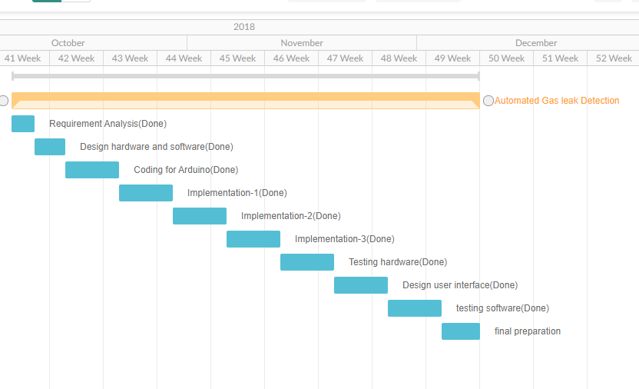
Timeline

Slide 9
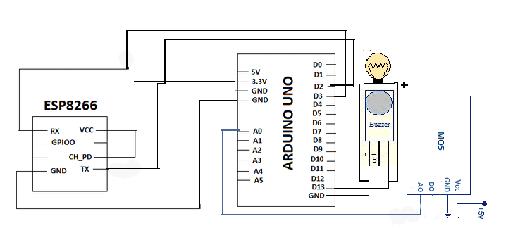
Circuit diagram

Slide 10
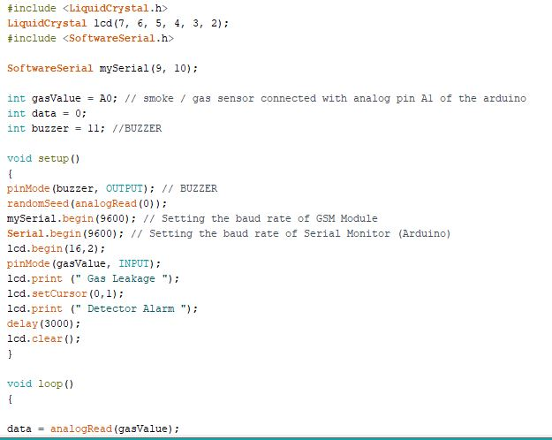
coding

Slide 11
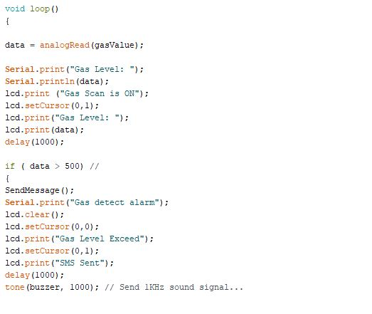
Coding

Slide 12
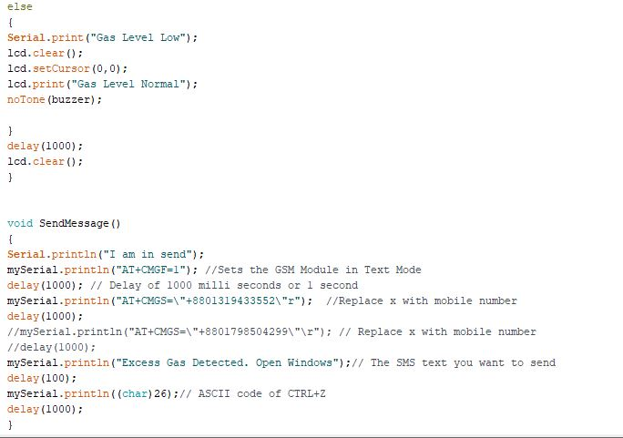
coding

Slide 13
Things we have learned
It was first time experience for two of the group members to work with Arduino and we learned a lot about Arduino and real-life system that can help us out in real life.
we learned a lot about the hardware and software collaboration.
least we are looking forward to making the system integrated with some more features like smoke and heat detector in the near future.

Slide 14
Thank you

