Slide 1
Automated Instructors
Notes:
Sometimes it’s hard for an instructor to take the time to record their lectures. For example, I’m in a coffee shop and it may be loud.

Slide 2
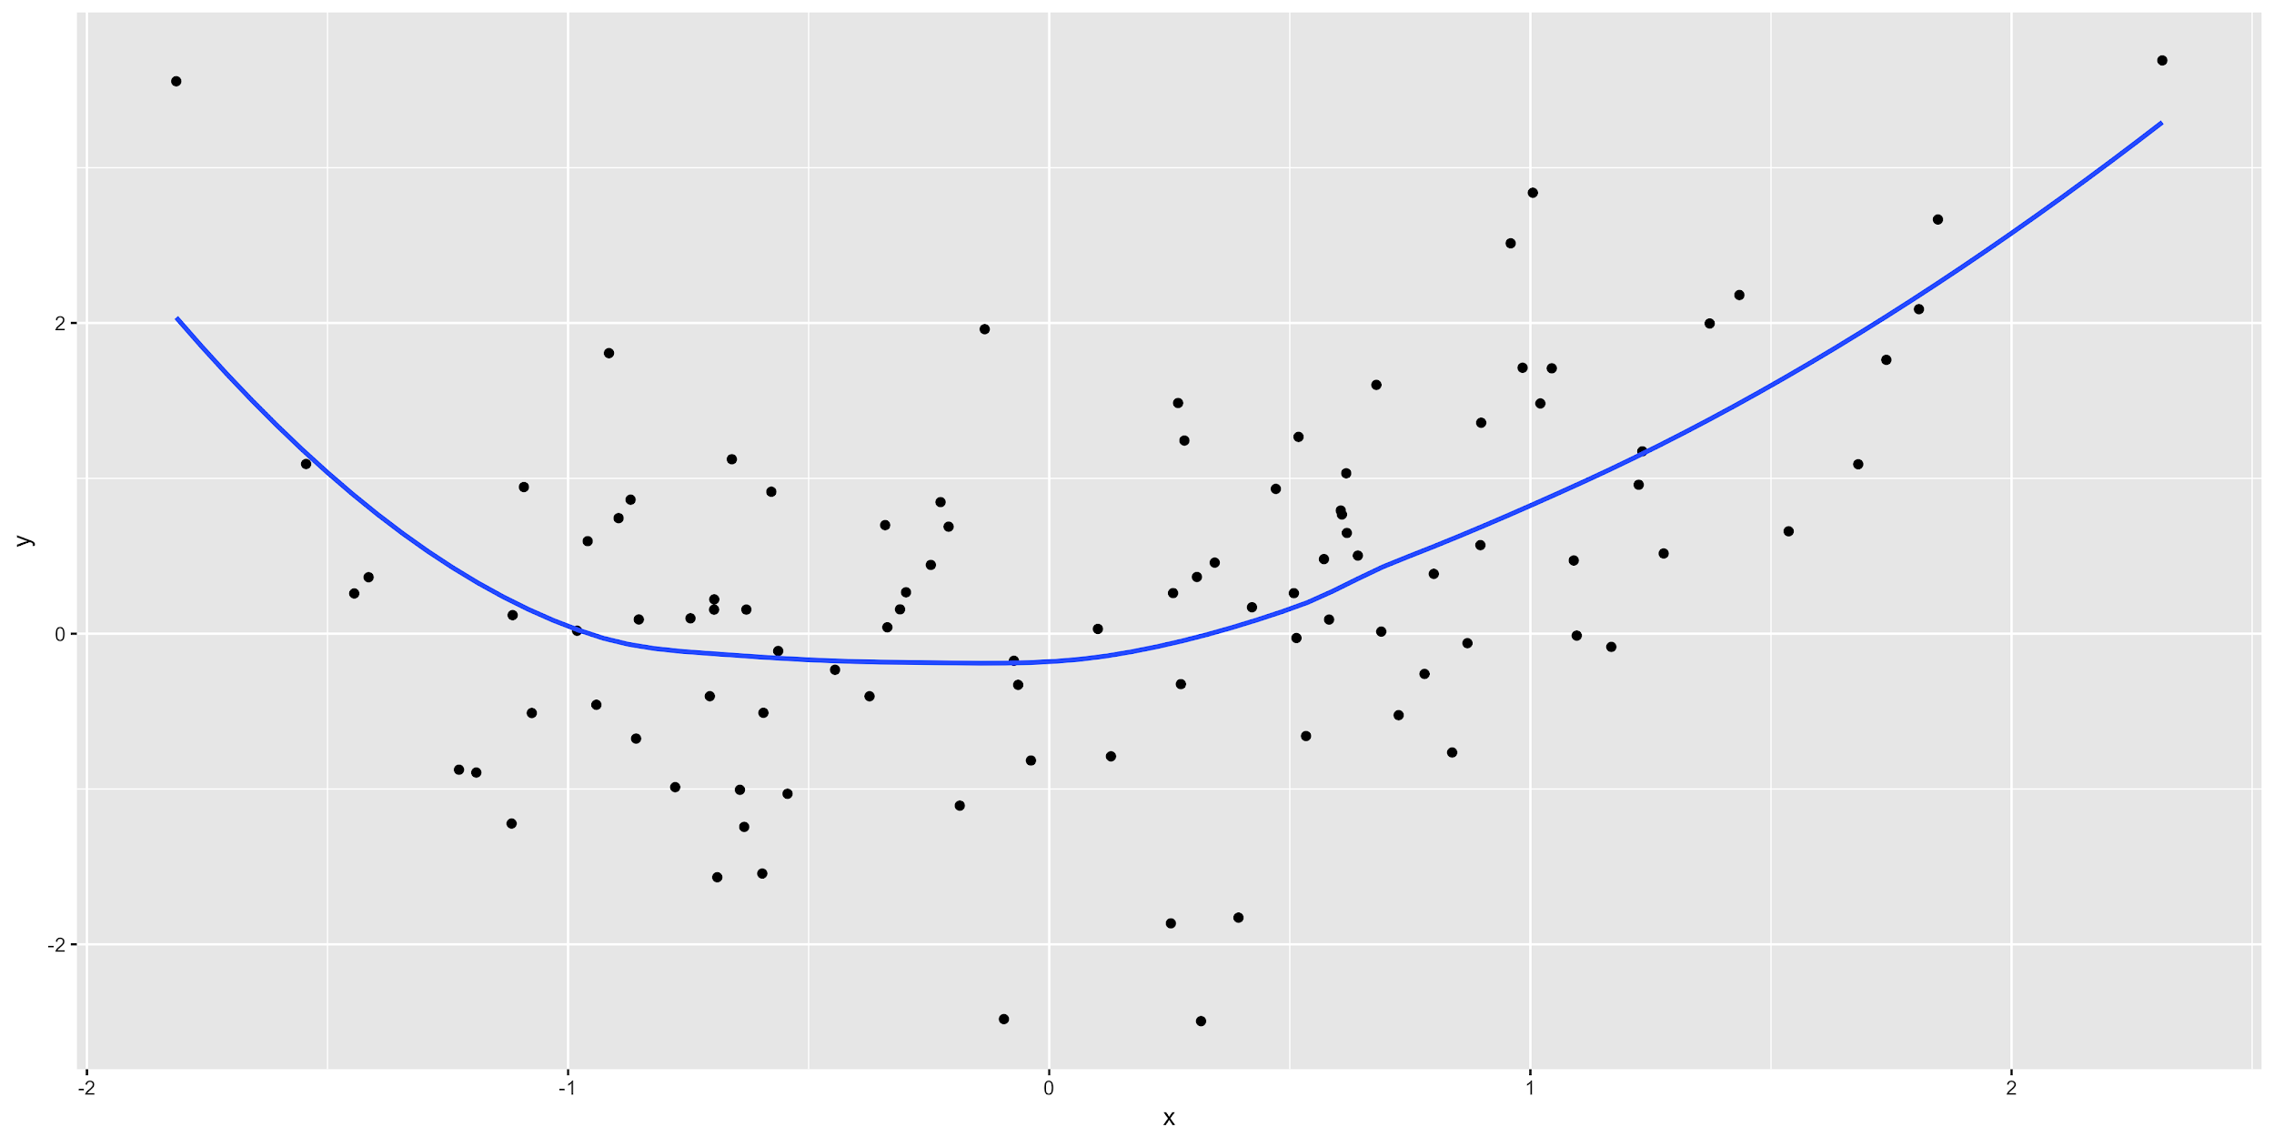
Notes:
Here is an example of a plot with really small axes. We plot the x versus the y-variables and a smoother between them.

