Slide 1
Homecare AI
Care assessments in, proposal-ready contracts out.
AI-powered workflow for home healthcare agencies.

Slide 2
The problem
Slow: intake calls → manual notes → manual pricing → manual contract drafting
Inconsistent: variability across coordinators/branches leads to pricing and scope errors
High-stakes: delays and mistakes cost revenue, compliance risk, and client trust

Slide 3
The solution
Transcript ingestion (upload audio or import text)
Services & billables extraction
Contract drafting from templates
Review + edit + export (PDF/CSV) in one place

Slide 4
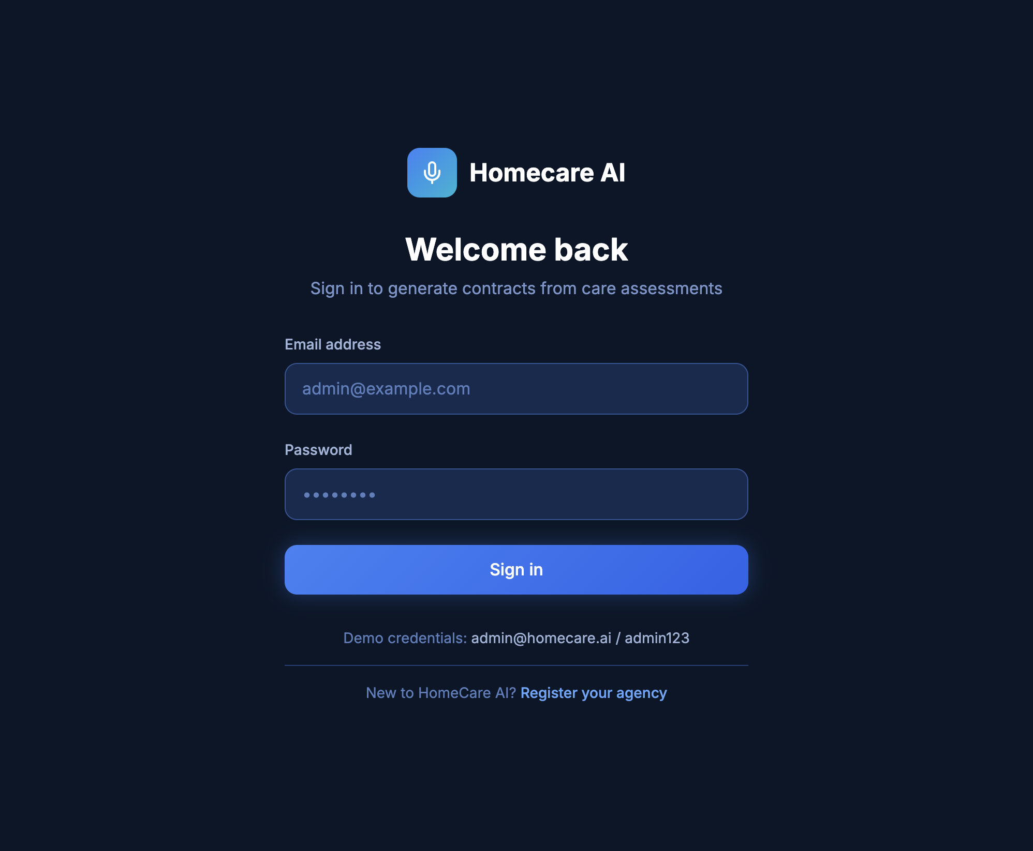
Demo login (admin UI)

Slide 5
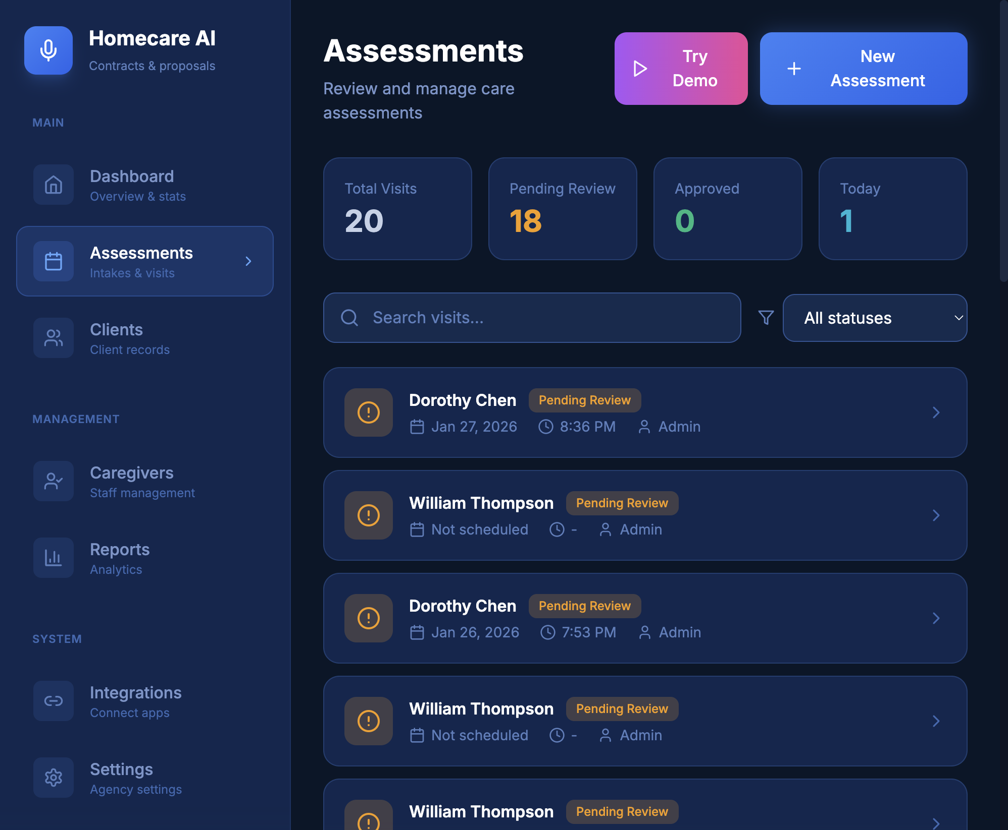
Assessments inbox (the work queue)
Start a new assessment or run a guided demo flow.

Slide 6
Workflow: assessment → pipeline → proposal
Start or import an assessment
Run pipeline steps (transcribe → bill → contract)
Review outputs in the right-side panel
Export PDF/CSV for client + billing ops

Slide 7
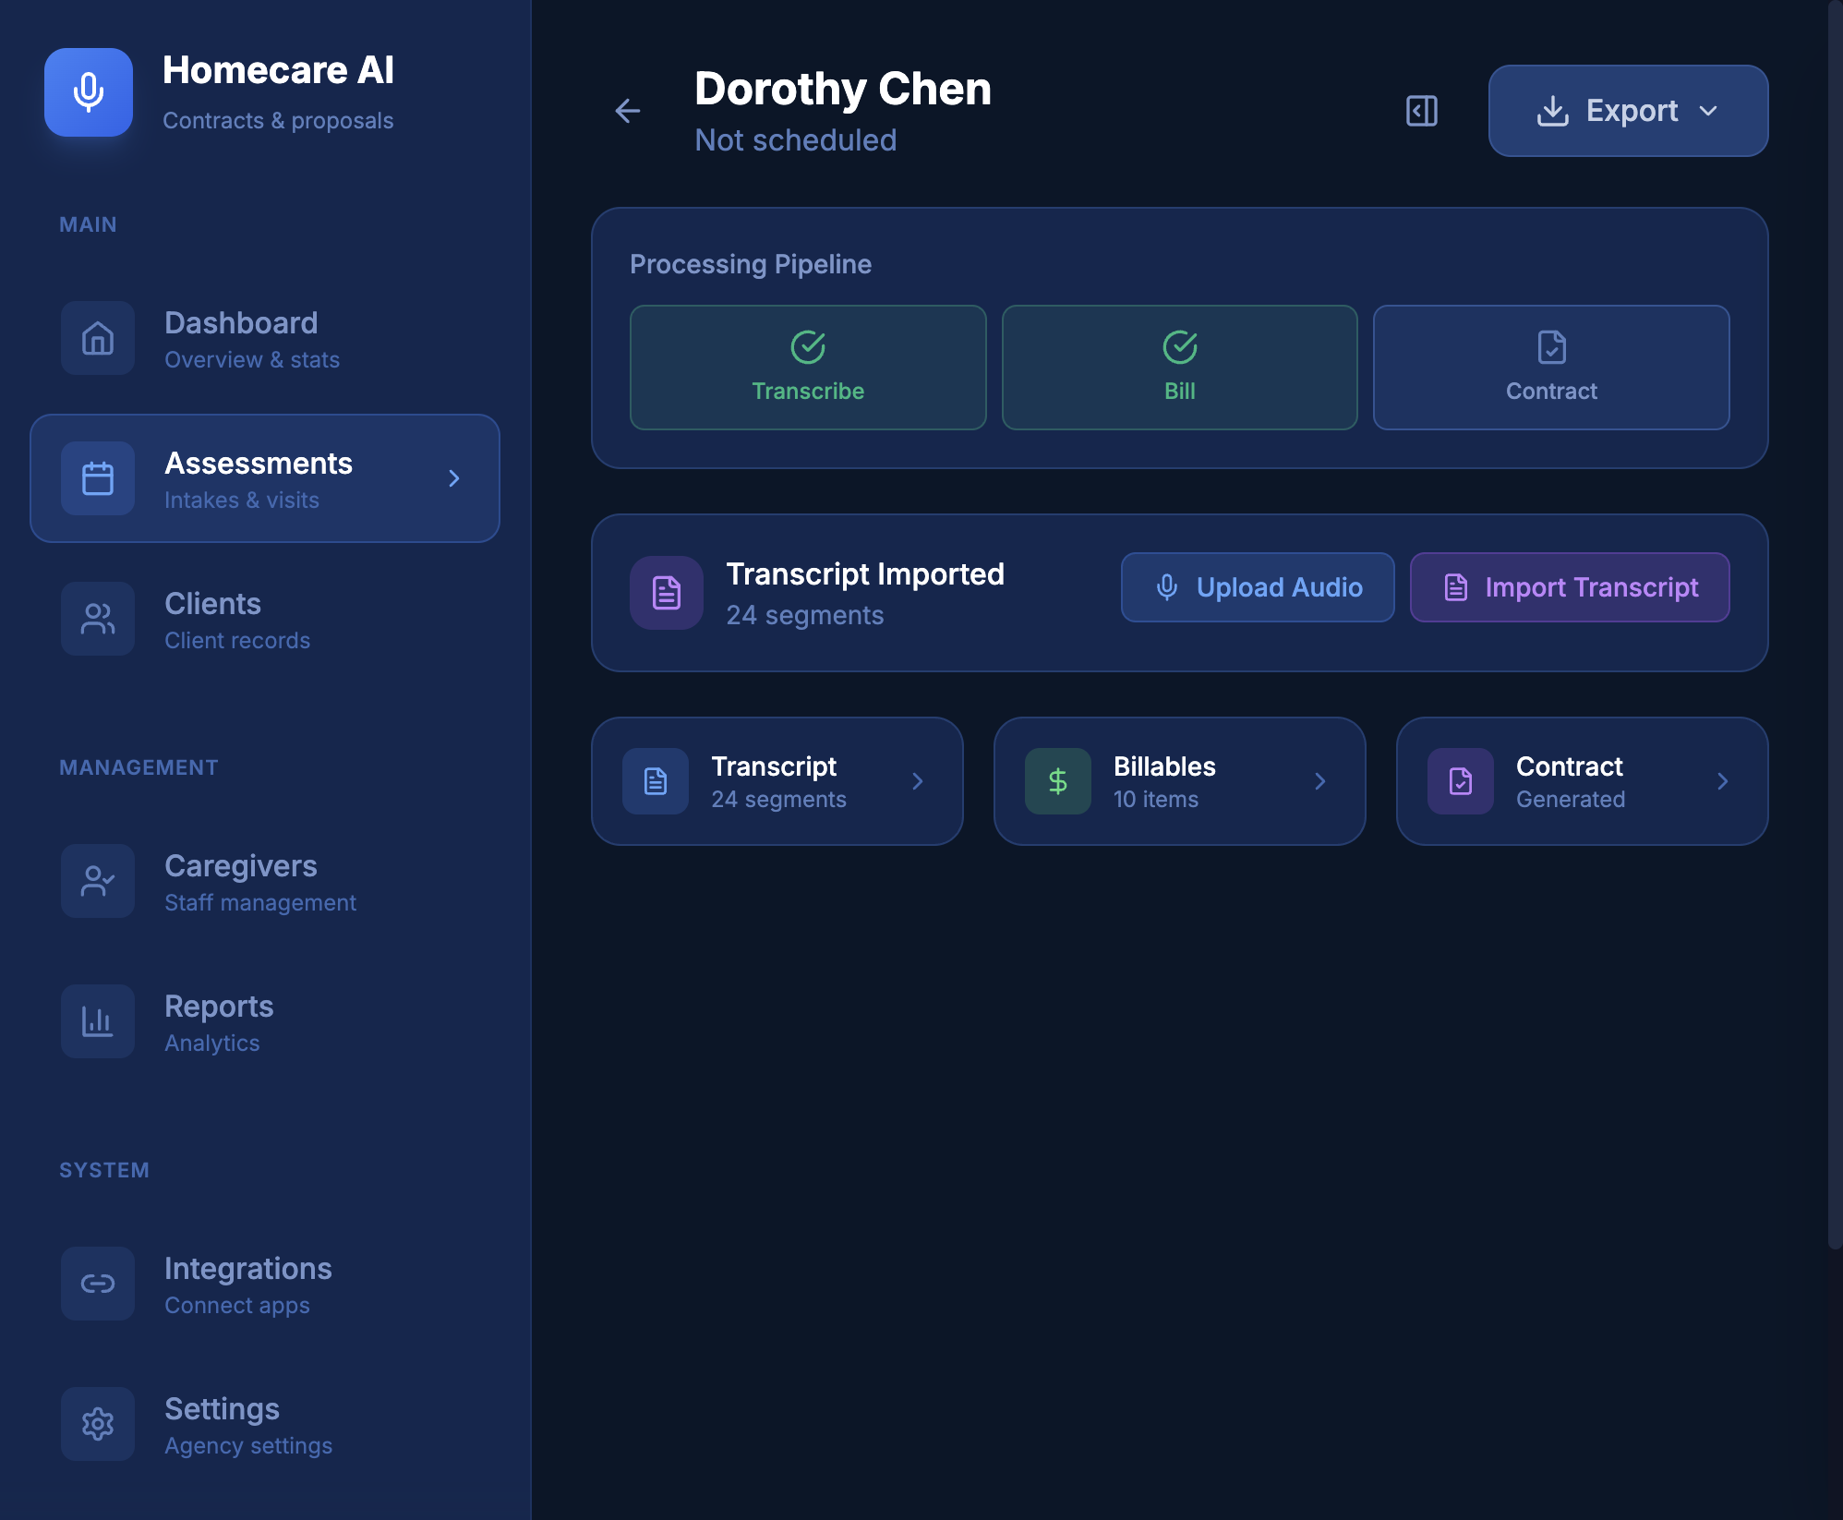
Intake capture + pipeline controls

Slide 8
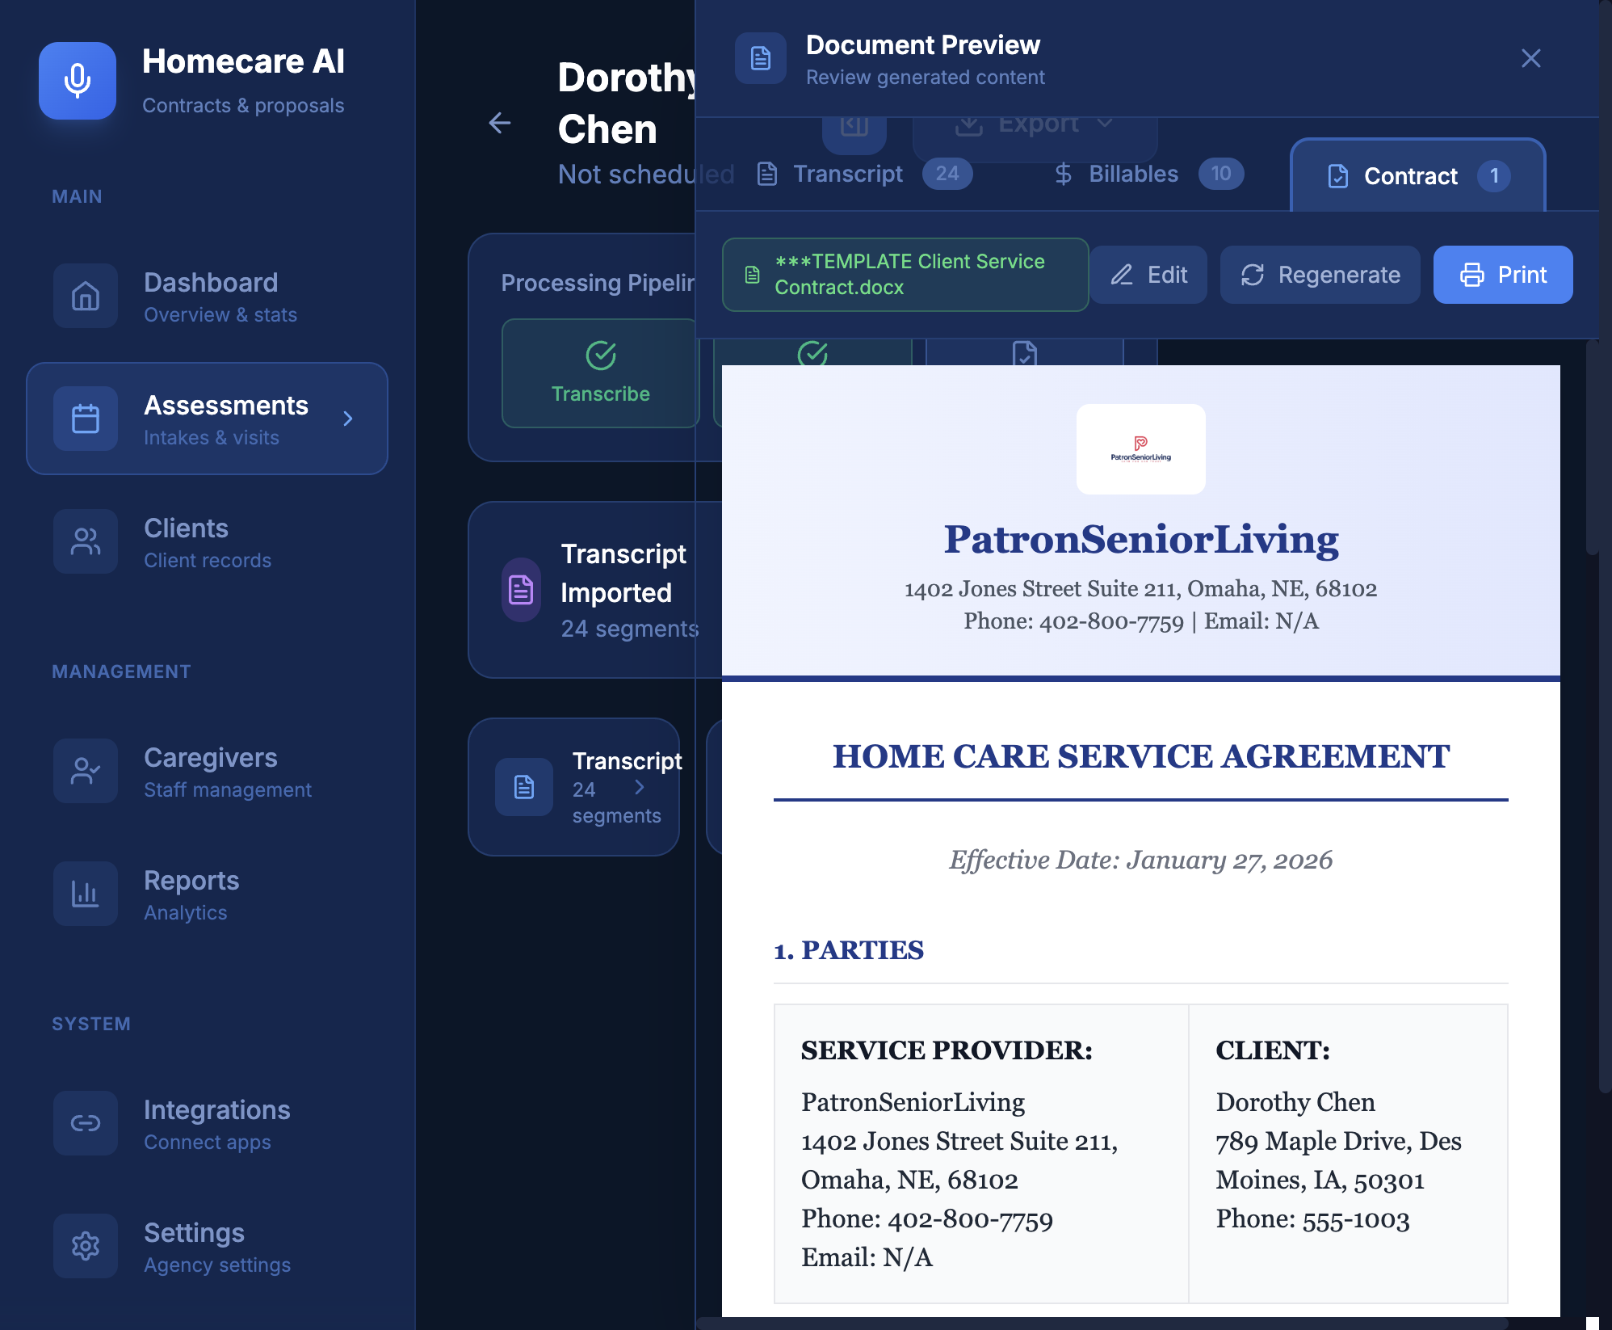
Contract generation (human-in-the-loop)
Edit/regenerate, then export.

Slide 9
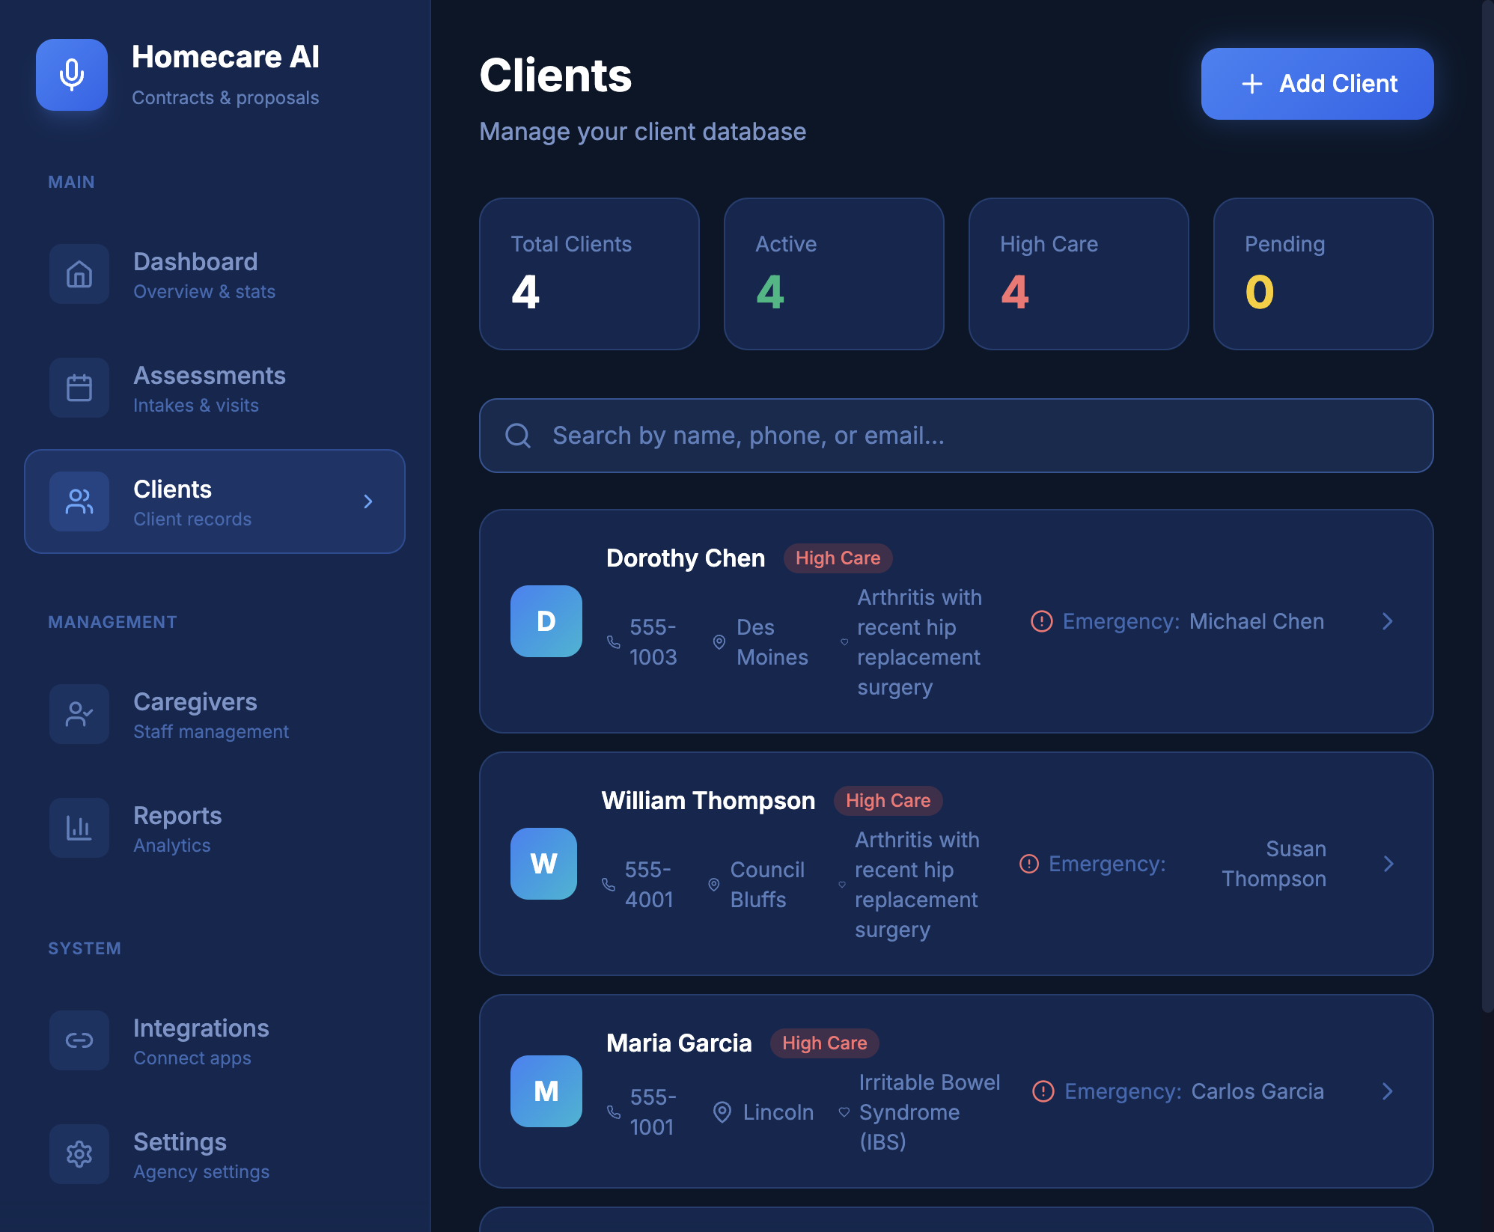
Client CRM (lightweight, agency-friendly)

Slide 10
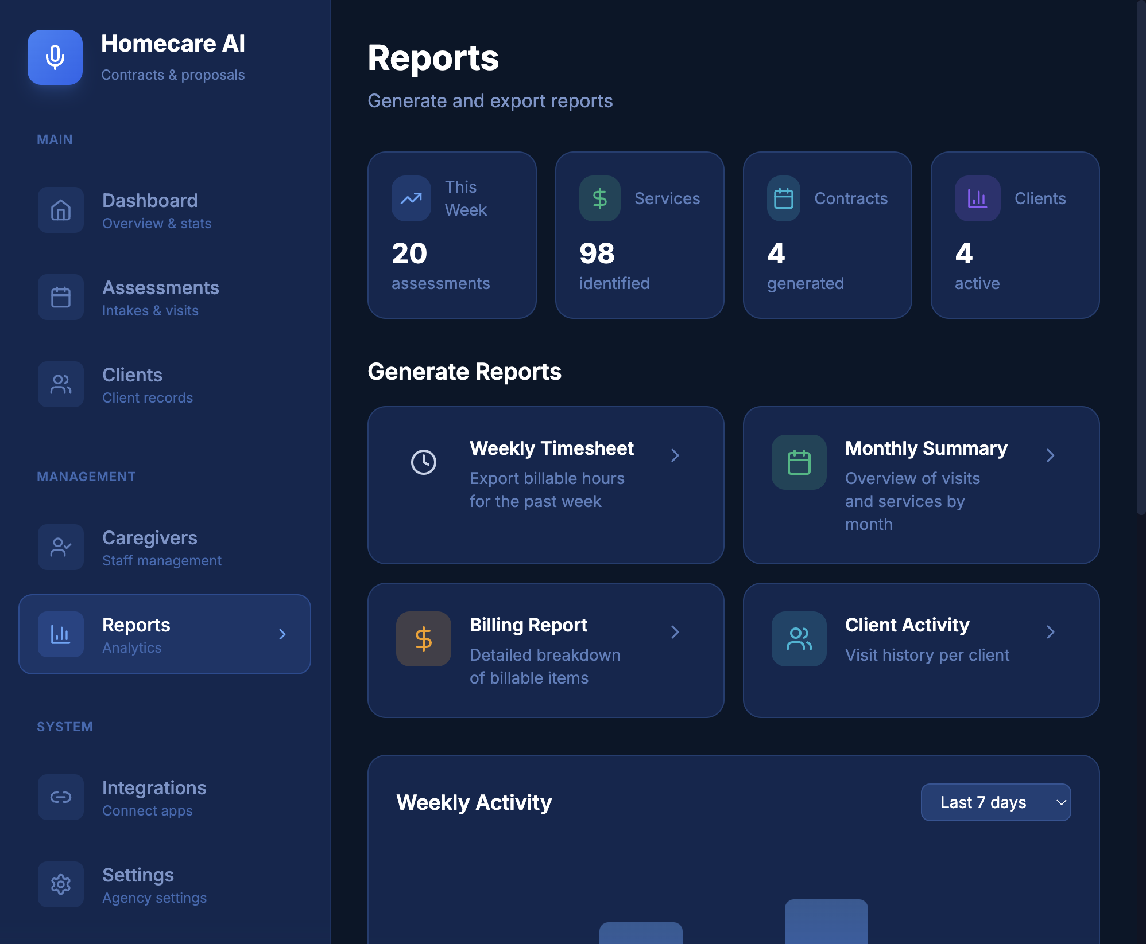
Reporting & exports

Slide 11
How it works (high level)
Frontend: Next.js admin UI
Backend: FastAPI API + auth
Pipeline: worker jobs (transcription, extraction, contract generation)
Storage: Postgres (entities) + S3/MinIO (audio)

Slide 12
Business model (initial)
Subscription per agency / location
Tiered plans by usage (visits/month, storage, seats)
Optional onboarding + integrations

Slide 13
What we’re building next
Deeper template controls + clause library
More robust validation + audit trails
Integrations (EMR/CRM, billing systems)
Multi-location analytics and admin tooling

