Slide 1
Title
Homecare AI (AI Voice Contractor)
AI-powered care assessment engine for in-home healthcare agencies
From intake/visit conversation to proposal-ready service contract
Contact: [Name], [Email], [Phone], [Website]

Slide 2
Problem
Contracts take too long after intake or assessment calls
Manual documentation is inconsistent and error-prone
Agencies lose revenue from missed billables and slow turnaround
Staff spend hours on paperwork instead of care coordination

Slide 3
Solution
Upload a call recording or transcript
AI extracts care needs and services
Generates proposal-ready contract, notes, and billables
Admin review + one-click export

Slide 4
Company Positioning
Industry: Home Healthcare
Tech: Healthcare IT (HealthTech)
Model: Vertical SaaS
Differentiator: AI automation
Buyer: Agencies (B2B)

Slide 5
Product Overview
Contract-first workflow for faster intake conversion
End-to-end pipeline: transcribe -> diarize -> extract -> generate
Admin UI to review and approve contracts
Integrations: storage, calendar, billing exports

Slide 6
Product Detail (Pipeline)
Audio upload -> S3-compatible storage
Speech-to-text (Whisper)
Optional speaker diarization (Pyannote)
LLM extraction for billables and care needs
Contract + SOAP note generation from templates

Slide 7
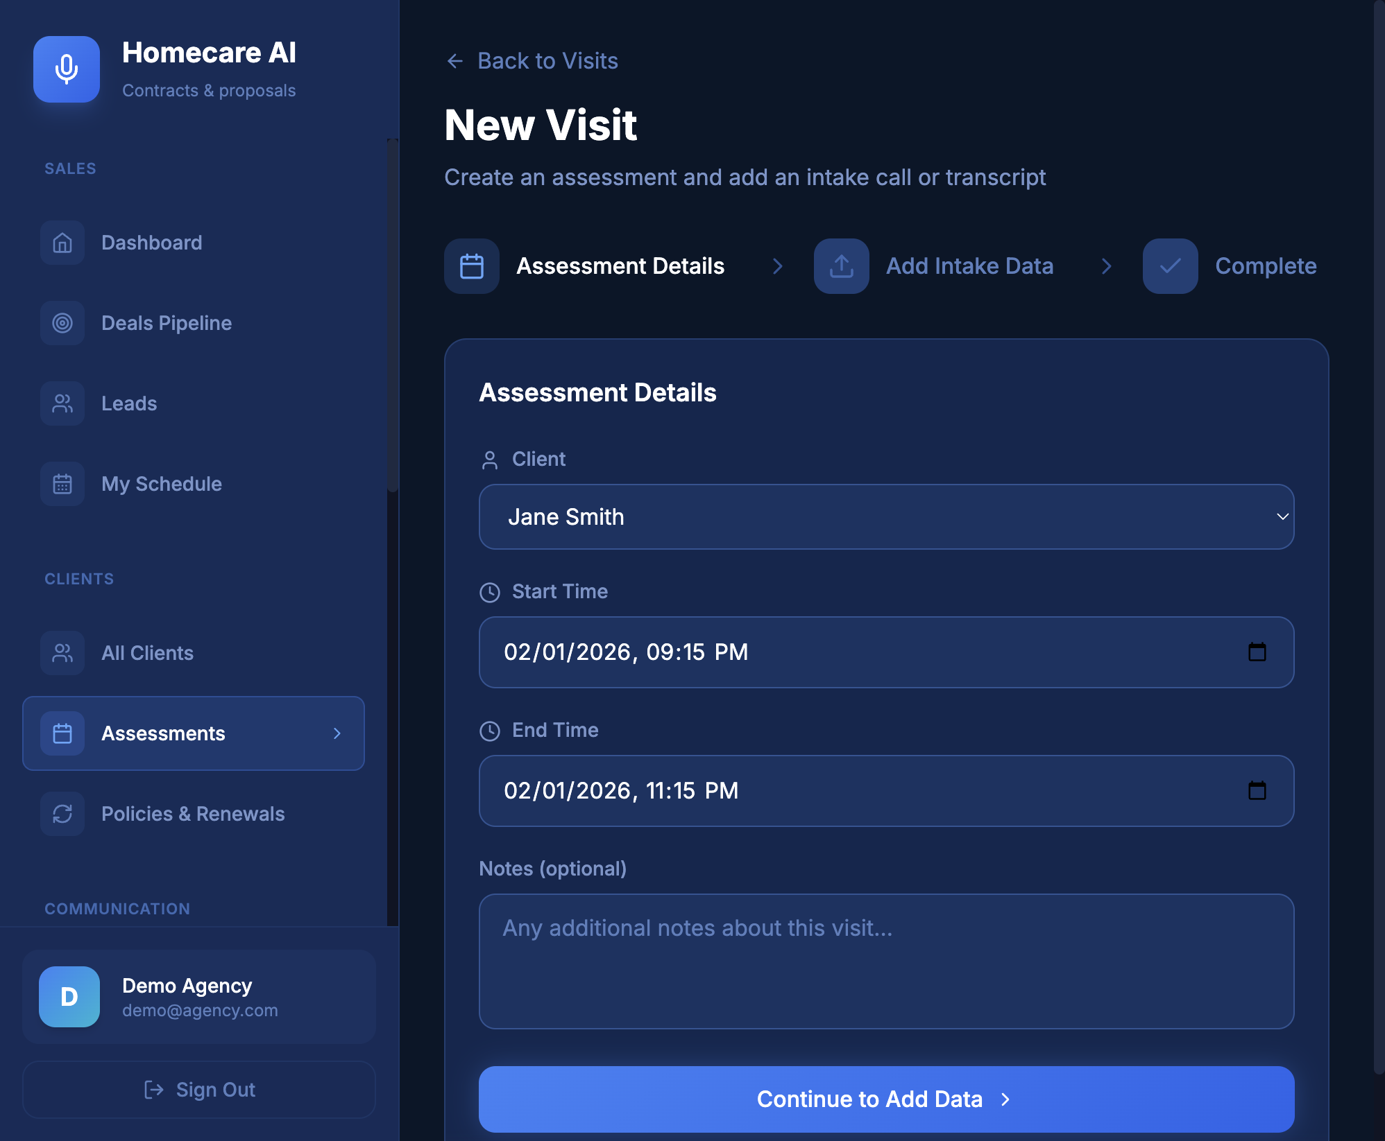
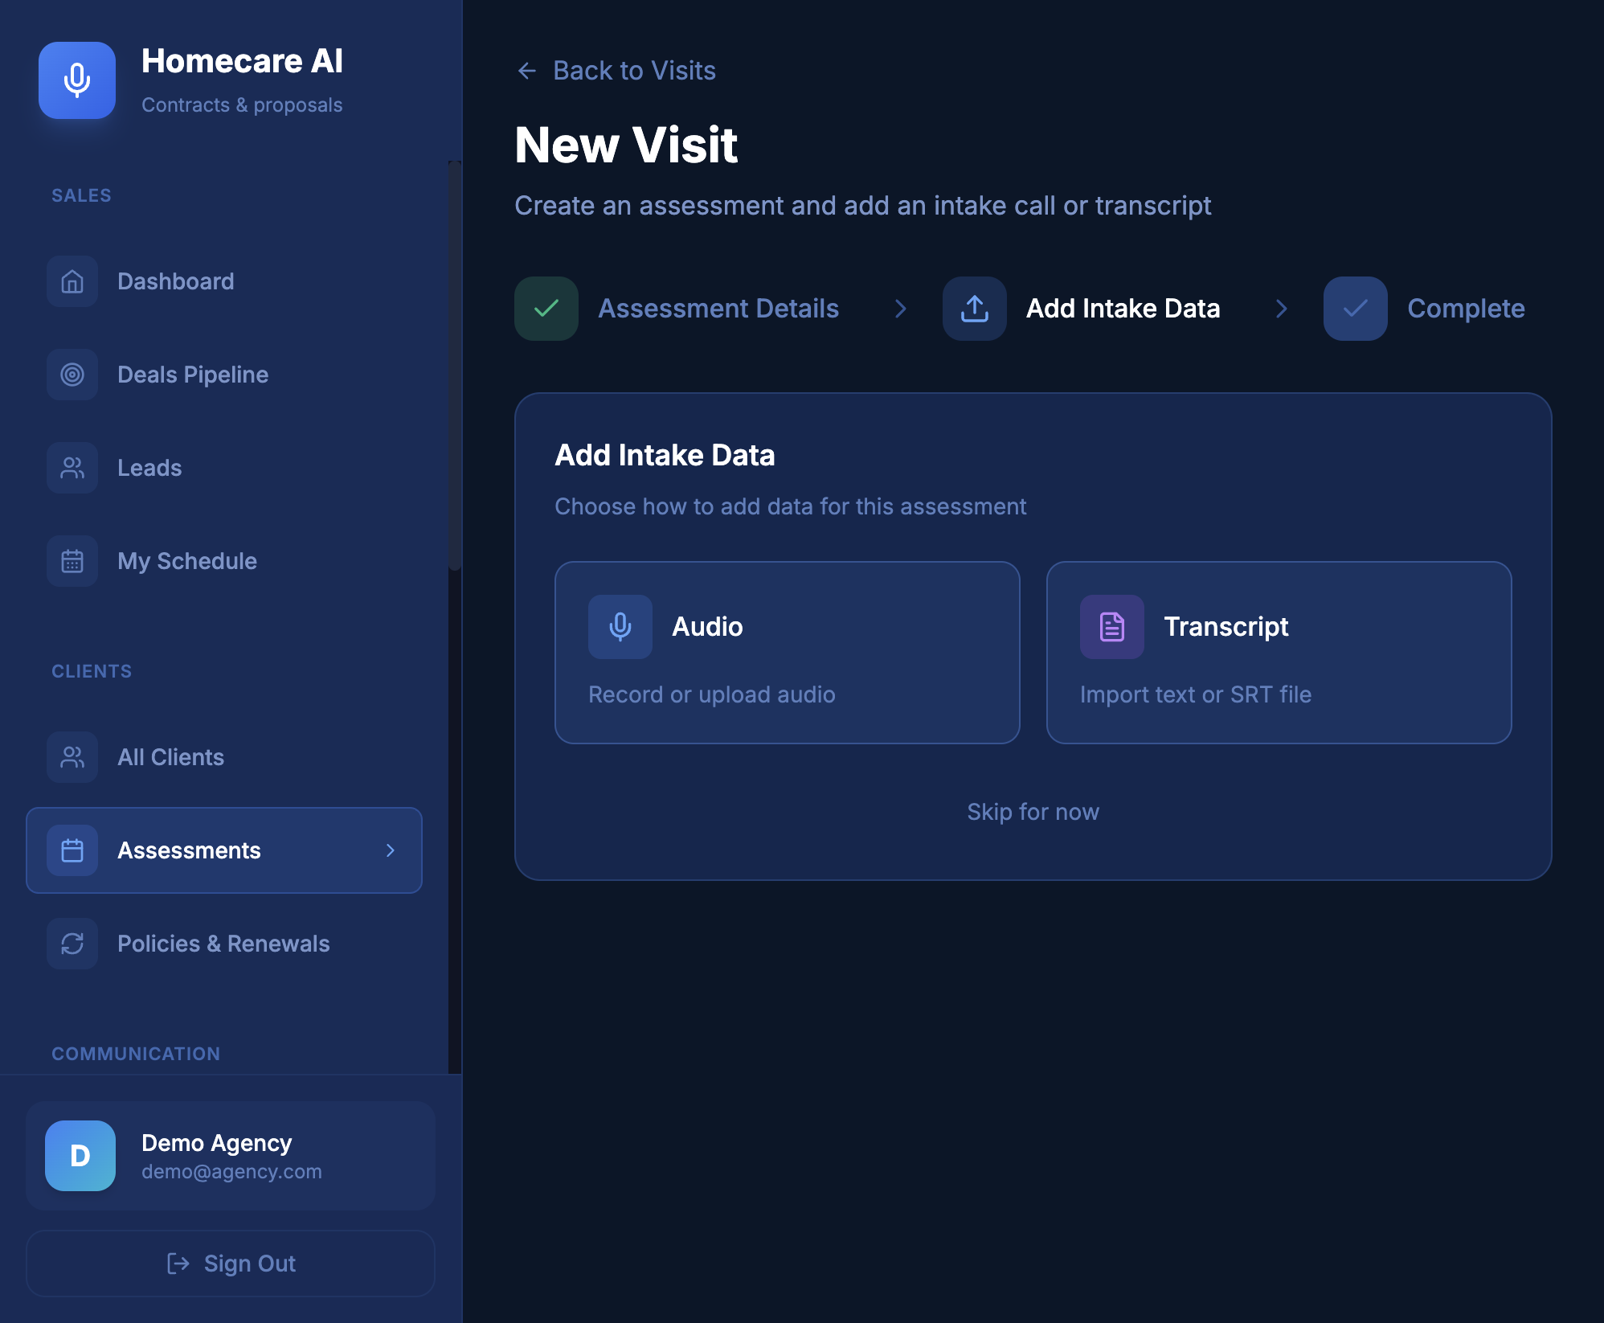
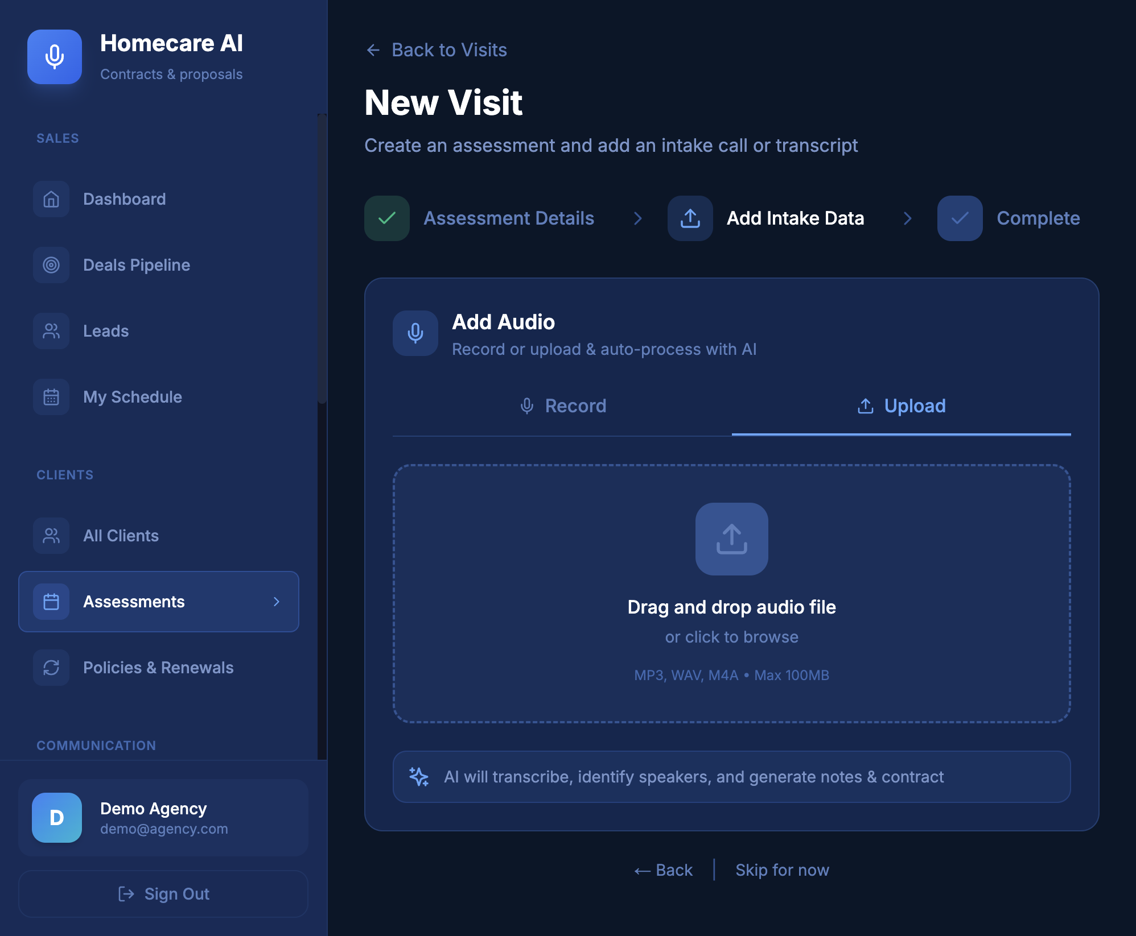
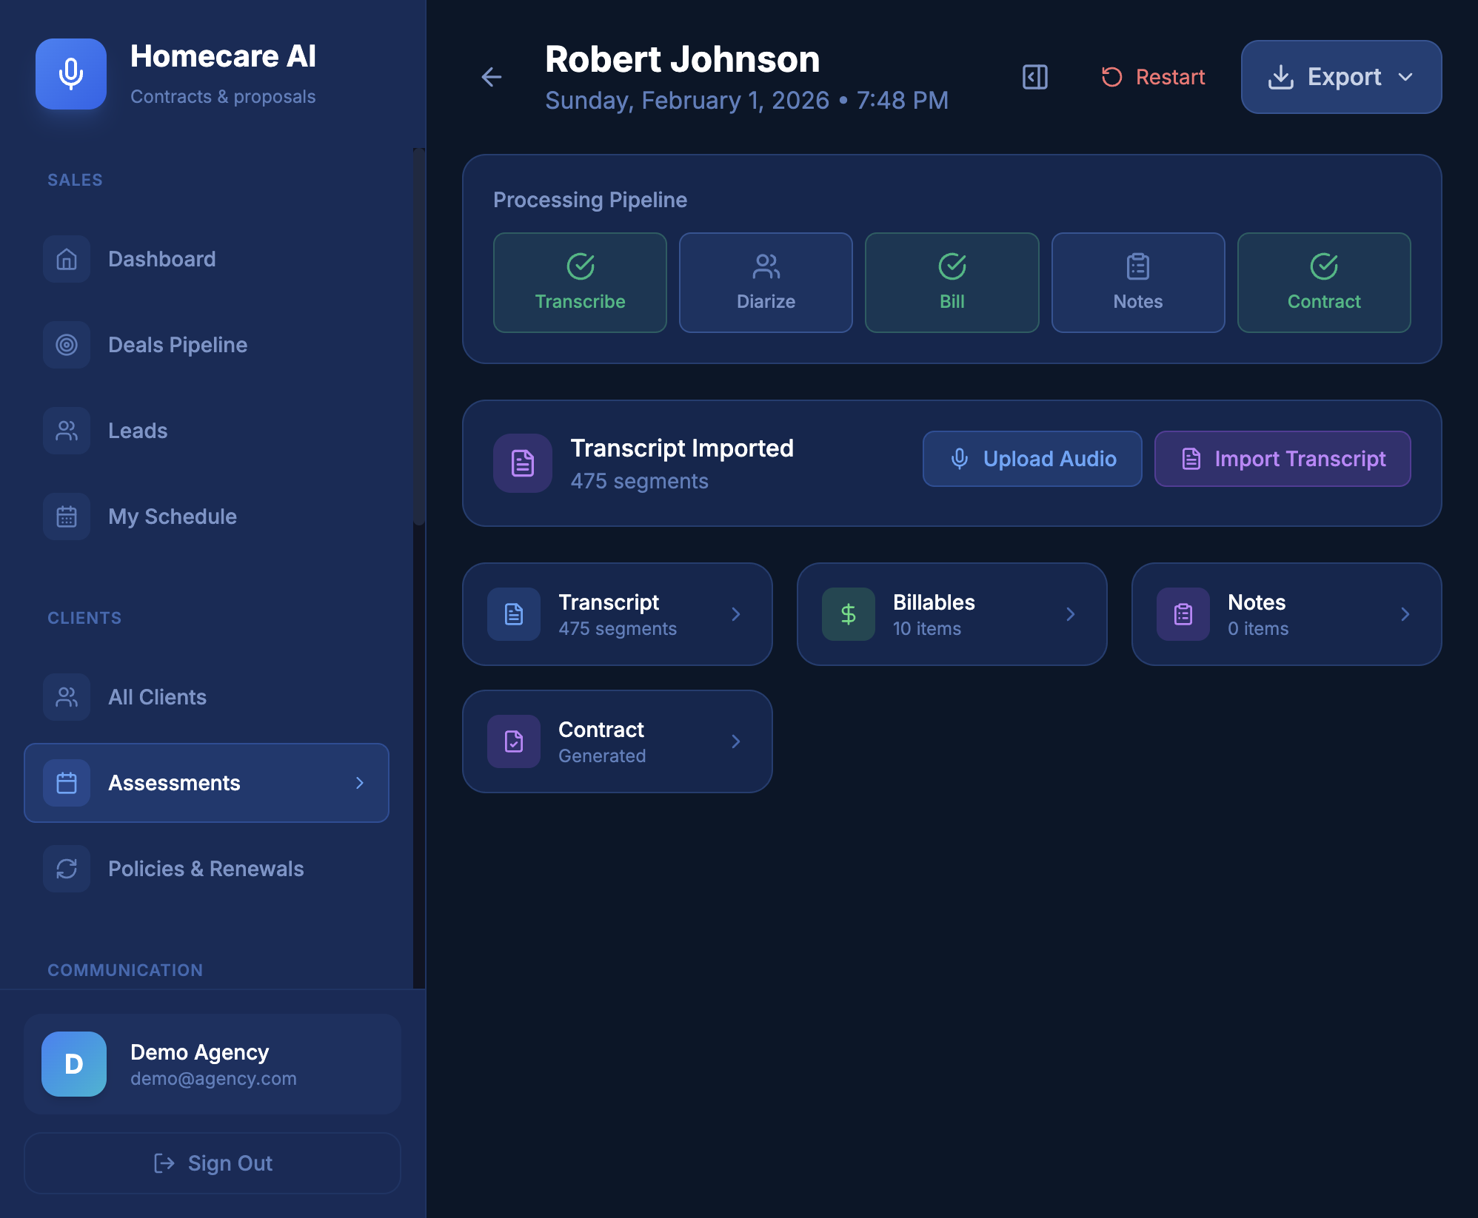
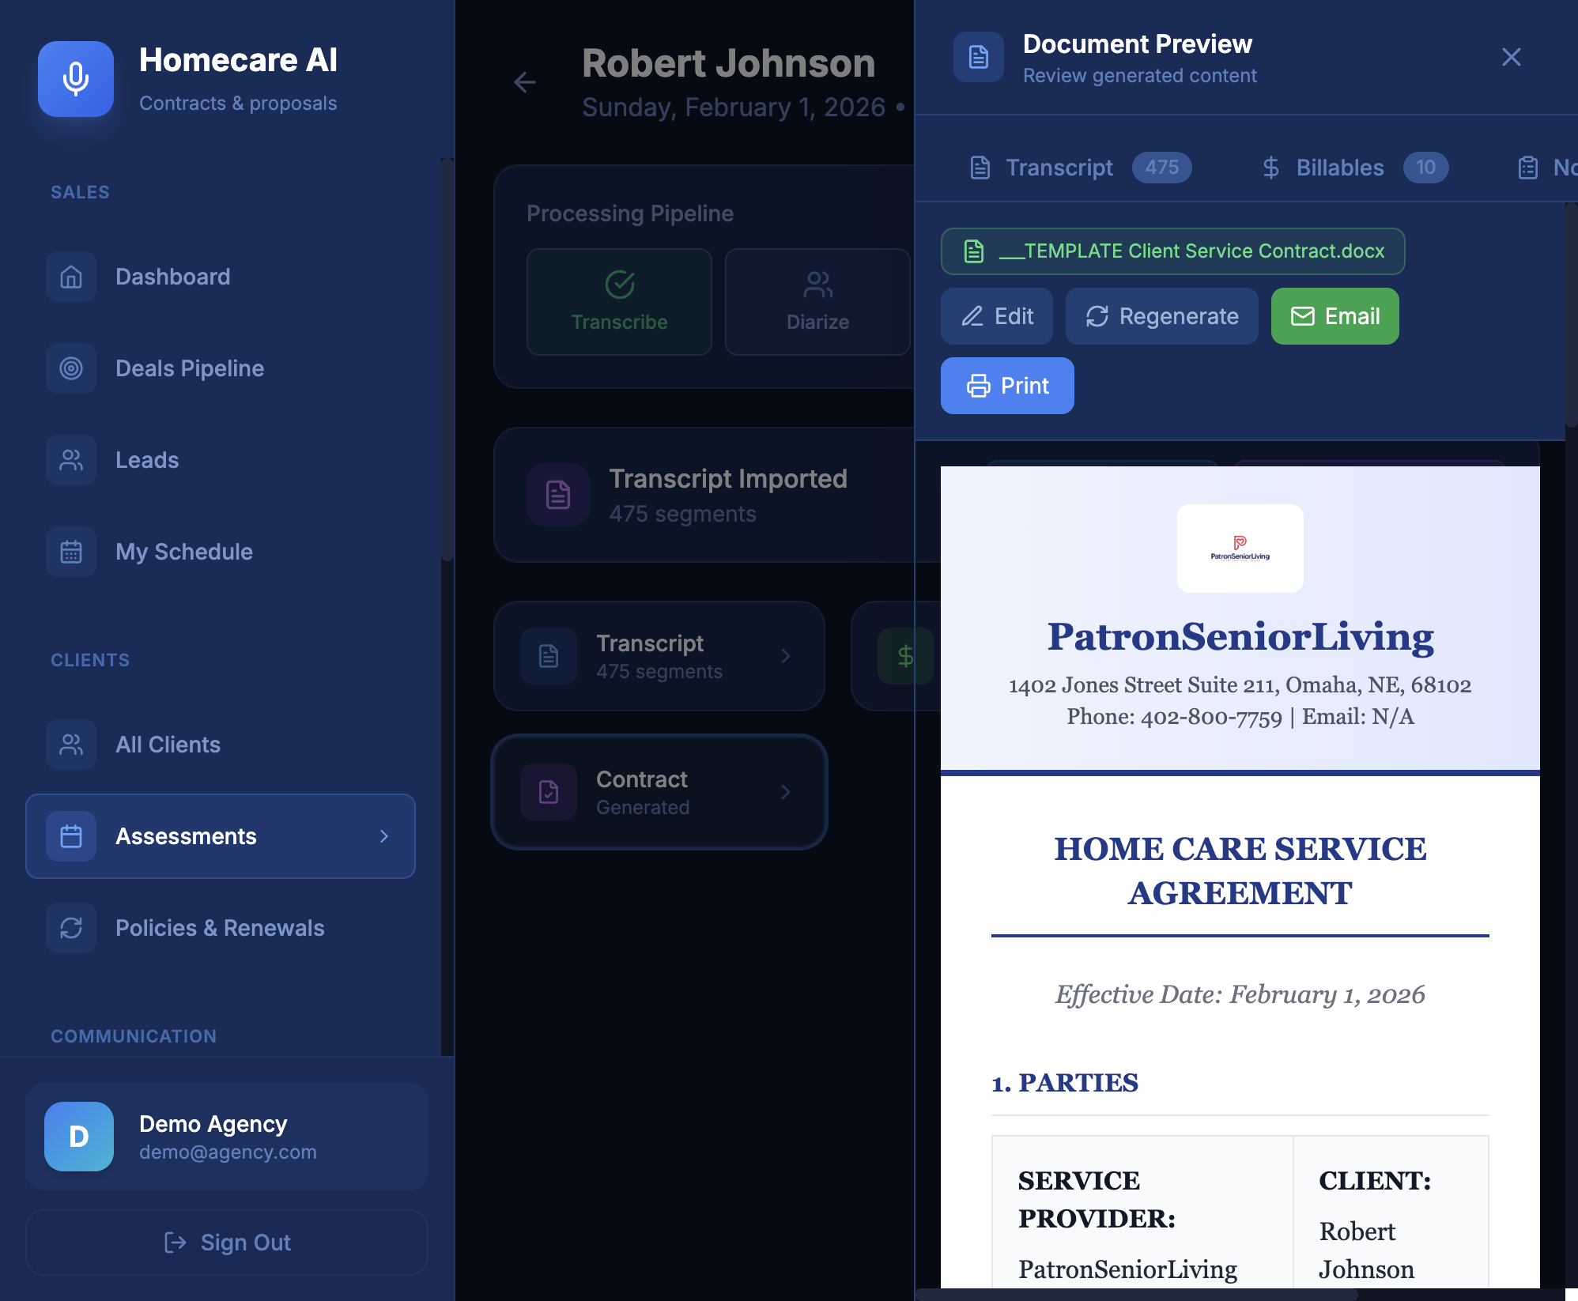
Assessment Flow (Screenshots)

Slide 8
Competitive Landscape
WellSky
AlayaCare
AxisCare
CareSmartz360
Differentiator: contract-ready output with AI automation

Slide 9
Business Model
SaaS per agency
Usage-based add-on (per assessment/minute)
Professional services for template onboarding
B2B partnerships with agencies and care networks

Slide 10
Go-to-Market
Direct outreach to multi-location agencies
Pilot programs with fast ROI
Channel partners: billing software, staffing platforms
Content marketing: compliance + speed wins

Slide 11
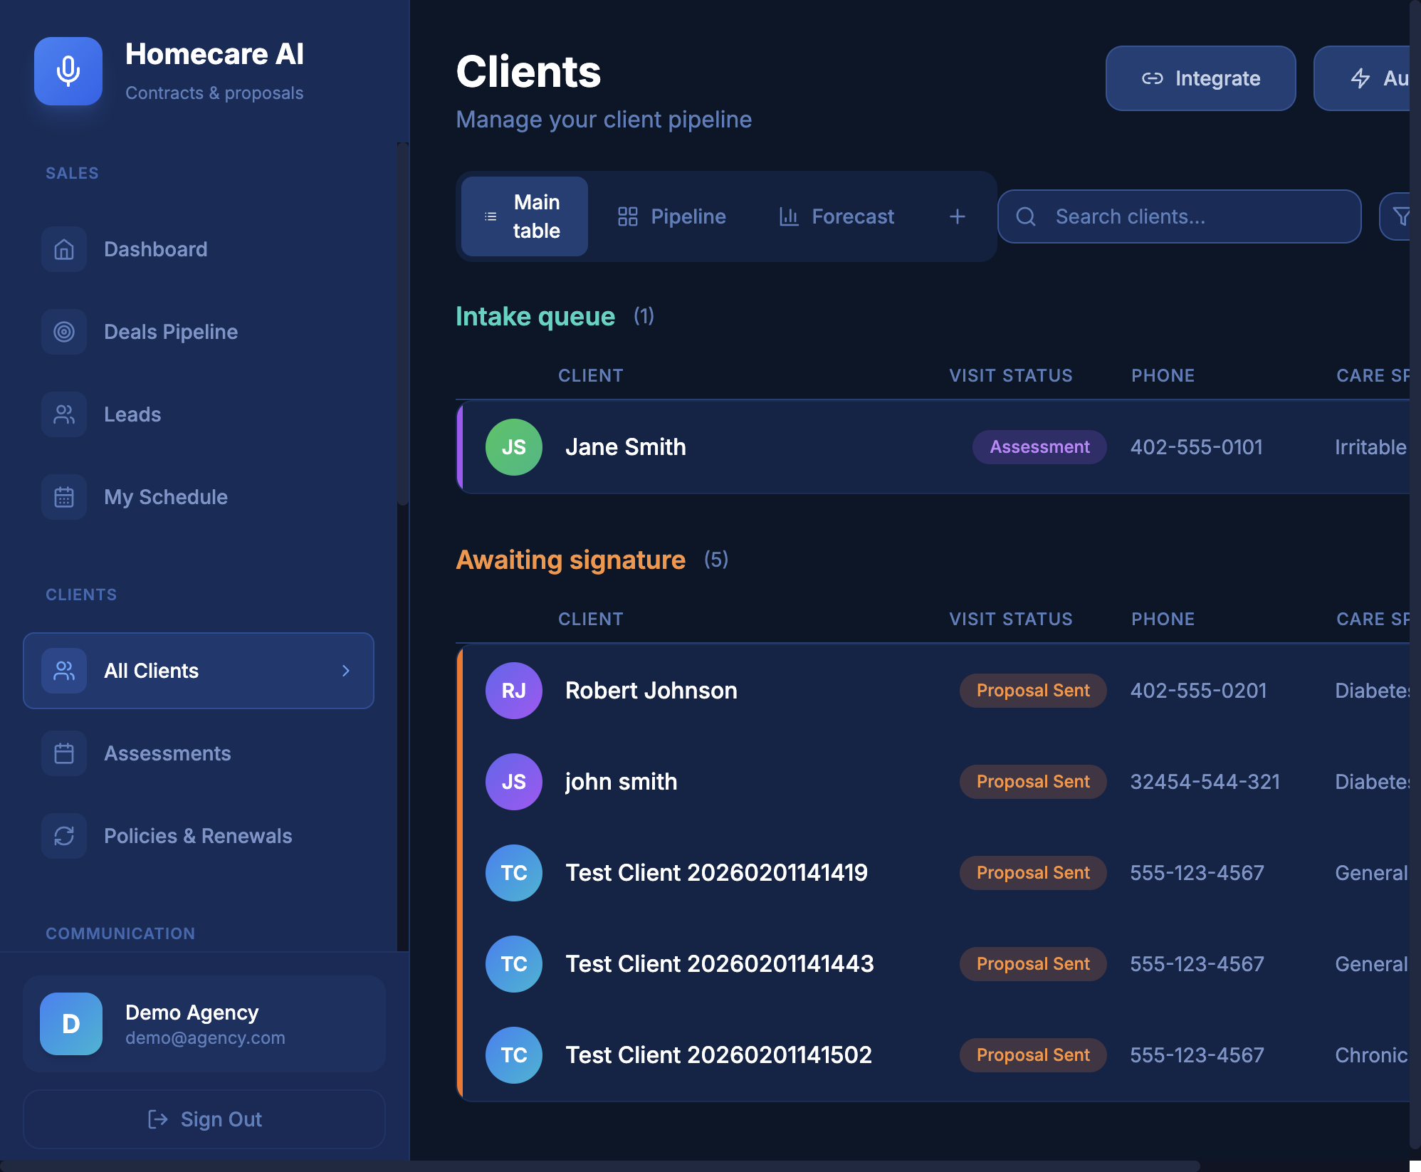
CRM Tools (Screenshots)

Slide 12
Traction (Current)
MVP built: web app, API, worker pipeline
Full demo flow: intake -> contract export
Deployment on Railway-ready architecture
Next: pilots and paid trials

Slide 13
Technology Advantage
Contract-first workflow reduces time-to-revenue
Structured billables reduce missed revenue
Template-driven docs ensure compliance and consistency
Modular pipeline supports upgrades and new models

Slide 14
Market Size (HealthTech Sector)
TAM: Global HealthTech market ~$1.1T (2025) → ~$2.8T by 2032 (CAGR ~13.5%)
SAM: Global Healthcare IT market ~$480B (2025) → ~$961B by 2030 (CAGR ~14.9%)
SOM: Healthcare software & SaaS ~$43B (2024) → ~$158B by 2034 (CAGR ~13.8%)

Slide 15
Roadmap
Q2: 3-5 agency pilots + measurable ROI
Q3: multi-template support + analytics dashboard
Q4: integrations + enterprise compliance features
Q1 next year: scale outbound + channel partners

Slide 16
Team
Founder/CEO: Muse Ibrahim
[Add key hires or advisors]
[Add clinical or compliance expertise]

Slide 17
Ask
Raising: $[amount] pre-seed
Use of funds: product, compliance, pilots, sales
Goal: convert pilots to paid accounts in 6 months

Slide 18
Contact
Name, title
Email, phone
Website

