Slide 1
Venues in Dehradun, India - Ashish Dhiman
The Battle of Neighborhoods

Slide 2
Hey Visitor!
This project aims to help you in locating your favorite venue in the city based on your choice of type of eatery, price, ratings etc.
Forthcoming slides briefs about the overview of the project with some intricacies as well.

Slide 3
Contents
Introduction
Data Collection
Data Cleaning
Methodology
Analysis
Results & Discussion
Conclusion

Slide 4
Introduction
The aim of the project is to identify venues in Dehradun, India based on their rating and average prices. In this notebook, we will identify various venues in the city of Dehradun using Foursquare API and Zomato API, to help visitors select the restaurants that suit them the best.
Target Audience: Whenever a user is visiting a city they start searching for places to visit during their stay. They primarily look for places based on the venue ratings across all venues and the average prices such that the locations fits in their budget.
Here, we'll identify places that are fit for various individuals based on the information collected from the two APIs topped with Data Science. Once we have the plot with the venues, any firm/individual can launch an application using the same data and suggest users the necessary information

Slide 5
Data
To begin with, let's look at Dehradun on the Map using the folium library. Latitude & Longitutes where the map is centered are supplied manually.
The data is fetched from two different APIs.
Foursquare API: The Foursquare API to fetch venues in Dehradun starting from the centre upto 10 Kilometers in each direction.
Zomato API: The Zomato API provides information about various venues including the complete address, user ratings, price for two people, price range and a lot more.
The data from multiple resources might not always align. Thus, it is important to combine the data retrieved from multiple resources properly.

Slide 6
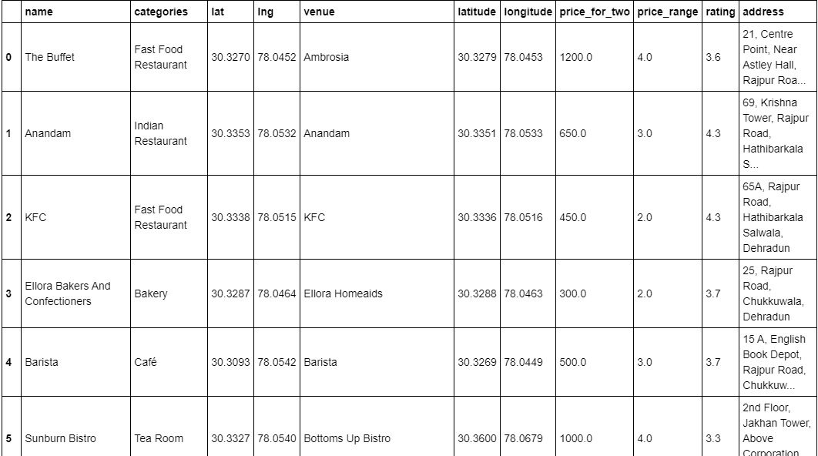

Slide 7
Methodology
As a first step, the data from two APIs (Foursquare and Zomato)is retrieved. Extract venue information from the center of Dehradun, upto a distance of 10 Km. The latitude and longitude values are then used to fetch venue rating and price from Zomato.
Secondly, the data retrieved from the two APIs on the map is explored and the top category types are identified. The data from the two sources is carefully combined based on the name, latitude and longitude values from the two sources. The final dataset would include the rating and price values for each venue.
Next, Analyze the data that is created based on the ratings and price of each venue. Identify places where cluster of venues are located so that any visitor can go to one place and enjoy the option to choose amongst many venue options. Also explore areas that are high rated and those that are low rated while also plotting the map of high and low priced venues. Lastly, cluster the venues using partitioning i.e. K-means based on the available information of each venue. This will allow one to clearly identify which venues can be recommended and with what characteristics.
Finally, discuss and conclude which venues to be explored based on visitor requirement of rating and cost.

Slide 8
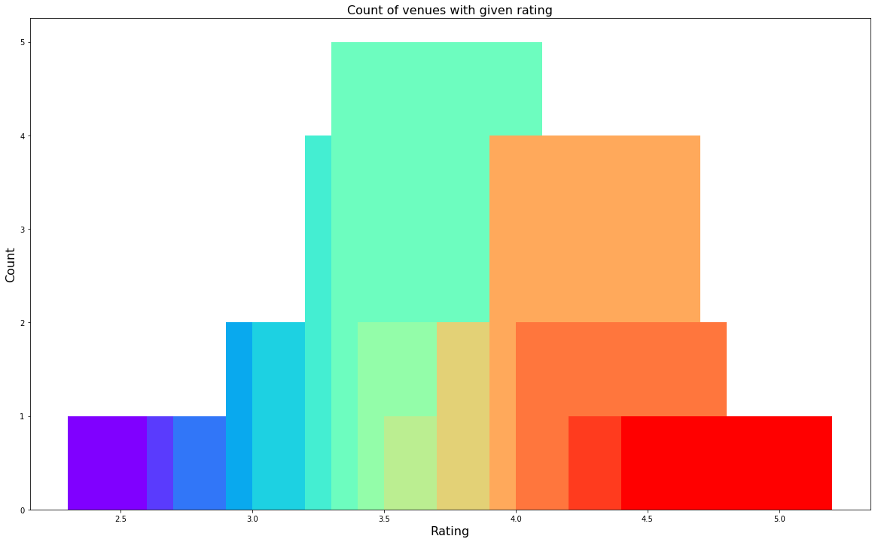
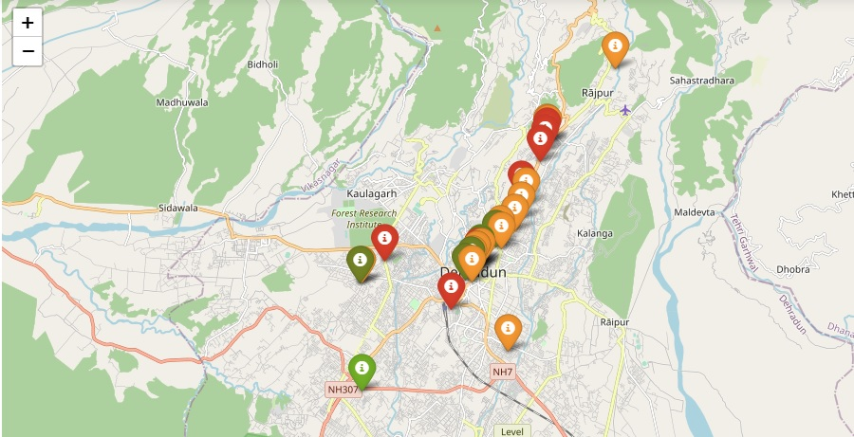
Analysis

Slide 9
Results & Discussions
After collecting data from the Foursquare and Zomato APIs, a list of 37 different venues is acquired. However, not all venues from the two APIs were identical. Hence, they were to be inspected, their latitude and longitude values as well as names to combine them and remove all the outliers. This resulted in a total venue count of 29.
It was infered that from the total set of venues, majority of them were Cafes, Fast Food joints and Indian Restaurants.
While the complete range of ratings range from 1 to 5, the majority venues have ratings close to 4. This means that most restaurants provide good quality food which is liked by the people of the city, thus indicating the high rating.
When the price values of each venue is analyzed, it's implied that many venues have prices which are in the range of Rs 250 to Rs 500 for one person. However, the variation in prices is very large, given the complete range starts from Rs 75 and goes up to Rs 750. On plotting the venues based on their price range on the map, it was discovered that venues located near Clock Tower are relatively priced lower than venues in Rajpur Road.
Finally, through clusters it is evident that there are many venues which are relatively lower priced but have an average rating of 3.81 i.e. Cluster1. On the other hand, there are few venues which are high priced and have average rating of 3.79.
If a visitor is looking for cheap places with relatively high rating, you should check near Clock Tower, Chakrata Road, ISBT. If a visitor is looking for the best places, with the highest rating but might also carry a high price tag, you should visit Rajpur Road.
Any firm/individual can use this information to build up an online website/mobile application, to provide users with up to date information about various venues in the city based on the search criteria (name, rating and price).

Slide 10
Conclusions
The purpose of this project was to explore the places that a person visiting Dehradun could visit. The venues have been identified using Foursquare and Zomato API and have been plotted on the map. The map reveals that there are three major areas a person can visit: Clock Tower, Rajpur Road and Chakrata Road. Based on the visitor's venue rating and price requirements, he/she can choose amongst the three places.

Slide 11
Thank You!
Visit Again.

